Slide 1
Values Based Safety Culture: A Tool to Reduce Distracted Driving
Presented by:
Grant M Watson
NASA Langley Safety, Health, and Mission Assurance Director

Slide 2
The Laws & Policies That Govern My Relationship With My Cellphone
Presidential Executive Order 13513, Federal Leadership on Reducing Text Messaging While Driving
“Federal employees shall not engage in text messaging (a) when driving GOV, or when driving POV while on official Government business, or (b) when using electronic equipment supplied by the Government while driving.”
LaPD 1700.7 Traffic Management
“Drivers of motor vehicles on NASA property or driving a NASA vehicle both on and off NASA property are prohibited from using hand-held communication devices while the vehicle is in motion except for emergency, security, and fire vehicles during official operations.”
Virginia Law (ref, http://www.dmv.org/va-virginia/safety-laws.php)
Anyone under 18 years old is banned from using cell phones or any other personal communication devices while driving.
Texting is banned for all drivers. In Virginia, it is considered a primary offense, which means police can pull you over if they suspect you of texting while driving.

Slide 3
Just Because You’re Not Violating a Policy or Law Does Not Make Your Behavior Safe.
My car almost ran over my daughter because I was using a cellphone
Some reason why we behave in an unsafe way.
Ignorance (never saw it coming): I knew what I was doing was not safe.
Attitude (it will never happen to me!): I teach and preach to not think this way.

Slide 4
The Cost of Accidents
(produced by HARSCO: http://www.harsco-i.com.qa/about_us/health_safety/dvd)

Slide 5
Just Because You’re Not Violating a Policy or Law Does Not Make Your Behavior Safe.
My car almost ran over my daughter because I was using a cellphone
Some reason why we behave in an unsafe way.
Ignorance (never saw it coming): I knew what I was doing was not safe.
Attitude (it will never happen to me!): I teach and preach to not think this way.
Convenience (it will make life easier): This was one reason why I did it.
Schedule pressure (we all have busy lives): This was another reason why I did it.
Habit (we have good & bad ones): A hard habit for me to break.

Slide 6
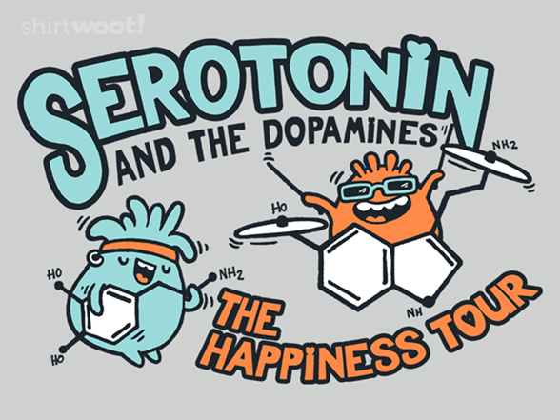
Pleasure: A Hard Habit to Break
The Neurotransmitter Dopamine – “The Reward Molecule”
“Dopamine is responsible for reward-driven behavior and pleasure seeking. Every type of reward seeking behavior that has been studied increases the level of dopamine transmission in the brain.”
Dopamine starts you seeking, you get a reward when you find something, which makes you want to seek more.
“The dopamine system is especially sensitive to cues that a reward is coming.”
Some addictive drugs act on the dopamine system (e.g., cocaine blocks reuptake of dopamine, leaving it in the synaptic gap longer).
Curtsey of: http://shirt.woot.com/offers/ serotonin-the-dopamines
Ref: https://www.psychologytoday.com/blog/the-athletes-way/201211/the-neurochemicals-happiness
Ref: https://www.psychologytoday.com/blog/brain-wise/201209/why-were-all-addicted-texts-twitter-and-google
Ref: http://www.techtimes.com/articles/19689/20141108/blame-it-on-dopamine-heres-why-people-text-and-drive-despite-being-aware-of-risks-involved.htm

Slide 7
I’m free to go to the bookstore!!
Yes I can pickup the other girls at Susan's and take them home.
We are “hardwired” to use our cell phones to seek a reward, which makes the compulsion of distracted driving a hard habit to break.

Slide 8
Values Based Safety
It’s not about policy and laws, it’s about people.
You need to “touch the heart to teach the mind.”
This requires bringing emotion into the conversation.
The message needs to be personal.
You need to be personal: Be open about your experiences with distracted driving and safety.
Your audience needs to personalize the message: This cannot be achieved by flipping through slides or showing a movie.
This is Hard Work, Especially in a Work Environment

Slide 9
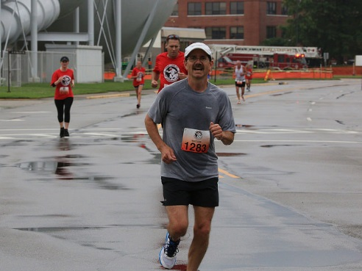
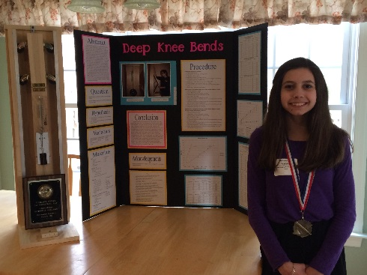
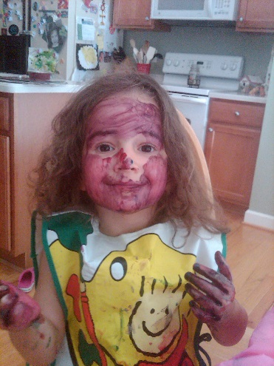
Personalizing Safety – List Three things in the next five years you don’t want to miss.
Running the Richmond Marathon this Fall
My Daughter Sam’s High School Graduation in 2020
My Daughter Vika Growing into a “tween”

Slide 10
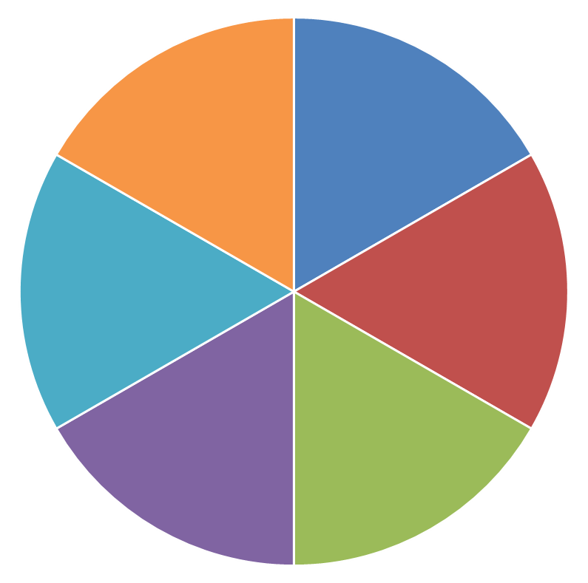
Distracted Driving – A Gamble With Life
1
2
6
3
5
4
Spin The Wheel
Your Numbers Up

Slide 11
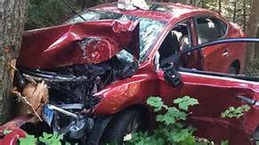
You Hit a Tree: Luckily only bumps, bruises and 2 broken legs.
Return To Wheel

Slide 12
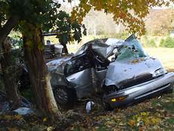
You Hit a Tree: Your passenger did not survive.
Return To Wheel

Slide 13
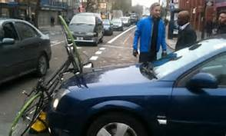
You Hit a Bicyclist: Everybody is Ok, but you do have to pay for his $1000 racing bike.
Return To Wheel

Slide 14
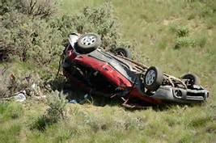
You Rolled 7 times: You did not survive.
Return To Wheel

Slide 15
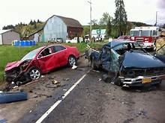
You Hit a Car: You walked away, but a mother of four did not survive.
Return To Wheel

Slide 16
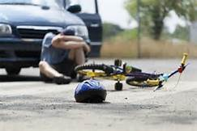
You Hit a Bike: Hopefully the young boy being transported in the ambulance will survive.
Return To Wheel

Slide 17
Back Up / Extra Slides

Slide 18
Abstract
Why do drivers still text while driving in the 46 states with laws that ban it? Why do NASA Langley employees still engage in distracted driving when we have strong distracting driving polices? For example, Presidential Executive Order 13513, Federal Leadership on Reducing Text Messaging While Driving, which states “Federal employees shall not engage in text messaging (a) when driving GOV, or when driving POV while on official Government business, or (b) when using electronic equipment supplied by the Government while driving.” The reason distracted driving still occurs is it takes more than laws and policies to change driver behaviors; it takes a culture that values personal safety above the rewards of distracted driving. During this session, Mr. Watson will share steps NASA Langley has taken to develop a value based safety culture to encourage employees to reduce at-risk safety behaviors, such as distracted driving.

Slide 19
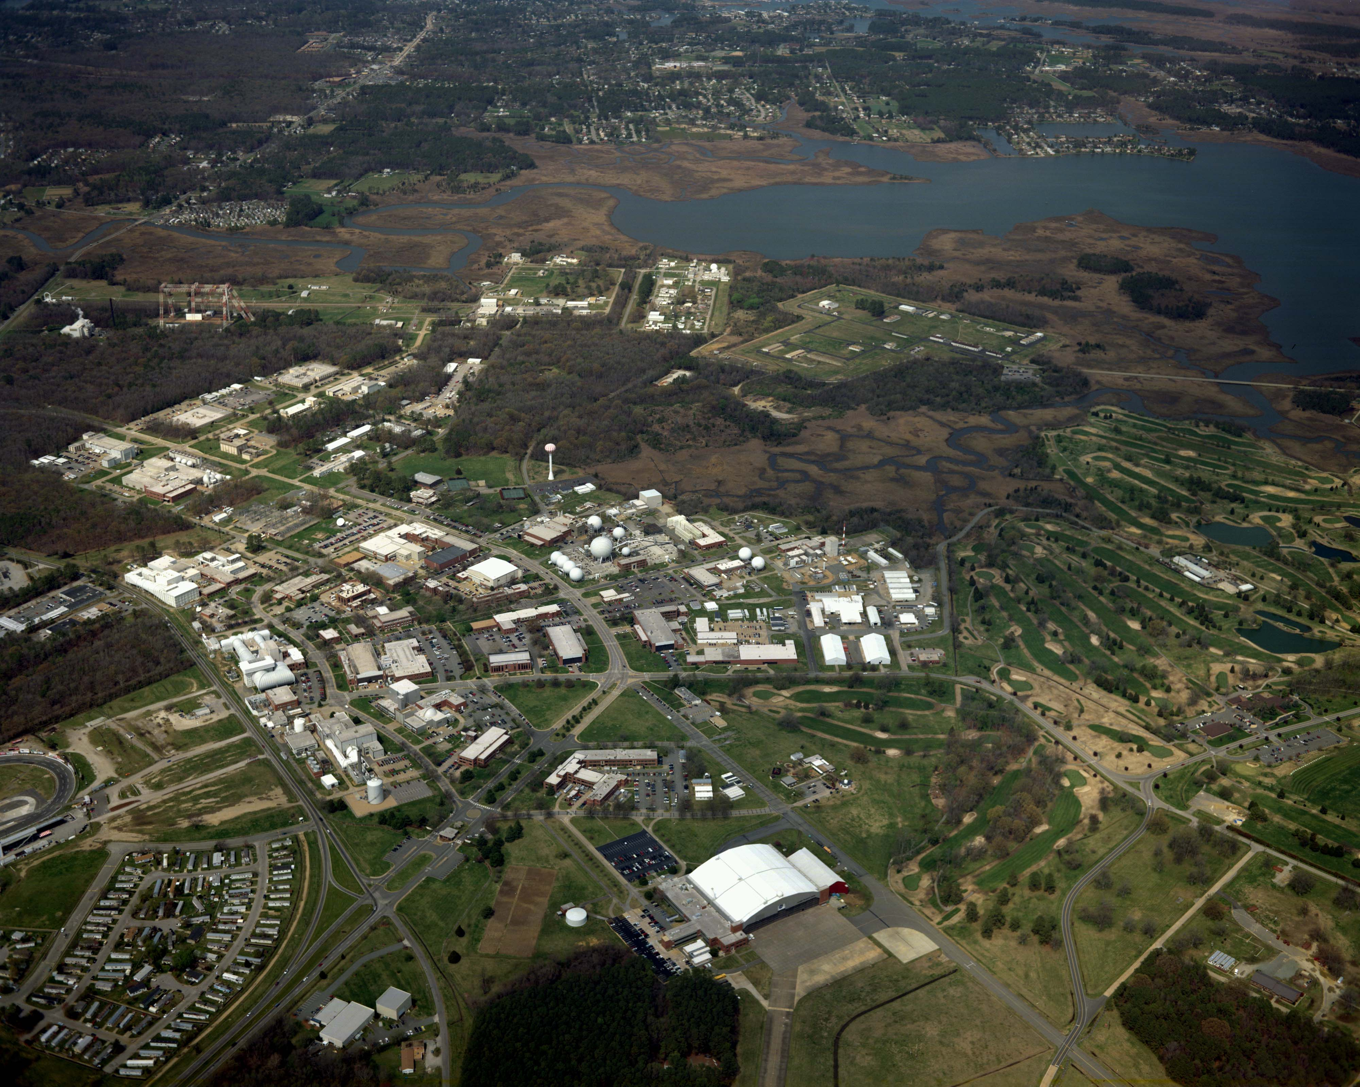
Workforce of ~3,600
~1,800 Civil Servants
~1,700 Contractors
Diverse workforce of researchers, engineers, technicians (maintenance and high-tech), and business/administrative personnel
NASA Langley Research Center is a small town

Slide 20
