Slide 1
Can monitoring and feedback also improve secondary task engagement in novice teen drivers? An Analysis From Two Teen Driving Naturalistic Driving Studies
Charlie Klauer, Ph.D.
Lead, Teen Risk and Injury Prevention Group
Center for Vulnerable Road User Safety

Slide 2
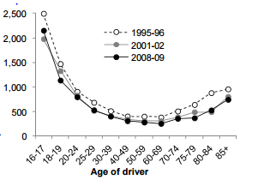
Why Study Teen Driving?
Driver in Police-Reported Crashes per 100 million miles driven
* Cited from AAA-FTS, 2012

Slide 3
Study 1: SPDS Study Design (2010-2013)
90 teens from four counties in Virginia were recruited
41 males, 49 females
Collected continuous video and driver performance data
Collected survey/questionnaire data at 5 time points throughout the duration of the study.
Data were collected from 15 months up to 22 months (9 months of learner’s permit plus up to 12 months)
Notes:
I am going to talk about two teen naturalistic driving studies…naturalistic driving studies are when we instrument someone’s vehicle with highly capable data acquisition systems…

Slide 4
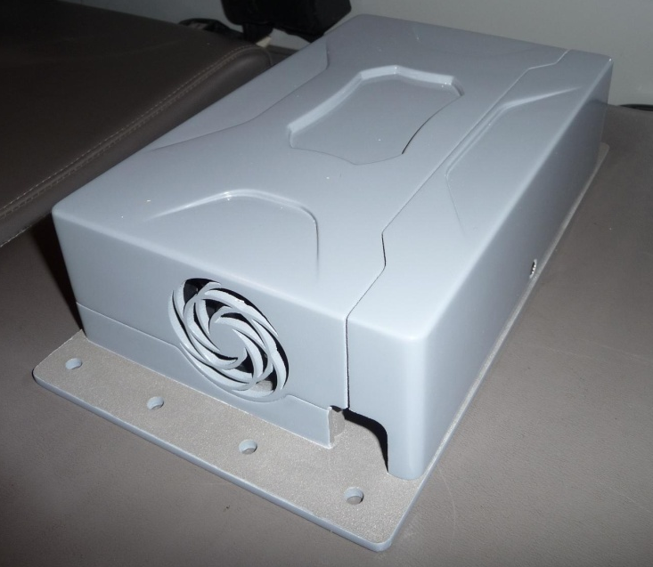
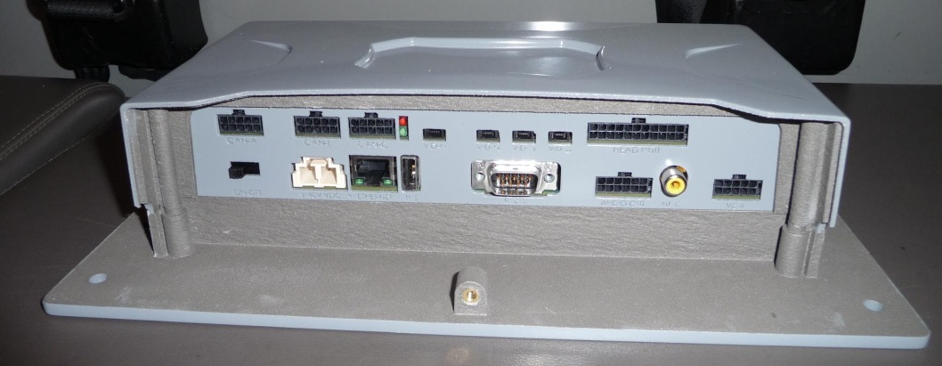
DAS Photos
6.25’’
9.5’’
2.75’’
11.5’’
Main Unit
Front Radar Assembly
Head Unit
January 11, 2010
4

Slide 5
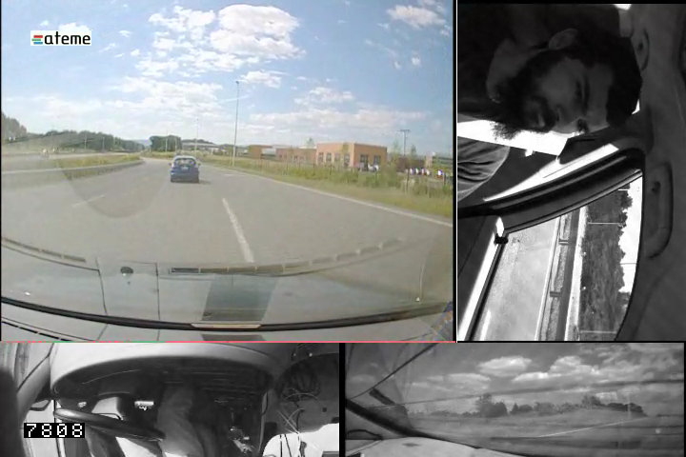
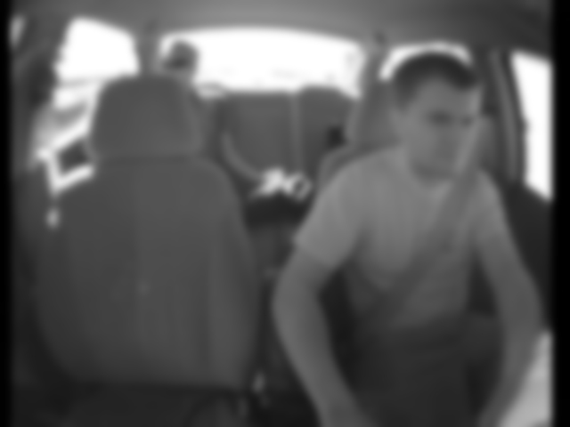
Camera Image Samples
Forward View - color
15 Hz continuous video
640x320 pixels
Driver Face – Rotated for max pixel efficiency
Right-Rear View
Center stack – Pedal Interactions
Periodic still cabin image, permanently blurred for passenger anonymity
January 11, 2010
5

Slide 6
Study 2: Driver Coach Study (2013-2015)
Assess the benefits of a state-
of-the-art driver monitoring and feedback system for improving novice driver safety
Match participant sample Supervised Practice Driving Study
Can crash/near-crashes be reduced with real time and post hoc feedback?

Slide 7
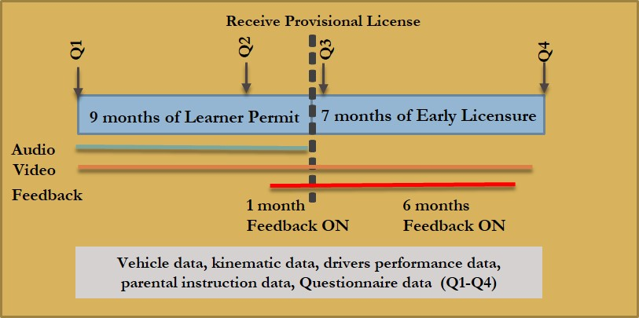
Driver Coach Study Design
90 participants’ vehicles will be instrumented within 2 weeks of receiving learner’s permit
Data will be collected for 9 months (learner’s permit) + 7 months (provisional license)

Slide 8
Monitoring and Feedback
Monitor
Hard braking
Hard cornering
Swerve
Lane departure
Exceeding maximum speed
Hard acceleration
Feedback
Real-Time
Auditory alert plus speech
Post hoc
Weekly email notification to parent and teen indicating new coded events
Link to website that will provide e-report card and 16 seconds of video
* Under development

Slide 9
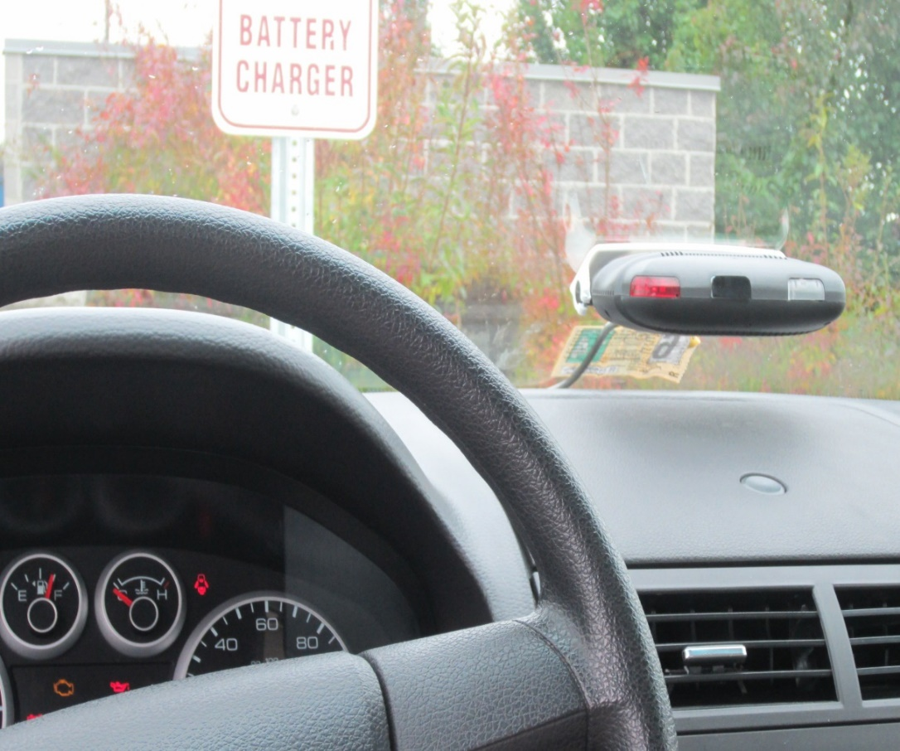
Driver Coach Mini-DAS

Slide 10
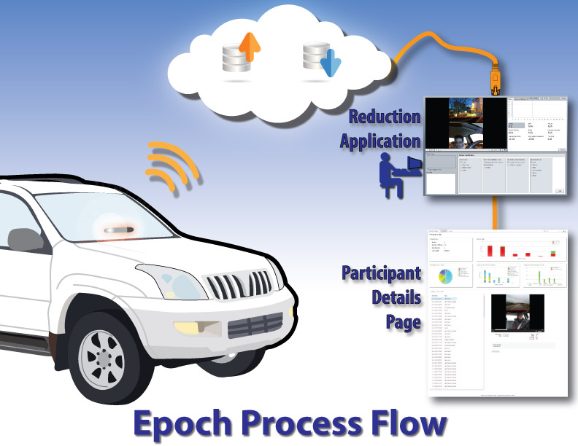
Epoch Process Flow
Infrastructure has been developed to support rapid post-hoc feedback for studies using on-board monitoring.

Slide 11
Driver Coach Feedback Website

Slide 12
General Results from Driver Coach
Crash/near-crash rates were lower for teens who received feedback than teens who did not receive feedback BUT:
Only for teens whose parents logged into website
40% of all parents in DCS did not log into website

Slide 13
Research Questions
Does real-time/post hoc feedback on KRD events subsequently reduce secondary task engagement?
What are the trends in secondary task engagement for young drivers over time?

Slide 14
Overall Secondary Task Engagement

Slide 15
Secondary Tasks

Slide 16
Overall Cell Phone Use

Slide 17
Conclusions
Real time and post hoc feedback has little impact on teen’s engagement in secondary task.
However, there is evidence to suggest that teens are more judicious about WHEN to engage with feedback present
Time trends in engagement are toward more dangerous engagement in wireless device use (visual-manual tasks)
There are many dangerous distractions apart from wireless devices…we need to communicate eyes on the forward roadway.

Slide 18
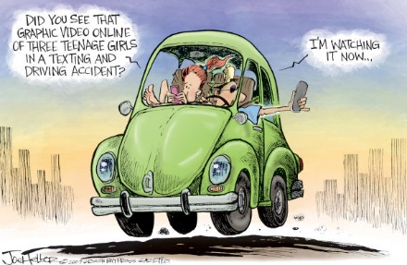
Any Questions or Comments???

