Slide 1
Can technology prevent distracted driving crashes? Effectiveness of crash avoidance tech
Drive Smart Virginia
2017 Distracted Driving Summit
September 28, 2017
Jessica Cicchino

Slide 2
Theoretical crash reductions if 100% effective
Crashes relevant to 4 crash avoidance systems
(FARS and GES, 2004-08)
 | all | injury | fatal
front crash prevention | 1,165,000 | 66,000 | 879
lane departure prevention | 179,000 | 37,000 | 7,529
side view assist | 395,000 | 20,000 | 393
adaptive headlights | 142,000 | 29,000 | 2,484
total unique crashes | 1,866,000 | 149,000 | 10,238

Slide 4
Percent of crashes relevant to system where distraction was critical reason, National Motor Vehicle Crash Causation Survey
Kusano & Gabler, 2014

Slide 5
Front crash prevention effectiveness

Slide 6
Effects of forward collision warning and with autobrake on police-reported rear-end striking crashes
2010-15 data on police-reported rear-end striking crashes from 22 states with VINs
Merged police-reported data with insurance claim exposure data and data from automakers on collision avoidance features
Compared crash rates per insured vehicle year for vehicles with systems and same make/model/year vehicles without optional systems
Controlled for other collision avoidance technologies, calendar year, vehicle series/model year, state, vehicle density, rated driver age group, gender, marital status, deductible, insurance risk

Slide 7
Study states
WA
MT
ME
ND
VT
OR
MN
NH
ID
SD
WI
NY
MA
WY
MI
CT
RI
IA
PA
NJ
NV
NE
IN
OH
UT
IL
DE
MD
CO
WV
VA
DC
CA
KS
MO
KY
TN
NC
AZ
NM
OK
AR
SC
MS
AL
GA
TX
LA
HI
AK
FL
Notes:
In 2015, these 25 states made up 50% of the population, 53% of the VMT, and 55% of the deaths

Slide 8
Effects of front crash prevention systems on rear-end strikes
Percent difference in crash rates
low speed
warning only
warning with autobrake
Notes:
In 2-vehicle crash: impact to front of subject vehicle, rear of struck vehicle, and manner of collision is front-to-rear (first impact to struck vehicle not taken into account)
In 3+ vehicle crash: impact to front of subject vehicle, and manner of collision is front-to-rear

Slide 9
Effects of front crash prevention systems on rear-end strikes with third-party injuries
Percent difference in crash rates
low speed
warning only
warning with autobrake
Notes:
Rear end strikes examined in 22 states
In 2-vehicle crash: impact to front of subject vehicle, rear of struck vehicle, and manner of collision is front-to-rear (first impact to struck vehicle not taken into account)
In 3+ vehicle crash: impact to front of subject vehicle, and manner of collision is front-to-rear

Slide 11
Front crash prevention: Turned on?

Slide 12
Percent of vehicle owners who reported driving with forward collision warning turned on
Notes:
In surveys of drivers with various crash avoidance technologies, it’s apparent that lane departure warning is viewed as less desirable than other systems including forward collision warning.
However, these are self-report data

Slide 13
On-off status of front crash prevention systems
By manufacturer
 | percent with system on | number observed
Chevrolet | 87 | 142
Cadillac | 92 | 206
Volvo | 94 | 52
Mazda | 95 | 20
Honda | 98 | 239
total | 93 | 659
Notes:
336 cases excluded. Ford system is always on (n=115); 122 Lexuses (PCS-off status (n=18) undetermined or default to on (n=104)); 70 Volvo XC90 (no FCP data); 1 Cadillac, 5 Chevrolet (FCA setting was selected as ‘other’); 6 Mazda (no SBS/SCBS in menu); 17 Toyota

Slide 14
Front crash prevention testing and rating

Slide 15
Front crash prevention ratings
vehicles without forward collision warning or autobrake; or vehicles equipped with a system that doesn’t meet NHTSA or IIHS criteria
vehicles earning 1 point for forward collision warning or 1 point in either 12 or 25 mph test
vehicles with autobrake that achieve 2-4 points for forward collision warning and/or performance in autobraking tests
vehicles with autobrake that achieve 5-6 points for forward collision warning and/or performance in autobraking tests

Slide 17
Front crash prevention ratings
2013-17 models, as of September 2017

Slide 18
Lane departure warning effectiveness

Slide 19
Effects of lane departure warning on police-reported crashes
2009-15 data on police-reported crashes from 25 states with VINs
Crash types
Single-vehicle, head-on and sideswipe crashes
No vehicle turning, changing lanes, passing, merging or backing prior to crash
Limited to roads with speed limits ≥ 40 mph, no snow/ice

Slide 20
Effects of lane departure warning on relevant crash types of all severities
Percent difference in crash rates

Slide 21
Effects of lane departure warning on relevant crash types with injuries
Percent difference in crash rates

Slide 22
Observed and expected crashes for vehicles with lane departure warning
Not controlling for driver demographics
 | observed crashes | expected crashes | difference
all relevant crashes | 1189 | 1450.0 | -18%*
relevant crashes with injuries | 206 | 272.4 | -24%*
relevant fatal crashes | 2 | 13.9 | -86%*
*=statistically significant

Slide 23
Lane maintenance systems: Turned on?

Slide 24
Percent of vehicle owners who reported driving with lane-maintenance systems turned on
Notes:
In surveys of drivers with various crash avoidance technologies, it’s apparent that lane departure warning is viewed as less desirable than other systems including forward collision warning.
However, these are self-report data

Slide 25
Low use is likely limiting system effectiveness
2016 IIHS observations at dealership service centers
 | percent with system on | number observed
Ford/Lincoln | 21 | 115
Honda | 36 | 239
Chevrolet | 50 | 147
Cadillac | 56 | 204
Lexus/Toyota | 68 | 147
Volvo | 75 | 105
Mazda | 77 | 26
total | 51 | 983
Notes:
Low use is likely limiting the effectiveness of the systems
Current study evaluated performance of Ford and GM as the use of vehicles with lane departure prevention systems was stark. (Note the table above includes use rates for lane departure warning and lane departure prevention)
14 percent of Fords in lane departure prevention mode turned on
64 percent of GMs with lane departure prevention turned on
Does system performance contribute to the low rate observed in Fords?

Slide 26
GM lane departure warning on-off status by warning modality
 |  | percent with system on | number observed
beep | Cadillac | 33 | 18
 | Chevrolet | 39 | 66
 | total | 38 | 84
vibrating seat | Cadillac | 58 | 142
 | Chevrolet | 49 | 49
 | total | 56 | 191
Notes:
NHTSA naturalistic study about 2000 vehicles 1/3 Equinox (beep only), 1/3 XTS, 1/3 SRX. 55% of sample aged 60-79.
setting Overall beeps safety seat safety seat with HUD
On 49.6 31.9 63.8 56.8
Off 50.4 68.1 36.3 43.2

Slide 27
On-off status by maximum observable lane-maintenance intervention level
Percent with system on

Slide 29
Experiences with front crash prevention and lane departure prevention

Slide 30
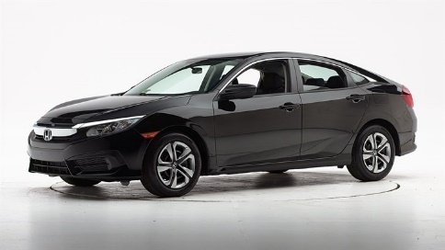
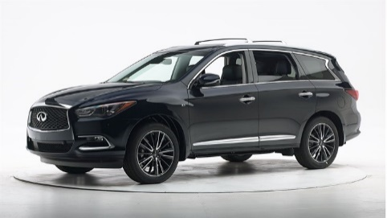
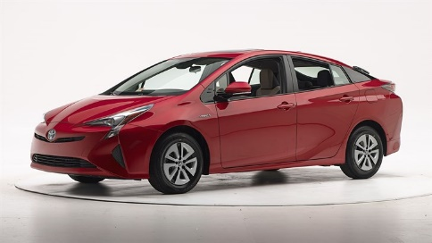
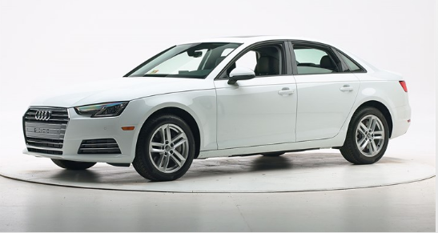
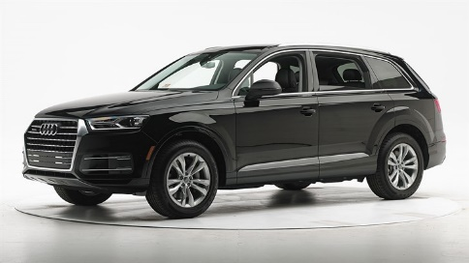
What system attributes influence the driver’s willingness to use vehicle technologies?
51 IIHS employees used one or more vehicles between August 2016 and July 2017
Nearly 50,000 miles and 2 years of driving
Vehicles used 104 times for 1 to 22 days and 6 days on average
Drivers completed surveys each day and after use
2016 Honda Civic
2016 Infiniti QX60
2016 Toyota Prius
2017 Audi A4
2017 Audi Q7
Notes:
Not all vehicle technologies are well trusted and for different reasons

Slide 31
I would keep this technology on all the time
Percentage of drivers who experienced a warning and agreed or strongly agreed

Slide 32
I would keep this technology on all the time
Percentage of drivers who experienced a warning and agreed or strongly agreed
front crash prevention
lane departure prevention
Notes:
The front crash prevention and lane departure prevention systems in these vehicles all provided a warning prior to automatic braking or steering correction by the vehicle.

Slide 33
Which attributes of front crash prevention predicted the desire to keep the system on?
Drivers reported their level of agreement about front crash prevention:
Always understood why a warning was issued or automatic braking occurred
Warnings were useful
Warnings felt urgent
Warnings were not annoying
Warnings occurred infrequently

Slide 34
Always understood front crash warnings and automatic braking
Percentage of drivers who experienced a warning and agreed or strongly agreed

Slide 35
Front crash warnings occurred infrequently
Percentage of drivers who experienced a warning and agreed or strongly agreed

Slide 36
Which attributes of lane departure prevention were related to the desire to keep the system on?
Drivers reported their level of agreement with statements about lane departure prevention:
Consistently detected lane markings on the roadway
Warned only for unintentional lane departures
Always understood why the warnings occurred
Warnings felt urgent
Warnings were not annoying
Warnings were useful

Slide 37
Lane departure prevention consistently detected lane markings
Percentage of drivers who experienced a warning and agreed or strongly agreed

Slide 38
Lane departure warnings were not annoying
Percentage of drivers who experienced a warning and agreed or strongly agreed

Slide 39
Lane departure warnings were useful
Percentage of drivers who experienced a warning and agreed or strongly agreed

Slide 40
Summary
Front crash prevention and lane departure warning are preventing crashes, and many crashes they prevent are likely the result of distracted driving
Effectiveness of lane departure warning could be greater if drivers always kept it turned on
Modality, frequency, consistency, and type of warning or intervention can affect use

Slide 41
Jessica B. Cicchino, Ph.D.
Vice President, Research
jcicchino@iihs.org

