Slide 1
Driver Mitigation of Inattentive and Impairment using Vehicle Measures
Julie J. Kang, Ph.D.
Office of Vehicle Safety
Research Crash Avoidance-
Electronics Control
Notes:
Good afternoon, and thank you for inviting me here to speak on behalf of NHTSA’s Vehicle Safety Research Office. I will present one of our key research programs that has examined the issue of drowsy drivers from a vehicle technology perspective.
Goal: Develop alcohol-detection algorithms for vehicle-based signatures (preliminary phase that led to overall ACMI work)
Oct 2007 – March 2010
Contractors: NADS and U. of Wisconsin, Timothy Brown and John Lee

Slide 2
Jellyfish caught snoozing give clues to origin of sleep (Nature, 2017)
The purpose and evolutionary origins of sleep
Can’t explain why
Every complex animal sleeps
How minimal can an animal’s nervous system get before the creature lacks the ability to sleep?
They selected the jellyfish because they have neurons but no central nervous system.

Slide 3
Sleep
Researchers observed pulses decreased by 1/3
Slower to respond to external stimuli
Even an organism without a brain—shows sleep-like behavior
Suggests that origins of sleep are more primitive than thought
All animals sleep
Notes:
Researchers observed that the rate at which Cassiopea jellyfish pulsed their bell decreased by one-third at night, and the animals were much slower to respond to external stimuli such as food or movement during that time. When deprived of their night-time rest, the jellies were less active the next day.
which was an average of one pulse per second by day, dropped by almost one-third at night. They also documented night-time pulse-free periods of 10–15 seconds, which didn’t occur during the day.
Without an established jellyfish alarm clock, the scientists used a snack of brine shrimp and oyster roe to try to rouse the snoozing Cassiopea. When they dropped food in the tank at night, Cassiopea responded to its treat by returning to a daytime pattern of activity.
Lastly, when the team forced Cassiopea to pull an all-nighter by keeping it awake with repeated pulses of water, they found a 17% drop in activity the following day.

Slide 4
Importance of Sleep and Safety
A 2002 NHTSA-sponsored Gallup survey
95% of the driving population considered drowsy driving threat to safety
AAA’s 2014 Traffic Safety Culture Index
Drivers consider it unacceptable for people to drive when they are so sleepy that they have a hard time keeping their eyes open
More than 1 in 4 drivers reported having driven when they were so tired that they had a hard time keeping their eyes open in the past 30 days.
1 in 5 reported having done this more than once
2.4 percent reported having done this fairly often or regularly.
Notes:
Moving up the evolutionary chain – adequate sleep is important with humans as well, especially when it comes to performing complex tasks like driving.
A 2002 NHTSA-sponsored Gallup survey
95% of the driving population considered drowsy driving threat to safety
AAA’s 2014 Traffic Safety Culture Index
Drivers consider it unacceptable for people to drive when they are so sleepy that they have a hard time keeping their eyes open
More than 1 in 4 drivers reported having driven when they were so tired that they had a hard time keeping their eyes open in the past 30 days.
1 in 5 reported having done this more than once
2.4 percent reported having done this fairly often or regularly.

Slide 5
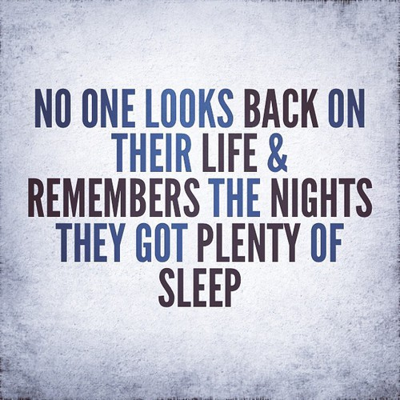
Culture of Sleep Deprivation
Notes:
While we have established that sleep serves an essential primary function for all living animals… people thinks that drowsy driving is unsafe….
It is undeniable that there is a culture that is centered around sleep deprivation.
We are constantly broadcast with sleep bragging messages that minimize the importance of sleep.
So, addressing these safety concerns about drowsy driving can be difficult when our values do not align with avoiding drowsy driving.

Slide 6
NHTSA Addresses Drowsy Driving
Notes:
There are several ways in which NHTSA as a safety agency addresses the issue of drowsy driving. One very visible way is through our campaigns which are targeted towards modifying behavior.
Here you can see an example of both facts and solutions. First and foremost, it states, “Drowsy is deadly”. It claimed 846 lives in 2014
It also presents facts which discuss the magnitude of the issue and ways to mitigate the problem. Signs & symptoms of drowsy driving
Strategies for dealing with drowsiness on a trip

Slide 7
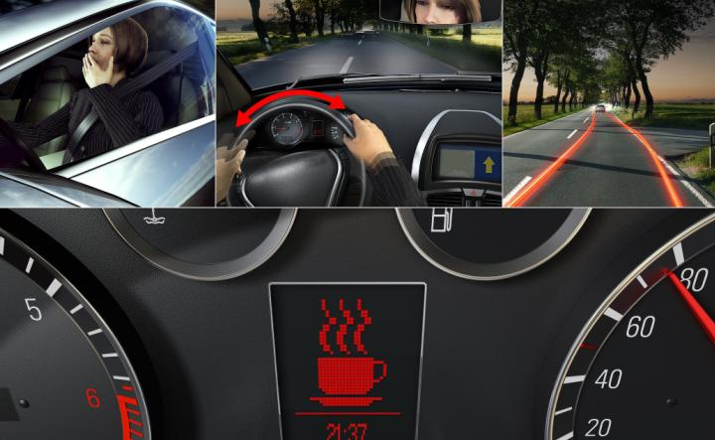
Technological Solutions for Drowsy Driving
Shift of cultural perspective
Driver Monitoring of Inattention and Impairment using Vehicle Measures (DrIIVE)
To better understand the potential of the classification algorithms
To demonstrate the effectiveness of potential countermeasures
Notes:
So one method for addressing this issue is to shift the cultural perspective of drowsy driving. NHTSA also takes the approach from examining the drowsy driving issue using technological interventions.
This is how we came up with the idea of the DrIIVE project.
To better understand the potential of the classification algorithms that support vehicle-based countermeasures
To demonstrate the effectiveness of potential countermeasures proof of concept for the use of this system in the development of driver safety technologies

Slide 8
Goals of DrIIVE Project
Develop a capability to accurately identify and distinguish among alcohol-impaired, drowsy, and distracted driving.
More fully understand the signatures of impaired driving and the potential of a system of classification algorithms to identify these signatures.
Identify and evaluate the effectiveness of vehicle-based countermeasures.

Slide 9
Algorithm
Vehicle sensors
Steering, pedals
Camera – forward, driver facing
Cost, Public Acceptance, Market
Signal Detection
Window length
Case Classification
Driver performance
v.s. steering trends
Standard for Performance
Testing
Notes:
Algorithm – set of steps to accomplish a task – in this case, our algorithm was developed to detect different types of impairment.
So, important issues that we needed to consider in this portion of the study were:
Vehicle sensor types: 1. Steer and pedals
2. Forward facing camera – info on lateral lane position
3. Driver facing cameras and seat pressure sensor to detect posture changes.
Considerations: What vehicle sensors would we use? (Cost in terms of the equipment and processing power), sensitivity with public acceptance (are people going to feel comfortable with)
Signal detrending - One concern with using steering angle as an input to any algorithm is how the results will be influenced by common situations like turning, lane changes, and driving on curves (Eskandarian et al, 2007). On one hand, if care is not taken in training a model, these differences could confound the model and we would end up detecting variations in steering trends rather than our target: driver state. On the other hand, if one successfully removes trends from the steering signal, is vital information being stripped from it, causing driver state classification to suffer? To
Algorithm Construction and Evaluation
Construction and Evaluation
How does the system work as a function of length of drive
Does the system include a stage of establishing a baseline driver signature or customization based on past drives?
Does the system use other vehicle data to modulate its performance, such as detecting driver interaction with in-vehicle systems
Window length - Non-overlapping windows trade off the amount of data against timeliness (one output per window). Overlapping windows solve this problem, issuing classifications more often than the data window size.
Window length affects algorithm output rate. Windows can overlap or not.

Slide 10
Mitigation
What do we want the driver to do?
How early can you detect?
Depending on driver state and algorithm, a system could:
Alert the driver, and other drivers
Augment warnings
Limit dangerous behavior, such as speeding
Provide feedback to shape behavior
Need to detect impairment and inattention at multiple levels: drive, event, or in real time
Notes:
The second component of the study is the mitigation strategy. It really boils down to – what do we want the drivers to do? Part of that decision is driver by perhaps what level of drowsiness can we detect? Even if we can detect at a very early stage – what will the person do if we indicate

Slide 11
Research Objectives
Refine and implement algorithms for real-time detection of driver drowsiness
Does real-time drowsiness mitigation reduced risk, specifically risk of drowsiness-related lane departures?
Do characteristics of the mitigation interface affect efficacy?
Are staged alerts more effective than discrete? Does modality influence mitigation efficacy?
Do real-time mitigation alerts reduce subjective drowsiness?
Are forward collision warnings effective for drowsy drivers?

Slide 12
Criteria for Algorithm Evaluation
Accuracy: The accuracy of a classifier is the percentage of the test set cases that are correctly classified by the classifier.
Sensitivity: Sensitivity is also referred as true positive rate i.e the proportion of positive cases that are correctly identified.
Precision: precision is defined as the proportion of the true positives against all the cases called positive results (both true positives and false positives)
Specificity: Specificity is the true negative rate that is the proportion of negative cases that are
correctly identified
PPV or positive predictive value: proportion of the true positives against all the cases called positive.
NPV or negative predictive value: proportion of the true negative against all the cases called negative
Algorithm robustness (accuracy of algorithm within several different scenarios)
Acceptable false alarm rate or miss rate
Timeliness

Slide 13
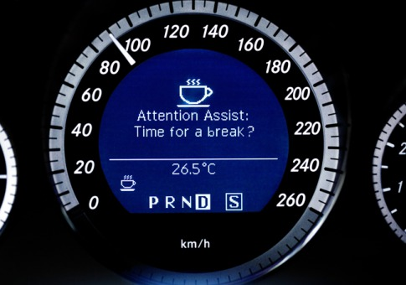
Mitigation
What do you want the driver to do?
How do you alert drivers?
What sensory modality is used?
Does the alarm increase in intensity and/or repeat more frequently as the level of impairment detected increases?
Does the system requires the driver interaction to silence or re-set the system?
The present effort may find that this is sufficient, but will not learn whether it is necessary (it is not varied).

Slide 14
Wrap-up
We need to continue to discuss the path forward for:
Better data to objectively understand the effects of drowsy driving and responses to countermeasures
Spreading the word about the risks associated with drowsy driving, along with indicators and strategies for dealing with it
Clear laws and policies to help transform attitudes and behaviors regarding drowsy driving
Developing and testing technology solutions to drowsy driving to aid drivers when they find themselves sleepy while driving

Slide 15
Thank you for your attention Julie.kang@dot.gov

Slide 16
The Risks and Who is Most Affected
Drowsy Driving is not just falling asleep
Impaired alertness, attention, reaction time, judgment, and decision-making
Higher crash risk for people who:
Have a sleep disorder
Sleep less than 6 hours/night
Young male drivers (17-23 years old)
Shift workers
Driving on rural roads and highways
Driving between midnight and 6 am – especially on the weekend
Drinking Alcohol or using other sleep inducing drugs
Notes:
Could compare drowsy impairment to alcohol intoxication

