Slide 1
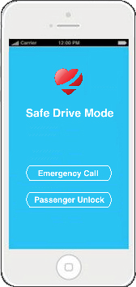
Roadmap to reduce distracted driving by 50% in five years

Slide 2
Problem is getting worse
1.6 million
Cell Phone Distracted Driving crashes annually, costing
$33 billion
in insurance claims annually
Sources:
27% of crashes involve cell phone use. National Safety Council’s Annual Estimate of Cell Phone Crashes 2013.
Average auto liability claim in 2013 = $15,443 (bodily injury) + $3,231 (property damage) = $18,674. Insurance Information Institute’s 2014 Insurance Fact Book.
Notes:
Each year there are more deaths caused by Distracted Driving than were killed at the World Trade Center (2,997) attacks in 2002. The problem will increase if there is no intervention as more hi-tech teens start to drive.

Slide 3
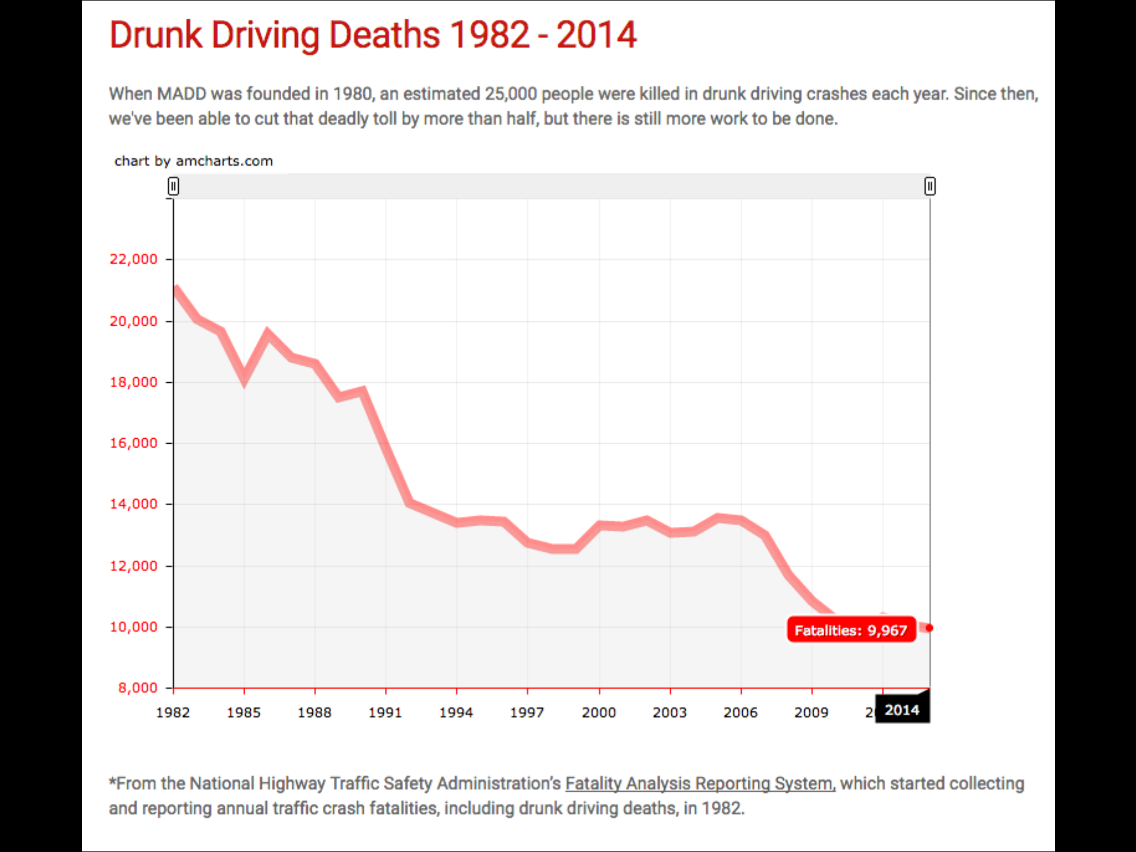
What will it take to change?
MADD led the charge to reduce Drunk Driving fatalities by more than 50% since 1980.
We cannot wait 36 years to achieve the same results for Distracted Driving.
BOLD GOAL
5 Years to Reduce Distracted Driving by 50%!

Slide 4
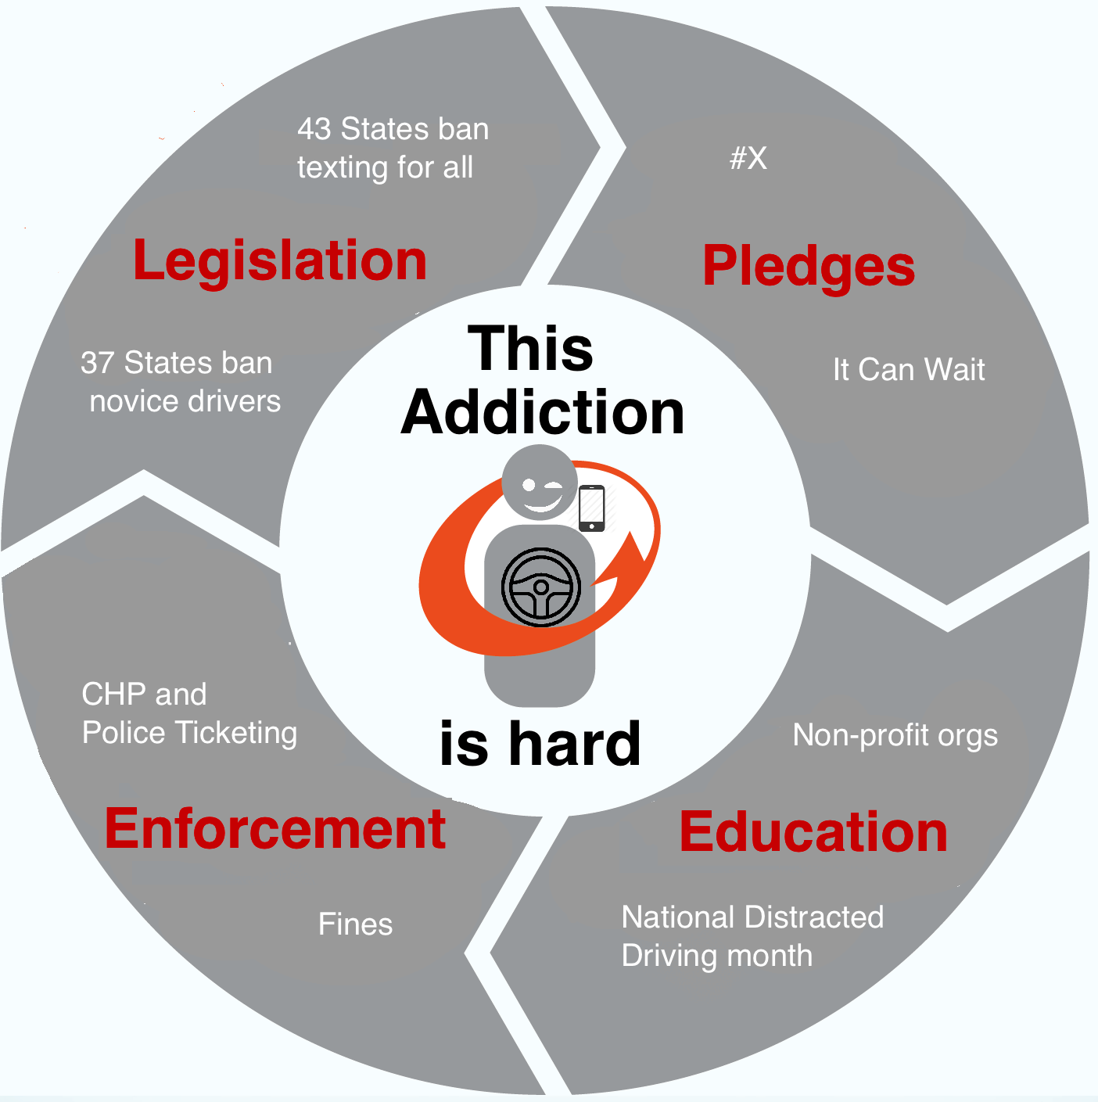
Technology can accelerate
+

Slide 5
LifeSaver Videos
LifeSaver driving peace of mind video
LifeSaver how it works video
Jacy Good PSA
Jacy Good’s LifeSaver testimonial

Slide 6
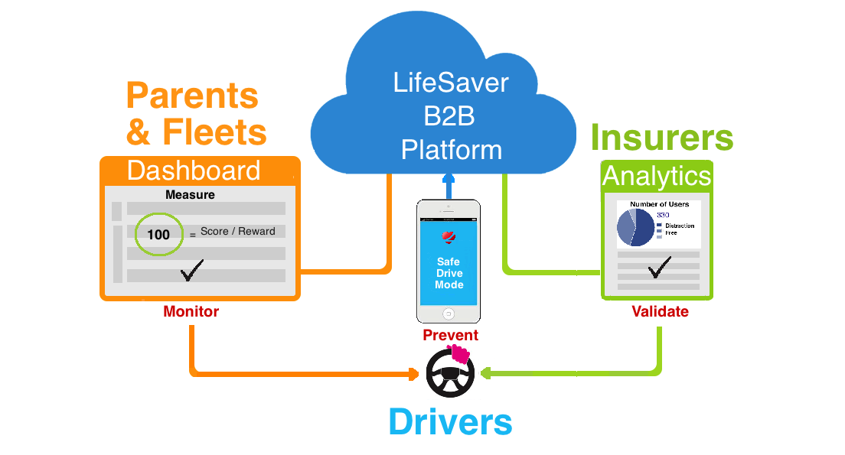
LifeSaver Solution
2. Our smartphone app blocks phone use while driving
1. Our Dashboard provides fast deployment of LifeSaver to drivers, linking them to the fleet manager or parent
3. Reporting and Analytics ensures compliance and validates effectiveness

Slide 7
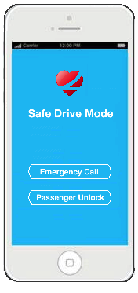
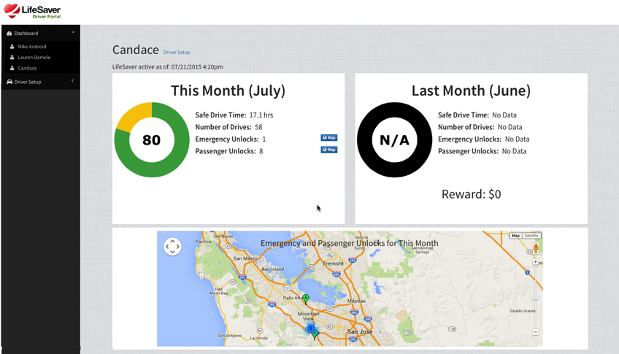
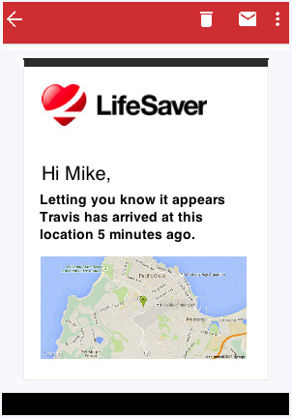
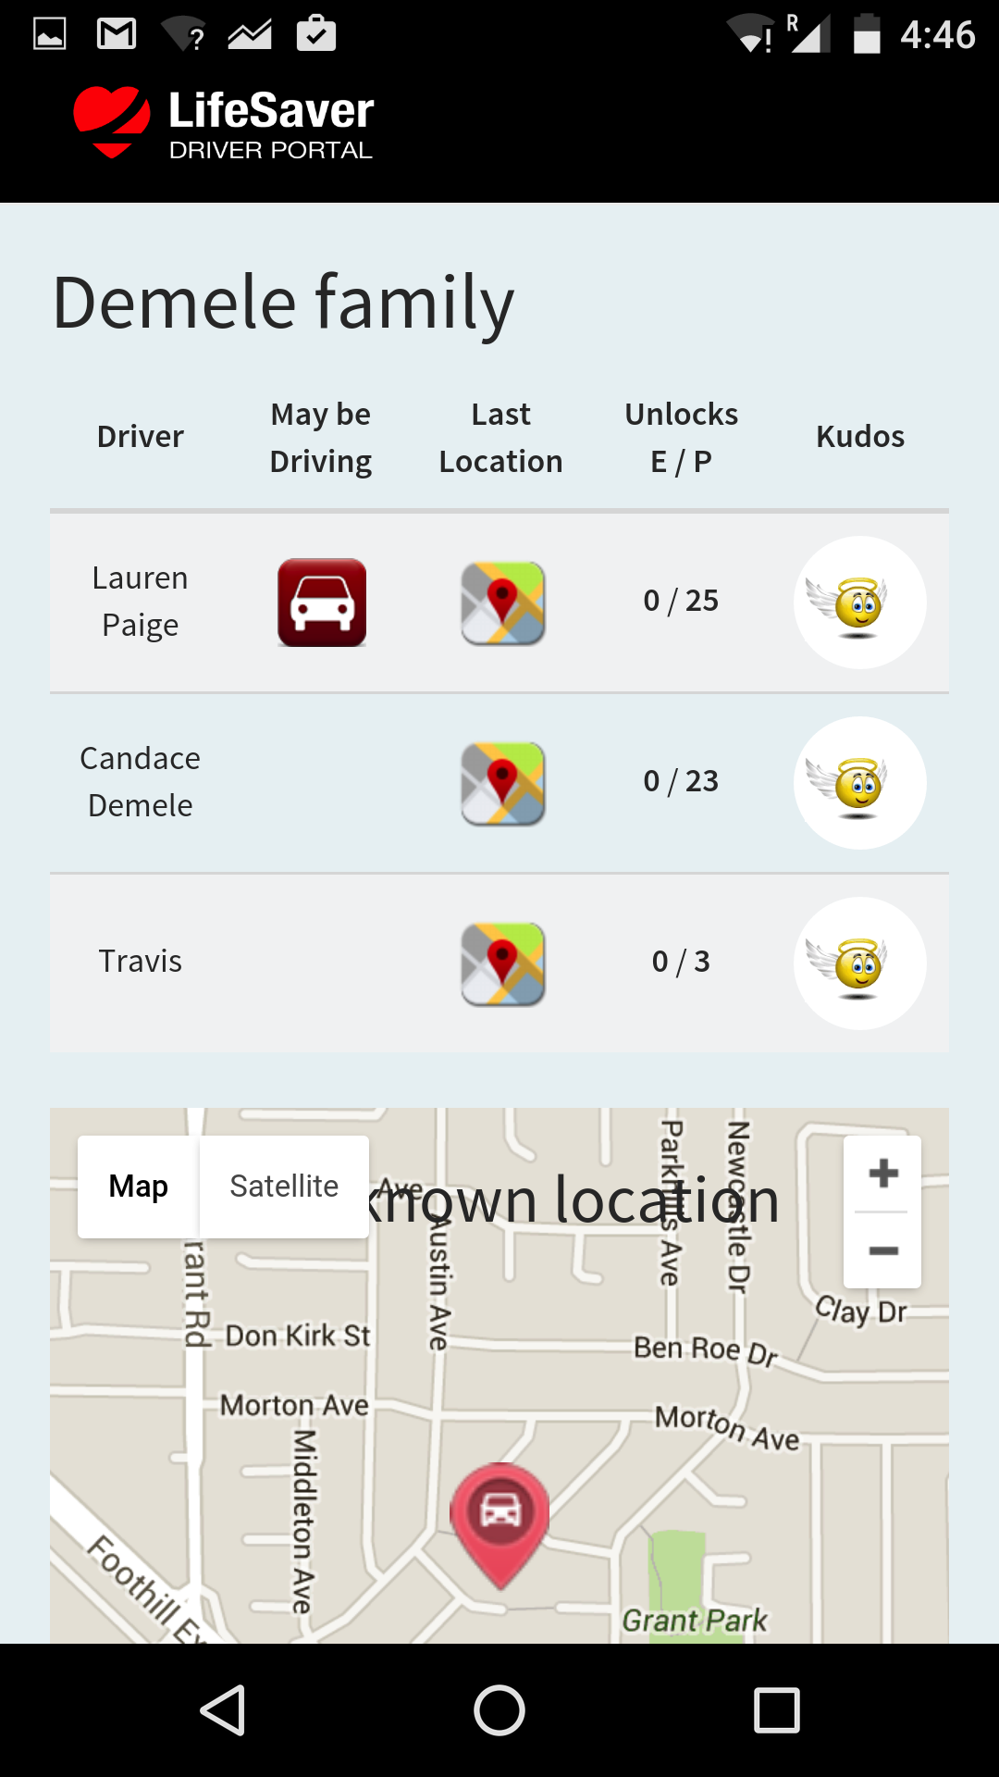
Peace of Mind for Consumers
Safe Drive Mode protects Travis from mobile distraction while driving
Driver Portal provides parents a mission control dashboard for accountability and rewards
Arrival Notifications let Mom and Dad know that he made it safely
Family View offers an easy way to avoid texting or calling him when he’s driving
Notes:
With Safe Drive Mode the phone screen is blocked making it impossible text or make phone call . Driver Portal on website makes driver phone use instantly accessable to parents or safety
supervisor. Arrival Notifications show safe arrival via text to parent or dispatcher. Family View allow parents access to view when vehile being driven.

Slide 8
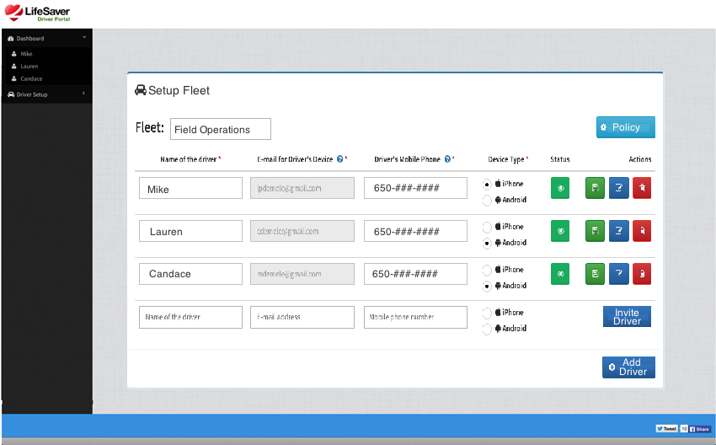
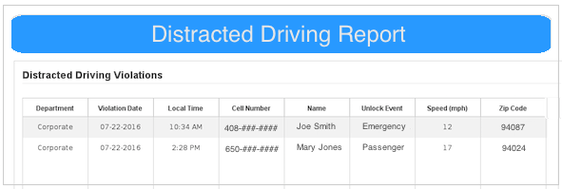
Fleet demand is accelerating
Easy App Deployment to employee phones through dashboard invitation – no hardware required
Admin Features
for fleet and safety officer management
Daily Reporting provides a list of employees with LifeSaver violations and inactivity

Slide 9
Thank you!
Jim Howell, Head of Sales
jimhowell@lifesaverapp.com
859.552.6016
Notes:
Ladies and gentlemen with your help and the help of the public we can meet the goal of 50% reduction in distracted crashes in 5 years using the roadmap outlined today. This will result in thousands of lives saved and billions if dollars in reduction of insurance claims.

