Slide 1
A Multi-Modal Approach to Distractions
4th Annual Virginia Distracted Driving Summit
Virginia Beach, VA
September 29, 2016
Notes:
Good morning, my name is Rick Narvell and I am a Human Performance Investigator with the NTSB. Thank you for inviting me to speak to you about a very important issue that affects transportation safety.
[Next slide]

Slide 2
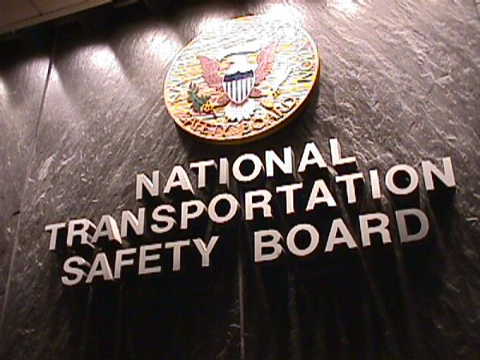
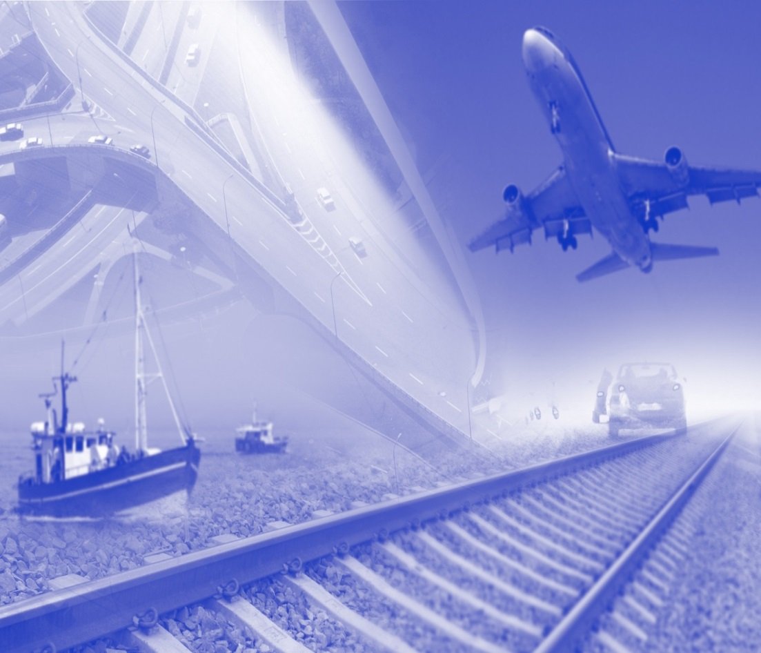
Independent Federal Agency
Mission:
Objectively investigate accidents in regulated transportation
Develop recommendations to prevent future accidents
Notes:
The NTSB investigates accidents to find out not only what happened, but why it, and to make recommendations to improve transportation safety. Recommendations are the NTSB’s most important tool for bringing about life-saving changes.
Our goal is to prevent accidents, and thereby reduce, and ultimately eliminate, injuries and fatalities.
[Next slide]

Slide 3
Outline
What is operator distraction?
Consequences of distraction:
Highway
Aviation
Marine
Railroad
Toward a solution
Notes:
Distraction in transportation did not start with the advent of the cell phone. The attention of a driver, pilot, or operator can be diverted by other internal or external sources.
Distractions can be cognitive, visual, auditory, or manual - or a combination of these. For instance, texting involves three: eyes off the road, hands off the wheel and on the portable electronic device, and mind on the text and not on the driving task.
You need to change the radio. You reach for the dial taking your hand off the wheel, or maybe texting you need to take both hands off the wheel.
You look down to see what station you're tuning in, taking your eyes off the road
You think about what kind of music is playing or what kind of music you'd like to be playing, or you think about what to send or answer in a text, actually just thinking about anything other than driving – cognitive distraction.
Auditory distraction is caused when sounds prevent drivers from making the best use of their hearing, because their attention has been drawn to whatever caused the sound. Eg: Music
All in one act.
For more inexperienced drivers like teens, other teen passengers, in particular, can be distracting and lead to tragic consequences.
Distraction, particularly on our roadways, is a serious and growing problem.
[Next slide]

Slide 4
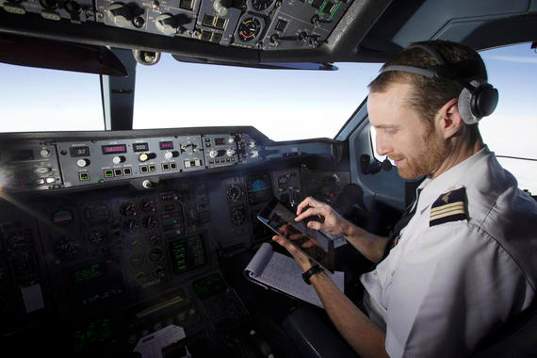

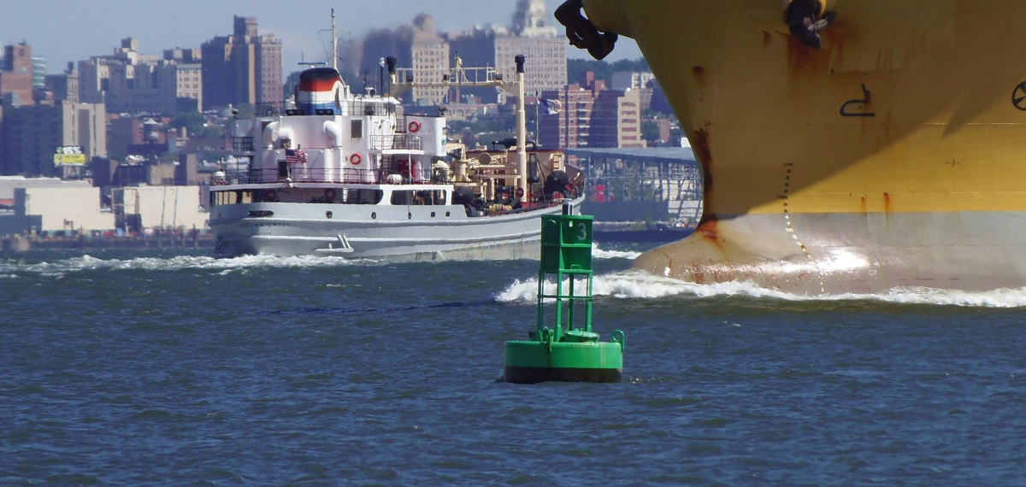

Operator Distraction
Any activity that diverts attentional focus from primary task
Diverse Sources & Impacts
task, equipment, environment, decision-making
cognitive, perceptual, physical
Notes:
Distraction in transportation did not start with the advent of the cell phone. The attention of a driver, pilot, or operator can be diverted by other internal or external sources.
Distractions can be cognitive, visual, auditory, or manual - or a combination of these. For instance, simple texting involves three: eyes off the road, a hand or hands off the wheel and on the portable electronic device (less something like Bluetooth), and mind on the text and not on the driving task.
You need to change the radio. You reach for the dial taking your hand off the wheel, or maybe texting you need to take both hands off the wheel – manual distraction.
You look down to see what station you're tuning in, taking your eyes off the road – visual distraction.
You think about what kind of music is playing or what kind of music you'd like to be playing, or you think about what to send or answer in a text, actually just thinking about anything other than driving – cognitive distraction.
Auditory distraction is caused when sounds prevent drivers from making the best use of their hearing, because their attention has been drawn to whatever caused the sound. Eg: music, or a crying child.
For more inexperienced drivers like teens, other teen passengers, in particular, can be distracting and lead to tragic consequences.
Distraction, particularly on our roadways, is a serious and growing problem.
[Next slide]

Slide 5
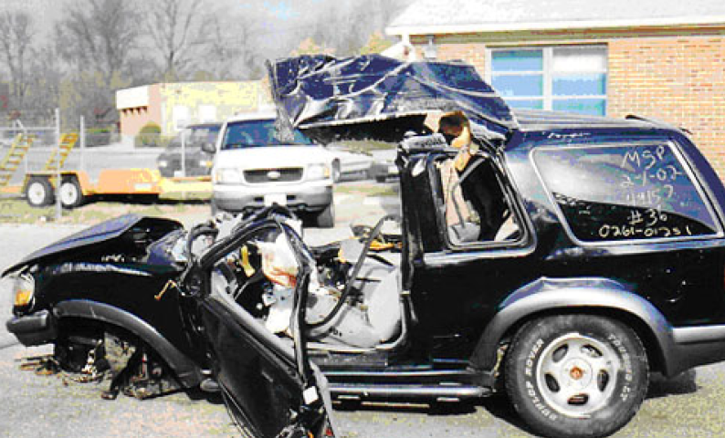
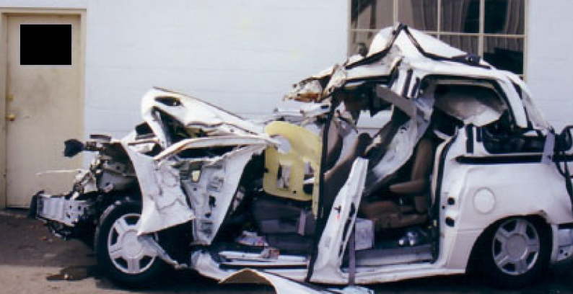
Highway – Cars
Largo, MD 01-FEB-2002
5 fatalities
1st NTSB accident where distraction was identified as probably or contributing cause
Teen driver distracted by passengers
Crossed median, flipped, and landed on minivan
Ford Explorer
Ford Windstar Minivan
Notes:
Our first accident investigation in which we identified distraction as a cause or contributing factor happened over 14 years ago on February 1, 2002. A young driver who was talking on her cell phone crossed a median, flipped over, and landed on a minivan.
That cell phone conversation killed five people. These types to accidents and incidents are occurring daily with many of your peers behind the wheel.

Slide 6
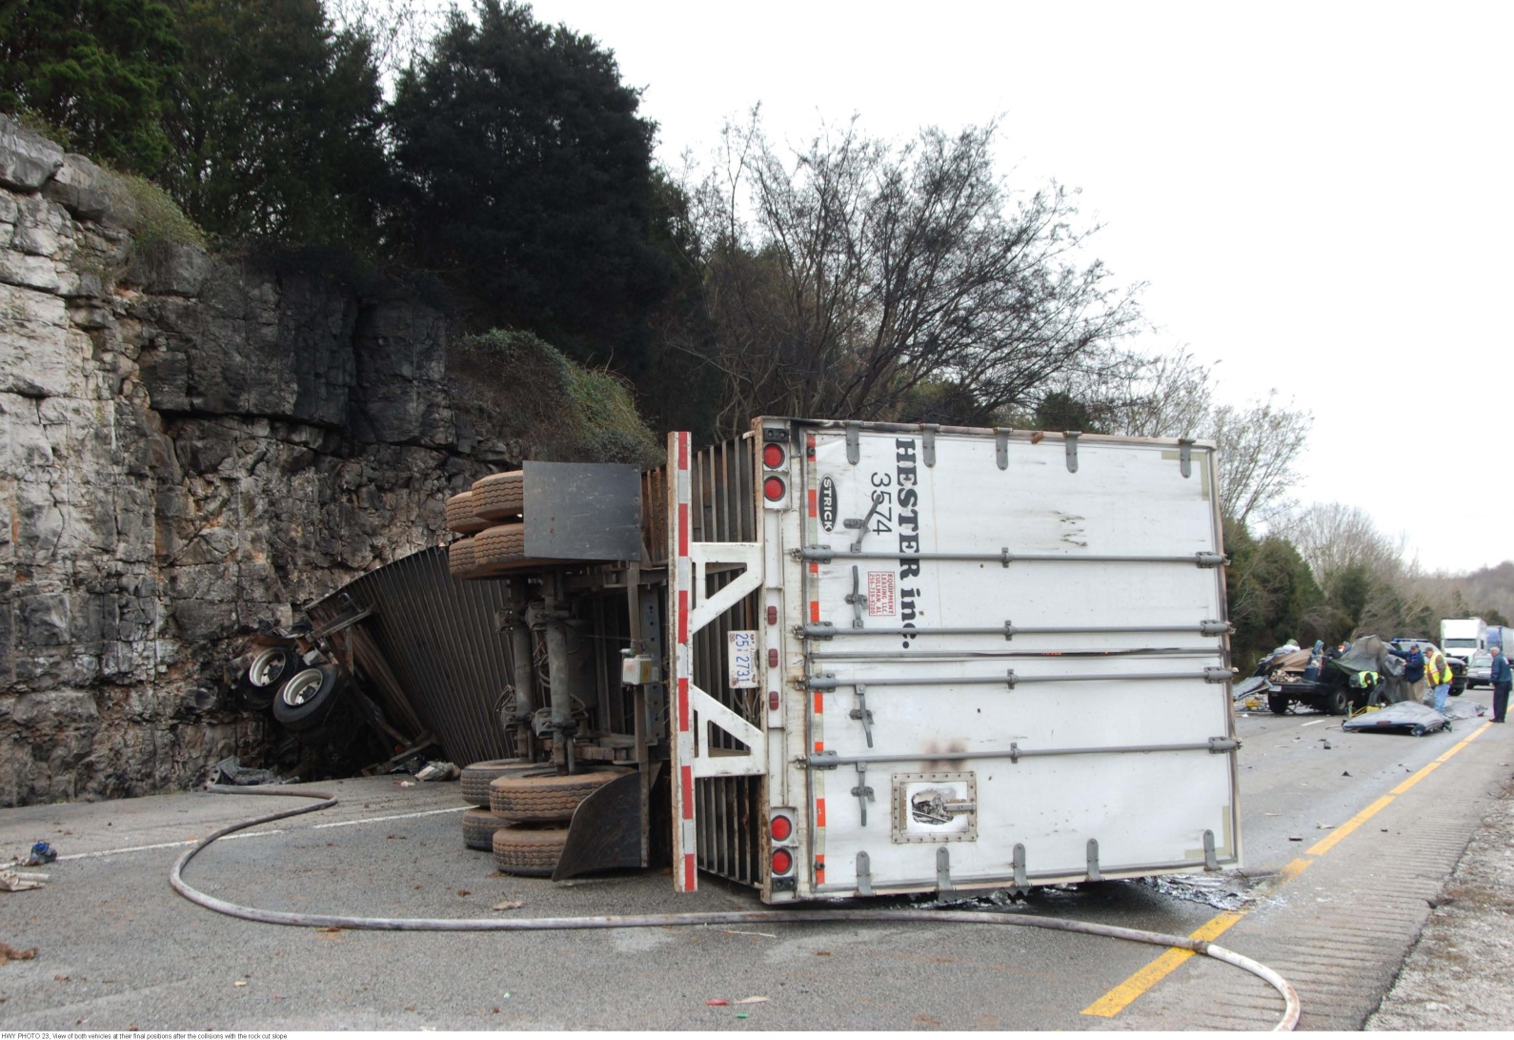
Highway - Trucks
Munfordville, KY 26-MAR-2010
11 fatalities
Truck collided with passenger van. Two children in van were restrained; incurred minor injuries
Driver distracted by cell phone
SR-11-29 Prohibit hand-held and hands-free by all CDLs
Notes:
On Friday, March 26, 2010 an 18 wheeler collided with a 15 passenger van causing a fire that resulted in the death of the truck driver, van driver and nine passengers. The two child passengers in the van who were properly restrained, sustained minor injuries.
The NTSB determined that the truck driver was distracted by his cell phone.
Recommendation H-11-29 (issued to all 50 states and D.C.): Prohibit the use of both hand held and hands –free cellular telephones by all commercial driver’s license holders while operating a commercial vehicle, except in emergencies.

Slide 7
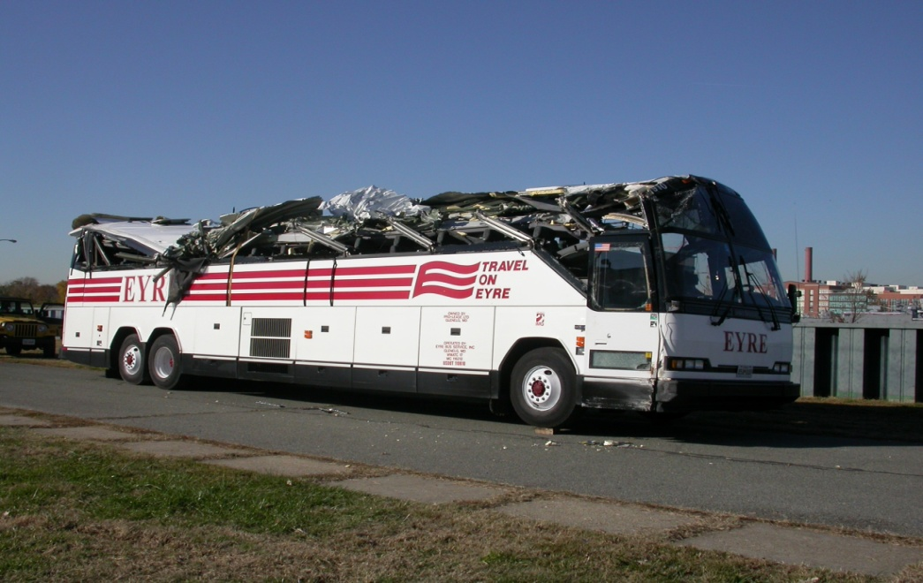
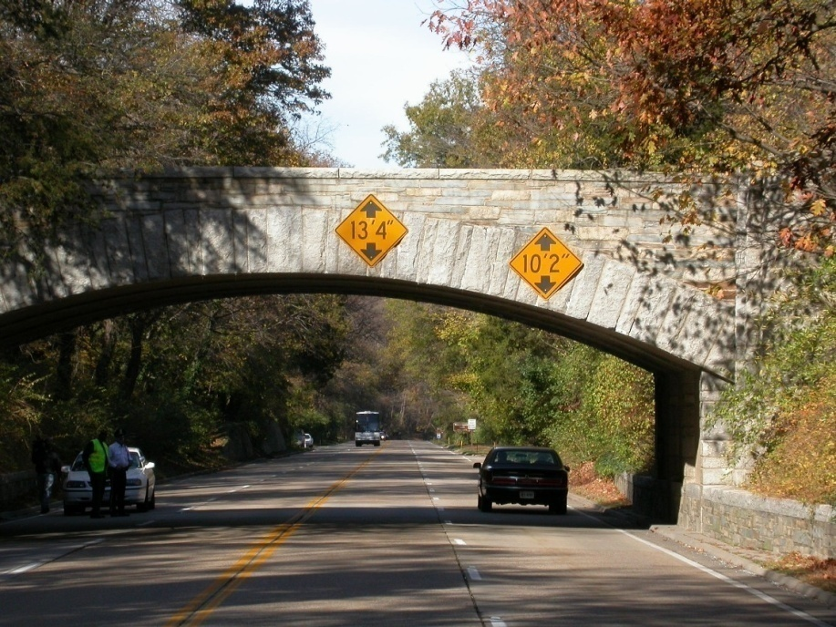
Highway – Motor Coaches
Alexandria, VA 14-NOV-2004
0 fatalities
Coach collided with overpass. 11 injuries
Driver using hands-free cell phone
Driver didn’t see bridge until he hit it
Notes:
Take for example the driver of this motorcoach, on the morning of November 14, 2004, a motorcoach collided with a bridge overpass on the George Washington Memorial Parkway in Alexandria, VA.
The motorcoach departed the Baltimore/Washington International Thurgood Marshall Airport for an approximately 60-mile trip to Mount Vernon, Virginia. This vehicle was the second of a two-bus team on a route the driver had driven many times before.
At the time of the collision, the motorcoach driver was engaged in a hands-free cell phone conversation. He told our investigators that not only did he not see the sign warning of low clearance or the lead bus changing lanes, he didn’t even see the bridge until he hit it. Thankfully, no one was killed in this crash. 10 passengers received minor injuries and 1 sustained serious injuries. The bus driver was distracted by a cellular conversation.
[Next slide]

Slide 8
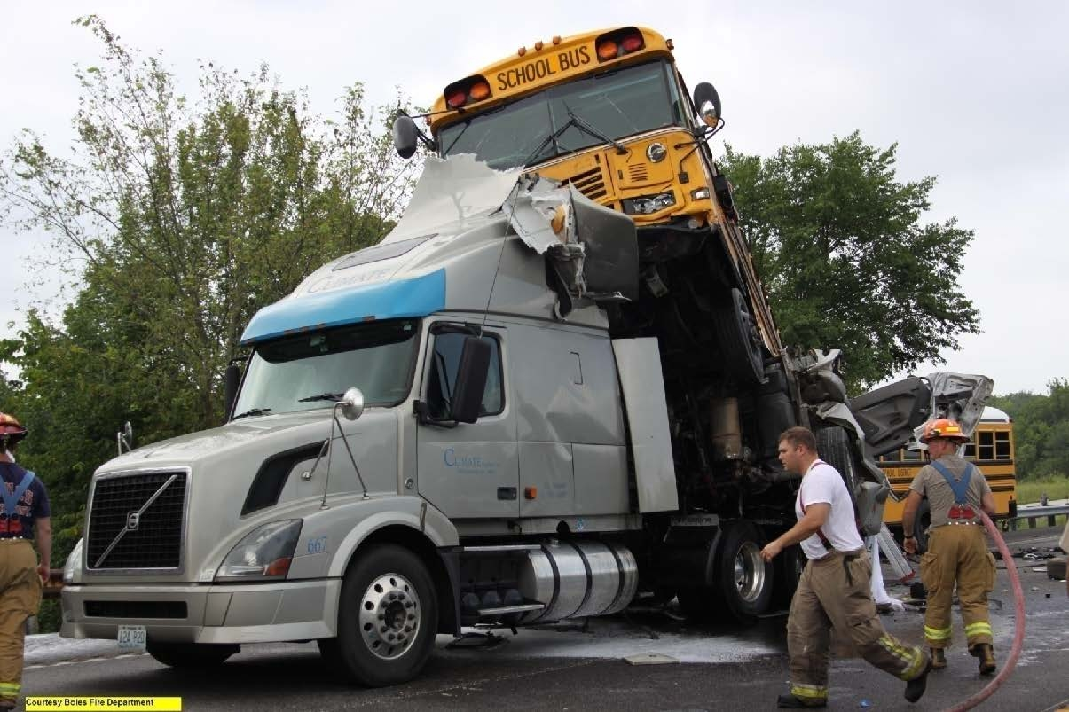
Highway – School Buses
Gray Summit, MO 05-AUG-2004
2 fatalities
Truck, pick-up, & school bus
Pick-up driver sent and received 11 messages prior to accident — he rear-ended truck
Pick-up driver not focused on driving
Notes:
On August 5, 2010, a teen driver of a pickup truck and a school bus passenger were killed in a multi-vehicle crash in Gray Summit, Missouri. Can you see the pick-up truck?
The young driver of the pickup truck was using a handheld wireless electronic device -- a cell phone. The driver sent and received 11 text messages in the 11 minutes prior to the accident. The last text was right before impact.
We will never know whether the driver was typing, reaching for the phone, or reading a text when his pickup ran into the truck in front of him without warning. The specific actions of the pickup driver are not revealed by his cell phone records. But we do know he had been distracted - cognitively, manually, and visually - while driving.
Driving was not his only priority.
[Next slide]

Slide 9
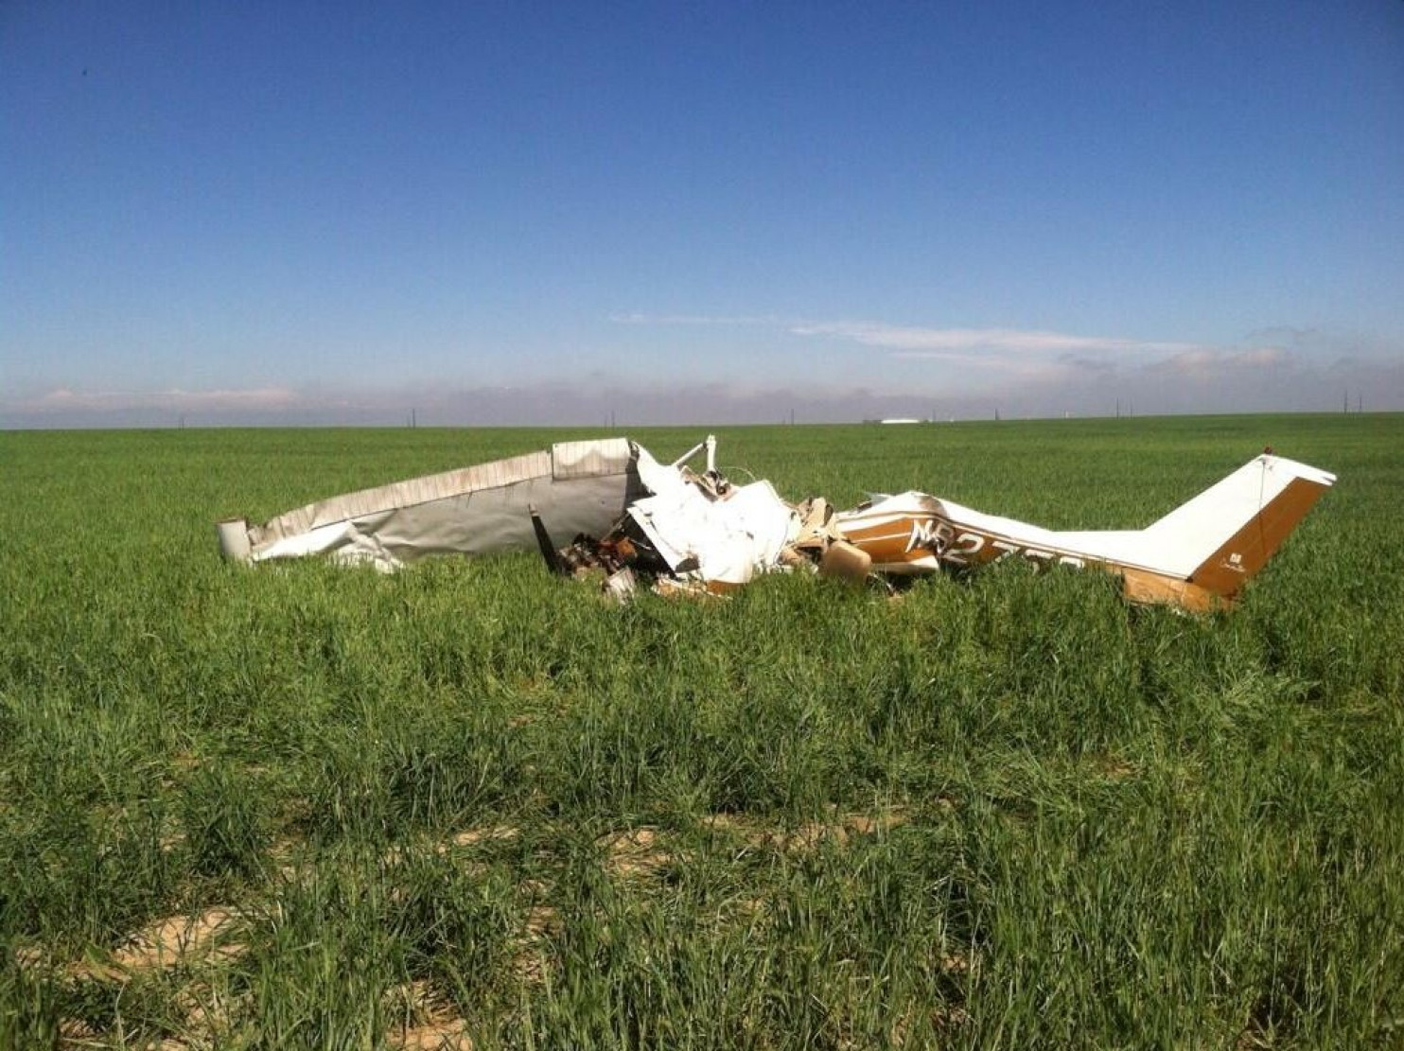
Aviation – Private Planes
Watkins, CO 31-MAY-2014
2 fatalities
Pilot became disorientated at night, lost control, stalled, and crashed
Pilot and passenger likely taking “selfies” during low-altitude maneuvers
Notes:
You might have recently heard of this, the headline in a news story read: “Selfies: Love them or hate them, just don’t take them while flying a plane.”
In our report the investigators determined that the small plane crash in Colorado that killed two people in May was “likely” the result of the pilot and passengers taking selfies.
PC: The pilot’s loss of control and subsequent aerodynamic stall due to spatial disorientation in night instrument meteorological conditions. Contributing to the accident was the pilot’s distraction due to his cell phone use while maneuvering at low-altitude.

Slide 10
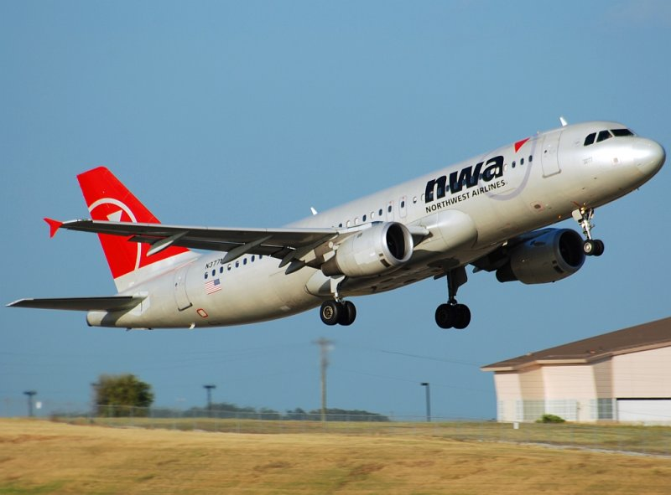
Aviation – Commercial Planes
Minneapolis, MN 21-OCT-2009
0 fatalities
Crew did not communicate with ATC for 1 hr 17 min and flew past destination by 100 miles
Flight crew failed to monitor radio and instruments
Distracted by conversations and use of laptop
Notes:
On October 21, 2009, Northwest Airlines (NWA) flight 188 did not communicate with air traffic control (ATC) for approximately 1 hour 17 minutes and flew past its landing point by 100 miles. The NTSB concluded that the flight crew failed to monitor the airplane’s radio and instruments and the progress of the flight after becoming distracted by conversations and activities unrelated to the operation of the flight. (use of a laptop)

Slide 11
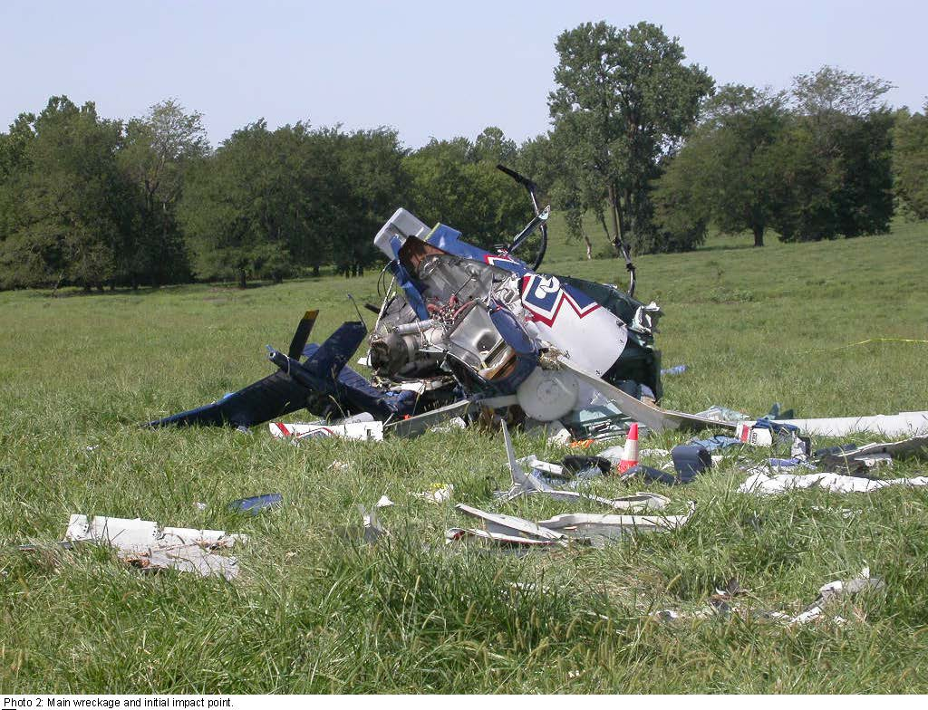
Aviation - Helicopters
Mosby, MO 26-AUG-2011
4 fatalities
EMS helicopter ran out of fuel
Pilot was engaged in personal texting during safety-critical ground and flight operations
Pilot was fatigued, lacked training, and made poor decisions
Notes:
August 26, 2011, an emergency medical services helicopter crashed, killing the pilot and three passengers. We determined that the helicopter ran out of fuel, in part because the pilot was engaging in personal texting during safety-critical ground and flight operations.

Slide 12
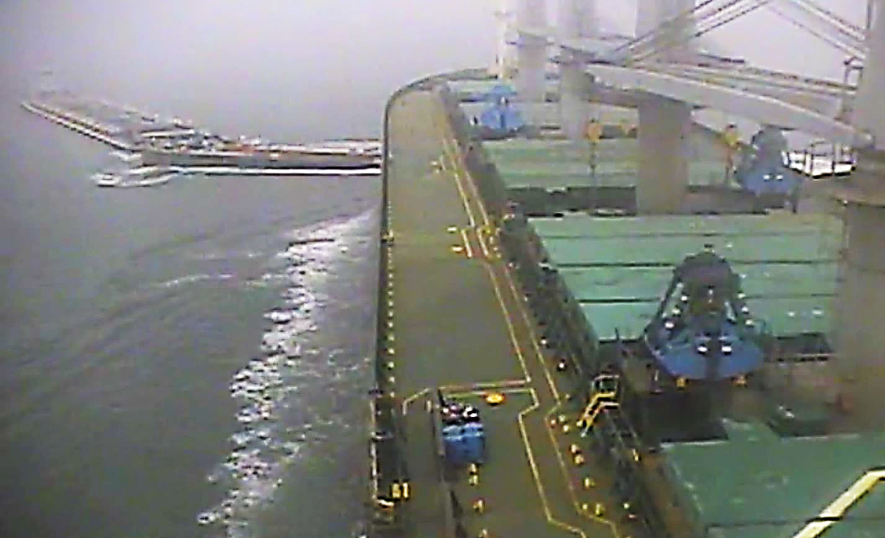
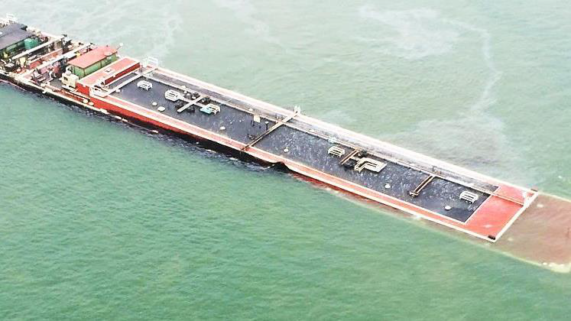
Marine – Commercial-Commercial Vessels
Lower Galveston Bay, TX 22-MAR-2014
2 injuries; oil spill in sensitive environment
Tow pilot crossed bow of deep draft bulk carrier in poor visibility
Tow pilot repeatedly in radio communication with other tows crossing channel
Pilot misjudged bulk carrier position and speed; poor decision-making and focus
Notes:
On March 22, 2014, about 12:35 central daylight time, the 607-foot-long bulk carrier Summer Wind with a Houston pilot on board collided with the 670-foot-long Miss Susan tow (a 70-foot-long towing vessel and two 300-foot-long tank barges loaded with fuel oil) in the Houston Ship Channel, Lower Galveston Bay, Texas. The visibility was restricted at the time due to fog. The bulk carrier was inbound to Houston, traveling in a north direction. The tow was bound for Port Bolivar on the east side of the Houston Ship Channel, traveling in an east direction.
The collision breached the hull of the forward tank barge in the Miss Susan tow, and about 168,000 gallons of fuel oil spilled into the waterway. Two crewmembers on board the Miss Susan sustained minor injuries related to inhalation of fuel vapor. The total estimated damage was nearly $1,378,000 (excluding oil response and recovery efforts).
The NTSB determined that the probable cause of the collision was the Miss Susan captain’s attempt to cross the Houston Ship Channel ahead of the Summer Wind, thereby impeding the passage of the bulk carrier, which could transit only within the confines of the channel. Contributing to the accident was the failure of the Houston pilot and the Summer Wind master to set a safe speed given the restricted visibility and nearby towing vessel traffic, and the failure of the Miss Susan captain and the Houston pilot to establish early radio communication with one another. Also contributing to the accident was the failure of Vessel Traffic Service Houston/Galveston to interact with the two vessels in a developing risk of collision, and the lack of a Coast Guard vessel separation policy for the Bolivar Roads Precautionary Area.

Slide 13
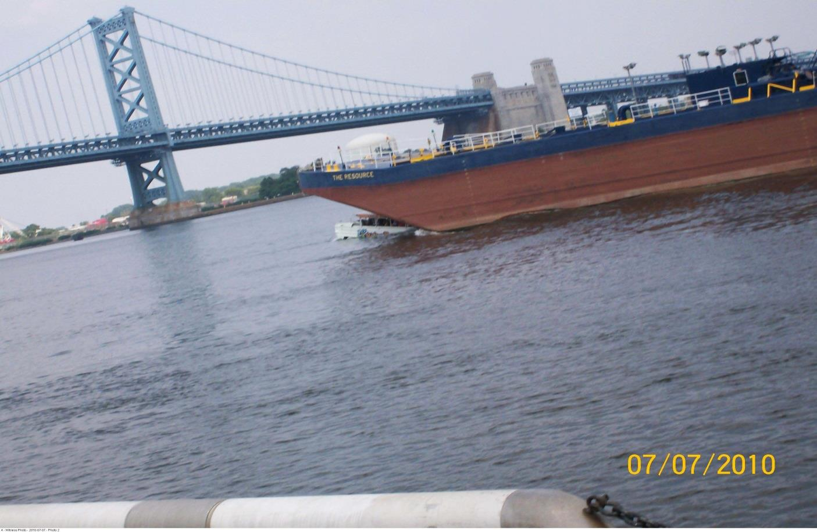

Marine – Commercial-Recreational Vessels
Philadelphia, PA 07-JUL-2010
2 fatalities; 26 injuries
Tugboat & barge collided with an anchored 33-foot amphibious passenger vehicle
Tugboat mate repeatedly used cell phone and laptop for personal matters
Mate was distracted and inattentive to navigating vessel
Notes:
On Wednesday, July 7, 2010, the empty 250-foot-long sludge barge The Resource, being towed alongside the 78.9-foot-long tugboat Caribbean Sea, collided with the anchored 33-foot-long amphibious passenger vehicle DUKW 34 in the Delaware River at Philadelphia, Pennsylvania. DUKW 34 carried 35 passengers and 2 crewmembers. On board the Caribbean Sea were five crewmembers. As a result of the collision, DUKW 34 sank in about 55 feet of water. Two passengers were fatally injured, and 26 passengers suffered minor injuries. No one on the Caribbean Sea was injured. Damage to DUKW 34 totaled $130,470. Damage to the barge was minimal; no repairs were made.
The NTSB determined that the probable cause of this accident was the failure of the mate of the Caribbean Sea to maintain a proper lookout due to
his decision to operate the vessel from the lower wheelhouse, which was contrary to expectations and to prudent seamanship, and
distraction and inattentiveness as a result of his repeated personal use of his cell phone and company laptop computer while he was solely responsible for navigating the vessel.
Contributing to the accident was the failure of Ride The Ducks International maintenance personnel to ensure that DUKW 34‘s surge tank pressure cap was securely in place before allowing the vehicle to return to passenger service on the morning of the accident, and the failure of the DUKW 34 master to take actions appropriate to the risk of anchoring his vessel in an active navigation channel.

Slide 14
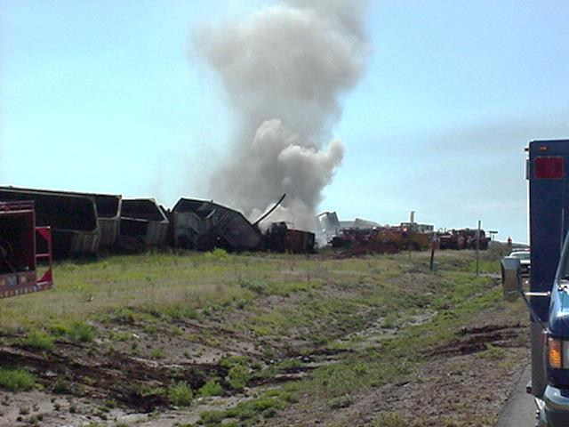
Railroad – Freight Trains
Clarendon, TX 26-MAR-2002
1 fatality; 3 injuries
Coal train collided head-on with intermodal train in track warrant (dark) territory
Coal train engineer used cell phone for personal matters while receiving track warrant
After-arrivals procedure is inherently dangerous and demands focused operators
Notes:
At 8:57 a.m., central daylight time, on May 28, 2002, an eastbound Burlington Northern Santa Fe (BNSF) coal train collided head on with a westbound BNSF intermodal train near Clarendon, Texas. Both trains had a crew of two, and all crewmembers jumped from their trains before the impact. The conductor and engineer of the coal train were critically injured. The conductor of the intermodal train received minor injuries; the engineer of the intermodal train was fatally injured. The collision resulted in a subsequent fire that damaged or destroyed several of the locomotives and other railroad equipment. Damages exceeded $8 million.
The NTSB determined that the probable cause of the May 28, 2002, collision at Clarendon, Texas, was
(1) the coal train engineer’s use of a cell phone during the time he should have been attending to the requirements of the track warrant his train was operating under and
(2) the unexplained failure of the conductor to ensure that the engineer complied with the track warrant restrictions.
Contributing to the accident was the absence of a positive train control system that would have automatically stopped the coal train before it exceeded its authorized limits.
Next slide please.

Slide 15
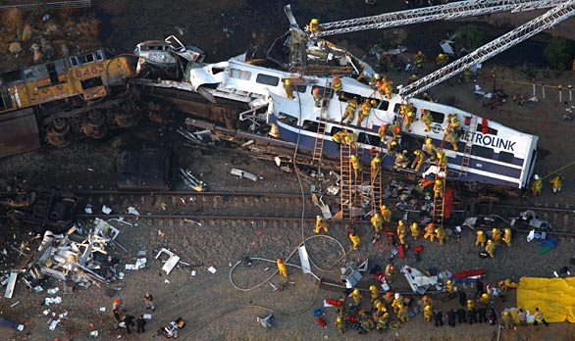
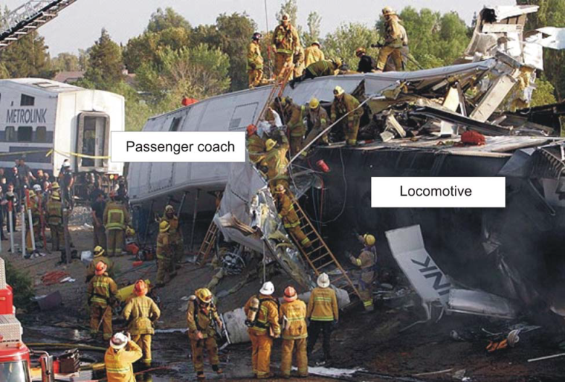
Railroad – Passenger Trains
Chatsworth, CA 12-SEP-2008
25 fatalities; 102 injuries. One of the deadliest rail accidents investigated by NTSB.
Metrolink passenger train collided head-on with freight train
PAX locomotive telescoped into lead PAX car about 52 feet
PAX engineer received 22 text messages, sent 21 text messages, and made 4 calls while operating train
Notes:
About 4:22 p.m., Pacific daylight time, on Friday, September 12, 2008, westbound Southern California Regional Rail Authority Metrolink train 111, consisting of one locomotive and three passenger cars, collided head-on with eastbound Union Pacific Railroad freight train LOF65–12 near Chatsworth, California. The Metrolink train derailed its locomotive and lead passenger car; the UP train derailed its 2 locomotives and 10 of its 17 cars. The force of the collision caused the locomotive of train 111 to telescope into the lead passenger coach by about 52 feet. The accident resulted in 25 fatalities, including the engineer of train 111. Emergency response agencies reported transporting 102 injured passengers to local hospitals. Damages were estimated to be in excess of $12 million.
The NTSB determined that the probable cause of the collision was the failure of the Metrolink engineer to observe and appropriately respond to the red signal aspect at Control Point Topanga because he was engaged in prohibited use of a wireless device, specifically text messaging, that distracted him from his duties. Contributing to the accident was the lack of a positive train control system that would have stopped the Metrolink train short of the red signal and thus prevented the collision.

Slide 16
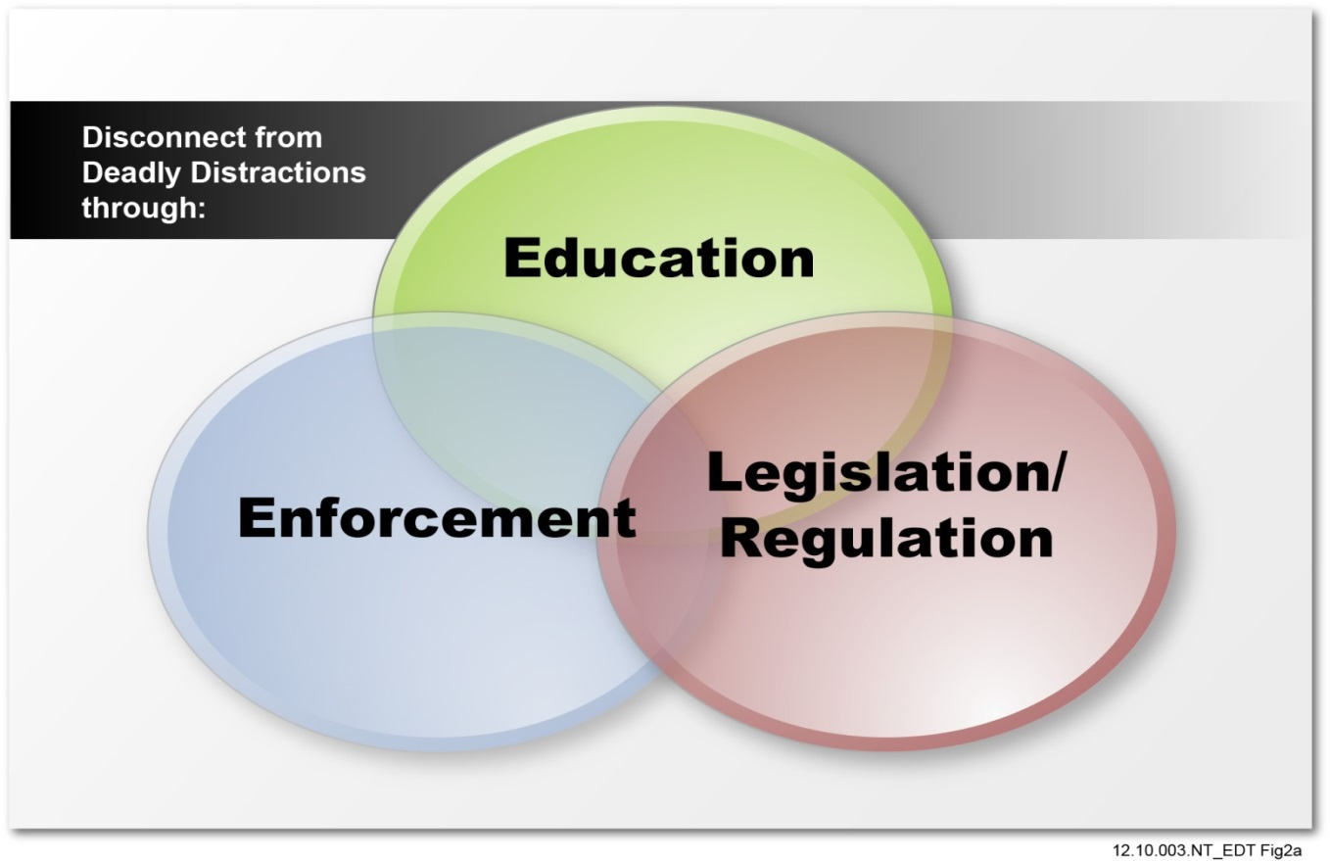
Towards a Solution
Critical changes are needed to reduce accidents and save lives
Distraction is pervasive cause of human error
Distractions are diverse
Operators must understand distractions and how to avoid them
Policies and practices must reinforce that operator’s primary task is control of vehicle at all times
Notes:
To affect change we need each of you, individuals and organizations. We need a cultural shift to bring about a wide spread change, one that will require good laws and regulations; extensive education; and strong enforcement.
But it starts with you in this room, you can be that voice of reason for a friend, parent or family member. And you can be a good role model. Not only by not driving distracted, but by also not leading others to drive distracted.
Policies start at the top with the leadership enforcing best practices within the organization:
(Talk about the difficulties we faced with seatbelts, impaired driving).
[Next slide]

Slide 17
For Information
Rick Narvell
Human Performance Investigator
Office of Railroad, Pipeline, and Hazardous Materials Investigations
National Transportation Safety Board
(O) (202) 314-6422 (C) (202) 320-6317
narvelr@ntsb.gov
www.ntsb.gov
Notes:
Thank for your time.

