Slide 1
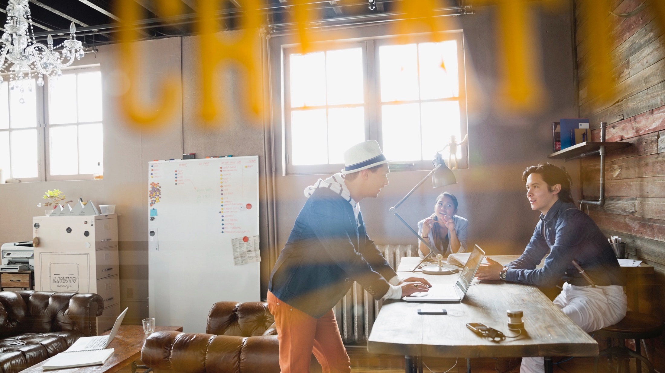


Teens. Driving. And Keeping it Real. How Our Youngest Drivers are Connecting
SEPTEMBER 29, 2016

Slide 3
Notes:
Q: Does anyone know who this is?
A: Matthew McConaughey
Q: Can anyone guess how many YouTube followers he has?
A: 80K followers

Slide 4
5.5M YouTube followers
Notes:
Q: Can anyone tell me who this is?
A: This is Meg DeAngelis. She is 21 years old, a former cheerleader at the University of Central Florida, and a fashion/beauty blogger.
Q: Can anyone guess how many YouTube followers Meg has?
A: 5.5M YouTube followers.

Slide 5

Notes:
Among older teens, which social media platform are they using the most?

Slide 6
67%
Notes:
A: Surprisingly it’s still Facebook.

Slide 7
50%
Notes:
But Snapchat and Instagram are chomping at Facebook’s lead, and are the leading platforms for teens when it comes to maintaining more immediate and closer relationships.

Slide 8
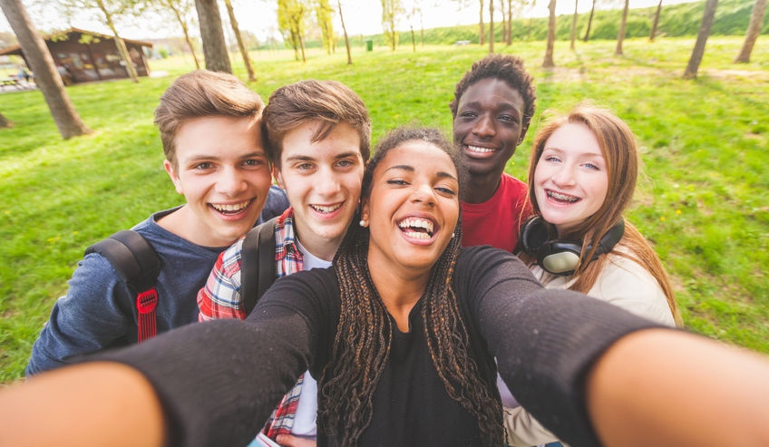
Straddling Millennials and GenZ

Slide 9

9 hours/day
consuming media

Slide 10
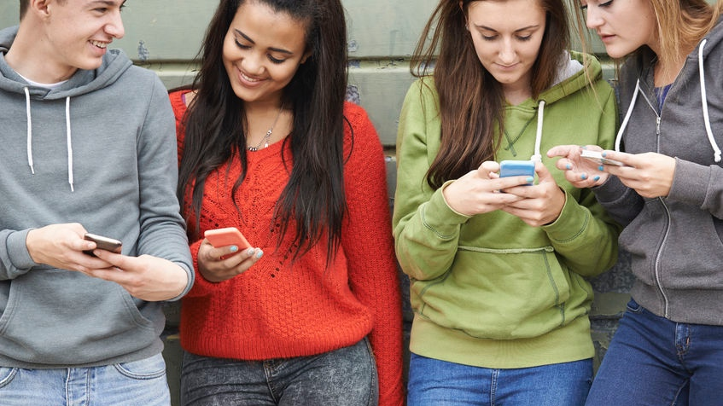
67%
have a smartphone

Slide 11
4 hours/day
on their smartphones

Slide 12
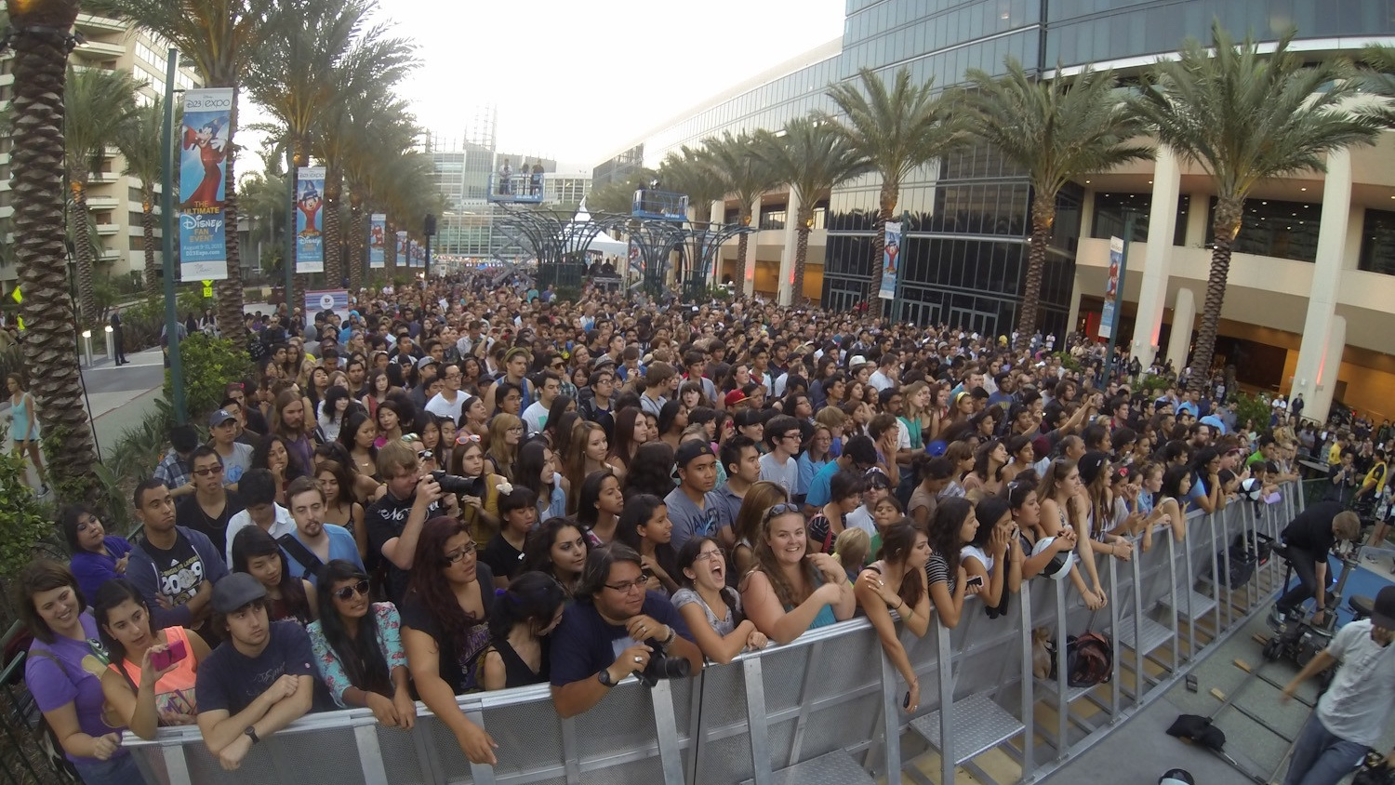
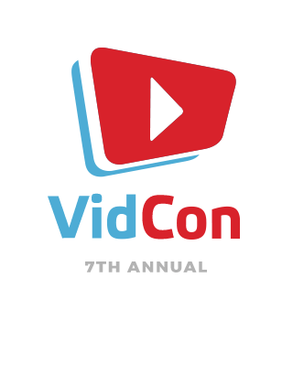
Video is king

Slide 13
Empowering Teens to Do Good

Slide 14
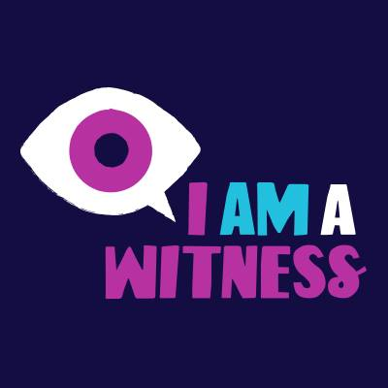
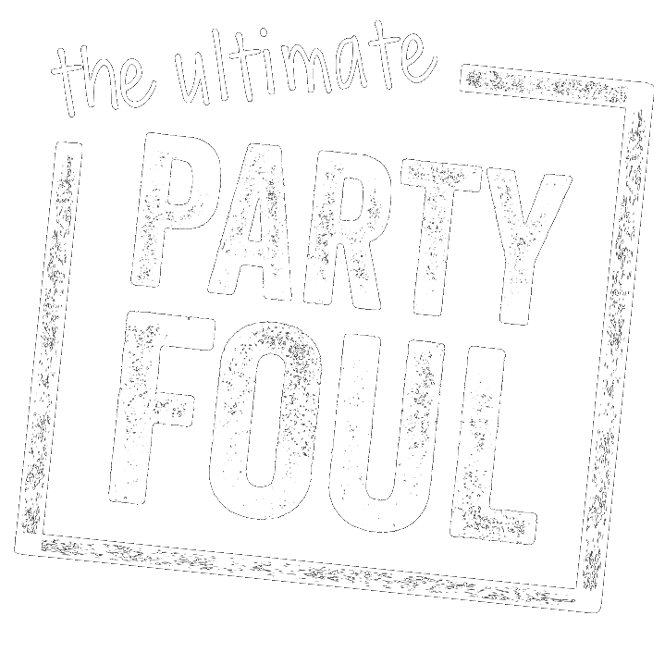



Underage
Drinking & Driving
Bullying
Texting & Driving

Slide 15

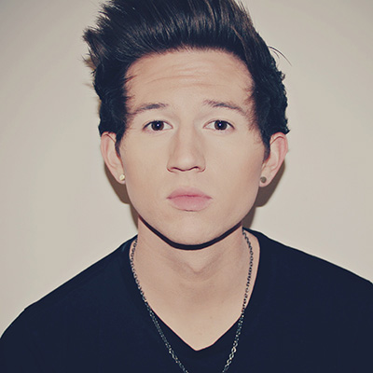
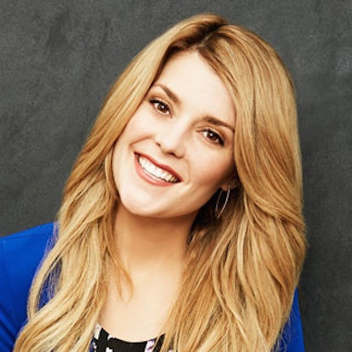
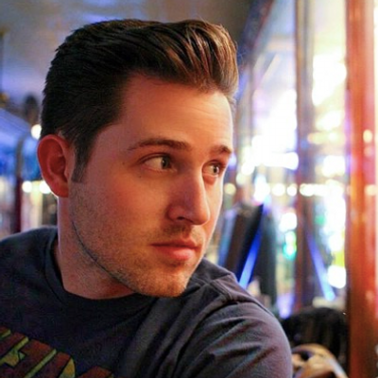

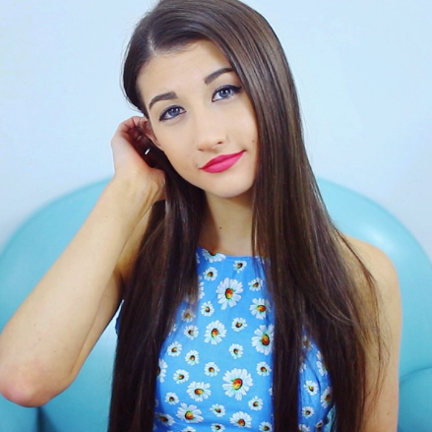
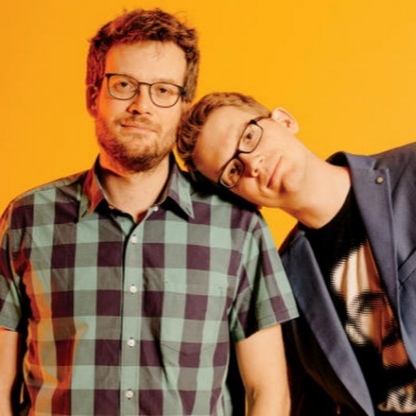
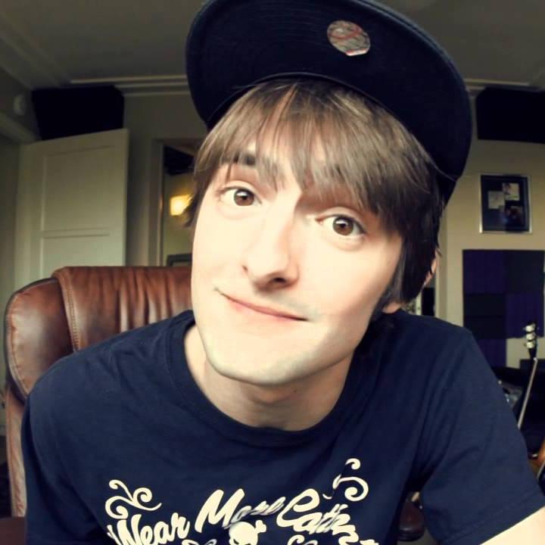
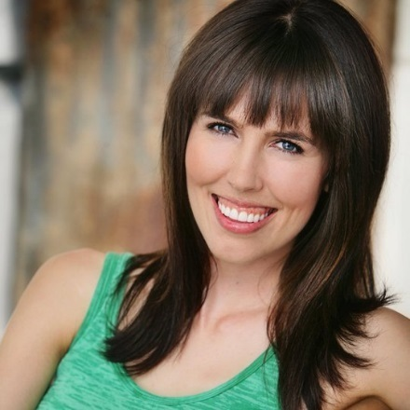
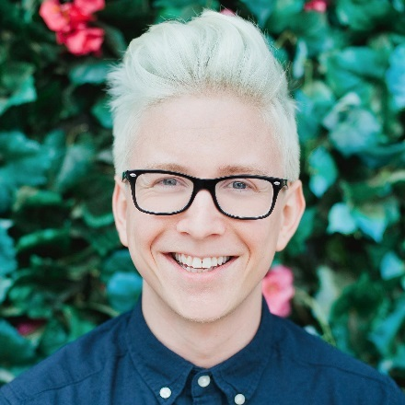
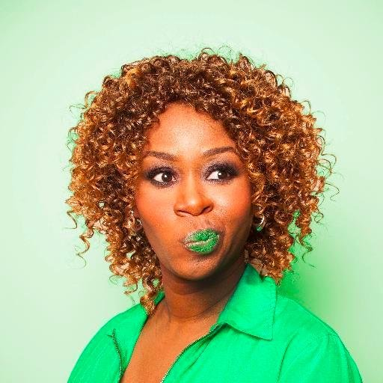
Ricky Dillon
3M
Grace Helbig
3M
JoshuaDTV
1.3M
Taylor Davis
1.4M
Meg DeAngelis
5.5M
Vlogbrothers
2.8M
Dave Days
1.5M
Brittani Louise Taylor
1.2M
Tyler Oakley
8.1M
GloZell Green
4.4M

Slide 16
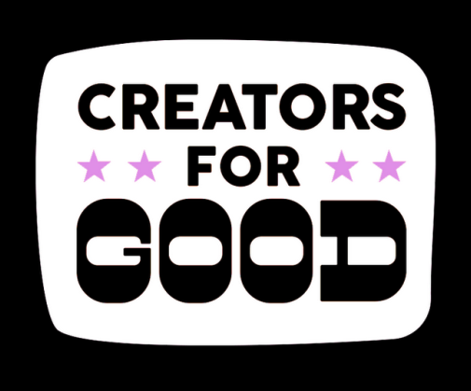
Personal and organic content
Reach new & engaged audiences
Lasting impact

Slide 17
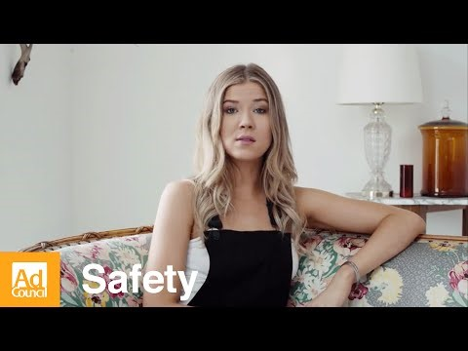
Notes:
https://www.youtube.com/watch?v=qLY8arYdr_k

Slide 18
Notes:
Hey, remember Meg? As part of our Creators for Good program, she took on our Texting and Driving issue, and created a video on her channel. The full video is 8 mins long, and here is an edited version with just the highlights.

Slide 19

Notes:
https://www.youtube.com/watch?v=B6cXn5Q7QuE

Slide 20
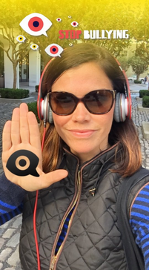
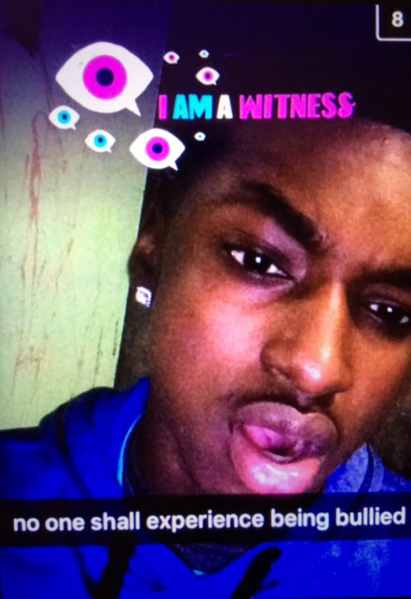
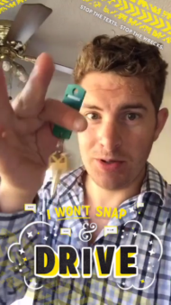
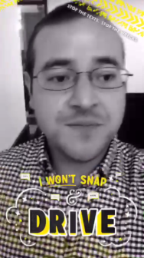
Notes:
So let’s talk about Snapchat.
In some cases, collaboration with influencers is integral for a successful social media channel strategy.
For example, Snapchat. It’s difficult as a brand or cause to have your own successful channel for two main reasons:
The content that succeeds on Snapchat is often scrappy and unplanned, a fact that is, in some ways, directly contradictory to a brand or organization’s efforts to be polished, consistent, and organized in their social planning.
The only way for people to see your content is if they follow you – unless you’re one of the brands featured on the Discover component to the platform.
So, it helps on Snapchat, too, to collaborate with an influencer who can create the scrappy content and promote your cause in a way that comes across as authentic and cool. With Bullying Prevention we employed this tactic, working with platform-specific influencers to promote the issue and resources available (including the emoji here, but more on that later).
Results…. Our Bullying filter launch so early that Snapchat wasn’t even capturing results yet.
For Texting, our one day global filter resulted in 210M filter views and 9.4M uses

Slide 21
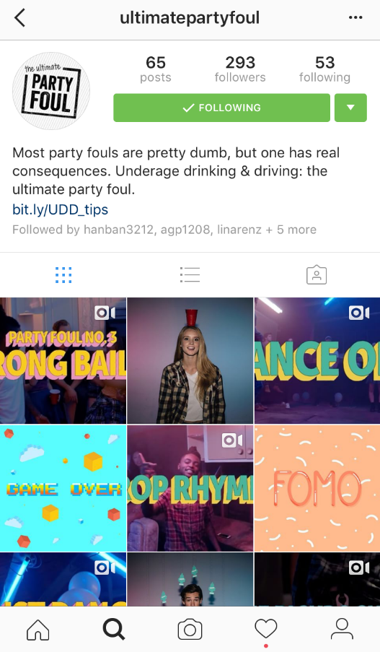
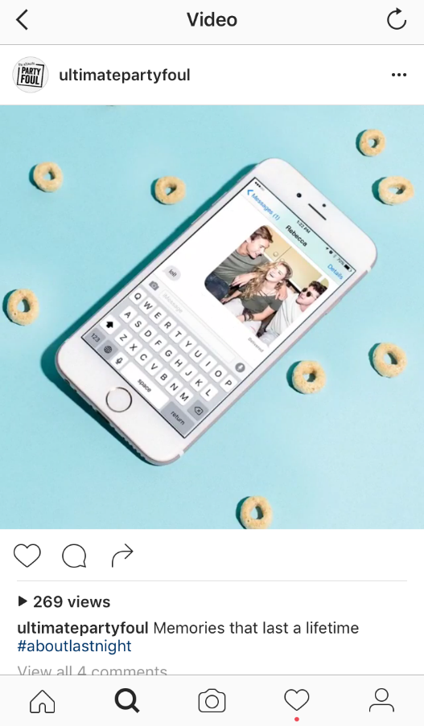
Excuses
#Protips
“Fail” videos
Party scenes
Original story
Notes:
Instagram. Harder to engage with teens – not great at driving to a site, so you need to have everything within your channel/posts.
295 followers
55 posts
26 likes per photo, 24 likes per video (on average)
Still lifes from party receive highest level of engagement overall; videos receive 2X # of comments

Slide 22
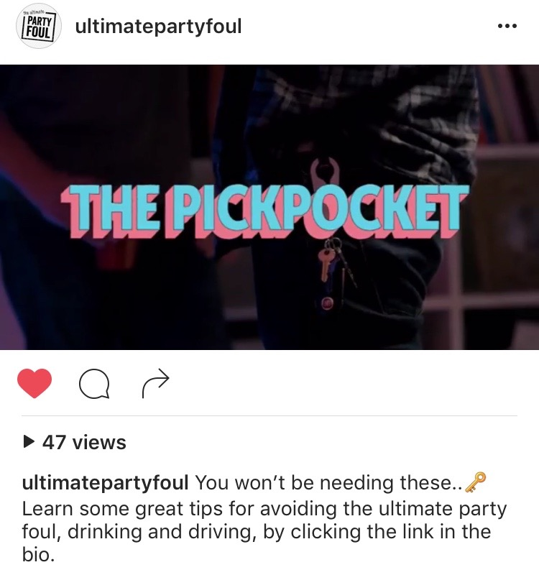


Slide 23

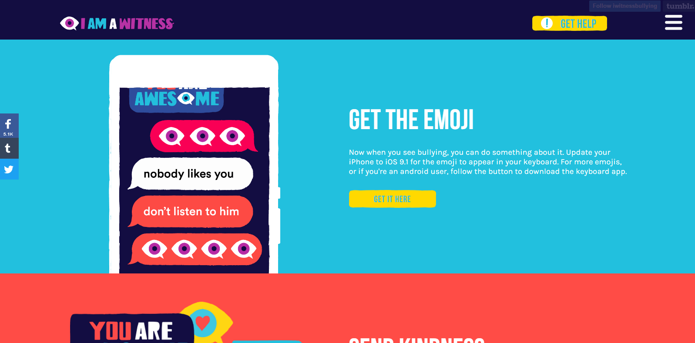
Notes:
All 3 sites are hosting on Tumblr
To tap into built-in social network for easy sharing and regularly add new assets

Slide 24
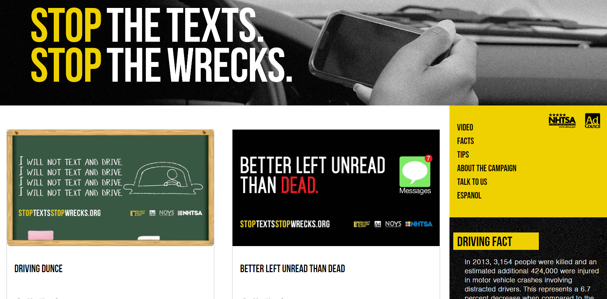
Notes:
All 3 sites are hosting on Tumblr
To tap into built-in social network for easy sharing and regularly add new assets

Slide 25
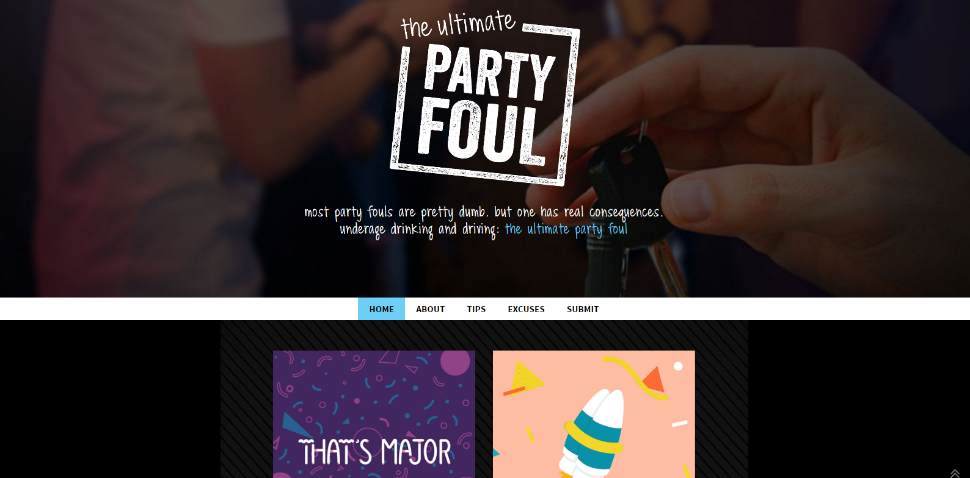
Notes:
All 3 sites are hosting on Tumblr
To tap into built-in social network for easy sharing and regularly add new assets

Slide 26
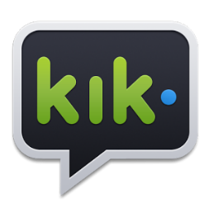

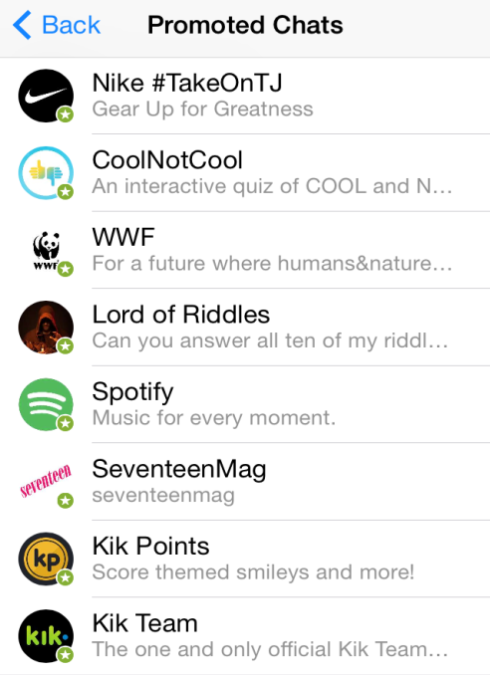
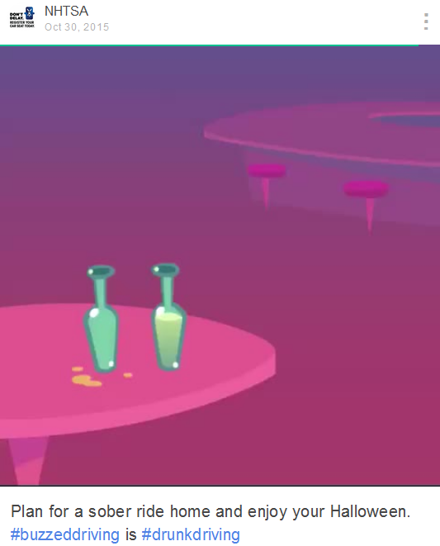
Notes:
Kik is another new platform our team has recently started employing for appropriate campaigns. In its current form, this is perfect for outreach to teens, as they’re the core audience. At its core, Kik is a chat network for friends, but it also allows users to share content they find around the web, complete activities to earn points, and interact with branded bots to get information about specific topics. It also offers brands the opportunity for one-on-one chats. We used Kik on our Teen Dating Violence campaign to provide information on safe relationships through the branded chat functionality, and encouraged users to take our quiz to earn points.
Since Kik is still evolving as a resource for brands and organizations, I would encourage your teams to experiment with the offerings and determine if there’s an opportunity to use the platform to communicate with your target.
Vine are 6 sec videos. but I wanted to highlight again that it’s a great platform for showcasing video content, and there are also influencers you can leverage to create or promote content on this platform like the others we’ve discussed.

Slide 27
WE
Notes:
62% of 12-17 yo use only emojis to communicate. 52% of 18-21s.

Slide 28

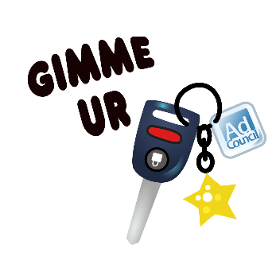
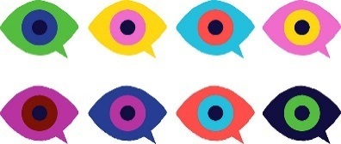
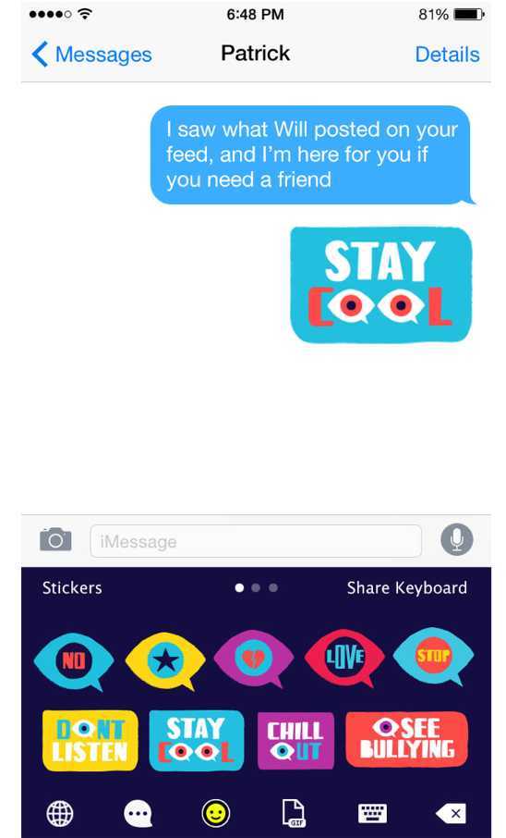
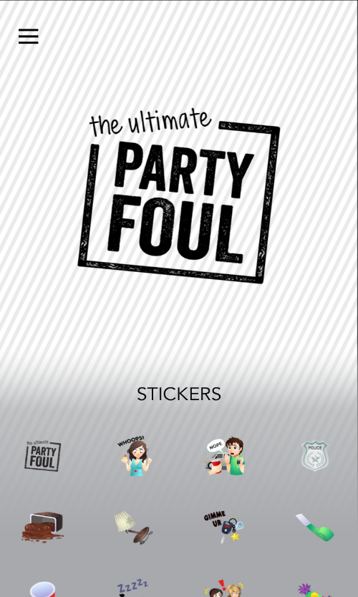
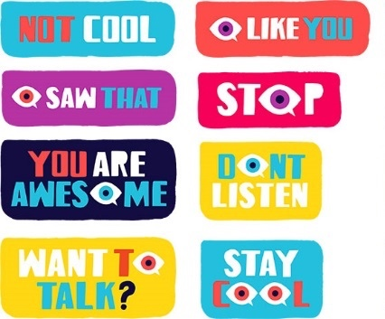
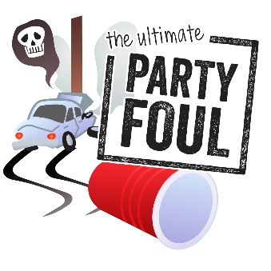
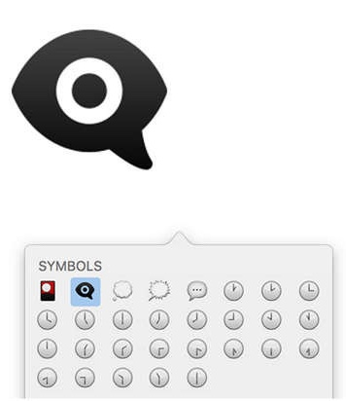
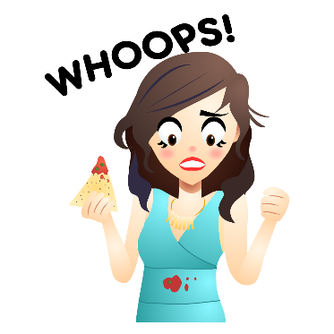
Notes:
In addition to the new opportunities for communication with the target that arise from new platforms and new ways to use social media, there have been several trends in social media recently that have changed how we communicate with our target across platforms.
The best example of this? The emoji. Emojis have quickly become the language of choice for teenagers-- they let someone communicate a feeling in a simple picture, and are increasingly popular for use across platforms.
We actually made the emoji the crux of our Bullying Prevention creative concept: an eye that a teen can use to communicate that they witness online bullying happening and do not approve. It provides an easy way to voice support for a victim and disappointment in a bully without getting into a major confrontation.
Branded emojis are cropping up for brands and campaigns – we also used one for our Underage Drinking and Driving Prevention campaign, depicted here.
With emojis, it’s critically important that whenever you are communicating with your target on social, you’re promoting the emoji. Since emojis are not native to the social platforms; they require a user to download an app, the ongoing promotion is critical to their ultimate success. Earned media also can help in driving the conversation.

Slide 29
Leveraging the Power of Your Voice

Slide 30
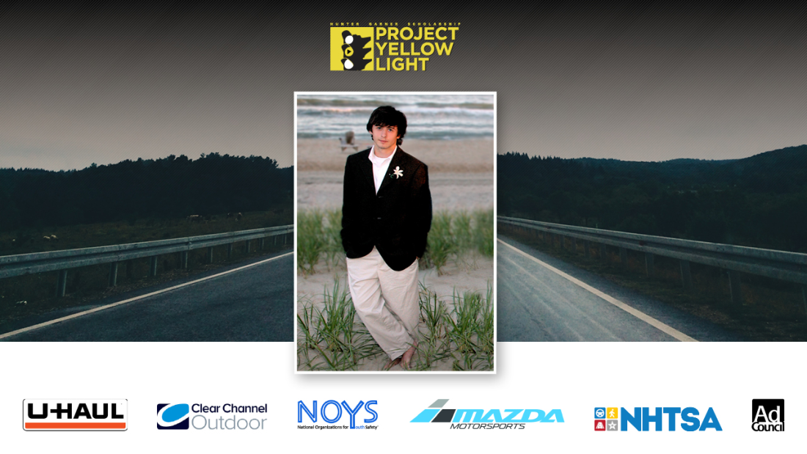
Notes:
Project Yellow Light is a scholarship competition designed to bring about change and harness the creative thinking of the next generation of aspiring filmmakers and designers. Project Yellow Light is an opportunity for young adults to communicate to their peers about the dangers of distracted driving.
Partners include Ad Council, NHTSA, U-Haul, Clear Channel Outdoor, Mazda Motorsports, and the National Organizations of Youth Safety (NOYS).
Winning applicants receive scholarship funds along with having their submissions turned into official Ad Council PSAs which get distributed across the nation.
Project Yellow Light has partnered with Ad Council since 2012.

Slide 31
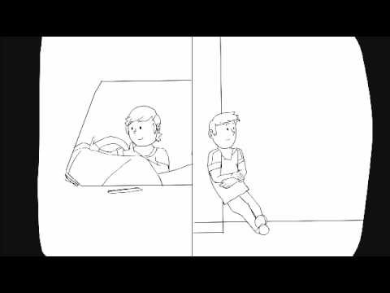
Notes:
https://www.youtube.com/watch?v=AMdNs4n2VjE

Slide 32
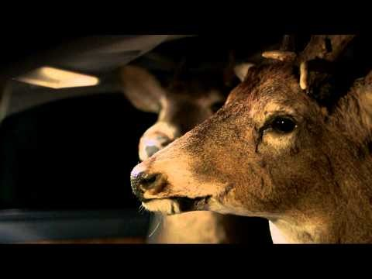
Notes:
https://www.youtube.com/watch?v=fgBWKSIX2Hc

Slide 33
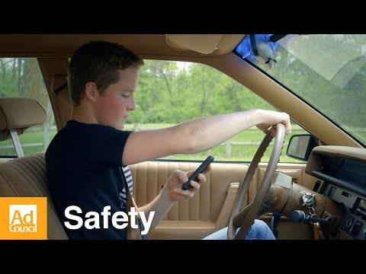
Notes:
https://www.youtube.com/watch?v=tT415epIpY8

Slide 34
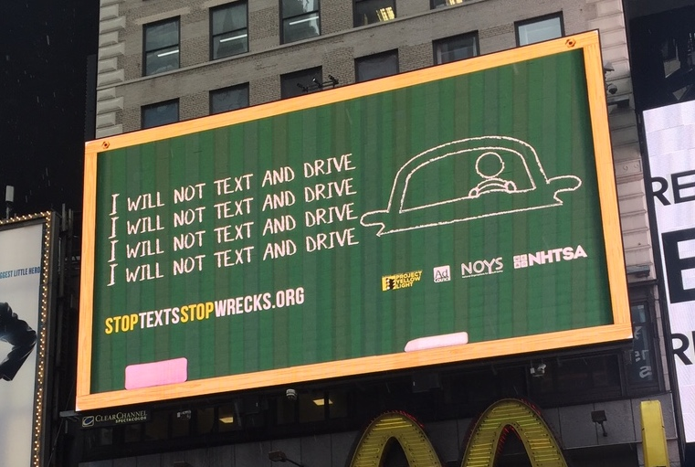
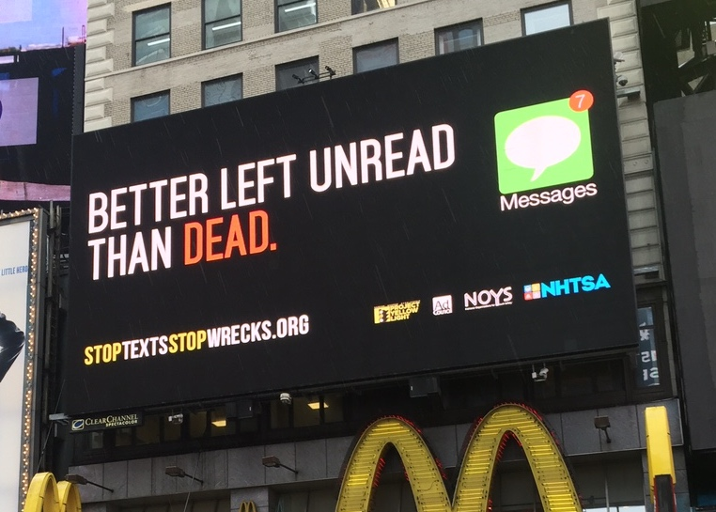

Slide 35
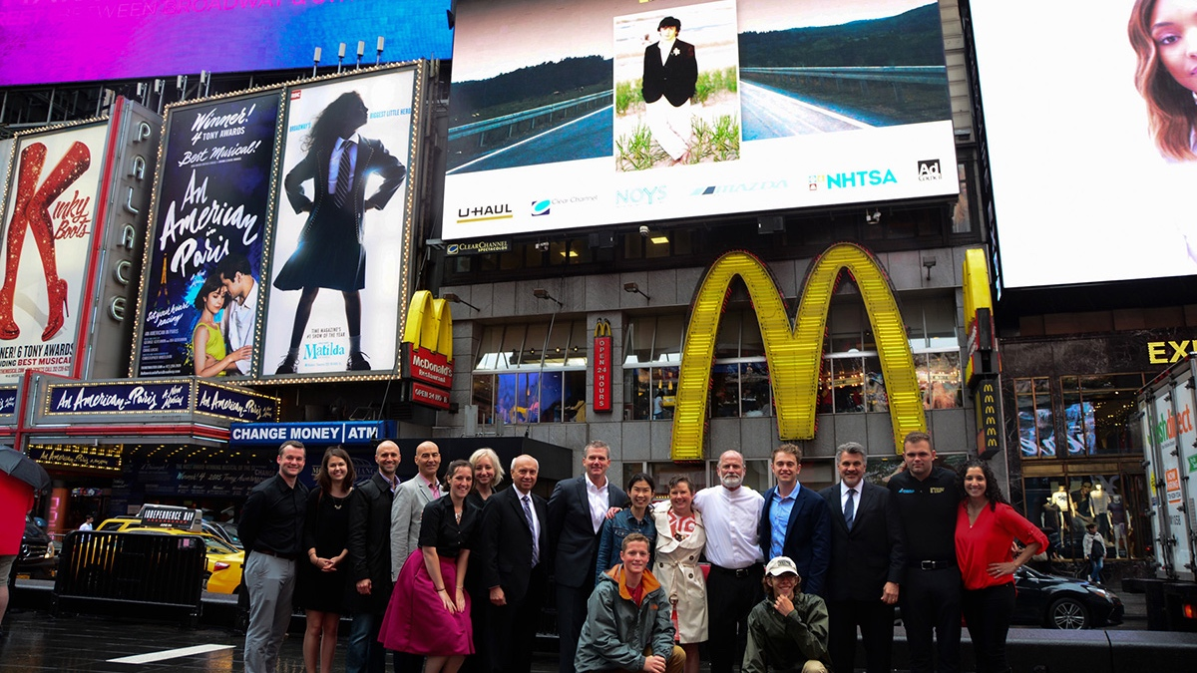

Slide 36
2017 submissions will open on October 31, 2016

Slide 37
projectyellowlight.com

Slide 38

THANK YOU
Q&A

Slide 39
Sources
http://www.adweek.com/socialtimes/how-is-gen-z-using-social-media/636574
https://www.commonsensemedia.org/sites/default/files/uploads/research/census_executivesummary.pdf
Mintel - Marketing to the iGeneration - US - April 2016

