Slide 1
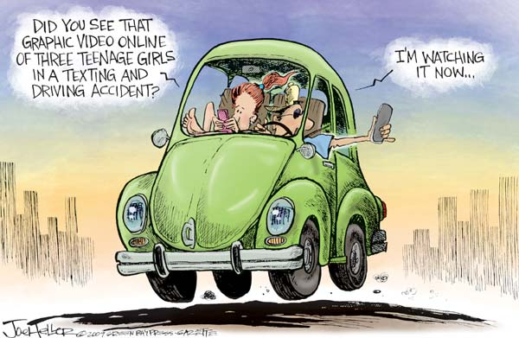
Distracted Driving
https://www.youtube.com/watch?v=c5d-RDiwEXM

Slide 2



Leveraging Vehicle Based Safety Technology to Curb Distracted Driving
Frank J. Cruice, CSP, CRSP, CHCM
Sr. Dir. – Corp. Safety/Security
Thomas E. Pollard, CTP, CDS, CDT
Director Fleet Safety

Slide 3


Slide 4
Perdue’s Private Fleet
680 Power Units, 70 Straight Trucks , 1900 Trailers
650 drivers
615 Non-Commercial vehicles,
VMT, 37 MM Commercial / 11MM Non-Commercial.
Our entire commercial fleet has “Vehicle Based Video Technology”.
We also strategically use a host of other vehicle based safety technology.
Videos for PPT\EWT21067 ACC .dce

Slide 5
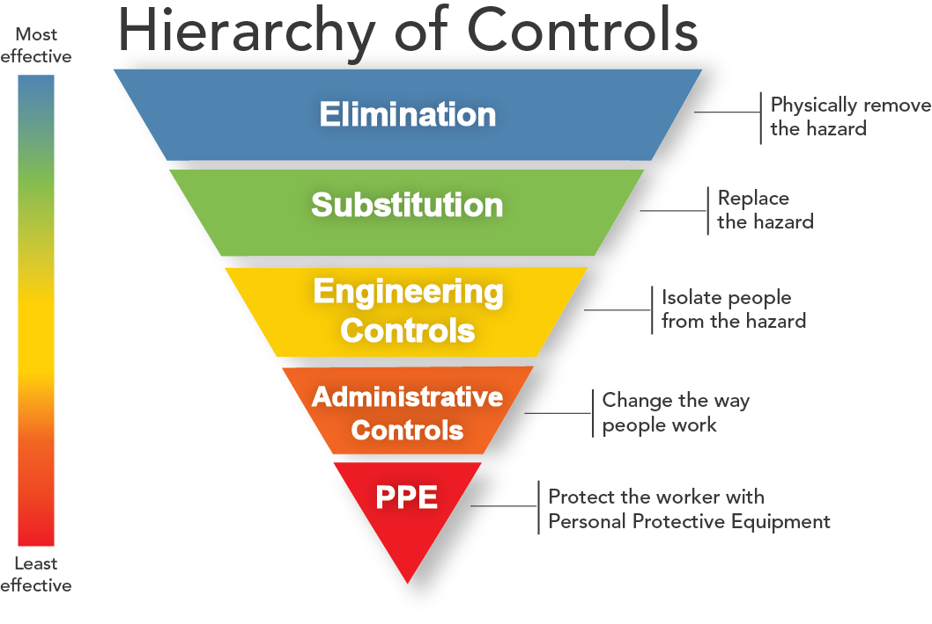
Distracted Driving

Slide 6
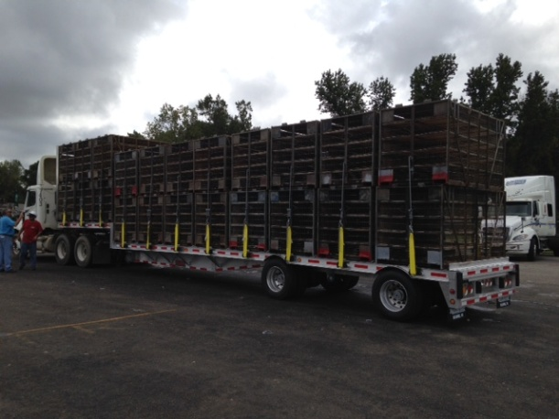


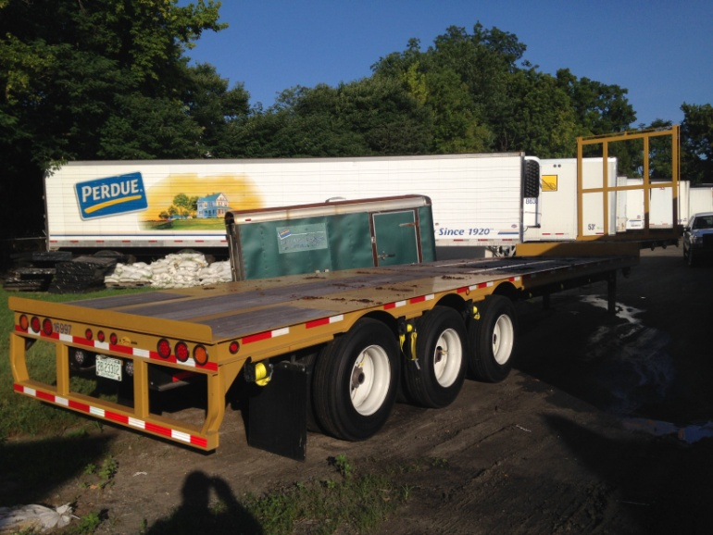


ELIMATION
Hierarchy of Controls of Distracted Driving
Fleet Utilization
  Increase payload
  Equipment specification
  State Legislating Agencies

Slide 7
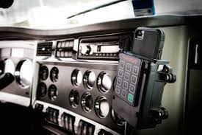
SUBSTITUTION
  Mobile Device Cradles / Docking Stations
    Intervention for repeated offenders
You’ll Need to Plug-in Your Smartphone To Start the Truck
Videos for PPT\168728 Cell Ph .dce
Hierarchy of Controls of Distracted Driving

Slide 8
Engineering Controls
  Speed Governance / Speed Limiting
    Short haul fleet = 58 MPH
    Over the road fleet = 62 MPH
  Vehicle Stability Controls
    Roll stability truck and trailer
  Auto-Shift
    Hands on wheel
    Less cognitive process
    Less fatigue
Hierarchy of Controls of Distracted Driving

Slide 9
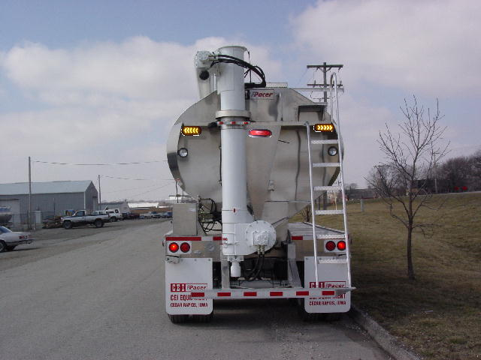
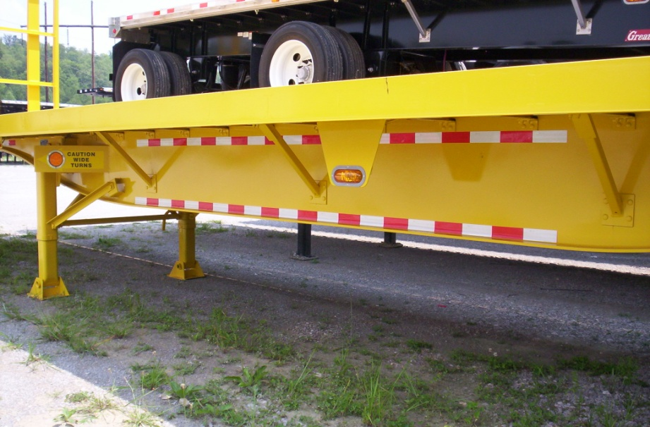
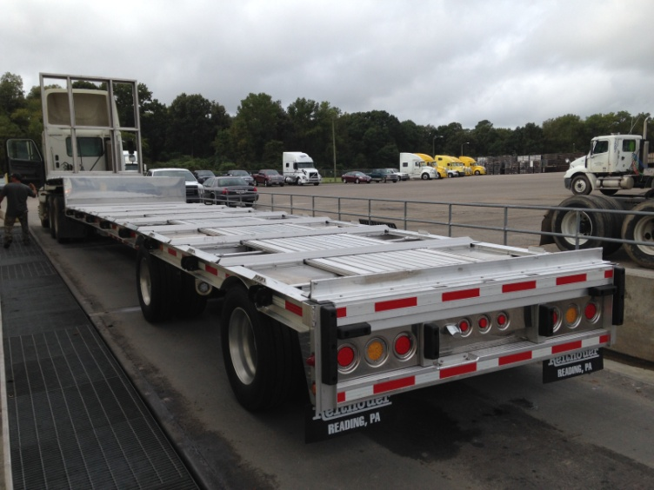
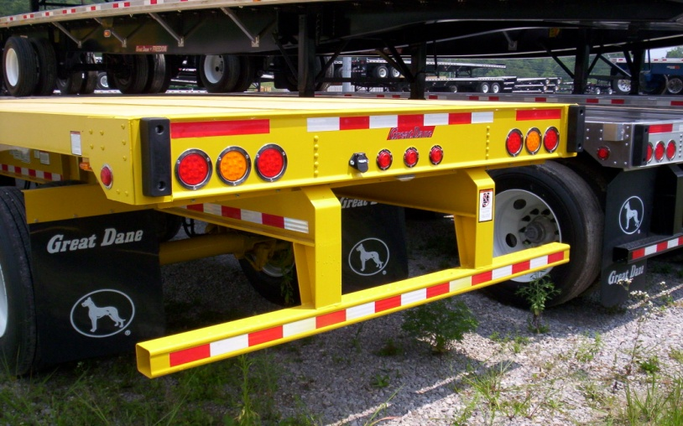
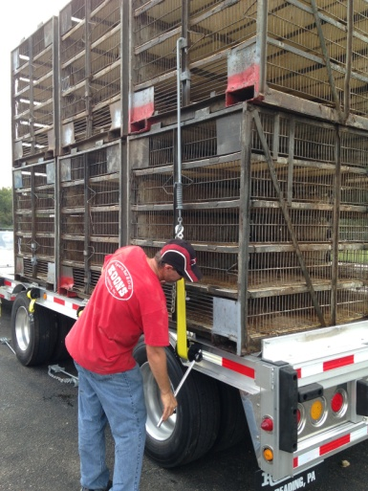
Engineering Controls
Hierarchy of Controls of Distracted Driving
Low Center of Gravity
Vehicle visibility & lighting

Slide 10
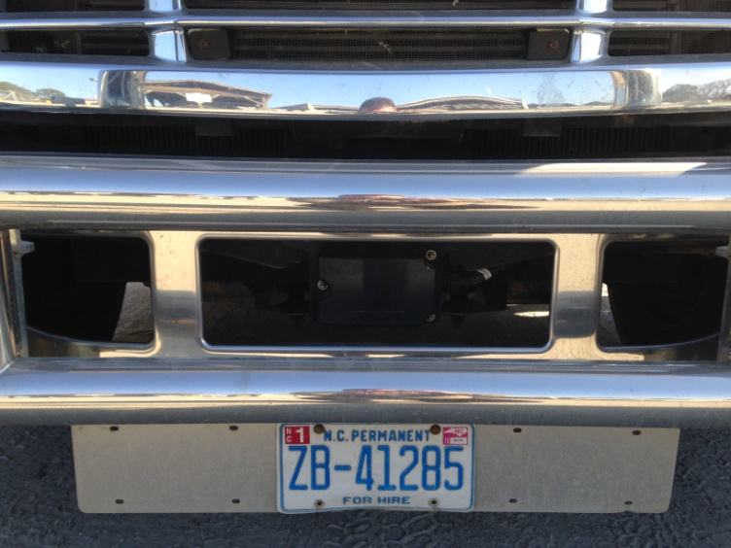
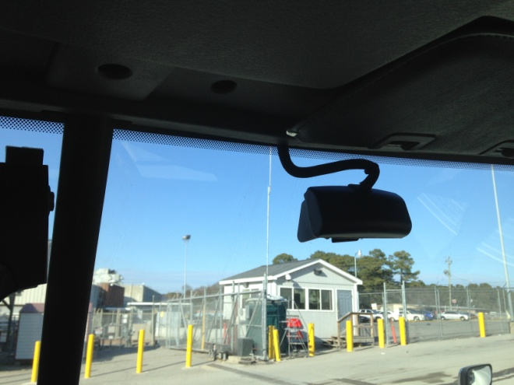
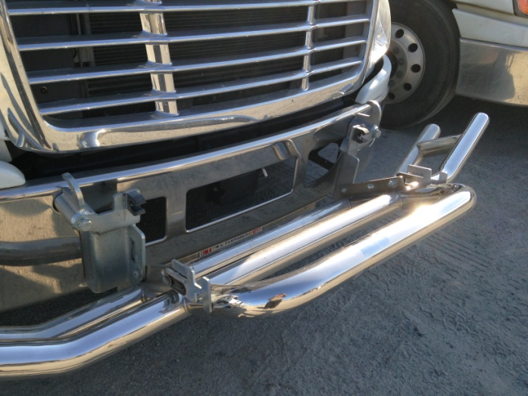
Engineering Controls
Hierarchy of Controls of Distracted Driving
Videos for PPT\FDW80375 FWD .dce
Collision Avoidance
  (FWD Radar; Lane Departure & Blindside)
    Alert for slower or stopped vehicles ahead
    See through fog and alert to vehicles ahead
    See and alert for unintentional lane drift / departure
Videos for PPT\ESM90181 FWD Glare.dce
Videos for PPT\FDA78734 Lane Depart .dce

Slide 11
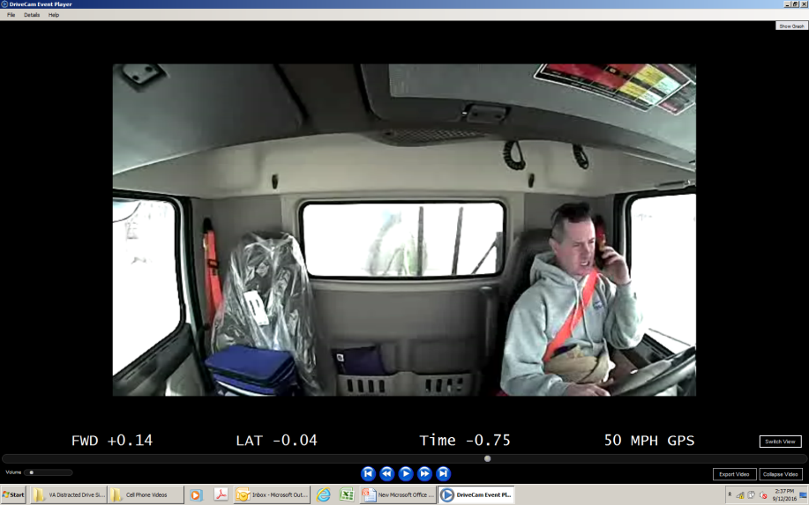
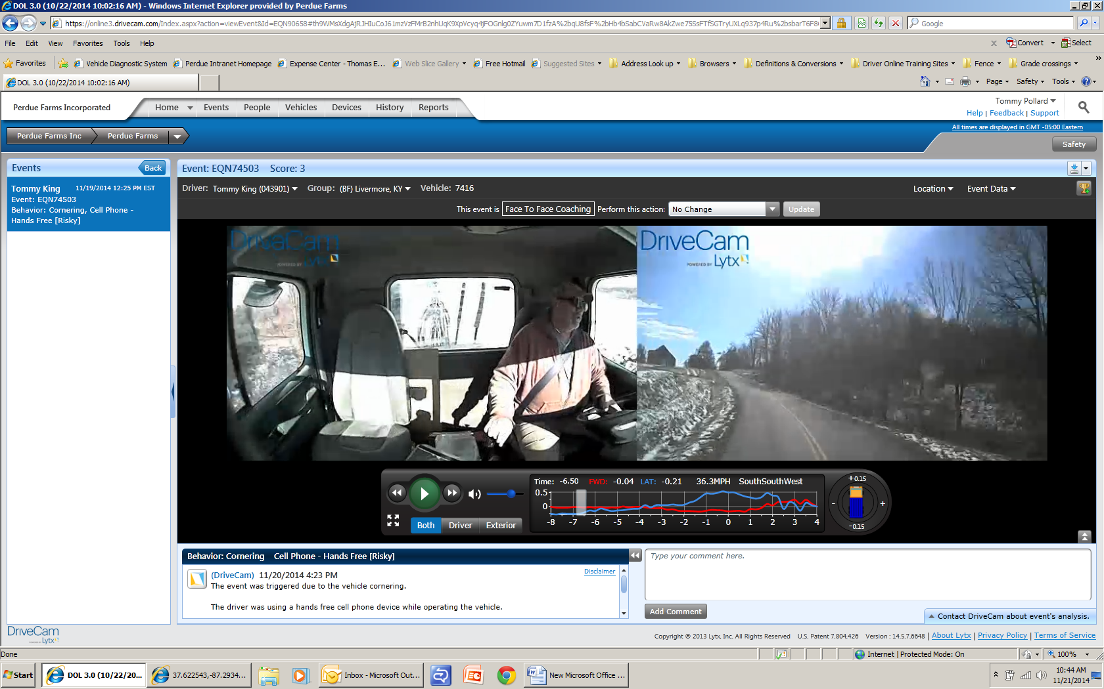
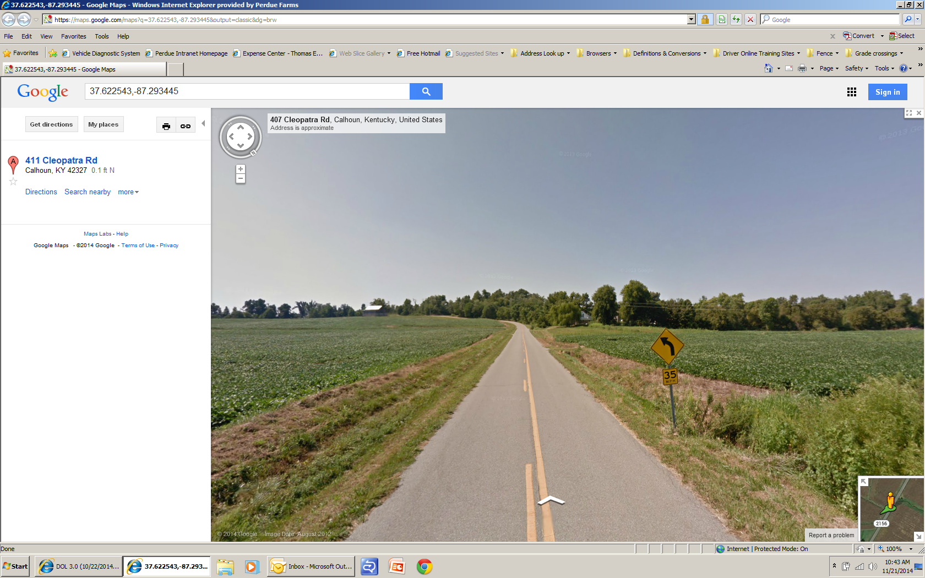
ADMINSTRATIVE CONTROLS
Coach the Driver via Event (ERDs)
Training on Distracted Driving
Driver Meetings
Media Releases/Newsletters
Policies & SOPs to include driver accountabilities
Cornering Policy – 10 MPH Below the Advanced Warning
35 MPH
50 - 37 MPH
Hierarchy of Controls of Distracted Driving

Slide 12
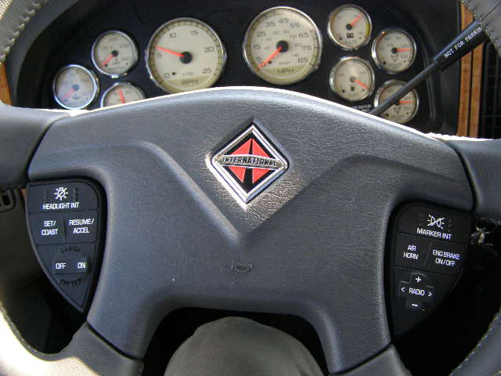
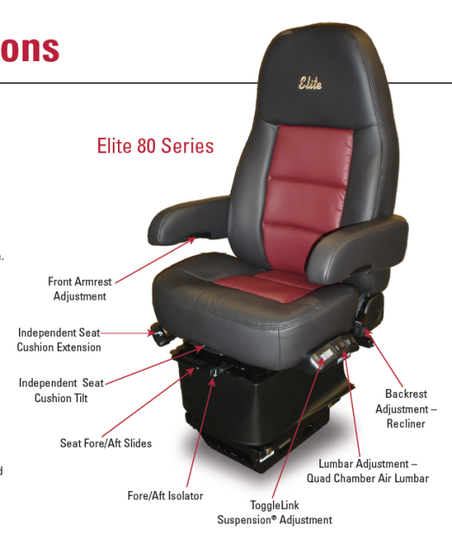
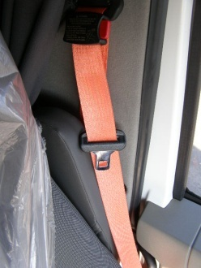
PPE
Hierarchy of Controls of Distracted Driving
Proximity Controls
  Less or no “Reaching”.
Seat Belts
  Creating the “Visual Standard”
  Seat Belt Chimes
Blue Tooth Technology
  Hands Free noise cancelling
Active intervention
  Adaptive cruise control
  Active visual and audible alerts
Fatigue reducing seats
  Lumbar and side support
Protect Driver and Company
  Frivolous actions
Videos for PPT\FDF03695 Active FWD .dce
Videos for PPT\EZF18314 ACC Intersect .dce
Videos for PPT\EWT21067 ACC .dce

Slide 13

Vehicle Based
Behavioral Safety
Vehicle Mounted
Safety Technology

Slide 14
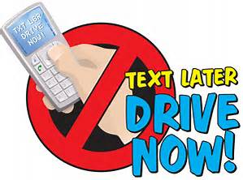
Distracted Driving
Vehicle Based Safety Systems
Know what you want to achieve……
  Driver Behavior management?
  Maintain compliance with changing rules & regs?
  Reduce accidents and risk exposure to litigation?
  Action based improvement required by insurance?
  Reduce the cost of accidents?
  Driver acceptance to add technology

Slide 15
Does it give you the data you need?
Action Items
Increase accountability for Cell Phone (24%)
Focus on drivers who repeat behaviors (13%)
Near Collision IRB Review (required)

Slide 16
Does it Bring Value?
Commercial
Highway Crashes
Size of Commercial Fleet
Avg. # PWR Units 650
Avg. Miles
37 MM

Slide 17
Does it make sense?

Slide 18
Does it reduce management time?
In Cab Camera
Speed limiters
Roll Stability
Lower Center of Gravity
Single Vehicle “Roll Over” reduction.

Slide 19
Does it reduce risk exposure?
Began Rollout 2010 with out 2011 Models.
Fleet completion about 95%
ERA95293.dce

Slide 20
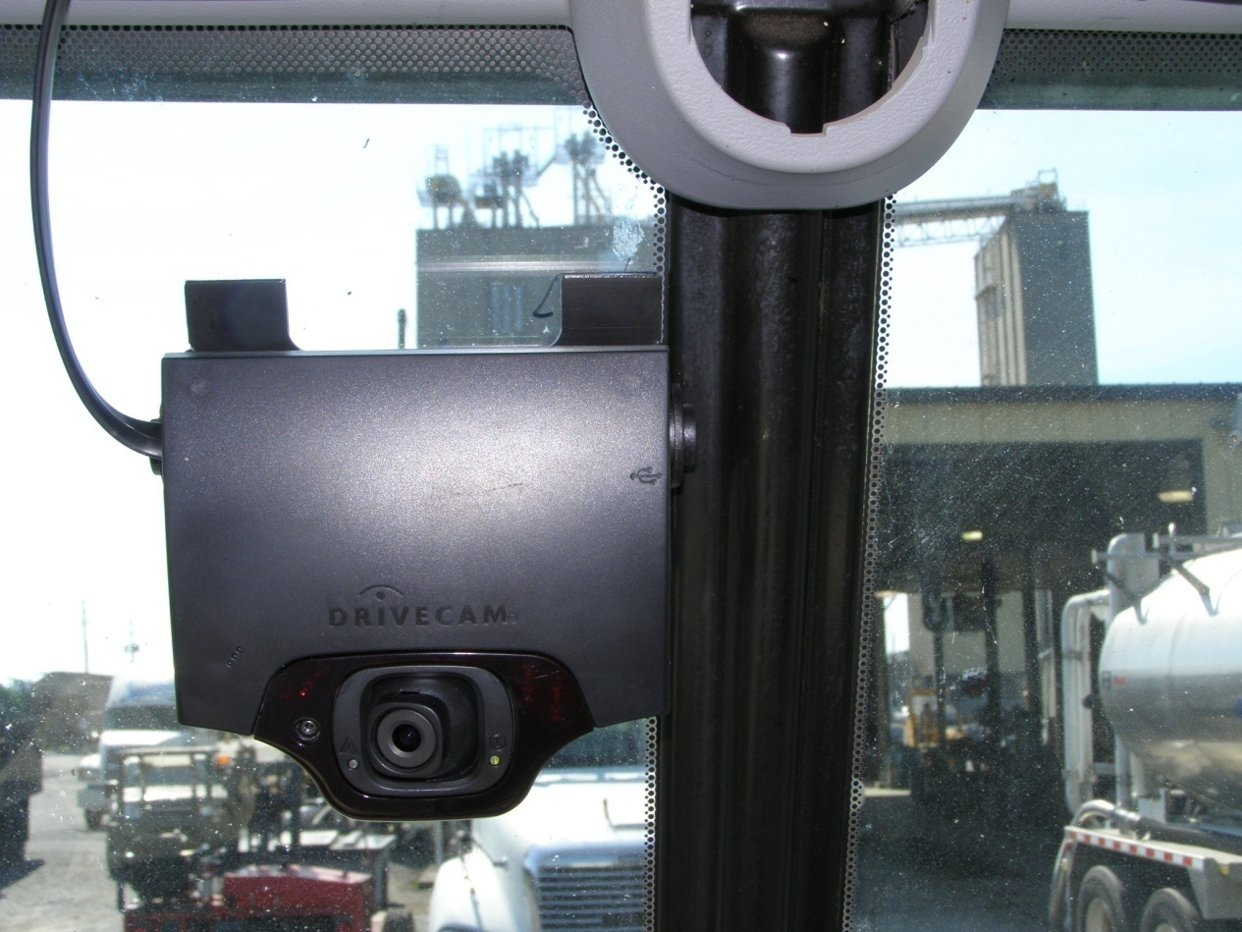
Truck Mounted Event Recorder
Continuous Improvement
Notes:
Use this template to create Intranet web pages for your workgroup or project. You can modify the sample content to add your own information, and you can even change the structure of the web site by adding and removing slides. The navigation controls are on the slide master. To change them, on the View menu, point to Master, then choose Slide Master. To add or remove hyperlinks on text or objects, or to change existing hyperlinks, select the text or object, then choose Hyperlink from the Insert menu.
When you’re finished customizing, delete these notes to save space in your final HTML files.
For more information, ask the Answer Wizard about:
The Slide Master
Hyperlinks

Slide 21
The Journey to a New Beginning
In 2008 we needed an intervention crashes of large trucks at one of our locations. That need has led us on a journey of continuous improvement of driver behavior. One part of our strategy was the use of video.
What we found is, “Video motivates and drives change”.
Seeing the actions of motorists leads to self improvement.
Senior management to the front line supervisor now have believable data to better manage drivers and vehicles.
Seeing is Believing…

Slide 22

Driver Acceptance
Driver acceptance is critical.
Management engagement / ownership is critical
Managers and Drivers will understand if you;
Show Why
Show it is current with today’s technologies
Show that upper management is committed to the process
Show that it is part of your overall strategy
Show it will build accountability from management to driver
Explain how it works
When you see behavior;
  How you react will determine how your drivers respond
Show that the process adds value

Slide 23
Manager Acceptance
Coaching & Intervention will influence driver improvement.
Coaching / Consequences, change behavior.
Management workload decreases as behaviors change.
Accident case management time decreases drastically.
“Threshold of Enforcement”
37 Cameras, about 50 Drivers

Slide 24
Adding Value to your,
“Case Management Process”
Vehicle Mounted Camera Process
Eliminate the guess work. Previously we spent over 80% of our energy reaching agreement on what happened, and less than 20% on preventing re-occurrence.
Now we see what happened and we get closure very quickly. Now we spend most all of our time on preventing re-occurrence.
Create a level platform:
  By paralleling the “Truck Camera ” process with Defensive Driving education, we eliminate the barrier between the Transportation Supervisor and driver.
  Coach, using defensive driving strategies
  Coaches and drivers now use the common language of DDC.
  Coaches and drivers alike learn by engaging in the process.

Slide 25
Lessons Learned
No matter what technology you choose consider the following;
Train managers so they deliver effective coaching. (Annual Refresher).
(Coach to Defensive Driving)
  Don’t get stale (revitalize) Add to your deliverables and find continuous ways to improve. Check and keep process integrity.
  Seek “Continuous Improvement” on deliverables. Every couple years compare the process and service.
  Networking with industry. (NPTC, ATA, ASSE, MATS, Etc.)
  Create “Visual Standards” to associates and motoring public alike.
Use the PIP (Performance or Driver Improvement Process) to improve driver behavior. Avoid the negative impact of “Discipline”
Focus “Behavioral Management” on “Repeated Behaviors”

Slide 26

Questions,,, &@$&@$Q@&^
Thank you for your time.

