Slide 1
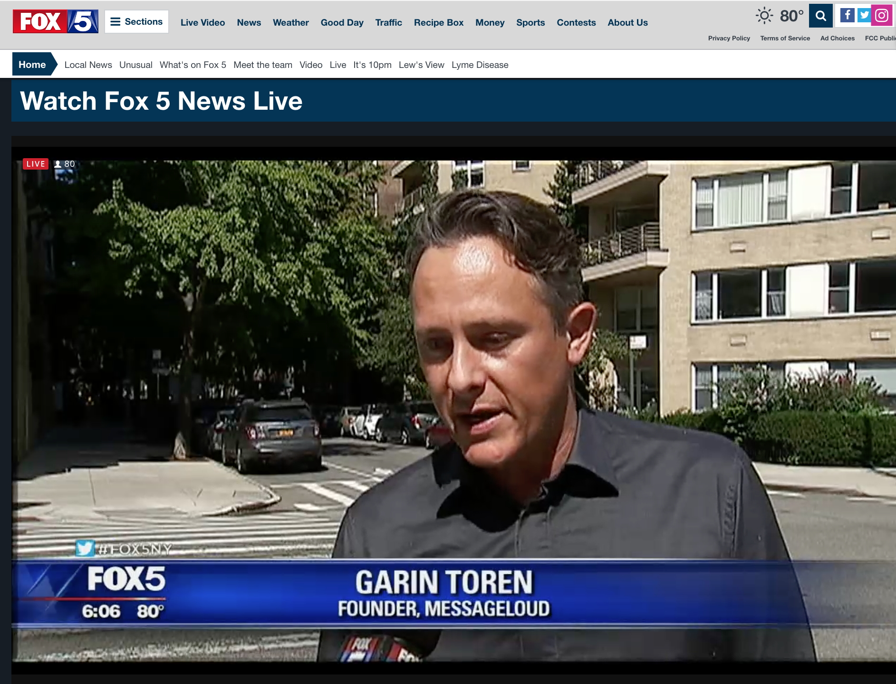

Slide 2
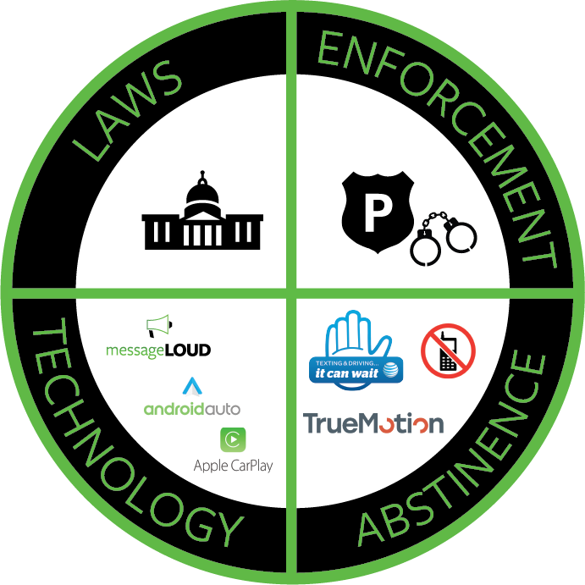
DISTRACTED DRIVING
Garin Toren
Founder & CEO
messageLOUD

Slide 3
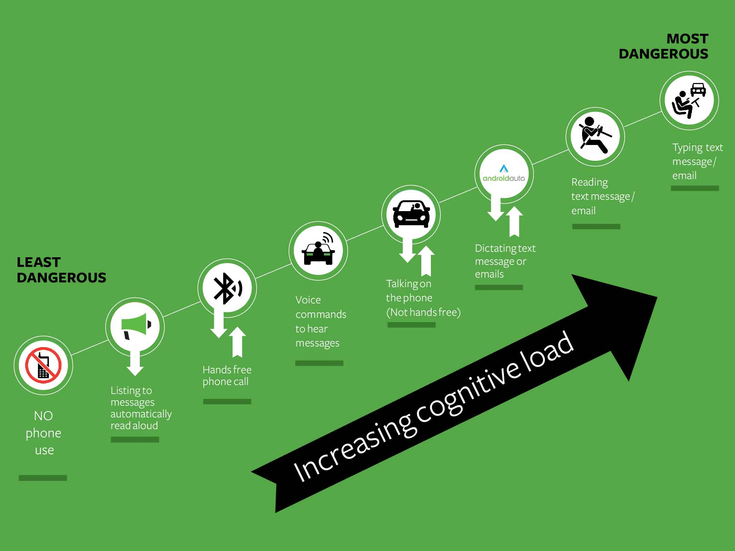

Slide 4
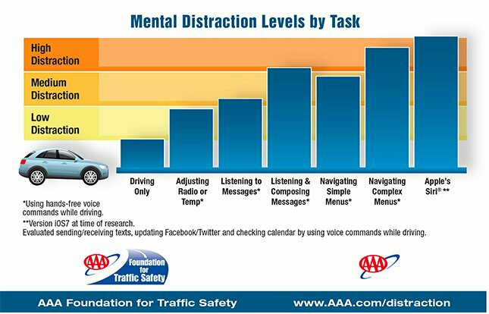
Foundation For Traffic Safety

Slide 5
Accepted Safety Standards?
LISTEN is legal / safe:
Radio, CD, navigation, audio book
TOUCH is legal / safe:
AC, lights, windscreen wipers, radio

Slide 6
Introducing messageLOUD
A driver safety smartphone app that automatically reads your texts (sms’s), Email, WhatsApp, Facebook and every other message type, out loud.
AND
Allows you to delete, skip or call the sender back, completely eyes-free.

Slide 7
Key functionalities
Turns itself on (and off) automatically
Reads aloud automatically
100% eyes-free
ALL messages & notifications – no excuse to touch the phone
Set length of reading, which messages etc.
Does not read promotional or social media emails.
No voice commands / dictation
Auto response
Pauses for navigation
Dims music

Slide 8
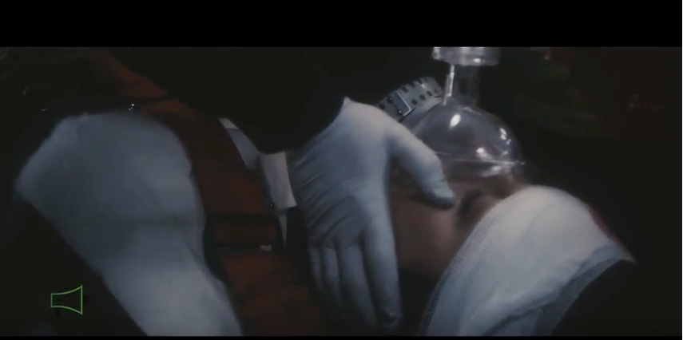
A Second Chance

Slide 9
Thank you
Thank you for your time today.

