Slide 1

The Distracted Pedestrian: Using Virtual Reality to Reduce Walking while Texting
David C. Schwebel, PhD
University of Alabama at Birmingham
Co-author collaborators: Leslie A. McClure, Bryan Porter

Slide 2
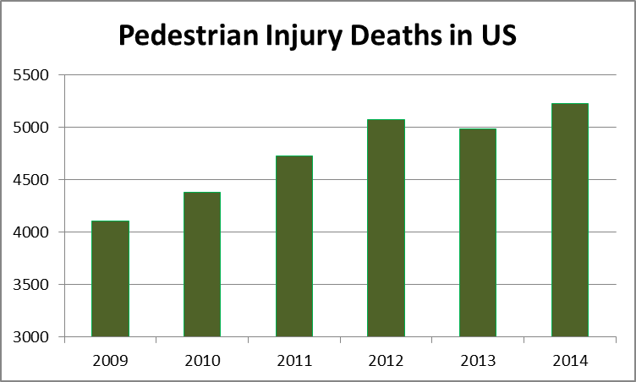
Pedestrian Injuries - Background

Slide 3
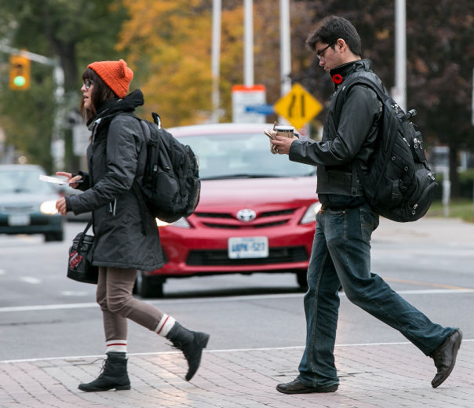
Why the increase???
More driving – lower cost gas
More walking – health promotion
More distraction – both drivers and pedestrians

Slide 4
Background of Our Study
Goal: reduce distracted pedestrian behavior on urban college campuses
Young adults have high rate of smartphone and technology use
Urban college campuses have high rates of pedestrian activity

Slide 5
Scope of the problem
Before describing details of intervention, how bad is the distracted pedestrian problem? Our baseline data explains.
Two campuses
  Old Dominion University, Norfolk, VA
  University of Alabama at Birmingham, Birmingham, AL
Two target intersections – major boulevard with median and minor cross-street, signaled with traffic light
  Hampton Blvd & 45th St in Norfolk
  University Blvd & 14th St in Birmingham

Slide 6
Observational Data Collection - Methods
Behavior coded continuously, weekdays 7:45 AM-5:45 PM
30 minute coding blocks from rotating single corner
3 sets of observations
  5 minutes, traffic count
  5 minutes, random selection of approaching pedestrian with observation for full crossing and detailed coding on individual differences, crossing behavior, and distraction
  15 minutes, coding of all approaching pedestrians as distracted or not distracted
  (5 minutes rest/rotate)

Slide 7
Observational Data Collection - Outcomes
Traffic count (vehicles/hour)
5-minute individualized coding
  Apparent gender
  Estimated age
  Enter with walk sign
  Look left before entering road
  Enter within crosswalk
  Look right while leaving median
  Exit within crosswalk
  Distraction and type (phone, text, headphones, etc.)
  Multiple distractions

Slide 8
Observational Data Collection - Outcomes
15-minute coding of all pedestrians
  Distracted vs. not distracted
  If distracted,
    Talking on phone
    Texting/looking down at phone
    Wearing headphones
    Reading
    Eating
    Other distractions
  Multiple distractions

Slide 9
Results: Baseline Scope of Problem
1,020 individualized observations
89% young adults
51% female
No major demographic differences across campuses

Slide 10
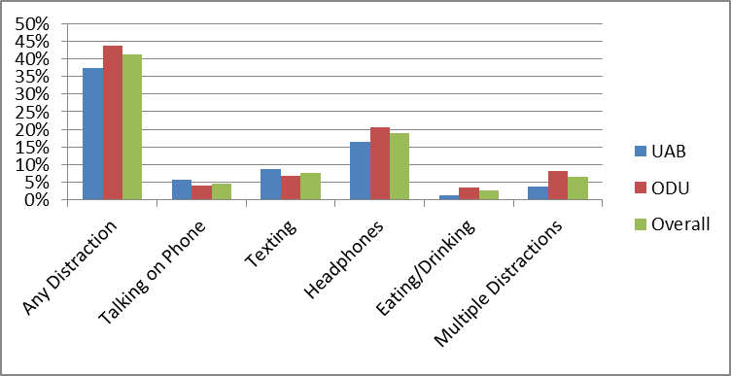
Baseline Results: Individualized Pedestrian Distraction (N=1,020)

Slide 11
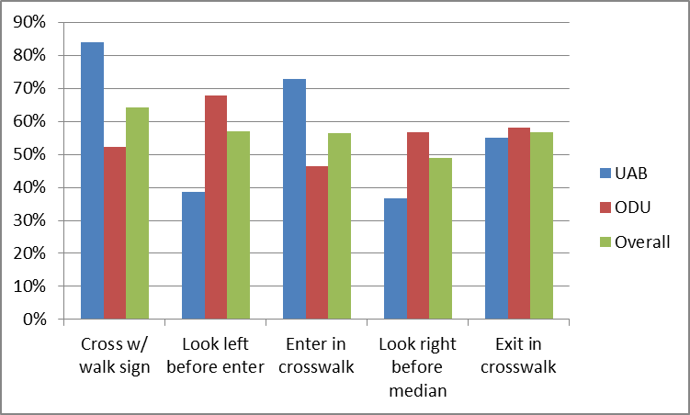
Baseline Results: Individualized Pedestrian Safety (N=1,020)

Slide 12
Results: Individualized Pedestrian Gender Differences (N=1,020)
Distraction
  Women more likely to be distracted from talking on the phone, texting, and multiple distractions
  Men more likely to be distracted from headphones
Safety
  Women more likely to exit within the crosswalk
  Men more likely to look right at median

Slide 13
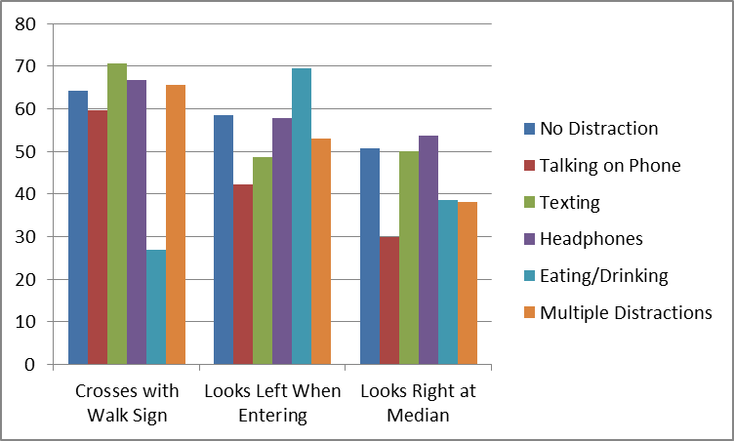
Baseline Results: Distracted Pedestrians Engaging in Safe Behaviors (N=1,020)

Slide 14
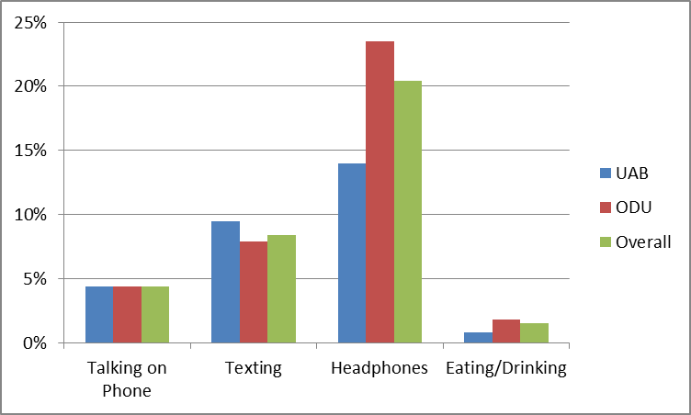
Baseline Results: 33% of All Pedestrians were Distracted (N=9,523)

Slide 15
Scope of the problem
Data show there is a problem - pedestrians are distracted on urban college campuses
How do we create change???
Health behavior theory – change is difficult

Slide 16
Health Behavior Change
Distracted driving interventions show mixed results – distracted pedestrian interventions are few in number
Distracted driving policy change has some efficacy – distracted pedestrian policy is extremely sparse
Theory suggests we should:
  Increase perceived vulnerability
  Persuade individual that change is possible, worthwhile, and of personal benefit
  Change perceived/actual norms

Slide 17
Our approach
Quasi-experimental pre-post design with control group
  Baseline data collected at two campuses, ODU and UAB
  Intervention at UAB – exposure to distracted pedestrian risk in virtual reality
  Post-intervention and 2-month and 6-month follow-up observation at both campuses
  Survey data collected at UAB at baseline, post-intervention, and 5 months

Slide 18
The intervention
Exposure to crossing the street while texting in a virtual pedestrian environment (goal: increase perceived vulnerability)
Significant media and advertising on campus during “Distracted Pedestrian Week” (goal: change norms, persuade change is possible)
  Local television coverage
  Posters and signs around campus
  “Buzz” of discussion on topic created
  Virtual pedestrian environments open to public in two classroom buildings, M-F, 9-6, for “walking and texting” attempts

Slide 19
The virtual reality environment
Short film to give you a sense of what it looks like, from a study we conducted in a local school using it:
http://www.uab.edu/cas/safetylab/

Slide 20
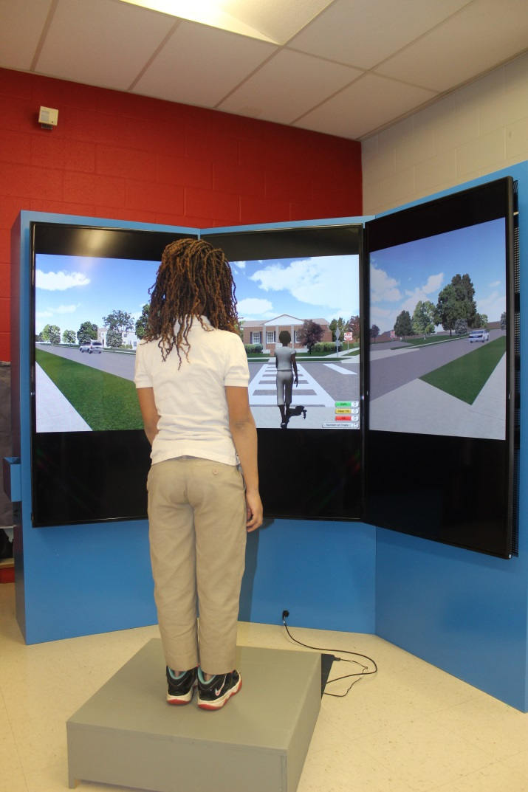
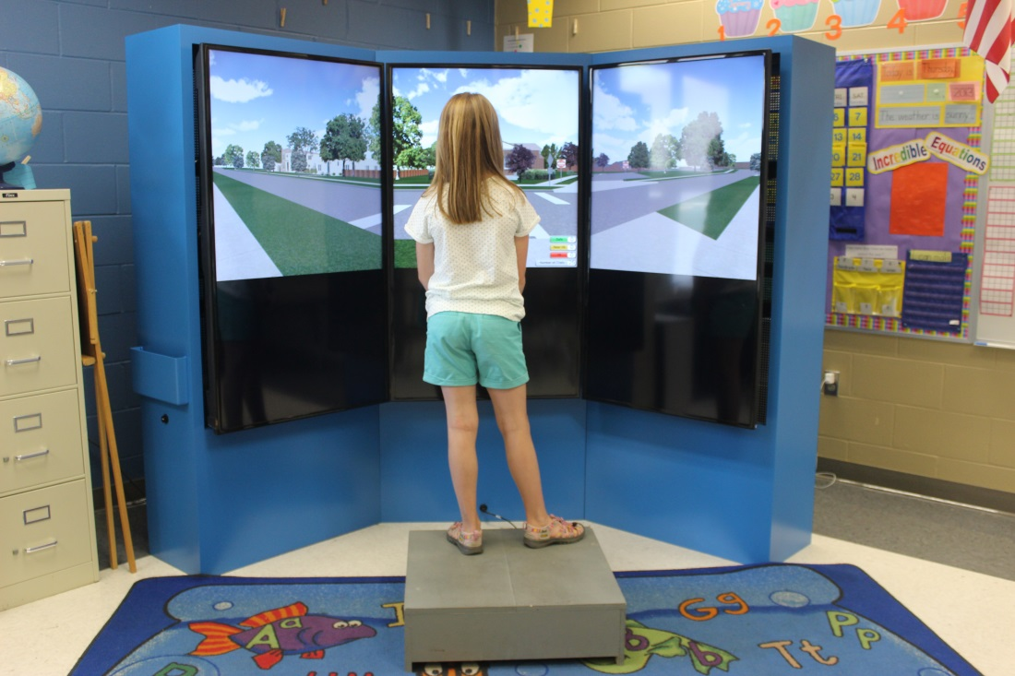
Community-Based VR

Slide 21
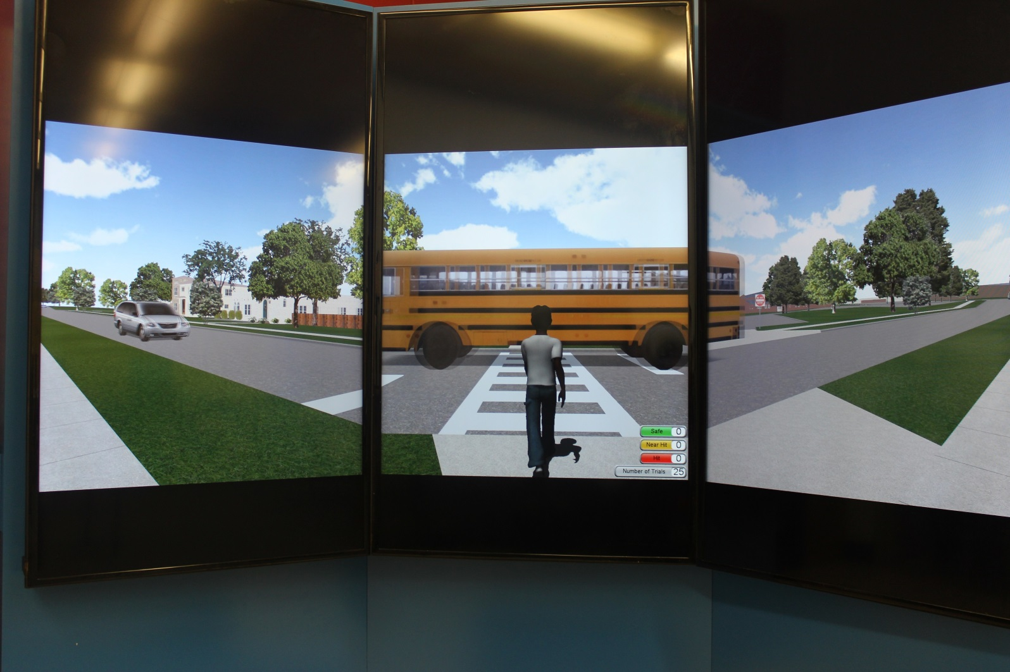
Community VR Screenshot

Slide 22
The intervention – yard signs
UAB

Slide 23
The intervention
Social media
  18,000+ distributed
  7000+ video views
See:
https://www.youtube.com/watch?v=VF9s2Y-k0AY

Slide 24
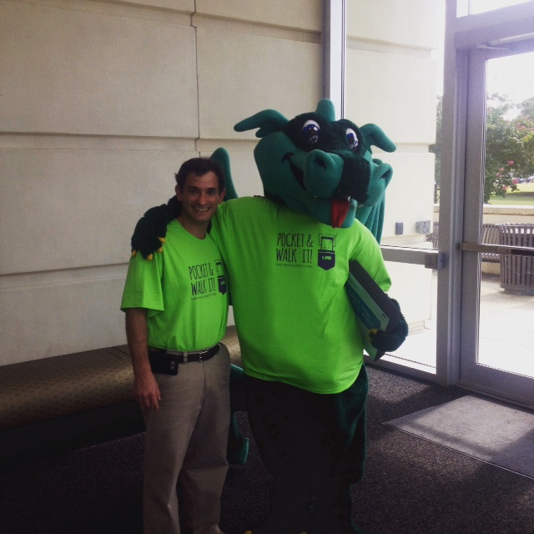
The intervention

Slide 25
Self-Report Survey Results
78% received flyer/brochure on pedestrian safety
83% feel VR experience made them think more carefully about distracted pedestrian behavior
61% self-report changed behavior since engaging in the VR
84% feel VR experience was worthwhile to improve their health/safety
95% would recommend others try the VR experience

Slide 26
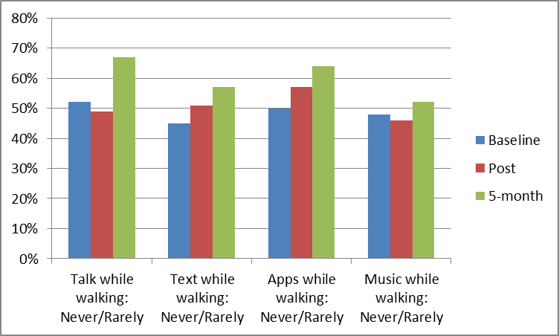
Self-Report Survey Results: Distracted Walking Behavior

Slide 27
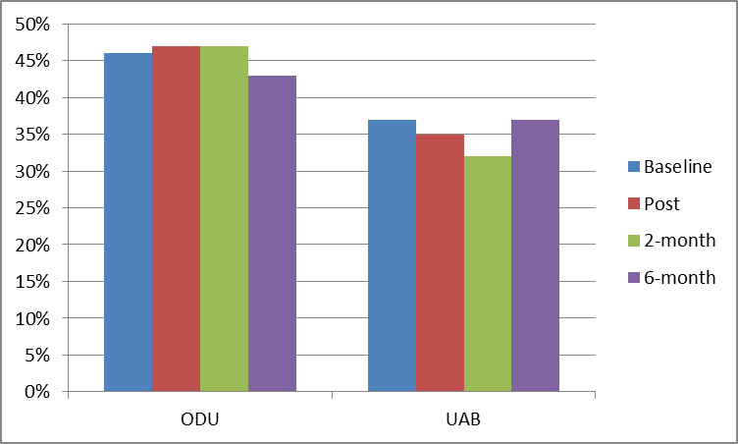
Preliminary Results: Individualized Pedestrians Observed Distracted
Note: Differences between campuses significant. Change over time not significant. Interaction not significant.

Slide 28
Summary
Distracted pedestrian behavior is common on urban college campuses
  About 33% of observed pedestrians crossing a major street were distracted
Creating a “buzz” on campus, plus allowing pedestrians to try crossing a virtual street while distracted yielded:
  Self-reported decrease in risky pedestrian behavior
  Small change in observed distracted pedestrian behavior (non-significant in preliminary analyses)

Slide 29
Acknowledgements
Bryan Porter & Old Dominion University team
Leslie McClure, Drexel University
Anna Johnston & UAB Youth Safety Lab team
Joan Severson, Yefei He, and Digital Artefacts team
Funding: Award Number R21HD078371 from the Eunice Kennedy Shriver National Institute of Child Health & Human Development. The content is solely the responsibility of the authors and does not necessarily represent the official views of the Eunice Kennedy Shriver National Institute of Child Health & Human Development or the National Institutes of Health

Slide 30
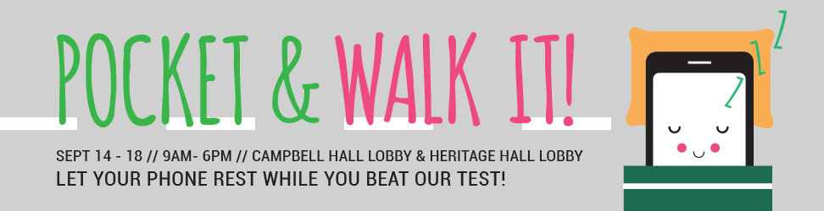
Questions???
David C. Schwebel, Ph.D.
Professor of Psychology
Associate Dean for Research in the Sciences
University of Alabama at Birmingham
1300 University Blvd., HHB 571
Birmingham, AL 35294 USA
Phone: (205) 934-8745
Email: schwebel@uab.edu

