Slide 1
Industry, Regulation and Research: Coming Together for Safer Vehicles
C. Y. David Yang, Ph.D.
Executive Director
6th Annual Distracted Driving Summit
September 19, 2018

Slide 2
EMERGING TECHNOLOGIES
Internal & External Research Topics
User Expectation
User Acceptance
User Experience
Safety Benefits
Research findings on technologies from user’s perspective
IMPACT:
Improve design of vehicle technologies
Collaboration to carry out relevant research
Actively contribute to relevant events
Supporting Activities

Slide 3
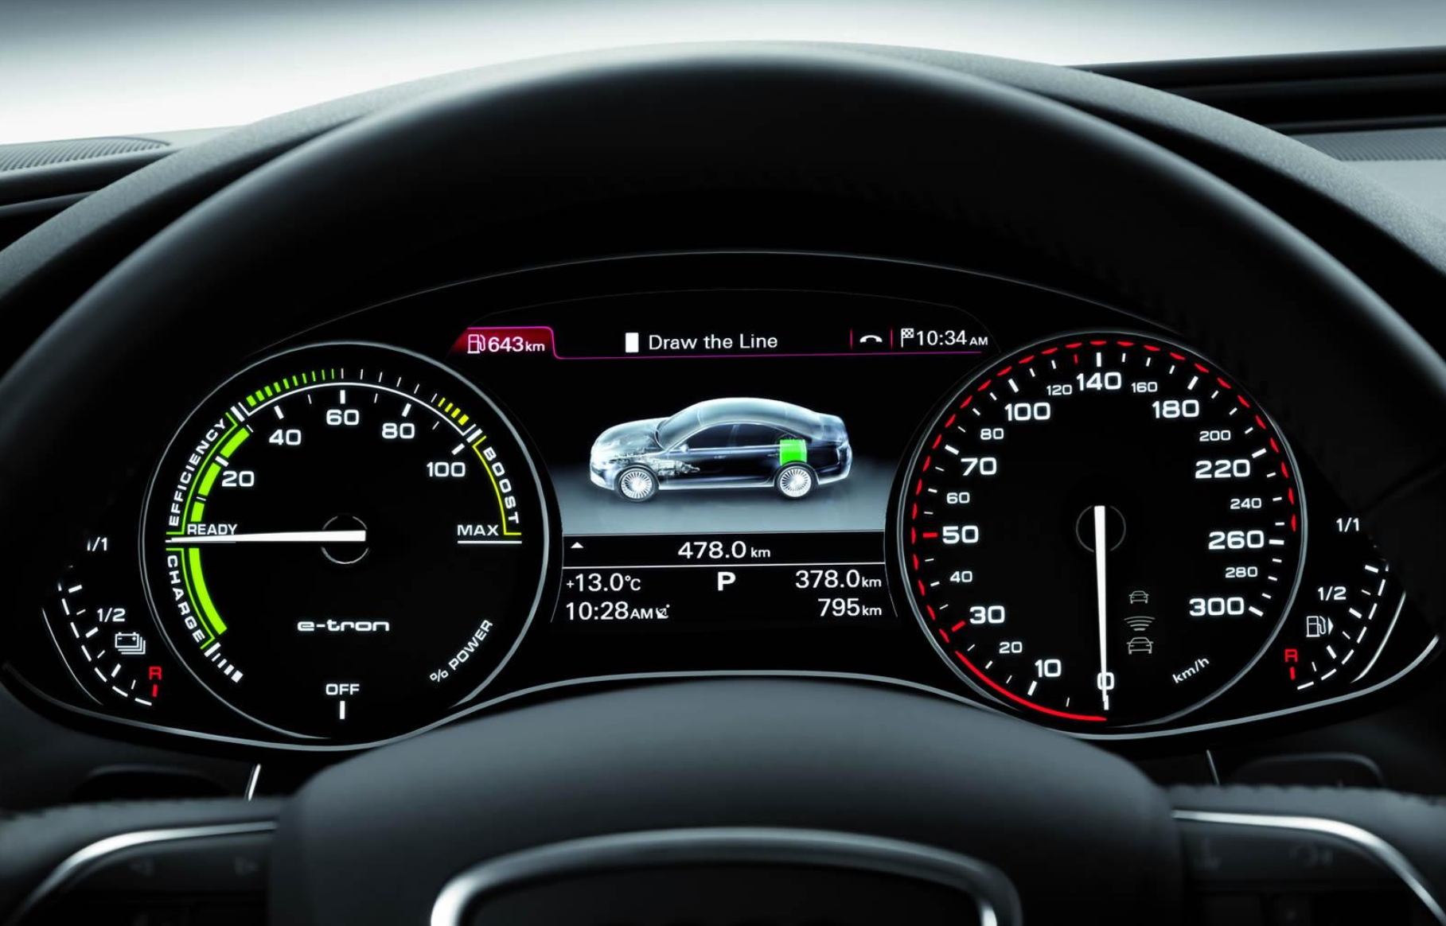
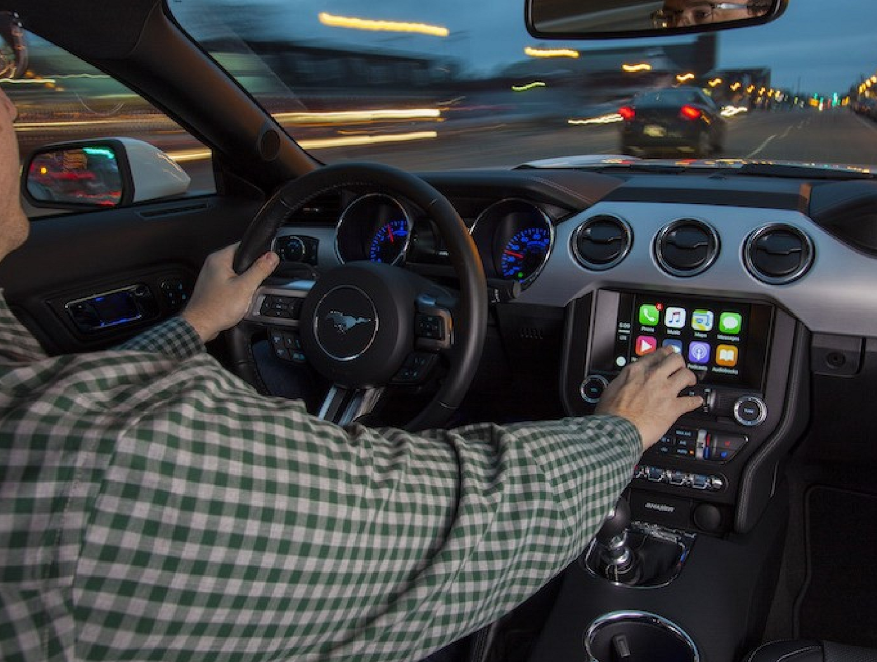
Visual & Cognitive Demand Associated with Vehicle Technologies
http://www.auto-power-girl.com/wallpapers/highresolution/audi_a6_l_etron_concept/79105
https://www.macrumors.com/2017/01/04/toyota-and-ford-consortium-in-car-systems/

Slide 4

Driver Distraction
Visual
High
Cognitive
Moderate
Eyes off the Road
Low
Mind off the Drive
Manual
Hands off the Wheel

Slide 5
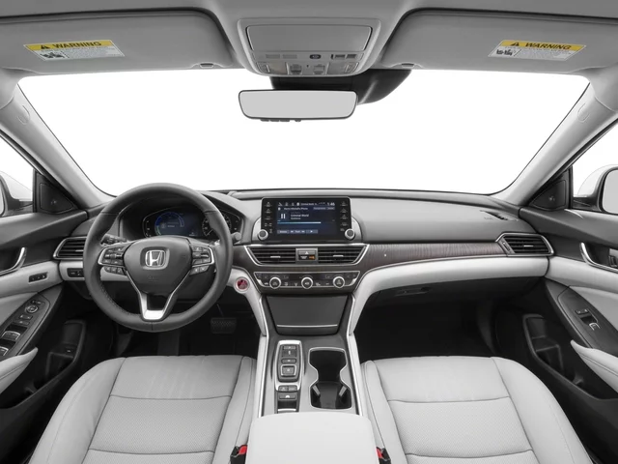
On-Road Study
Sample of 120 drivers
30 different vehicles
Cognitive and visual benchmark tasks
Measured driver workload
https://www.mygerrywoodhonda.com/new-Salisbury-2018-Honda-Accord-Hybrid+Touring-1HGCV3F91JA008918

Slide 6
Are some task types more impairing than others?
Audio Entertainment
Calling and Dialing
Text Messaging
Navigation

Slide 7
Are IVIS interactions easier to perform in some vehicles than others?
Evaluated 30 new 2017 vehicles
Stationary human factors evaluation
Comprehensive on-road assessment

Slide 8
Overall Demand by Task

Slide 9
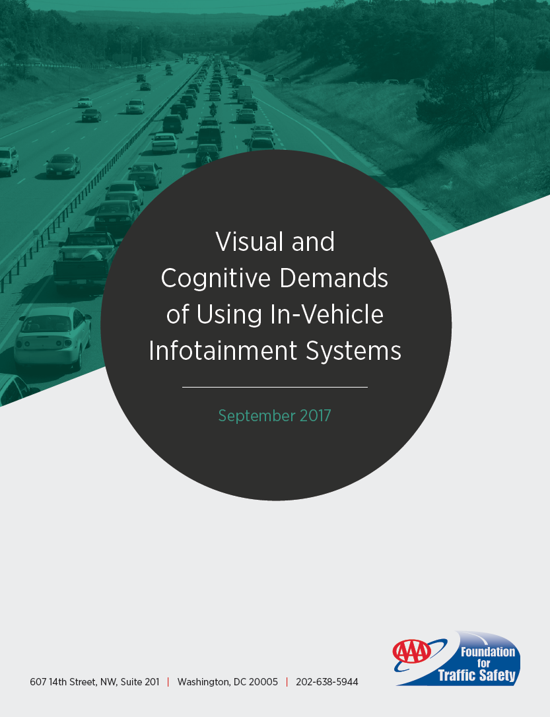
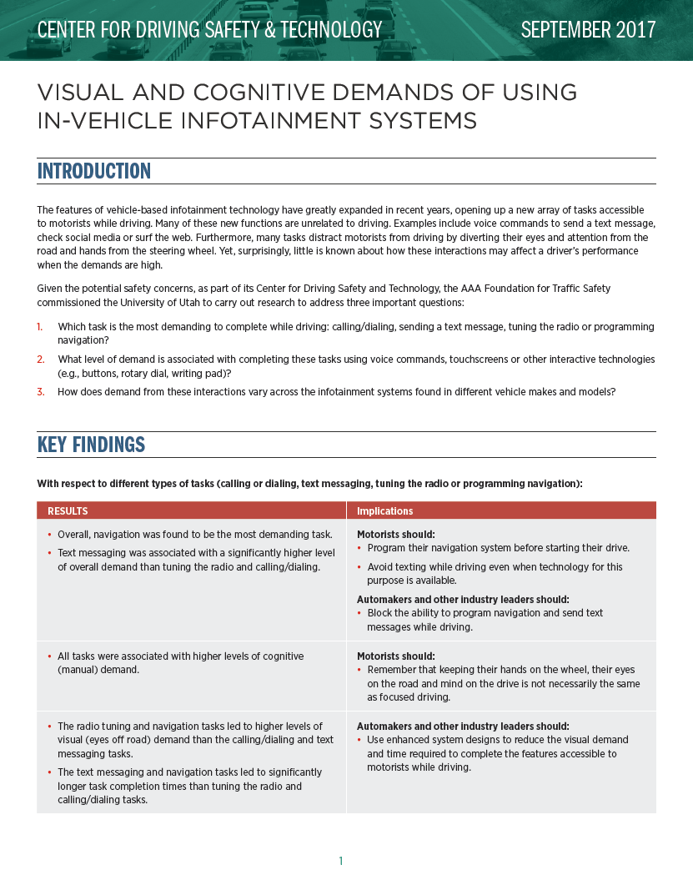

Slide 10
Key Findings & Implications from 2017 Release
Of the 30 vehicles tested, 23 vehicles generated high or very high levels of overall demand on drivers
Overall, navigation was found to be the most demanding task
Text messaging and navigation tasks led to significantly longer task completion times vs. tuning radio and calling/dialing tasks
Independent research funded by AAA Foundation → Continued improvements should be made on system designs to minimize demands; educate drivers on proper use of in-vehicle technologies

Slide 11
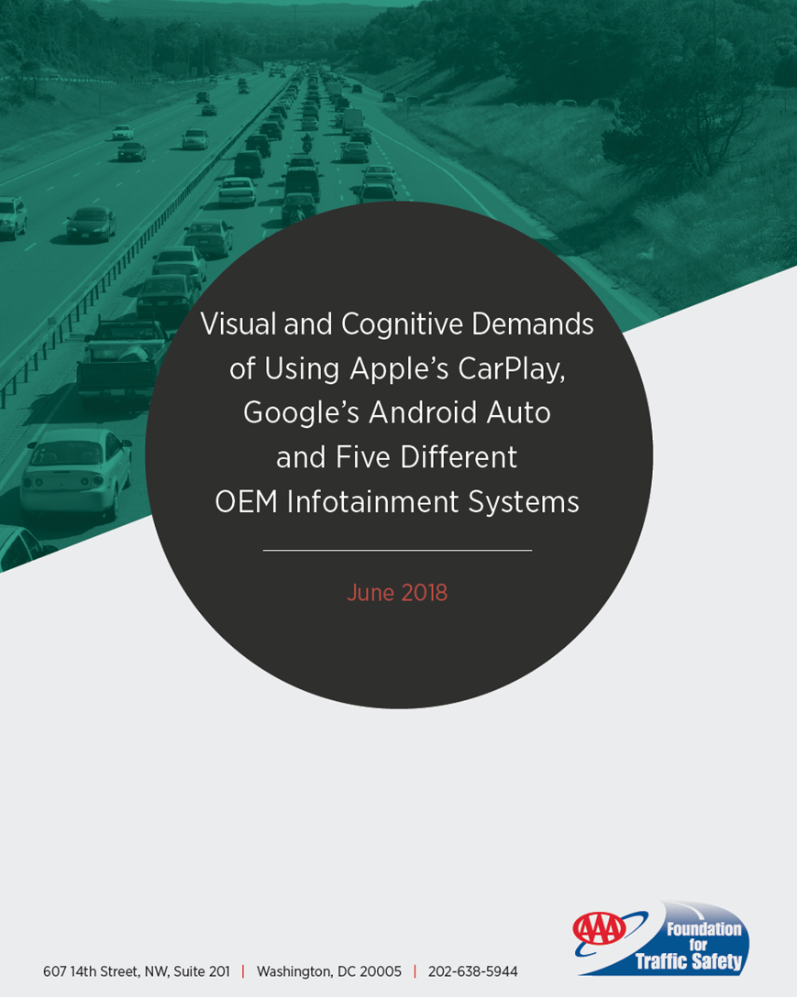
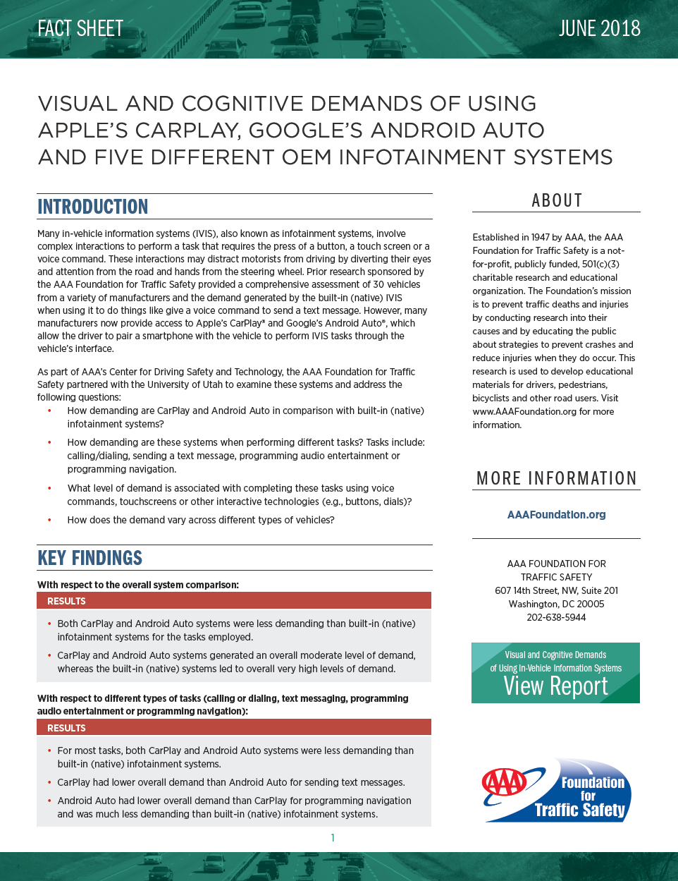

Slide 12
Key Findings & Implications from 2018 Release
CarPlay and Android Auto systems were less demanding than built-in (native) infotainment systems for the tasks employed – moderate level of demand
Visual demand associated with CarPlay and Android Auto was lower for both auditory/vocal and center stack interactions vs. native systems
Independent research funded by AAA Foundation → Offer suggestions to technology companies & automakers to enhance their designs, minimize demands placed on drivers

Slide 13
2018 Forum
Theme:
Forum on the Impact of Vehicle Technologies and Automation on …
  Vulnerable Road Users
  Driver Behavior & Performance
Date: November 7-9, 2018
Location: University of Iowa
Registration: http://www.aaa.biz/Conference/2018AAAFDN/forumreg.htm

Slide 14

https://quotefancy.com/quote/844804/John-Wooden-Good-things-take-time-as-they-should-We-shouldn-t-expect-good-things-to

Slide 15

Learn more about AAA Foundation
https://www.aaafoundation.org

