Slide 1
Distracted Driving/ Hands Free Ordinance
Daniel Sharp
Oro Valley Police Department

Slide 2
OVPD – Hands Free Enforcement
Crash reduction
Purpose
Training
Public Awareness
Action
Reporting
Build positive relationships
Inform public of outcomes
Be transparent
Enforce and Educate

Slide 3
Problem Identification- Changing a Culture
Purpose
The act of driving has always been a divided attention task.
The volume of potential distractions and the level of the driver’s attention dedicated to the distraction continues to increase.
The generation that was raised on cell phones and their associated distractions is now operating motor vehicles.
Notes:
Eating and drinking, radio, passengers, make up application
Car phone, cell phone, cell phone with text, smartphones, apps, email, social media

Slide 4
Identifying and Understanding the Problem
Training
Do the members of your community understand the safety hazards?
Do your elected officials understand the safety hazards?
Do your officers/deputies/troopers understand the safety hazards?
Cooperative efforts with your community members and elected officials is essential to success.
Notes:
Officers need an understanding, have to believe in the mission for effective enforcement
Provided officers with Bluetooth options
Even though they are exempt, it is for their safety and to lead by example

Slide 5
Creating Reasonable, Enforceable Legislation
Oro Valley instituted a “hands free” ordinance.
Allows for communication via an electronic communication device.
Requires the electronic communication device to be operated in a Bluetooth or audible speaker configuration and requires the device to be “hands free” at the time of communication.
The burden of proof is achievable and realistic.
Notes:
Reasonable- still allows motorists an opportunity to communicate.
Emergency exceptions
Enforceable- officer does not have to prove a specific use such as a texting ban

Slide 6
Education
Public Awareness
Education is a critical component to changing a culture.
Crafting your message
The focus is safety
Addressing allegations that the initiative is a money making endeavor
$50.00 first violation
$100.00 second violation
$200.00 third violation
$250.00 if involved in collision
Notes:
BE TRANSPARENT

Slide 8
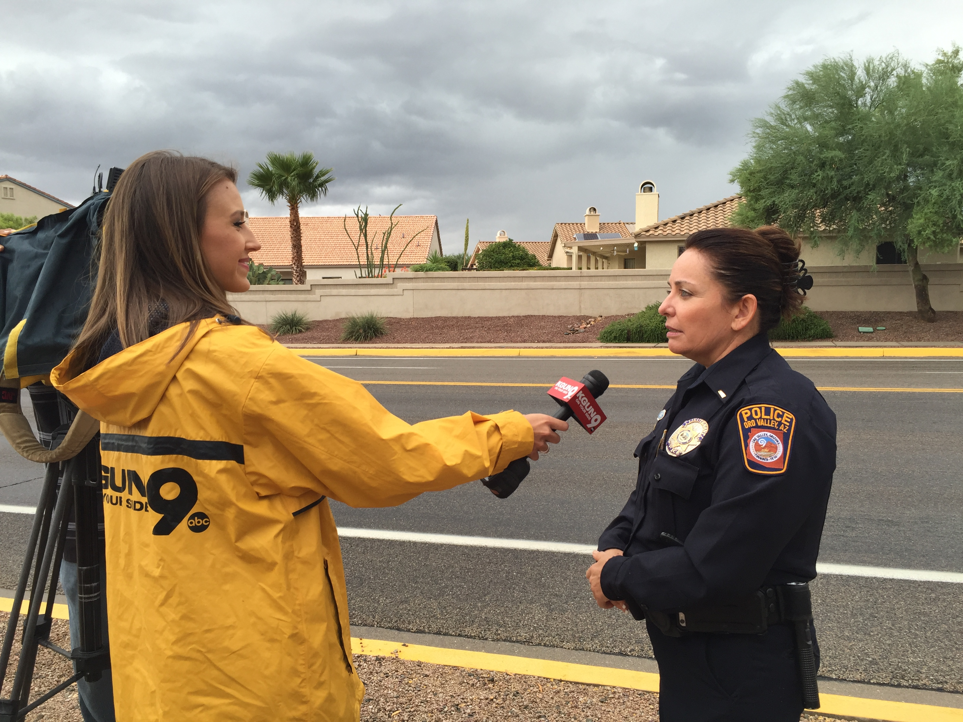
Education
Public Awareness
Getting your message out to your community
Public Service Announcements
Tagline- #handsfreeOV
Media Releases
Media Interviews
Community Educational Events
Partnered with local businesses
Handed out donated Bluetooth devices to attendees
Posted signs at all major
thoroughfares into the town
Notes:
During community events gave a block of instruction on how to use Bluetooth if needed

Slide 9
Education
Public Awareness
Worked with the Youth Advisory Council with support from the Town Council to create a public service announcement. It aired in the Oro Valley movie theater during the pre-movie loop.

Slide 11
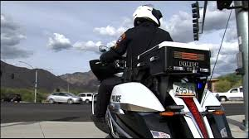
Implementation- Education Through Enforcement
Action
Department wide participation
9 month educational enforcement phase
Continued educational public out reach
Traffic stops were focused on education
1077 traffic stops conducted
All resulted in warnings

Slide 12
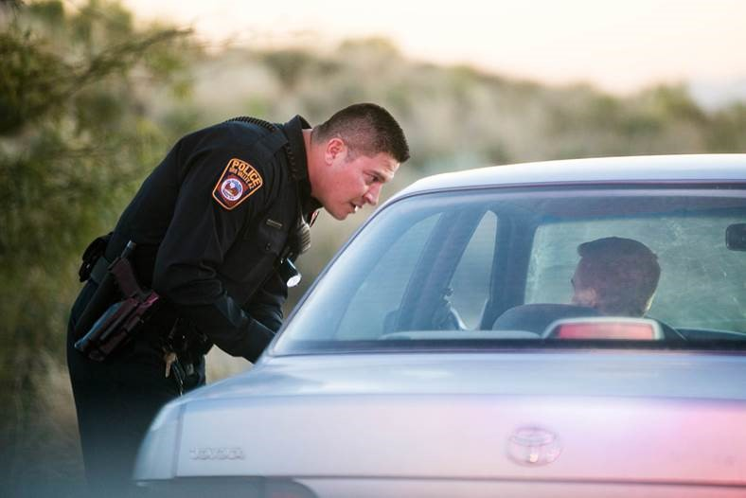
Transition to Enforcement
Action
The message remains unchanged
Notify the community before switching to an enforcement effort
Be Transparent
Remain focused on educational component through traffic contacts

Slide 13
Reporting
Reporting
Remain Transparent
Collect and report statistical data on activities
Reinforce Your message
Stay true to your message
Notes:
Monthly reporting

Slide 14
First Year Report
Reporting
Town Code effective January 2017
To date:
1928 traffic stops conducted for hands free violations
165 citations written
1763 warnings written
2017 saw
8% reduction in overall collisions
23% reduction in injury collisions
As compared to 2016

