Slide 1
Teen Driving Plan:
Adapting a clinical research-developed program for community delivery
Suzanne Hill
Associate Director, Outreach & Advocacy, CIRP

Slide 2

Center For injury research and prevention
Multidisciplinary team of scientists since 1997
Crashes #1 cause of death for adolescents
Scientific rigor for teen driving crash solutions since 2006
Research in action
Translate science for practical use and impact

Slide 3
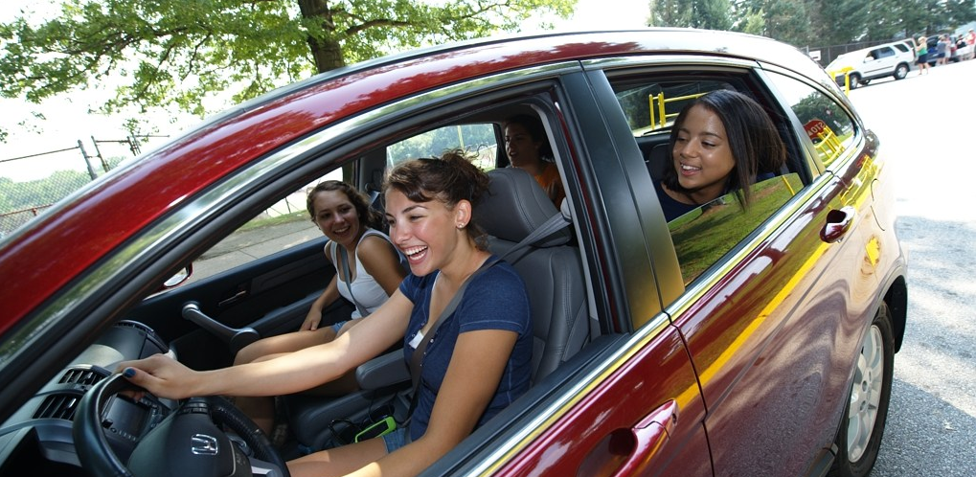
Teen driving safety research goal
REDUCE FREQUENCY AND SEVERITY
OF TEEN CRASHES

Slide 4
Areas of research focus:
Teen drivers' skill acquisition and training
Compliance with and enforcement of Graduated Driver Licensing (GDL) provisions
Improving teen driving behaviors

Slide 5
Areas of focus:
Teen drivers' skill acquisition and training
Compliance with and enforcement of Graduated Driver Licensing (GDL) provisions
Improving teen driving behaviors

Slide 6
Objectives for today
Importance and challenge of engaging parents in teens’ learning-to-drive
CHOP’s R&D of Teen Driving Plan (TDP)
Children Hospital of Wisconsin’s pilot of a community-delivered TDP program
Recommendations for how to use TDP components as an educational tool today… for free

Slide 7
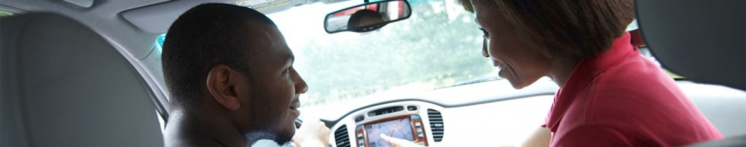
Why focus on parents?
Quick review of the science

Slide 8
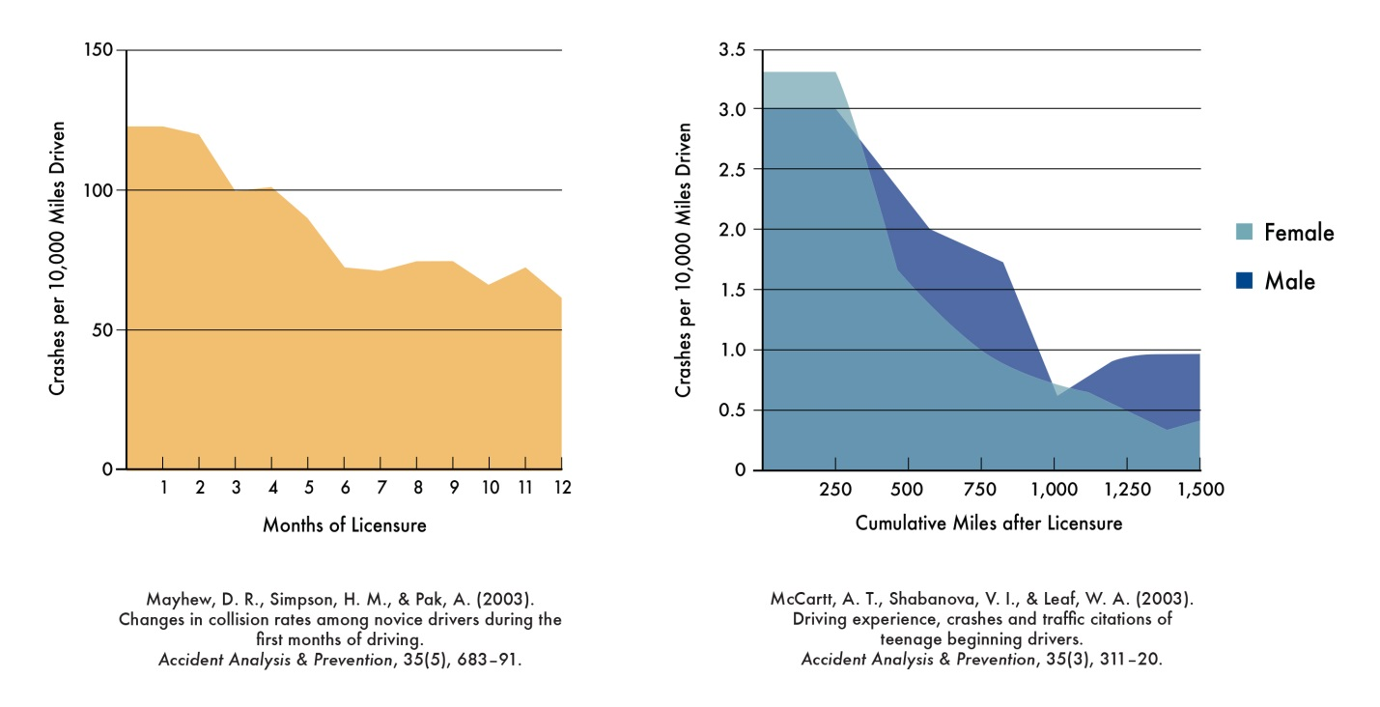
When to Intervene
Time zero
X
X
Notes:
Familiar Mayhew and McCartt curves from research over a decade ago. Overall, this pattern has stayed the same, even though overall fatalities have decreased.
Explain charts:
Y axis for each is crashes per 10,000 miles driven, x axis- months of licensure over 1st year of holding a license and number of miles driven after licensure.
These curves have been inspiring researchers and teen driver safety advocates to ask “what can we do to change this curve!?!”
So lets look at this critical moment : The first day of licensure, where teens go from their lowest lifetime fatal crash risk as a driver to their highest lifetime fatal crash risk-- when they exchange their learner permit for a intermediate license. We have asked ourselves “what can we do to better prepare youth for this big day so that they are more skilled when they start driving on their own and thus less likely to crash.”
….Wouldn’t it be great if youth started this crash rate curve lower on the y axis. Think of the crashes that might be avoided!
And then what can be done after they are driving on their own to help minimize crash risk during these first 3-6-12 months or 1500 miles of driving

Slide 9
Graduated Driver Licensing
Reduces Crash Risk by up to 40%
Learner
Supervised driving
Intermediate
Solo driving
Full Stage
Unrestricted driving
16 years
Pass knowledge test; 12 mos. Holding period
>50 hours
Decal
17 years
Pass on road test; 12 mos. holding period
Restrictions
< 1 teen passenger
No driving 9/10 pm – 5 am
No Technology
Decal
18 years
Pass enhanced on road test
Clean driving record
Source: TIRF and National Safety Council, 2014
Notes:
To address those curves, research and legislative efforts to optimize state graduated driver license systems
GDL – single most effective intervention
Consists of three phases – learner permit, intermediate stage, and then unrestricted license
Designed to (1) delay full licensure and (2) restrict teens from engaging in behaviors or in situations that are known to increase their crash risk…”phase” them into more high-risk driving situations.
As you consider your teen driver safety programming, you want to be comprehensive, perhaps making sure you support teen drivers in each stage of their licensing process.
But for this presentation, I want to focus on the Learner Stage – in this line of research, our researchers hypothesized that if we can get novice drivers to transition to independent driving with more supervised experience driving in more a diverse range of driving conditions, and practicing the skills needed most to avoid crashing, we just might be able to shift that curve– where the crash rates are lower during the first months of driving.

Slide 10

Teens say “parents matter”
87% of teens report parents involved in teaching them to drive
40% only have parents teaching them to drive
Involved parents that set rules and monitor can lower teen crash risk by half
2x as likely to wear belts
70% less likely to drink & drive
Less likely to drive with multiple passengers
Half as likely to speed
Source: National Young Driver Survey, 2009
Notes:
Now we start meeting the third learning objective- Parents know the importance of their role in their teen’s learning to drive.
CHOP’s National Young Driver Study, a nationally representative study of high school students, was able to quantify the important role parents play in teen driving…
87% said parents were involved in their practice driving. 40% said only their parents were involved in this critical time. (as in no Driver Ed)
When it comes to whether or not teens reported risky driving behaviors, the teens who said their parents were involved, set rules and monitored them also crashed half as much as teens who reported their parents not being as involved.
These supported teens also were 2x as likely to wear seat belts, 70% less likely to drink and drive, half as likely to speed, and less likely to drive with multiple passengers.
Bottom line, though parents may not feel it sometimes, they still have a critical influence on their teen, especially when it comes to driving safely.
That is why we are asking you to help facilitate parents’ involvement. Parents really matter!

Slide 11
Serious Teen Crashes:
The Big Three Critical Errors
75% of teen crashes due to ERROR
Most Common Critical Errors:
21% Scanning/hazard detection
19% Distraction
21% Too fast for conditions
Source: Curry AE, et al. Accid Anal Prev. 2011.
Notes:
So let’s begin with some stats and the evidence behind TDP Practice Guide.
Mostly, the high crash rate for teen drivers is about inexperience and lack of driving skill as novice drivers, rather than intentional risk taking.
In a CHOP study, researchers analyzed a federal crash investigation database to look at the critical errors teens made right before they crashed. The most common noted by investigators at the crash scene were the failure to scan and detect hazards, being distracted by something inside or outside of the vehicle, and driving too fast for conditions.
Knowing the common critical errors is good. We know what we need to target as we teach teens to drive
There are real driving skills that can be taught and practiced to address each of these critical errors…; before teens starting driving on their own.

Slide 12

How to empower parents
Make the most of supervised driving with
Teen Driving Plan

Slide 13
Key message to parents science says
High quality, varied and appropriately challenging driving practice.
50-120 hours of practice
Track progress
Notes:
Now we begin the last learning Objective of “Parents Know What and How to Practice Drive.” The critical/ required component of this section is showing the “How to Use TDP Video”, which you will see shortly. However, we think these 5 slides help to reinforce the important components of this learning objective. So use these as you see fit. You can use all the slides as well as the video, and it works great. If you have less time, you may want to not use all the slides.
Lets begin – this slide emphasizes that its important that teens get high quality, varied and appropriately challenging driving practice. CHOP TeenDrivingPlan research confirms this.
It is recommended that teens log about 50-120 hours of practice in different driving environments and conditions before they start to drive on their own. Many different researchers have come to this conclusion.
Recall that keeping track of progress really help the successful families from the TDP randomize control trial.
This may seem daunting to parents, so encourage parents with a “Don’t worry, we are here to help you structure that practice driving with TeenDrivingPlan.

Slide 14
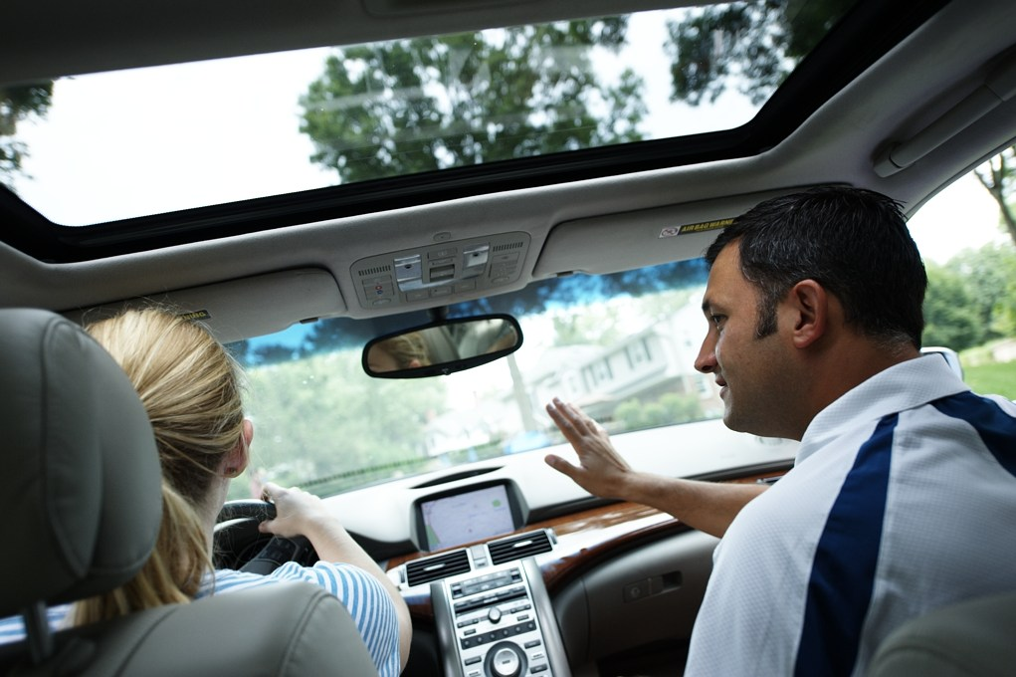
Right Learning Environment
Right now, it’s all about driving.
Driving is not automatic for teens
Keep calm and safe
Acknowledge good driving
Notes:
Talk to parents about how to create an effective learning environment.
Teens need a calm and supportive practice supervisor with knowledge and skills to instruct and give good feedback.
Here are tips to create the right learning environment:
For one, The only topic of conversation in the car during practice drive should be about the practice drive itself. Save the other topics related to family, academics, schedules, or friends to a different time and location.
Parents need to know that their own driving skill-- that now comes automatically-- actually took them a long time to learn. Remind them that skills used or risks taken by experienced drivers like them may not work for a new teen driver.
Teens can get defensive when they are told they are doing something wrong. Right? To keep the calm and stay safe, pull over to side of the road and explain what they did that was wrong and how to do the skill properly. Then give them the chance to do the skill correctly. Acknowledge when they do something well.
Part of the tools that parents can access is a short video about how to create a good learning environment.

Slide 15
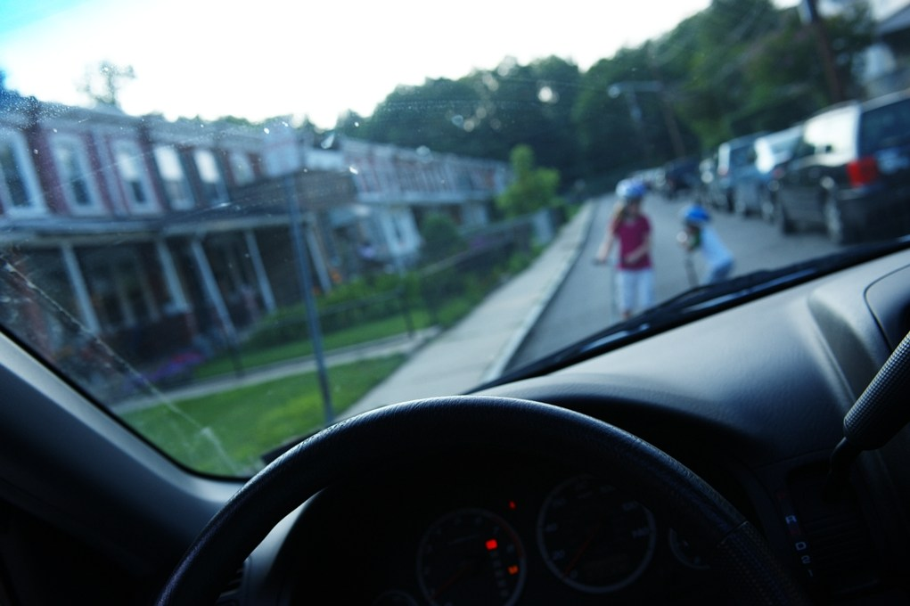
Focus on the Skills for Safety
Scan, Detect & React to Hazards
Manage
Distractions
Speed
Management
Notes:
As we’ve mentioned before, but can’t mention enough:
We know the errors teens make right before they crash.– and its not poor parallel parking. To prevent these crashes, practice drives should be used to develop a teen’s ability to scan, detect and react to many different types of hazards.
Teens also need to practice with parents how to manage speed depending on traffic to keep a safe distance from other cars and how to manage distractions.
These are the main deficits that lead to crashes.

Slide 16
Teens can’t tell us
they don’t know
what they don’t know
Tip 1: Assume they don’t know
Tip 2: Break each skill down
Notes:
Explain these types of skills eventually become automatic for experienced drivers, but teens truly do not know how to do these things until it’s broken down and shown to them.
Saying “slow down” or “watch out” is not enough. Teens think they are doing this. Rather, teens need to be taught how to slow down, including how to use their feet on the accelerator and brake pedals, and to where and for what they should be looking for hazards.
For instance, initially teens look only straight ahead at the car in front of them, they do not know how to scan the environment all around them.

Slide 17
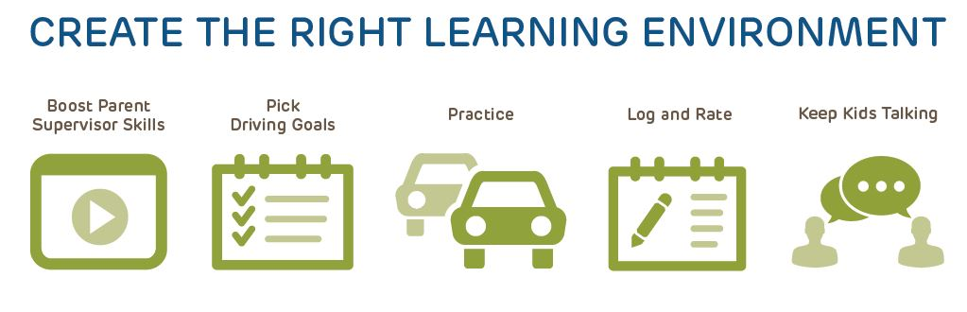
How does teendrivingplan work?

Slide 18
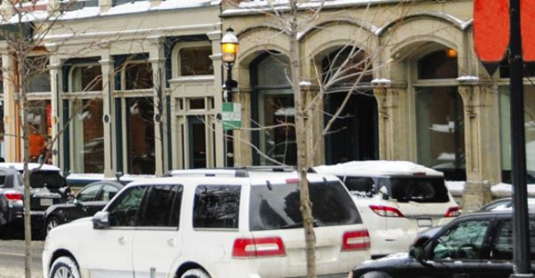
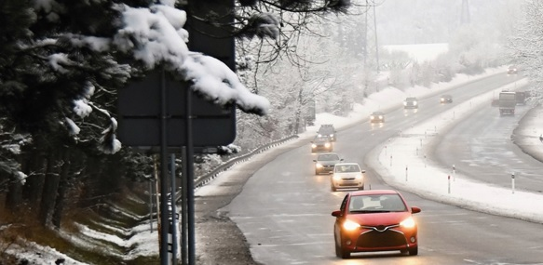
How does teendrivingplan work?
Helps parents take action to keep teen drivers safe & learning
Supervise practice in a variety of places, conditions and at night
Notes:
Shows parents how to supervise

Slide 19
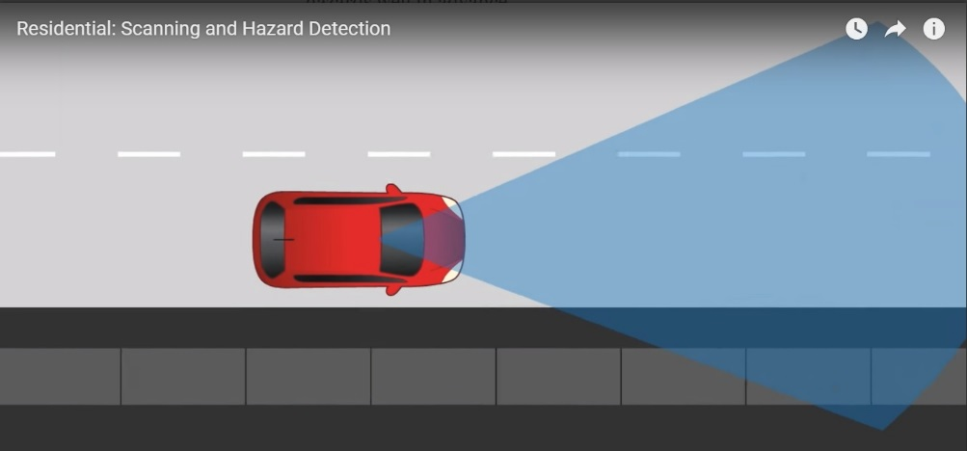
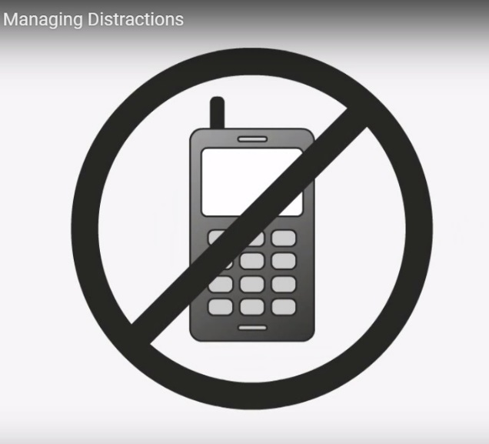
How does teendrivingplan work?
Helps parents take action to keep teen drivers safe & learning
Focus on teaching skills that matter for safety
Notes:
Shows them how to focus on teaching

Slide 20
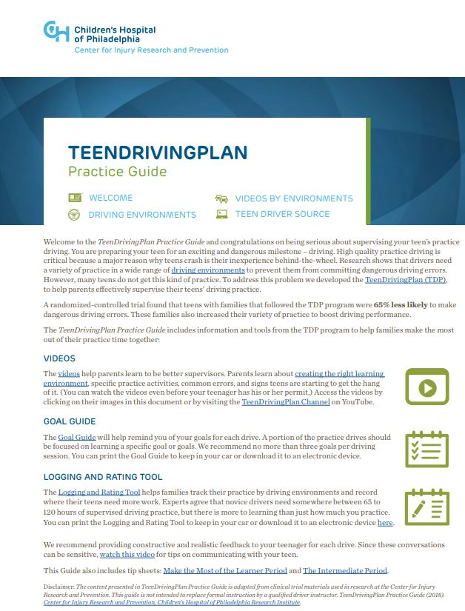
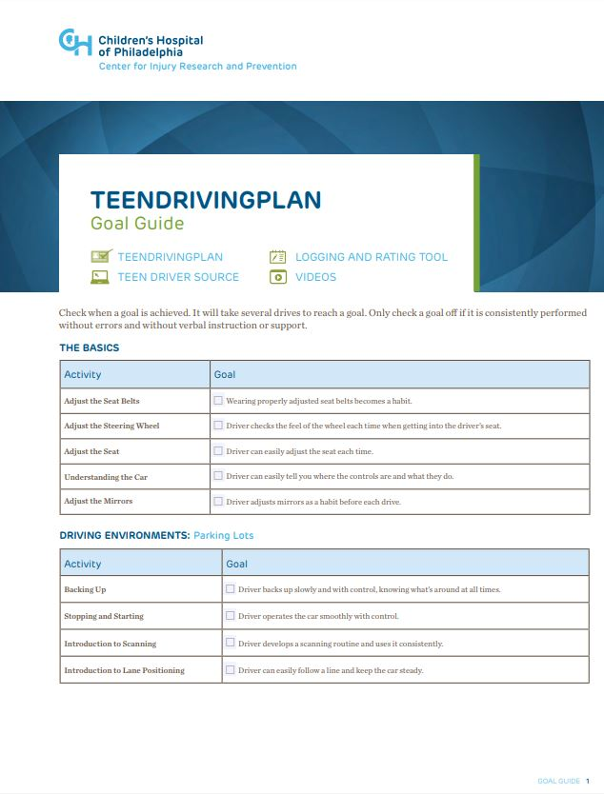
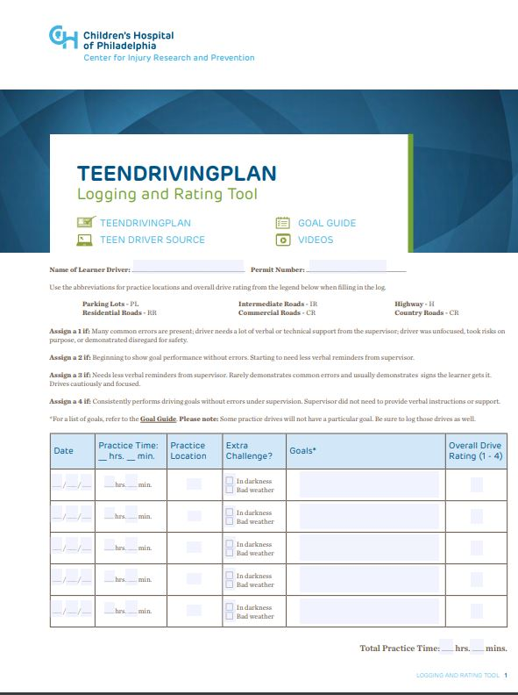
How does teendrivingplan work?
Helps parents take action to keep teen drivers safe & learning
Track skill development and practice hours
Notes:
Facilitates tracking

Slide 21
TeenDrivingPLan: How’s it different?
Theory and formative research to develop
Rigorously evaluated in clinical trial
Focus on instructional permit period of GDL
Focus on role of parent-supervised driving
versus
Most teen driver safety programs focus on post-licensure period & on risky driving
Notes:
Holding true to its behavioral theory and formative research, the key aim of TeenDrivingPlan is to increase parent’s self-efficacy, knowledge, and comfort (as in “low stress”) by providing them with tools and info they can use to increase the quantity and quality of practice drives during the learner or instructional permit phase.
In all, CHOP researchers have published multiple papers in the scientific literature involving the formative research to develop that theory, to test and confirm various elements of program while in development, and then rigorously evaluated an interactive web-based version of TDP in a randomized control trial. This version had an interactive dashboard for each family to learn how to practice specific driving skills and then plan, log and rate their practice drives. Because it was web-based, we could track how they used the program and prompt them to take study surveys.
In addition to the rigor in which TeenDrivingPlan was developed, the fact that TDP focuses on the instructional permit phase of driving and the role of parents as supervisors for their teen’s practice also makes this unique. When we started to build TDP, most teen driver safety programs focused on the probationary stage of licensure and on intentional risky driving.

Slide 22
Randomized control trial
Main Outcome: Driving SkilL
Measured: Pass-fail rigorous on road exam
65% less likely to fail
6%
5 of 86
Failed tODA
TDP
Mirman, et al. JAMA Pediatrics, 2014
Notes:
Let’s skip forward to the results of the randomized control trial of TeenDrivingPlan. In this trial, the learner teens who’s parents used TeenDrivingPlan were approximately 65% less likely to fail a rigorous on road driving assessment than the learner teens whose parents used the standard state-issued manual.
Specifically, 6% of TDP teens had assessments terminated compared to 15% in the control group
So TDP
group demonstrated better driver performance. Why?
JAMA Pediatrics abstract.
Journal of Adolescent Health abstract.
Injury Prevention abstract.

Slide 23
Driving Skill–
Proximal Outcomes
More social
support
Exposure
To TDP
More parent
Engagement
Better driver
performance
More practice
variety
More quantity of
practice
Mirman et al. J Adolescent Health, 2014
Notes:
Well, we did another analysis of this trial data. Researchers looked at the proximal outcomes that mapped to the intervention theory. Here is what we learned:
As compared to the control group, the intervention group reported increased parent engagement as practice supervisors (self-efficacy), increased communication and social support between parents and teens (lowering stress), greater quantity of practice driving, and increased practice variety.
To look at what of these proximal outcomes ultimately led to better driver performance -- we compared the group that passed the On-road Driving Assessment to the group that failed the on road driver assessment. We found that the group that passed recorded greater quantity of practice and greater variety of practice. In other words, they got lots of practice in different kinds of environments. These teens practiced >1-2 hours or more in each of the recommended driving environments.

Slide 24
TDP → TDP PRACTICE GUIDE
KEY ACTIVE INGREDIENTS
Variety of practice
> 1-2 hours in each driving environment
Light human touch
Research coordinator contact
Interactive content, tools
Within broader framework
TDP delivered within context of CHOP clinical trial
Static content not enough
Notes:
To translate this intervention for real world application by teen driver stakeholders like you, we determined what were the key active ingredients of TeenDrivingPlan in the Randomized control trial and turned these into the affordable TeenDrivingPlan Practice Guide.
We knew that the most important thing to emphasize in this program is the need to deliberately get variety of practice in different driving environments– that’s what led to better driving performance.
We also know that interaction with research staff played a role in keeping parents engaged in TDP. We called that our Light Human Touch.
For instance, parents got a reminder call from a research coordinator if they logged onto the App less than twice in 3 weeks, just to make sure they were not having technical difficulties. The research coordinators also had an orientation phone call with each parent before they started using TDP. So any translation of TDP needs a “light human touch” to engage parents and keep them engaged.
So about interactive content:
First, the need for interactivity of content has been confirmed in systematic review of parent-directed teen driver interventions.
Second, Parents need tools. In another analysis of the RCT data, successful teens’ parents spent time early-on doing learning activities on the site. They did little formal planning, but continued to use the Log and Rate tool throughout…. This fact could have resulted in their deliberately getting practice time in each environment. Seeing the dashboard with their progress and gaps, might have motivated this.
We also know we can underestimate the power of the CHOP brand in Philadelphia, and the knowledge that you are part of a CHOP clinical trial. This we knew we wanted TDP to be delivered locally by community partners parents trust.

Slide 25
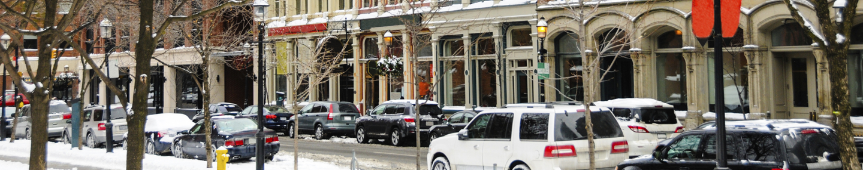
Community-Delivery of teen driving plan
Children’s Hospital of Wisconsin’s Pilot
Notes:
Starting with these key active ingredients, we worked with Children’s Hospital of Wisconsin, who used a adolescent health risk grant from the MCH grant to Wisconsin Department of Health Services to pilot implementation of TDP. Federal funding to the state was cut after the first year but WCH pivoted and continue to pilot in smaller scale.

Slide 26
TDP
TDP WI
Interactive
Content
Parent Education Materials
Light Human Touch
Parent Session
Emphasizing
variety of
practice
Within Supportive Framework
Community Partners
Notes:
In partnership with a small but mighty team in Wisconsin, we adapted the TDP used in the randomized control trial for community-based delivery. In short, this is how we adapted the web-based prototype that lived on a server behind the CHOP firewall to something that stakeholders and parents could start using relatively quickly. We brought over the active ingredients but without the expensive and already outdated web programming.
This pilot was about feasibility, rather than redoing RCT to measure effect of the TDP. Goal was to get people to use the TDP.

Slide 27
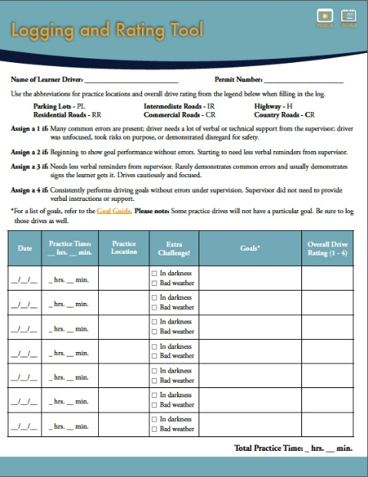
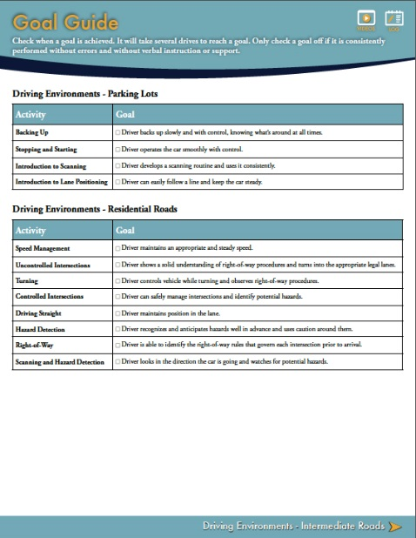
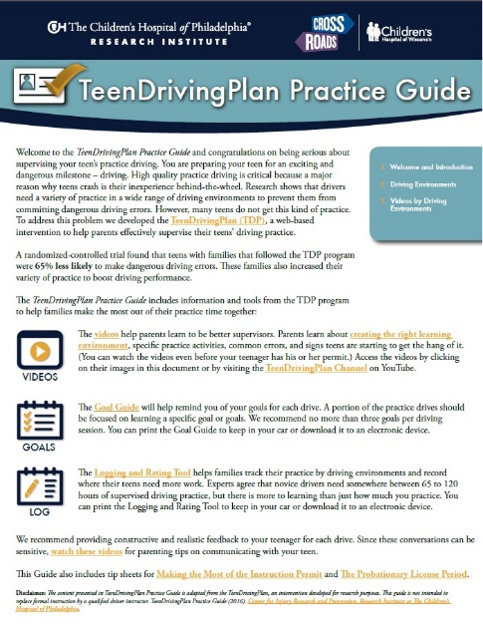
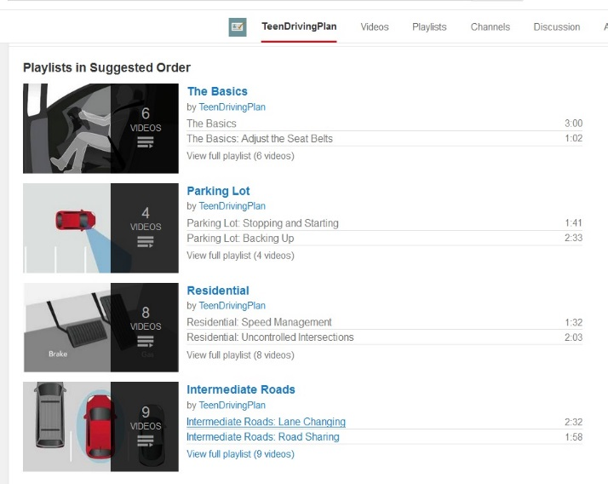
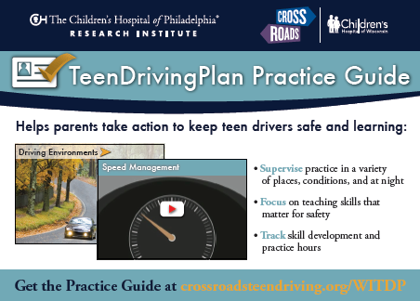
Program components
WI TDP program tools:
  Practice Guide
  Goal Guide
  Logging and Rating Tool
  52 short YouTube videos
Support tools:
  Information card
  Facilitator PPT for Parents Session
  Demographic form
  Parent pre-post tests
  Fidelity checklist
Notes:
They used a MCH grant to license the TDP materials
Goal of the TeenDrivingPlan Practice Guide are an increase in:
Parent engagement
Practice variety
Parent support of teens

Slide 28
Methods of delivery
COMMUNITY MODEL
Delivered by community facilitators
One hour in-person session with PowerPoint
Small groups such as driver education parent meeting
EMPLOYER MODEL
Delivered by community health educator
One hour in-person session with PowerPoint
Small group during the lunch hour at work
Health and wellness credit available
IN-HOME MODEL
Facilitated by community health educator and trusted parent representative
Self-guided exploration of resources using iPads
Organic, small group conversation
Notes:
CHOP researchers believed that part of TDP’s success in the clinical trial was the human touch of the CHOP research coordinators, who oriented each of the study participants on how to use access and use TDP through a web-based portal. Later, RC’s also contacted participants who had not accessed the web-based TDP in a few weeks to make sure participants could still access TDP. There were also a couple of surveys at certain time stamps in the study to ask how families were using the TDP. All may have served to keep parents engaged in using TDP.
Thus, community delivered model would probably need the human touch – 1. locally available and trusted organizations, 2. facilitated group orientation; 3. occasional reminders such as emails or email surveys to keep parents/families engaged

Slide 29
WI TDP Parent Session results
20 sessions
151 participants
5%
Teen with a Probationary License
20%
Teens with an Instruction permit
73%
Teens with no permit or license yet
72% of the parents attending were female
Notes:
EVALUATED THE DELIVERY OF THE PROGRAM NOT THE EFFECTIVENESS OF TDP
52% son, 45% daughter, 3 grandchildren, 1 niece, 3 other
94% white, 5% Hispanic, 2% Black

Slide 30
WI TDP parent Session results
After the TDP sessions, parents agreed that:
Graduated Driving Licensing (GDL) laws can reduce teen crash risk.
91%
94%
Involved caregivers that set rules and monitor their teens can lower crash risk.
100%
I have a better understanding of the risk factors for new drivers and GDL requirements.
I can identify different driving environments in which my teen should practice driving.
94%
I am able to enforce GDL requirements with my teen.
100%
86%
I feel I will be a better supervisor of my teen’s driving practice.

Slide 31
WI TDP Parent Session results
When a pre-survey component was added to questions without one, it showed significant movement in key areas:
 | In general, I feel I will be a better supervisor. |  | Overall, I have a better understanding of the risk factors for new drivers and GDL requirements. |  | Overall, I am able to enforce GDL requirements with my teen.
 | After | Before | After | Before | After | Before
Strongly agree | 86% | 14% | 43% | 0% | 86% | 29%
Agree | 14% | 29% | 57% | 14% | 14% | 43%
Neither | 0% | 29% | 0% | 43% | 0% | 14%
Disagree | 0% | 29% | 0% | 43% | 0% | 14%
Strongly disagree | 0% | 0% | 0% | 0% | 0% | 0%

Slide 32
WI TDP Parent Session Results
Successes included
  Engaged stakeholders
  Transfer of TDP tools
  Survey revisions
  Creation of additional tools
  Adaptability of TDP program to various environments
Challenges included
  Facilitator training
  Program fidelity
  Competing programs
  Engaging parents
  Sustained “human touch”

Slide 33
WI TDP Parent Session Conclusions
TDP program can be implemented in a wide variety of settings
TDP program can help parents understand new driver risks and how GDL and quality practice are protective
Once parents understand the need, they show interest in using the TDP resources

Slide 34
TDP WI
Free TDP
Parent Education Materials
teendrivingplan.org
Parent Session
Existing teen driving program
Emphasizing
variety of
practice
Community Partners
Community Partners
Notes:
All parent education content is available for from at teendrivingplan.org
Existing teen driving program – such as DriveSmart, Driver Ed
Community partners –the very people in this room
VA (in Wisconsin is was CrossRoads, community partners included local health departments, local employer, Driver ed school, parent influencers (football team parents, etc.)

Slide 35
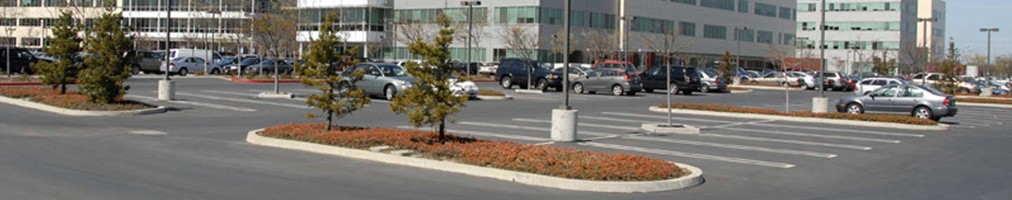
Homework assignment for families
teendrivingplan.org
Notes:
You might consider TeenDrivingPlan as the homework assignment for teen driver safety programs you are currently running.

Slide 36
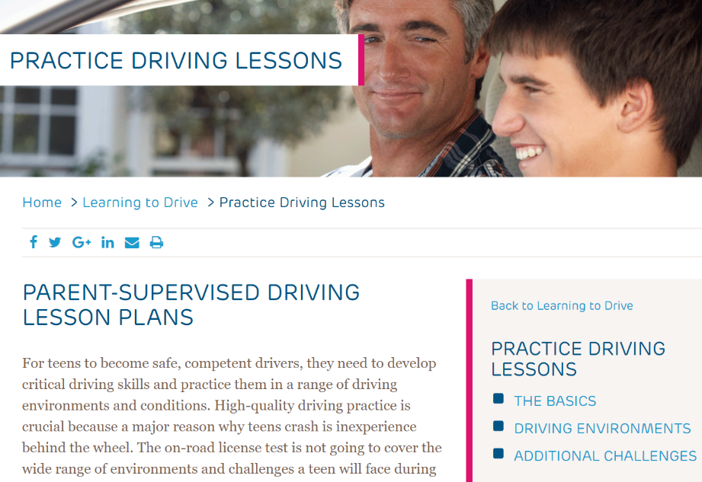
Teendrivingplan.org
6 driving environments
Tips & goals to practicing skills
50+ short videos
Downloadable PDFs: logging/rating tool and goal guide, complete guide
And more

Slide 37
You are the Light human touch
Parent sessions delivered within a wrap-around program; By trusted voice in community
  GDL orientations
  HS Parent Orientation night
  Your program focuses on specific risk?
One-on-One
  Driver Ed student struggling with specific skill
  LE or SRO citation or crash incident involving teen driver; assign specific remedial practice
  Others ideas?
Notes:
We believe TDP will be most effective if …
Use TeenDrivingPlan as homework assignments, assign specific supervised practice with parent using TDP for specific skill deficits you see in a learner driver
Use it as a take-home action from your risk-specific program ( lessons and videos for speed, distraction, rural roads;
Rx remedial practice with TDP (left-hand turns, curves, parking lot fender bender) after a traffic incident or citation.
Link over to TDP from your content where you see fit. Create playlists of your relevant videos to recommend to your families.

Slide 38

You are the Light human touch
Share links to teendrivingplan.org, link to specific lessons as homework
Add TDP YouTube videos to your playlist
Boost Effectiveness
Walk people through teendrivingplan.org as part of your program
  Show short intro video on how to use the TDP
Follow-up with families and provide reminders after the program
Notes:
We believe TDP will be most effective if …
Use TeenDrivingPlan as homework assignments, assign specific supervised practice with parent using TDP for specific skill deficits you see in a learner driver
Use it as a take-home action from your risk-specific program ( lessons and videos for speed, distraction, rural roads;
Rx remedial practice with TDP (left-hand turns, curves, parking lot fender bender) after a traffic incident or citation.
Link over to TDP from your content where you see fit. Create playlists of your relevant videos to recommend to your families.

Slide 39





Deena Liska, M.A.Ed., CPST-I
Teen Driving Coordinator
Ph: 414-231-4893 Fax: 414-231-4952
Email: dliska@chw.org
View our website: crossroadsteendriving.org
Like us on Facebook or follow us on Twitter

Slide 40
Teen driving plan resources
Suzanne Hill contact info – hillsu@email.chop.edu
Notes:
Page on how to use TDP as an educational tool, page on how to license the TDP

