Slide 1
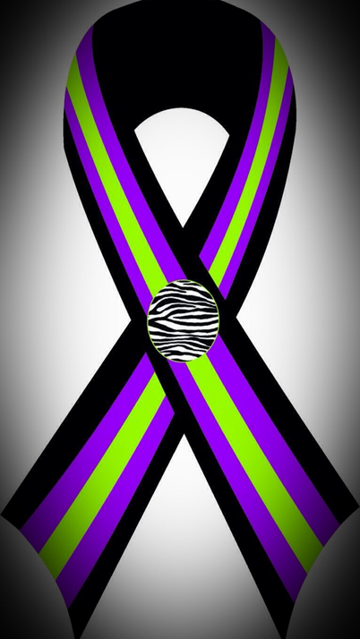
3 Ribbons For 3 Reasons “Losing Loved Ones in a Tragic Auto Accident”

Slide 2
3 Ribbons for 3 Reasons is for all the families that have lost multiple loved ones due to a tragic auto accident due to Distractive Driving.
This awareness was developed in memory of Bethany Dempsey, Lauren White, & Abby Cullen who we lost on August 27, 2013.

Slide 3
Why 3 Ribbons for 3 Ribbons was started
On August 27, 2013 a few minutes before 5:00pm my sisters boyfriend Mike, his son Michael, my sister Bethany, my niece Lauren, and soon to be niece Abby were traveling Southbound Route 3 in Millersville MD. Bethany, Lauren, & Abby were sitting in the backseat of their Camry SE when it was struck in the rear by a 2000 International flatbed truck carrying a forklift.
The traffic was stop and go, on Rt. 3 & the flatbed truck was
Traveling off the off ramp & never hit the brakes, killing Bethany,
Lauren and Abby. The impact caused a chain reaction and 6
other vehicles were involved causing the road to be completely
shut down for hours.

Slide 4
Continue…..
The Driver of the flatbed truck was distracted for 12.6 seconds. He gave officials 2 different stories. First story he gave was that he was putting trash into a bag in the floorboard of the truck, and Second story was he was trying to keep papers with MapQuest directions on them from blowing around in the cab.
There was NO Cellphone use or Texting during the accident. That was confirmed by investigators on scene.
12.6 seconds he didn’t have his eyes on the road, and as a result Bethany, Lauren, and Abby lost their lives.
Mike was driving and Michael was in the front passenger seat and survived the accident.

Slide 5
After what happened to my family, I wanted to do what I could to help prevent other families from going through what our family still goes through.
Working with Delegate Margaret Ransone & Drive Smart VA I have been able to work with Law Enforcement Agencies & High Schools throughout Virginia on the dangers of Distracted Driving.
Also I have honors of working w/ other families that have lost loved ones due to Distracted Driving.
Monday, August 1, 2016, marks the beginning of “Losing Loved Ones in a Tragic Accident Month" in Virginia, established by my legislation during the 2015 General Assembly Session. The resolution, which was introduced and adopted in February 2015, says, in part: “Virginians are asked to observe Losing Loved Ones in a Tragic Accident Month by honoring individuals and families that have been lost due to traffic crashes and remembering to always drive safely and responsibly.
Legislation Bill HJ 593

Slide 6
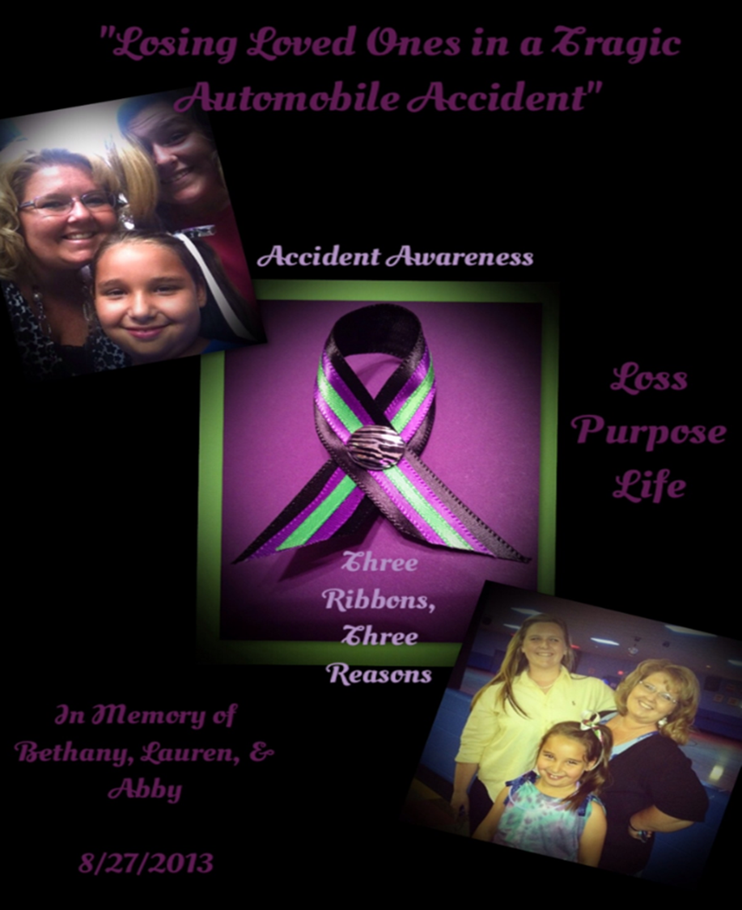
3 Ribbons for 3 Reasons Ribbon
Meaning
Black – Loss
Purple- Purpose
Lime Green- Life
Zebra- Family
These colors were picked because each color was a favorite color of the girls.

Slide 7
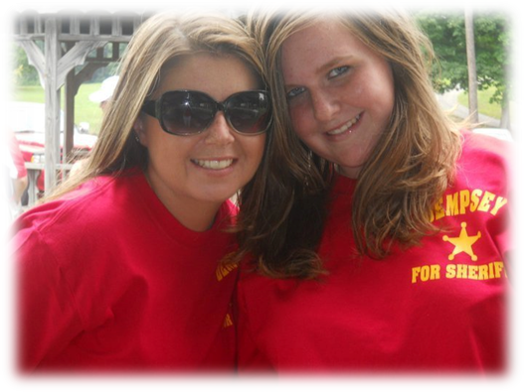
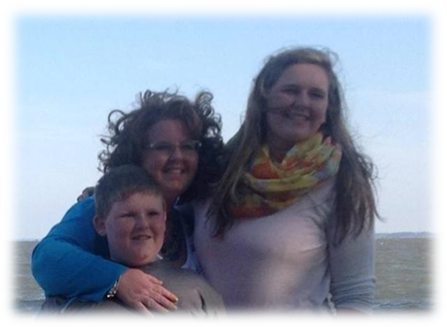
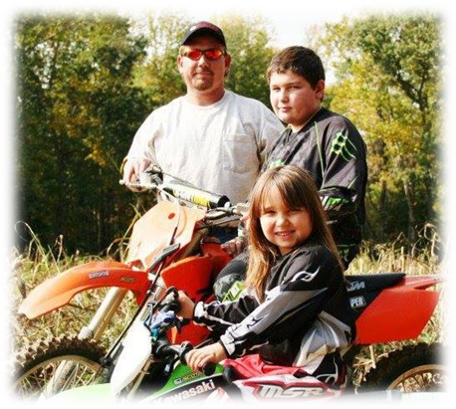
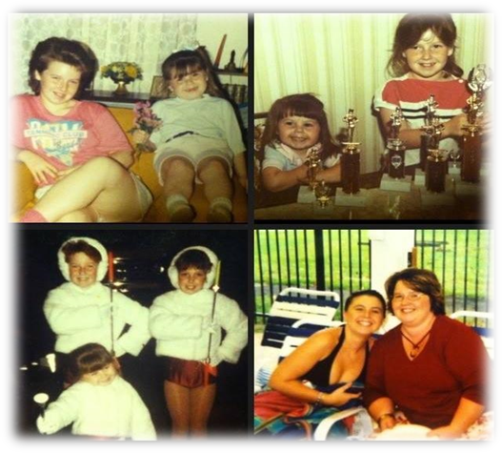
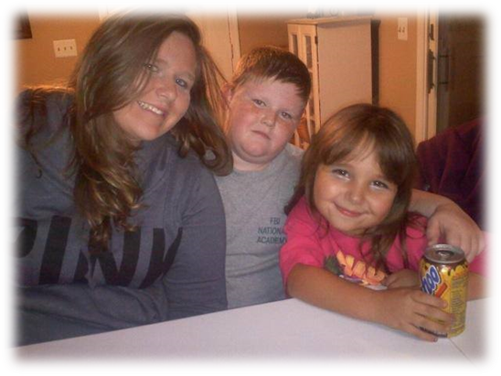
My Family

Slide 8
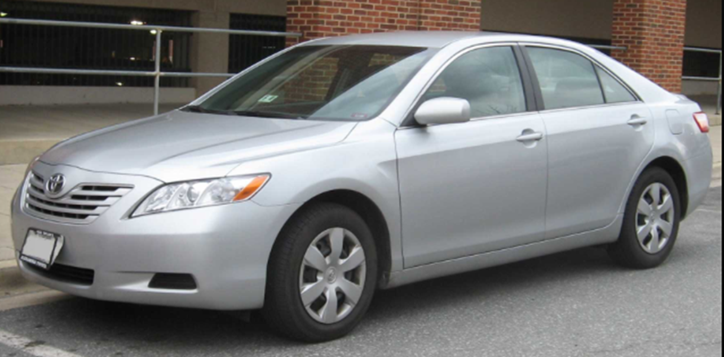
The 2009 Camry
Before the Accident

Slide 9
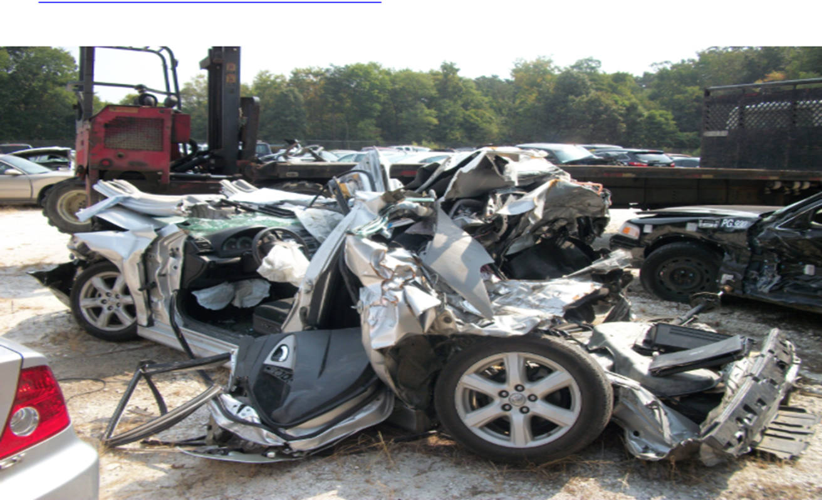
After the accident, Her car was traveling between 4 and 9 mph when it was struck.
It only took 12.6 Seconds

Slide 10
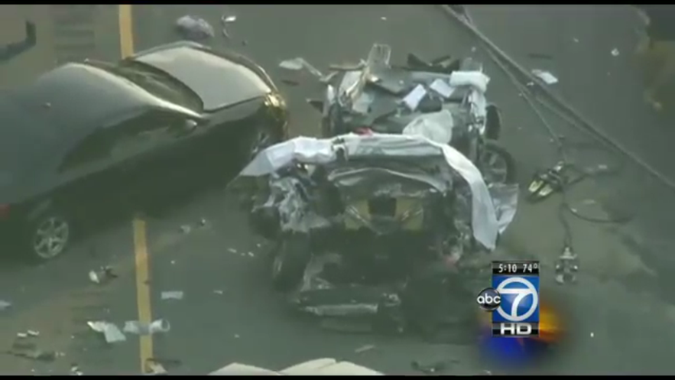
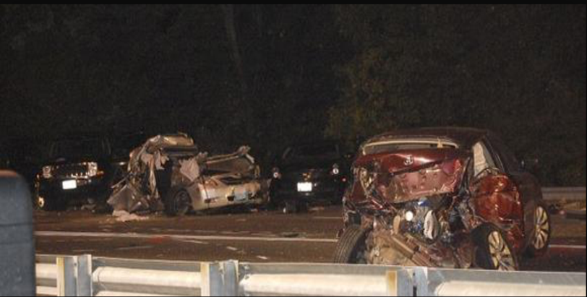
This was the scene.
The other occupants
in the other vehicles had minor to moderate injuries.
The Lieutenant that was investigating the scene stated that it was the worst he had seen in his career. The Command on scene contacted the Crisis Team and had them respond to the scene.

Slide 11
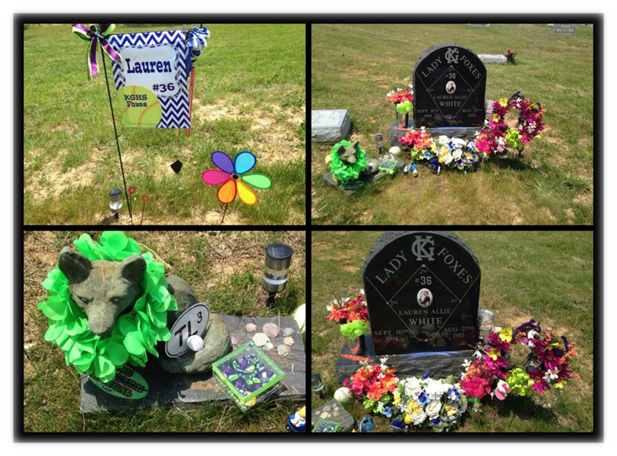
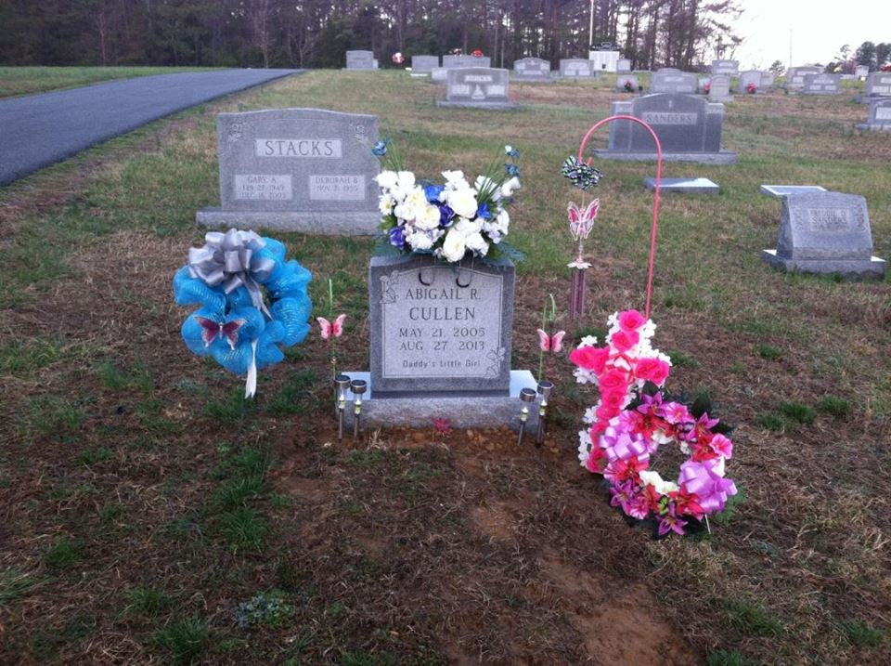
Now, this is where we visit Lauren & Abby on Birthdays & Holidays. When I just want to spend time with Lauren, I must go & visit a stone. When her friends want to be with her, they must visit a stone. Abby is right across from her school, her friends who are still in Elementary School must go visit a stone.
My sister was cremated & is home with my parents. Family & friends visit her when they go over. My nephew is now 16 years old & goes to my parents and must talk and visit with a box.

Slide 12
THE END RESULT
IN FEBUARY 2015 WE CAME FACE TO FACE WITH THE MAN THAT TOOK OUR FAMILY FROM US. THE JUDGE READ WHAT HIS SENTENCE WOULD BE & I COULDN’T UNDERSTAND WHY HE RECEIVED SUCH A LIGHT SENTENCE. I WAS HURT, SAD, AND FELT ANGRY. YES, I WILL NEVER FORGIVE WHAT HE TOOK FROM US, & HIS CARELESS ACT WHILE DRIVING, BUT I WAS MAD AT THE LAW MAKERS OF THE STATE OF MARYLAND. HE RECEIVED 3 YEARS JAIL TIME, (BUT THE JUDGE SUSPENDED ALL 3 YEARS), 5 YEARS SUPERVISED PROBATION, 5,000 DOLLAR FINE, & 200 HOURS OF COMMUNITY SERVICE FOR TAKING 3 INNOCENT LIVES.

Slide 13
THANK YOU FOR YOUR TIME, I HOPE THAT MY STORY OPENS YOUR EYES, I KNOW IT OPENED MINE.

