Slide 1
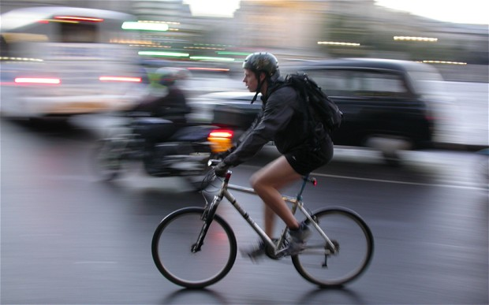
Moving Maryland
Toward Zero Deaths

Slide 2
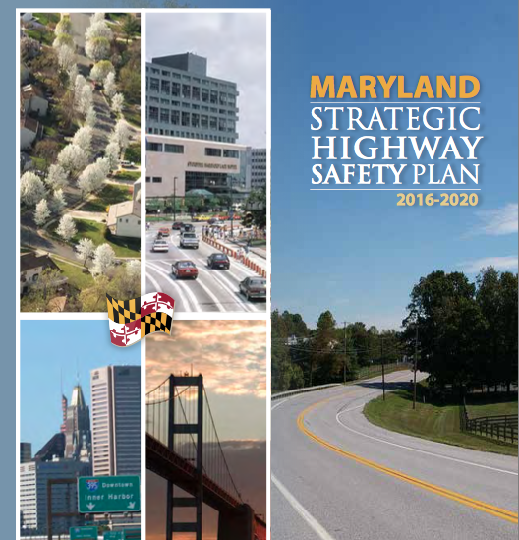
Goal: To ensure a safe, secure, and resilient transportation system for all users
Objective: Reduce the number of lives lost and injuries sustained on Maryland roads
Strategy: Build partnerships to strengthen state and local efforts to improve safety

Slide 3
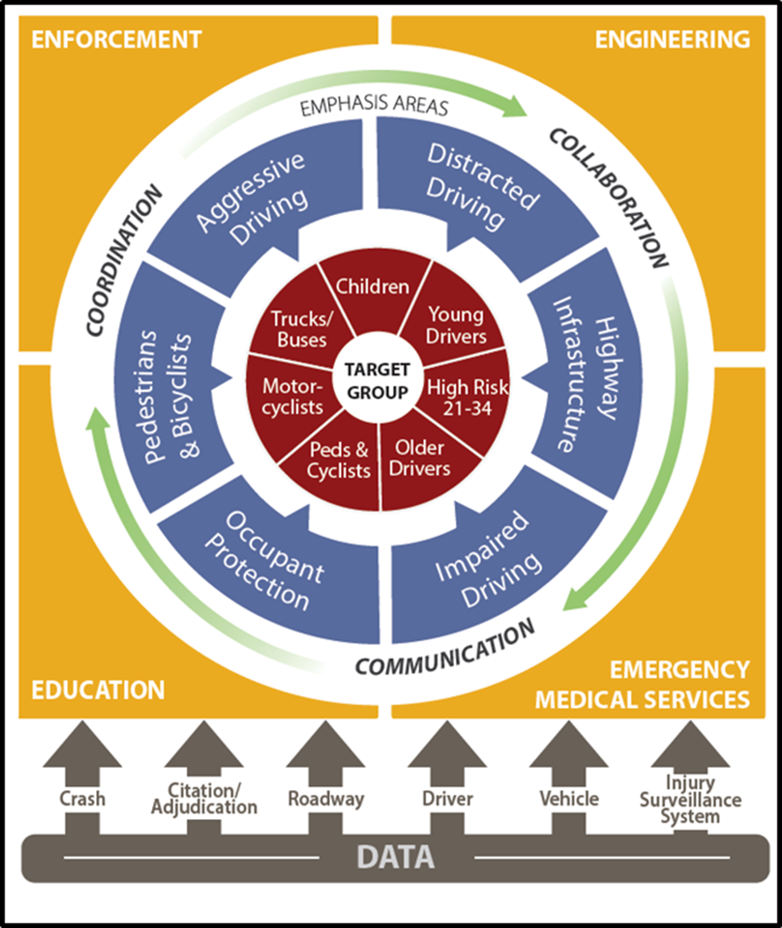
FROM PLAN TO ACTION

Slide 4
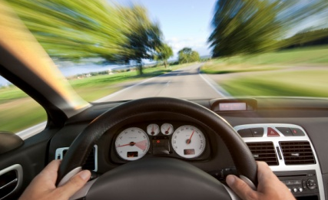
MD MOTOR VEHICLE OCCUPANT FATALITY CONTRIBUTING FACTORS
1,563 motor vehicle occupant deaths
for the period
2013-2017
(non-pedestrian and non-motorcycle).
Sixty-four percent (n=993) involved speeding, impairment, or
lack of belt use.
Unbelted = 493
(32% of all fatalities)
Maryland’s 2019 Observed SB Rate:
90.4%
191
61
178
63
136
65
299
Speed = 325
(21% of all)
Impaired = 605
(39% of all)
5 Year Totals
Notes:
Stigmatize negative behavior by promoting good behavior
Rideshares
Belt Use
Eliminating distraction
Slowing down
Pedestrian safety (Engineers)
Relevant - Work with employers to implement programs

Slide 5
Distracted Driving
Driving while engaged in any activity that could divert a persons attention away from the primary task of driving
Source: Distraction.gov/NHTSA
Notes:
Definition

Slide 6
Notes:
Types of distractions:
Looking for something in purse
Eating
Drinking
Watching movies
Texting
Talking on phone
GPS
Applying make-up
Adjusting Radio
Pet
We know that teens are not the only ones that are distracted while driving. Adults, parents, everyone is doing it. I used to do it.
How many of your parents drive distracted? (raise of hands) If we asked your parents what the most important thing in the world to them is, what would be the answer? So it doesn’t make sense – parents are putting their most important pocessions at risk.
You guys have to help me with your parents. YOU can be a positive role model for your parents if you decided to make the change and drive responsibly.

Slide 7
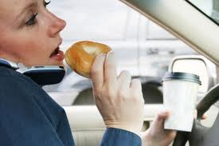
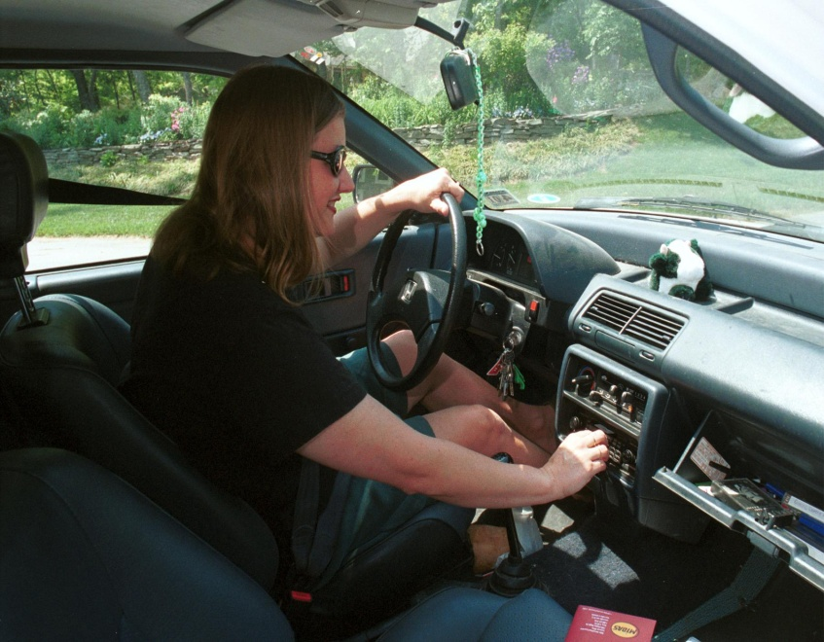
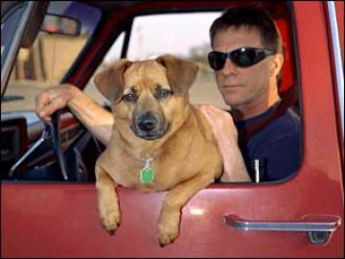
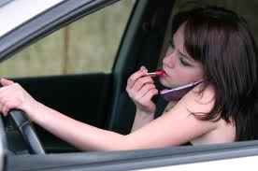
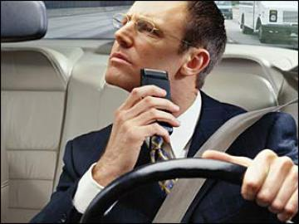
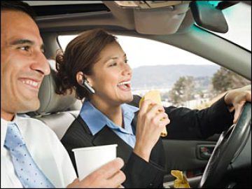
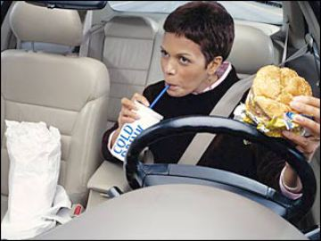
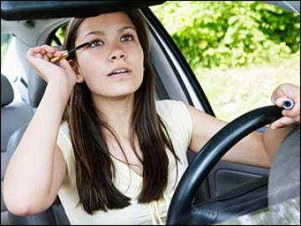
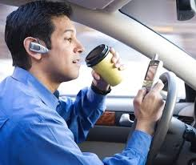
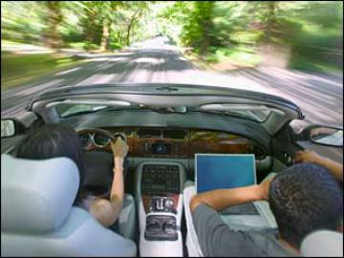
Notes:
Types of distractions:
Looking for something in purse
Eating
Drinking
Watching movies
Texting
Talking on phone
GPS
Applying make-up
Adjusting Radio
Pet
We know that teens are not the only ones that are distracted while driving. Adults, parents, everyone is doing it. I used to do it.
How many of your parents drive distracted? (raise of hands) If we asked your parents what the most important thing in the world to them is, what would be the answer? So it doesn’t make sense – parents are putting their most important pocessions at risk.
You guys have to help me with your parents. YOU can be a positive role model for your parents if you decided to make the change and drive responsibly.

Slide 8
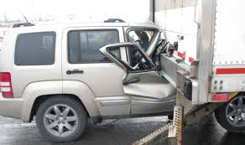
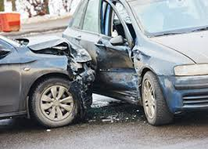
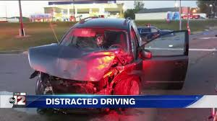
Notes:
Types of distractions:
Looking for something in purse
Eating
Drinking
Watching movies
Texting
Talking on phone
GPS
Applying make-up
Adjusting Radio
Pet
We know that teens are not the only ones that are distracted while driving. Adults, parents, everyone is doing it. I used to do it.
How many of your parents drive distracted? (raise of hands) If we asked your parents what the most important thing in the world to them is, what would be the answer? So it doesn’t make sense – parents are putting their most important pocessions at risk.
You guys have to help me with your parents. YOU can be a positive role model for your parents if you decided to make the change and drive responsibly.

Slide 9
Maryland Distracted Driving Data
 |  |  |  |  |  | 5 Year
 | 2014 | 2015 | 2016 | 2017 | 2018 | AVG. | %
Fatal Crashes | 131 | 108 | 171 | 208 | 176 | 159 | 0.3
Injury Crashes | 17,594 | 16,425 | 18,762 | 18,659 | 18,102 | 17908 | 33.2
Property Damage Crashes | 33,513 | 32,137 | 37,431 | 37,491 | 38,821 | 35879 | 66.5
Total Crashes | 51,238 | 48,670 | 56,364 | 56,358 | 57,099 | 53946 | 100.0
Total of All Fatalities | 138 | 120 | 180 | 220 | 189 | 169
Total Number Injured | 26,162 | 24,399 | 27,783 | 27,961 | 26,939 | 26,649
Nationally
9 fatalities
1,000 injuries
Per day
 |  |  |  |  |  |  |  |  |  |  | 5 Year
 | 2009 | 2010 | 2011 | 2012 | 2013 | 2014 | 2015 | 2016 | 2017 | 2018 | AVG. | %
Fatal Crashes | 238 | 230 | 215 | 216 | 166 | 131 | 108 | 171 | 208 | 176 | 159 | 0.3
Injury Crashes | 20,145 | 19,238 | 19,536 | 19,329 | 18,381 | 17,594 | 16,425 | 18,762 | 18,659 | 18,102 | 17908 | 33.2
Property Damage Crashes | 34,804 | 32,831 | 33,124 | 33,080 | 35,127 | 33,513 | 32,137 | 37,431 | 37,491 | 38,821 | 35879 | 66.5
Total Crashes | 55,187 | 52,299 | 52,875 | 52,625 | 53,674 | 51,238 | 48,670 | 56,364 | 56,358 | 57,099 | 53946 | 100.0
Total of All Fatalities | 252 | 249 | 231 | 246 | 182 | 138 | 120 | 180 | 220 | 189 | 169
Total Number Injured | 30,190 | 28,875 | 29,150 | 28,732 | 27,479 | 26,162 | 24,399 | 27,783 | 27,961 | 26,939 | 26,649
Notes:
Types of distractions:
Looking for something in purse
Eating
Drinking
Watching movies
Texting
Talking on phone
GPS
Applying make-up
Adjusting Radio
Pet
We know that teens are not the only ones that are distracted while driving. Adults, parents, everyone is doing it. I used to do it.
How many of your parents drive distracted? (raise of hands) If we asked your parents what the most important thing in the world to them is, what would be the answer? So it doesn’t make sense – parents are putting their most important pocessions at risk.
You guys have to help me with your parents. YOU can be a positive role model for your parents if you decided to make the change and drive responsibly.

Slide 10
What is MMUCC?
MMUCC is a voluntary guideline
First developed by NHTSA and GHSA in 1998
Provides a “minimum set” of standardized data elements to promote comparability
Foundation for State crash data systems and report forms
Notes:
Types of distractions:
Looking for something in purse
Eating
Drinking
Watching movies
Texting
Talking on phone
GPS
Applying make-up
Adjusting Radio
Pet
We know that teens are not the only ones that are distracted while driving. Adults, parents, everyone is doing it. I used to do it.
How many of your parents drive distracted? (raise of hands) If we asked your parents what the most important thing in the world to them is, what would be the answer? So it doesn’t make sense – parents are putting their most important pocessions at risk.
You guys have to help me with your parents. YOU can be a positive role model for your parents if you decided to make the change and drive responsibly.

Slide 11
Sources of distracted driving data
Police crash report
Citation/warnings
Other traffic records system data
Roadway, Driver, Vehicle, Injury Surveillance
Other sources
Notes:
Types of distractions:
Looking for something in purse
Eating
Drinking
Watching movies
Texting
Talking on phone
GPS
Applying make-up
Adjusting Radio
Pet
We know that teens are not the only ones that are distracted while driving. Adults, parents, everyone is doing it. I used to do it.
How many of your parents drive distracted? (raise of hands) If we asked your parents what the most important thing in the world to them is, what would be the answer? So it doesn’t make sense – parents are putting their most important pocessions at risk.
You guys have to help me with your parents. YOU can be a positive role model for your parents if you decided to make the change and drive responsibly.

Slide 12
Data Limitations
“NHTSA recognizes that there are limitations to the collection and reporting of FARS and GES data with regard to driver distraction. The data for FARS and GES are based on PARS and information gathered after the crashes have occurred.
One noteworthy challenge for collection of distracted driving data is the
PAR itself. Police crash reports vary across jurisdictions, thus creating
potential inconsistencies in reporting. Many variables on the police
accident report are nearly universal, but distraction is not one of those
variables. Some PARS identify distraction as a distinct reporting field,
while others do not have such a field and identification of distraction is
based upon the narrative portion of the report.”1
1 National Center for Statistics and Analysis. (2018, April). Distracted driving 2016.
(Traffic Safety Facts Research Note. Report No. DOT HS 812 517). Washington, DC: National Highway Traffic Safety Administration.
Lifesavers 2019 Presentations SWP - NHTSA
Notes:
Types of distractions:
Looking for something in purse
Eating
Drinking
Watching movies
Texting
Talking on phone
GPS
Applying make-up
Adjusting Radio
Pet
We know that teens are not the only ones that are distracted while driving. Adults, parents, everyone is doing it. I used to do it.
How many of your parents drive distracted? (raise of hands) If we asked your parents what the most important thing in the world to them is, what would be the answer? So it doesn’t make sense – parents are putting their most important pocessions at risk.
You guys have to help me with your parents. YOU can be a positive role model for your parents if you decided to make the change and drive responsibly.

Slide 13
MMUCC 4th Edition
P16. Driver distracted by
Definition: Distractions which may have influenced driver performance (internal or external)
Attributes:
Not distracted
Manually operating an electronic communication device
Talking on hands-free device
Talking on hand-held device
Other activity, electronic device
Passenger
Other inside the vehicle
Outside the vehicle
Unkown
Notes:
Types of distractions:
Looking for something in purse
Eating
Drinking
Watching movies
Texting
Talking on phone
GPS
Applying make-up
Adjusting Radio
Pet
We know that teens are not the only ones that are distracted while driving. Adults, parents, everyone is doing it. I used to do it.
How many of your parents drive distracted? (raise of hands) If we asked your parents what the most important thing in the world to them is, what would be the answer? So it doesn’t make sense – parents are putting their most important pocessions at risk.
You guys have to help me with your parents. YOU can be a positive role model for your parents if you decided to make the change and drive responsibly.

Slide 14
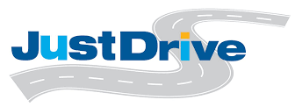
MMUCC 4th Edition
P16. Driver distracted by
Definition: Distractions which may have influenced driver performance (internal or external)
Attributes:
Not distracted
Manually operating an electronic communication device
Talking on hands-free device
Talking on hand-held device
Other activity, electronic device
Passenger
Other inside the vehicle
Outside the vehicle
Unkown
Notes:
Types of distractions:
Looking for something in purse
Eating
Drinking
Watching movies
Texting
Talking on phone
GPS
Applying make-up
Adjusting Radio
Pet
We know that teens are not the only ones that are distracted while driving. Adults, parents, everyone is doing it. I used to do it.
How many of your parents drive distracted? (raise of hands) If we asked your parents what the most important thing in the world to them is, what would be the answer? So it doesn’t make sense – parents are putting their most important pocessions at risk.
You guys have to help me with your parents. YOU can be a positive role model for your parents if you decided to make the change and drive responsibly.

Slide 15
MMUCC 5th Edition
P18. Distracted by
Definition: Distractions that may have influenced driver/non-motorist performance, involving both an action the source of the distraction
Attributes: Action
Not Distracted
Talking/listening
Manually operating
Other action
Source
Hands-free mobile
Hand-held mobile
Other electronic device
Vehicle integrated device
Passenger/other non-motorist
External
Other distractions (animal, food, grooming)
N/A
Unknowns
Notes:
Types of distractions:
Looking for something in purse
Eating
Drinking
Watching movies
Texting
Talking on phone
GPS
Applying make-up
Adjusting Radio
Pet
We know that teens are not the only ones that are distracted while driving. Adults, parents, everyone is doing it. I used to do it.
How many of your parents drive distracted? (raise of hands) If we asked your parents what the most important thing in the world to them is, what would be the answer? So it doesn’t make sense – parents are putting their most important pocessions at risk.
You guys have to help me with your parents. YOU can be a positive role model for your parents if you decided to make the change and drive responsibly.

Slide 16
Other coding
Failure to give full time and attention
Looked but did not see
Lost in thought
Standardization of definition across jurisdictions
Notes:
Types of distractions:
Looking for something in purse
Eating
Drinking
Watching movies
Texting
Talking on phone
GPS
Applying make-up
Adjusting Radio
Pet
We know that teens are not the only ones that are distracted while driving. Adults, parents, everyone is doing it. I used to do it.
How many of your parents drive distracted? (raise of hands) If we asked your parents what the most important thing in the world to them is, what would be the answer? So it doesn’t make sense – parents are putting their most important pocessions at risk.
You guys have to help me with your parents. YOU can be a positive role model for your parents if you decided to make the change and drive responsibly.

Slide 17
Sources of distracted driving data
Police crash report
Citation/warnings
Other traffic records system data
Roadway, Driver, Vehicle, Injury Surveillance
Other sources
Notes:
Types of distractions:
Looking for something in purse
Eating
Drinking
Watching movies
Texting
Talking on phone
GPS
Applying make-up
Adjusting Radio
Pet
We know that teens are not the only ones that are distracted while driving. Adults, parents, everyone is doing it. I used to do it.
How many of your parents drive distracted? (raise of hands) If we asked your parents what the most important thing in the world to them is, what would be the answer? So it doesn’t make sense – parents are putting their most important pocessions at risk.
You guys have to help me with your parents. YOU can be a positive role model for your parents if you decided to make the change and drive responsibly.

Slide 18
Questions Contact Info
Timothy Kerns, Director
MDOT Maryland Highway Safety Office
tkerns@mdot.maryland.gov
Notes:
If you have questions about this presentation, please contact us at MDOT SHA, for general questions, please contact Kari Snyder

