Slide 1
Focus on LIFE
Sending our people home
safe every day
Policy Update
Safe Driver 6.0 Basic Requirement: Mobile/Cell Phone Use While Driving
Presenter: Larry James
Cargill VA EHS Manager
9/25/2019
Revision Date: December 14, 2016
Notes:
Introduce self.
The purpose of today’s presentation is to provide [the audience] with information about Cargill’s updated Safe Driving policy, specifically related to mobile/cell phone use while driving.

Slide 2
LIFEsavers
LIFE altering and Injury or Fatality Elimination
LifeSavers are the 12 activities that present the highest risk to employees and contractors across all Cargill businesses. Each LifeSaver identifies key risks and minimum requirements for performing these activities safely. A statistic we are not proud of – more than 80 percent of our fatalities historically involve these 12 high-risk activities - 2014

Slide 3
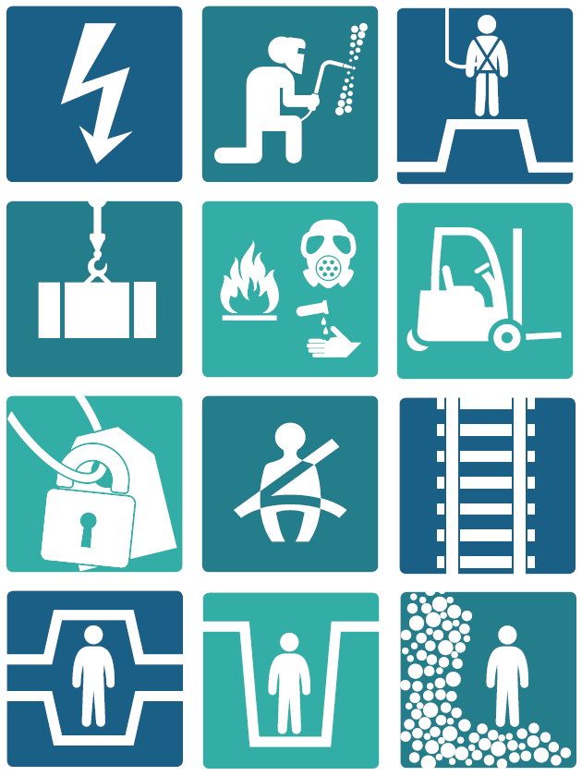
A focus on vehicle safety
Our commitment to eliminating fatalities at work
90% of all Cargill fatalities are related to one of these 12 LifeSaver activities.
The leading cause of work-related fatalities at Cargill is vehicle traffic incidents. 2016
Notes:
Hopefully you’ve seen this diagram before. We call these LIFEsavers – our 12 highest-risk activities across all of Cargill:
LIFEsavers represent where 90% of all fatalities over the last 15 years have occurred.
The policy change we’re talking about today addresses one of the most significant risks that nearly all of us face daily, which is “Motor vehicle – Traffic safety”
We have thousands of colleagues who drive millions of kilometers/miles every day on behalf of Cargill.

Slide 4
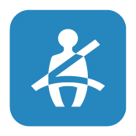
Motor Vehicle –
Traffic Safety
Wear your seat belt
Drive at appropriate speeds
Never drive impaired
Avoid distraction
LIFEsavers
21 deaths since 2004
are attributable to
vehicle-related incidents.
Notes:
More specifically, the focus areas of our LIFEsaver Motor Vehicle – Traffic Safety program include the four bullets you see here.
The policy change we’re going to talk about today relates to reducing and eliminating the risks associated with distractions while driving.

Slide 5
Why change the safe driving policy?
Globally, 1.25 million people die on the road every year
In the U.S. alone, there are nearly 3,000 deaths annually reported from distraction-effected crashes
CEO Dave MacLennan and the Executive Team have clearly said “we don’t want to wait until a tragic accident occurs before we change this policy”
We know it will be a challenge, but we want everyone to get home safely, each and every day
Notes:
Motor vehicle crashes are the leading cause of unintentional workplace deaths globally.
Globally about 1.25 million people die each year as a result of road traffic crashes, according to the World Health Organization.
In the U.S., nearly 3,000 deaths occur annually from distraction-effected crashes – crashes in which drivers lost focus on the safe control of their vehicles due to manual, visual or cognitive distractions.
Source: US DOT National Highway Traffic Safety Administration
An estimated 423,000 people in the U.S. are injured in motor vehicle crashes involving distracted drivers. Additionally, 540 pedestrians were killed in distraction-related crashes.
Source: NHTS’s Traffic Safety Facts Research, Distracted Driving 2012
We are not the first company to do this. Others have shown it can be done.
(A slide in the appendix lists other companies that have already instituted mobile/cell phone bans)

Slide 6
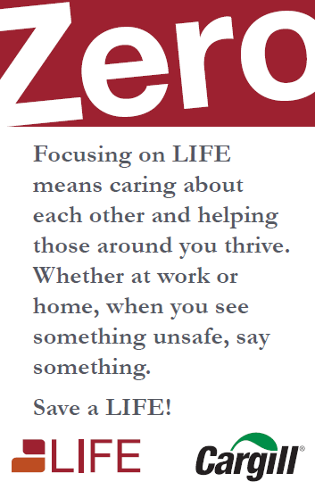
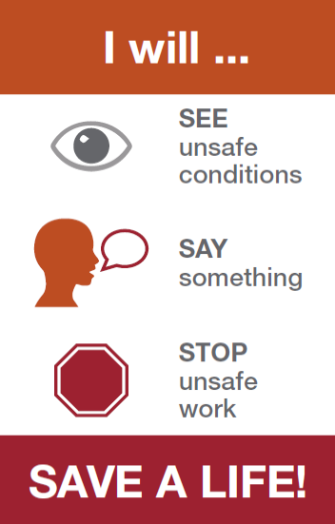
See, Say, Stop: Save a LIFE
This is a perfect example of applying SEE, SAY, STOP to make us a safer Cargill:
SEE: The evidence is clear that mobile/cell phone use while driving distracts us from the task of driving, even when using hands-free technology
SAY: CEO Dave MacLennan and the Executive team are clearly saying we need to change this if we’re going to prevent injuries and get to ZERO fatalities
STOP: The safe driver policy has been updated to eliminate the risk of distraction associated with using a mobile/cell phone while driving
Notes:
An important component of getting to ZERO is knowing our risks, and stopping unsafe work.
This is why we’re here today … to talk about one of our highest-risk activities … DRIVING.
And how we’re making a proactive change to stop unsafe work and keep our people and others on the road safe.

Slide 7
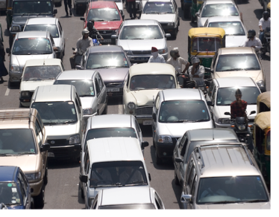
Getting to ZERO requires bold steps
Drivers must not use mobile/cell phones while driving on behalf of Cargill, including hands-free devices, except when the vehicle is parked in a safe location
Mobile GPS navigation may be used when programmed, and secured, prior to travel
Effective January 1, 2017
“But please, don’t wait until then.” Dave MacLennan, CEO
Notes:
We know distracted driving sharply increases the risk of a collision. The time is now to take a bold step – because the research is clear. We don’t want to wait until a fatality occurs before we get serious about distracted driving. It’s the right thing to do for our people, our customers and other business partners, and our families.
Talking on mobile/cell phones may not be the riskiest thing we do in our cars. But many other distractions are rare and/or occur for very short lengths of time. Mobile phone conversations are common and can be lengthy.
To this end, 6.0 Safe Driving policy is being updated.
This is a total ban on the use of hands-free and hand-held devices while driving on behalf of Cargill for conversations or to read, type, verbally dictate/compose (text-to-type) or send electronic messages or information, to search the internet, etc. This includes while operating personal or company-owned/leased or rented vehicles.
Requirements apply for all drivers and vehicles on company property.
Requirements apply at all times except when vehicle is parked in a safe location.
This also includes no mobile/cell phone use for Cargill-related business when commuting to and from work in a personal vehicle
Devices for navigation may be used when programmed prior to travel
The phone should be appropriately mounted when used as a GPS.
This policy is effective January 1, 2017
“But please, don’t wait until then.” DMac
Cargill’s updated safe driving policy is available at this location (copy into your browser):
http://internal.cargill.com/sites/cehs/requirements/Documents/EHS Corporate Procedures/Health and Safety/Vehicle Safety Requirements/6.0 Basic Requirements Safe Driver.pdf

Slide 8
Why CEO Dave MacLennan is committed to safe driving
Click on the graphic to launch Dave MacLennan’s video
Notes:
Click on the graphic to launch Dave MacLennan’s video. NOTE: the hyperlink in the slide will take you to a version that includes all translated versions. The link below will take you to the English version alone.
http://players.brightcove.net/1628196462001/rk3FZihJx_default/index.html?videoId=5122984123001
The video runs 1:18

Slide 9
The Facts
Distractions from the use of mobile phones contribute to about 25% of collisions.
Distracted driving is dangerous, claiming 3,166 lives in 2017 alone.
National Safety Council
Notes:
We can all learn a lot about the science and research that has been conducted over the past decade. The risks and danger that come with using our phones while driving, even hands-free, is real, and some of it may surprise you.
Distractions from the use of mobile phones contributes to about 25% of collisions. More specifically:
The National Safety Council estimates that 27% of crashes in the U.S. (~1.5 million) involve talking and texting on cell phones.
21% involved talking on handheld and hands-free cell phones (that’s 1 out of every 5 collisions!), and 6% involved text messaging.

Slide 10
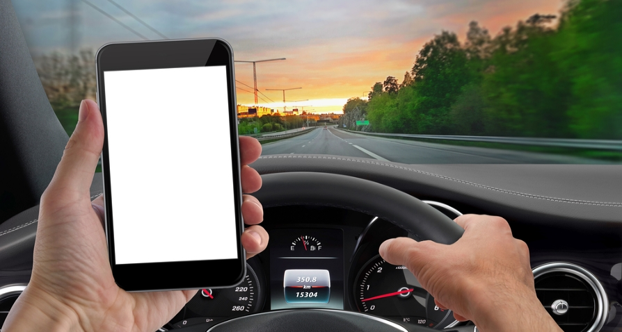
Distracted driving is dangerous!
But many do it anyway.
90% recognize the danger from distractions
35% admit to sending texts or email in previous month
DISTRACTED DRIVERS
10% fatalities
17% injuries
90% know it!
35% admit it!
Notes:
Research from the National Safety Council tells us that 10% of fatal crashes & 17% of accidents that caused injuries were the result of distracted drivers.
That may not surprise you, but 90% of drivers say they recognize the danger from distractions, yet more than 1/3 (35%) of these same people admitted to having read or sent a text message or e-mail while driving in the previous month. So, we know it’s dangerous, but many do it anyway.
Think about this:
Research tells us that 9% (or nearly 1 out of 10) drivers are talking on phones while driving at any given daylight moment. What if YOU are just slightly distracted too!? In situations like this, when a driver needs to react immediately, there may be no margin for error.
[Source info}

Slide 11
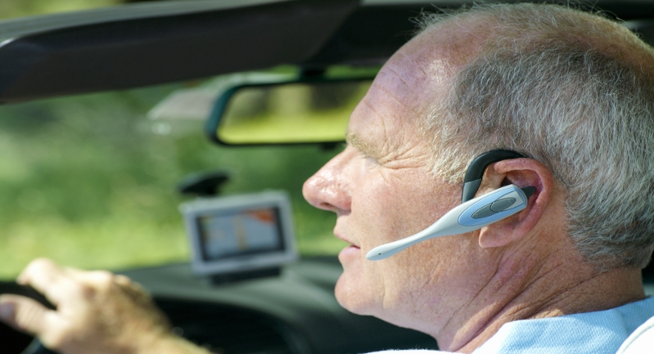
Isn’t hands-free, risk free?
Absolutely not.
Hands-free devices do not eliminate cognitive distractions.
Drivers using a handheld or hands-free device are 4 times more likely to be involved in a crash.
Notes:
More than 30 studies have found hands-free devices are no safer than hand-held mobile/cell phones because they did not eliminate cognitive (mental) distractions.
Cognitive distraction occurs when a driver’s attention is not directly on the act of driving. In other words, his/her mind is “not on the road.”
Cognitive distractions leads to “inattention blindness” in which drivers fail to process information from objects in the roadway, even when they are looking at them.
Distracted drivers can miss seeing up to 50 percent of what is around them, including pedestrians, bicyclists, traffic signs, red lights, and other vehicles.
Drivers using a handheld or hands-free device are 4 times more likely to be involved in a crash than when not using a phone
Source: Strayer, D.L., Drews, F.A. and Johnston, WA 2003.

Slide 12
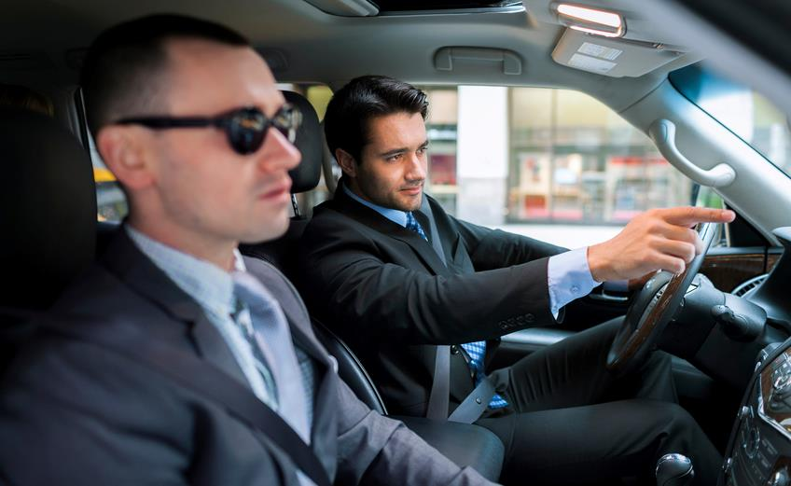
Talking on a hands-free device is the same as talking to a passenger, right?
No.
Drivers with adult passengers have an extra set of eyes and ears, and adjust their talking when traffic is challenging.
Notes:
Paying attention to a conversation with a disembodied voice contributes to numerous driving impairments.
This is partially because an adult passenger often assists a driver in making safer decisions since the passenger can see the driving environment & point out things the driver may not see.
Mobile/cell conversations are unique in that we must think about the other person’s reaction since we cannot see him/her.
Additionally, when a driver is talking to a passenger & the driving environment becomes challenging, the driver slows or stops the conversation so he/she can minimize cognitive distraction and concentrate on the road.
Source: National Safety Council
The New York Times also reported “Researchers at the University of Utah found that all conversations are not created equal. There is something uniquely distracting about talking on the phone when you’re behind the wheel; conversations with people inside the car are far less distracting to drivers. Unlike mobile/cell phone callers, adult passengers instinctively stop talking when driving conditions change, and they offer an extra set of eyes to alert drivers to nearly-missed exits or erratic drivers.”

Slide 13
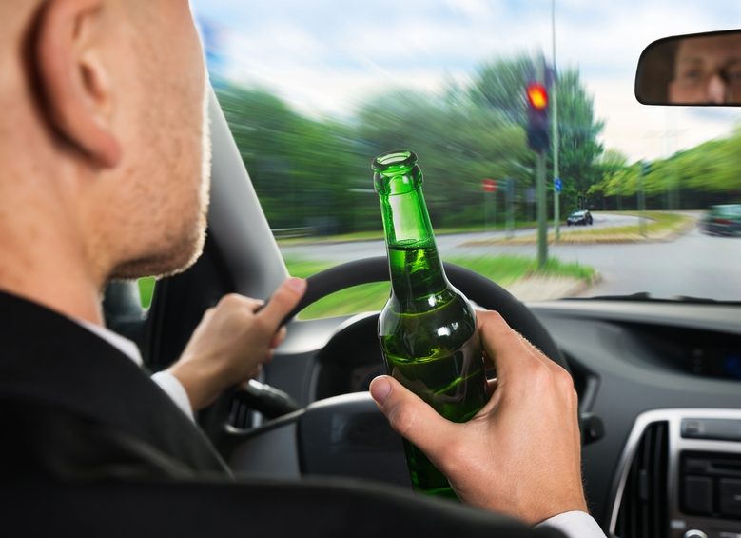
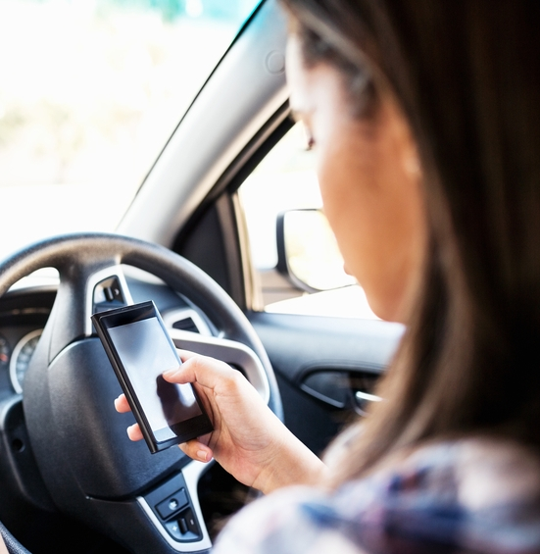
Which impairment has the greatest effect on reaction time?
A. Drinking and driving or…
B. Using a phone while driving?
Notes:
Distracted driving now joins alcohol and speeding as a leading factor in fatal and serious injury crashes. Studies show that distracted drivers have a slower reaction time than drivers impaired at .08 blood alcohol level.
[Source: National Safety Council]
NOTE: In some countries legal blood alcohol limit is “0.00”

Slide 14
Distracted drivers using mobile/cell phones have a slower reaction time than drivers impaired at .08 blood alcohol level.

Slide 15
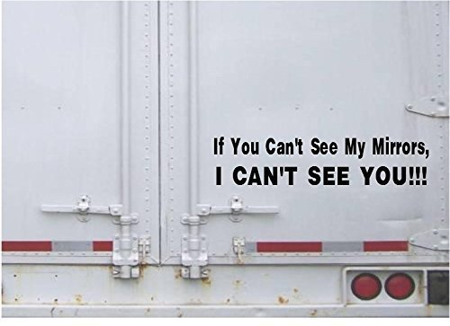
WHEN IS TOO CLOSE?

Slide 16
30% of DOT inspections failures are trailer lighting Do you really want to take that chance that the Brake Lights are working?

Slide 17
Following too closely behind another vehicle, or tailgating, is one of the most common causes of car accidents in Virginia and across the country.

Slide 18
Code of Virginia – C 46.2-816. Following too closely. The driver of a motor vehicle shall not follow another vehicle, trailer, or semitrailer more closely than is reasonable and prudent, having due regard to the speed of both vehicles and the traffic on, and conditions of, the highway at the time. ode of Virginia

Slide 19
According to the Virginia Department of Motor Vehicles (DMV), drivers should actually leave a distance between two-to-four seconds behind the car in front, depending on their speed. For instance, if you are traveling at a speed of less than 35 mph, you should be safe with a two-second cushion. If your speed increases to 35-to-45 mph, a three-second following distance should be safe, while a four-second distance would apply if you were going 46 to 70 mph.

Slide 20
Remember: The space between your vehicle and a large vehicle behind you on a highway should be four seconds at speeds of 46-70 mph, plus one second for every 10 feet of vehicle length. In Virginia, the maximum length allowed for tractor-trailers is 65 feet in total. So, the safe distance between a passenger vehicle and the largest commercial trucks on the highway is roughly 10 or 11 seconds.

Slide 21
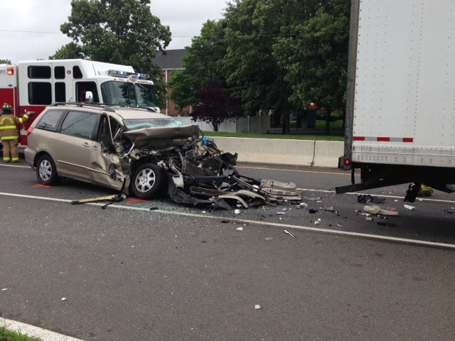
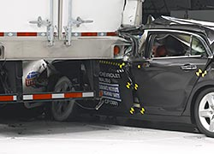
Tractor Trailer Rear End Crashes Often Are Fatal. ... The National Highway Traffic Safety Administration (NHTSA) has released statistics that show an average of 423 people die each year and another 5,000 are injured when passenger cars rear-end tractor-trailer trucks

Slide 22
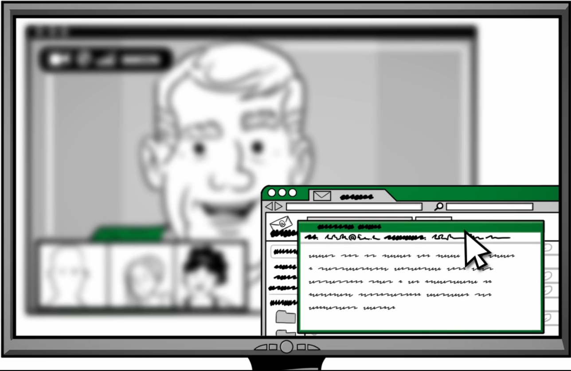
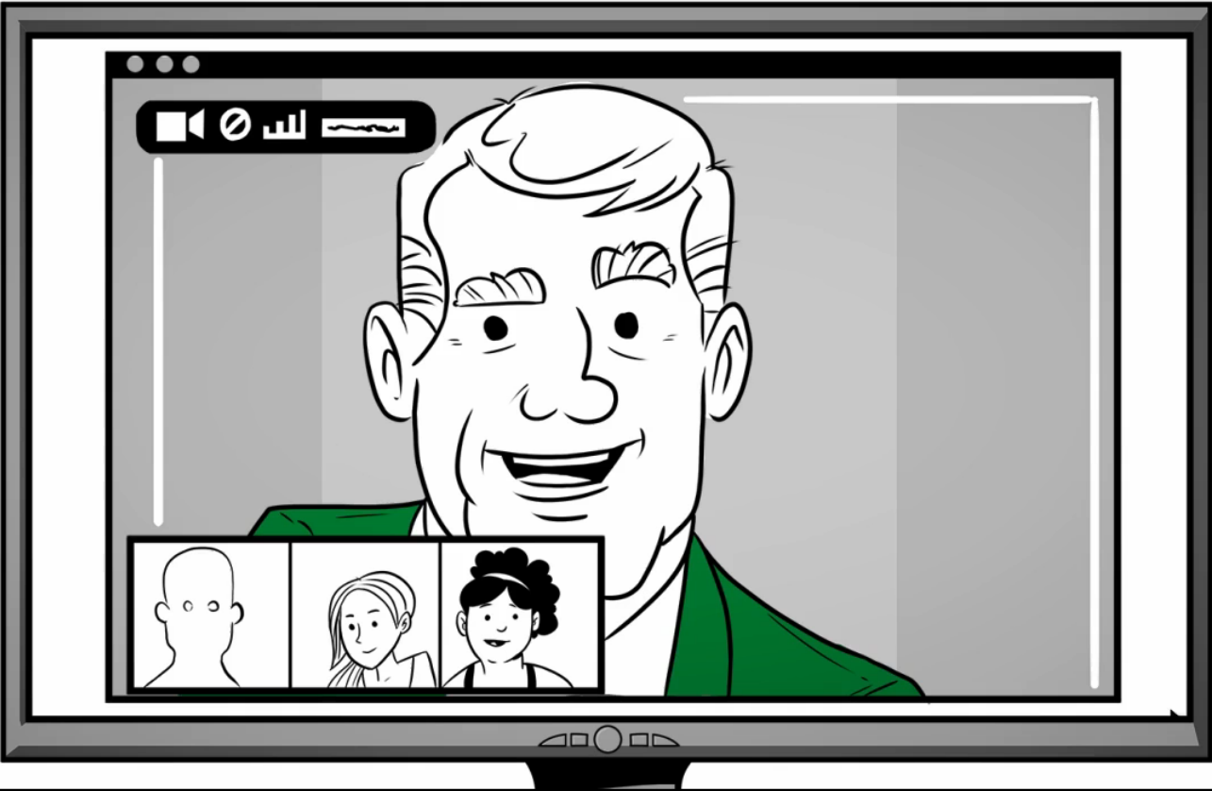
Multi-tasking is a myth
The human brain doesn’t think about two tasks at the same time, it switches tasks quickly
Try creating an email while listening to a conference call
Your mind has to switch between tasks
You will miss some of the conference call
Just like you will miss some of your visual surroundings when driving
Conference Call
Conference Call
Notes:
You may be thinking “I’m good at multi-tasking.” But did you know multi-tasking is really a myth – the human brain doesn’t really think about two tasks at the same time, it switches between tasks – very quickly.
Don’t believe me? Have you ever tried writing an email while listening to a conversation or a conference call? If not, try it. You’ll find your mind has to switch between the two tasks – and you will miss some of both tasks -- just like you will miss some of your visual surroundings when you’re talking on a phone while driving.
- Switching between thinking tasks results in slower response and reaction time.
Mental distractions like talking on a mobile phone, even hands-free, slow our reaction time.
When a driver needs to react immediately, there is no margin for error.
More information about multi-tasking:
David Strayer, Professor of Psychology at the University of Utah and his team observed 56,000 drivers as they approached an intersection, the majority of drivers who were talking on their phone failed to stop in accordance with traffic laws. And it didn’t matter if the driver was using a handheld or hands-free device. Even with both eyes on the road and both hands on the wheel, drivers’ performance was impaired
For every information input, the brain must make many decisions; whether to act on information processed, how to act, execute the action and stop the action. While this this process may take only a fraction of a second, all of these steps do take time. When driving, fractions of seconds can be the time between a crash or no crash, injury or no injury, life or death.
Contrary to popular belief, the human brain cannot multitask. Driving and talking on
a mobile/cell phone are two thinking tasks that involve many areas of the brain. Instead of processing both simultaneously, the brain rapidly switches between two cognitive activities.
Even small amounts of time spent switching between tasks (such as driving and talking on a mobile device) can lead to significant risks from delayed reaction and breaking time. For example, a vehicle is traveling 40 mph (64 kph), it goes 120 feet (36 meters) before stopping. This equals 8 car lengths. A fraction-of-a-second delay would make the car travel several car lengths.

Slide 23
How to Make This Work

Slide 24
To make this work …
Who currently uses their phone to talk while driving?
How about other forms of distracted driving?
Has anyone already stopped using their mobile phone while driving?
What can we do to make this work in our lives?
What are we teaching our young passengers?
Notes:
[This slide uses animation builds for the bullet points]
Presentation Leader:
Make sure everyone knows this is important to you … and you know this may be difficult for them.
And, be real. Ask, “how many here use their phone to talk while driving?” Then be the first to raise your hand … give them time to raise theirs too
Unless of course you’ve already stopped.
Tell your personal story – have you tried to stop yet? Making this change probably wasn’t, or won’t be, easy for you either!
KEY: GIVE PEOPLE TIME TO TALK HERE
Questions to open up conversation:
What concerns do you have about being able to do your job with this new policy?
Has anyone already stopped using their mobile phone while driving?
If so, what did you learn?
What can we do to make this work in our area?
Prior to the meeting, if you know someone who has had a close call or an incident associated with distracted driving, consider having them share their story during this time.

Slide 25
To make this work …
We may need to change how we work
Do not call or expect others to answer while driving
When calling someone, ask if they are driving
If they are - hang up, talk later
Schedule conference calls during non-drive times
Begin conference calls by asking anyone driving to please hang up
Rejoin when in a safe location, or listen to the recording later
Turn your phone off or silence it when you get in your vehicle
If you spend a lot of time on the road, plan your route for stops
Take breaks from driving for calls and to stretch
Notes:
In order for this change to work, we may need to change how we work:
First, consider how to remove the need to use mobile/cell phones while driving, such as:
We may need to change when we conduct conference calls, or record them so people who need to travel can listen when they’re not driving
Start all conference calls by asking if anyone is driving. If so, have them call back when they are in a safe location.
We should not call employees, or expect them to answer, while driving:
Make it a practice when you call someone’s mobile/cell phone to ask if he or she is driving. If the response is “yes,” take it upon yourself to call back later or ask that your call be returned when he or she has reached their destination.
People who have stopped using their phones while driving tell us it can be hard to break the habit. To do this, they recommend putting your phone on silent and place it where you can’t reach it.
Plan time for stops during your travels – for rest, and to make calls
When driving, your mind should be on the task of driving. Avoid distractions.
If you spend a lot of time on the road, organize your route and schedule to allow time to make and return phone calls from the parking lot of one location before leaving to drive to the next one. This strategy has helped employees who drive frequently to maintain productivity and accessibility.
And of course, we should question the need for all trips; driving is the most risky task most of us do each day

Slide 26
To make this work …
Talk with your customers, business and JV partners, friends and family
Let them know about Cargill’s mobile/cell phone policy. Explain Cargill’s commitment to “getting to ZERO.”
Cargill wants everyone to go home safely each day
Distracted driving sharply increases the risk of a collision
Discuss how you can make this work for them
Solicit their support to join us, and go phone-free while driving
Change your voice mail message to tell people you may be driving.
Consider special ring tones so you can identify family members in case of emergency. Pull over to a safe place to return a call.
Notes:
Talk with your clients and business and JV partners so they know about the policy, and what they can expect if they call you while driving and discuss how you can make this work for them (e.g., who to call if they have an urgent need, let them know whenever possible you’ll check your messages at 10, 12, and 2 each day). Solicit their support to join us, and drive distraction free.
Talk with your neighbors and family about the risks associated with talking and texting on a mobile/cell while driving. Solicit their support to join us
Change your voicemail greeting to tell people that you may be driving, and you’ll call them back when you can safely do so
Some early adopters have suggested creating special ring tones so they can identify family members in case of emergency. Pull over to a safe place to return the call. Example:
“Hello, this is __________________________ (name, title, company). I am either away from my phone or I am driving, and, for safety reasons, I don’t use my phone while driving. Please leave your name, number and a brief message. I will return your call as soon as I am able. Thanks so much.”
Optional addition if you are recording a greeting to communicate with callers while you are driving: “I should be at my destination within _____ and will return your call then. Thanks so much.”
Suggestion: Engage focus groups to help determine how to make this work within your business area.

Slide 27
To make this work …
Learn from those who have already stopped
“I learned that when I used to call people from my vehicle, I was really calling them on my preferred time, not theirs.”
“It was difficult at first. After a couple weeks I learned that I had to turn it off and put it in the back of the car.”
“I found myself in the past jumping on a conference call while driving, and getting to my destination and thinking back, how did I get here?”
“You’ll love it – it’s the only time of the day you’ll have to yourself!” RELAX!
Notes:
Did you know that several Cargill businesses have already implemented a cell phone ban?
Deicing Technologies has been cell-free for years
CAN is currently cell-free in the following countries:
Philippines
Thailand
Indonesia
Vietnam
Columbia
Costa Rica
Guatemala
Honduras
Nicaragua
Some parts of Mexico
Many people are already making the effort to stop. The quotes come from Cargill people we’ve talked to – we’ll add their names and locations after we get their permission.
The first quote is an excellent example of “cognitive distraction.” (reference slide 10)
A common theme among those who have stopped:
It can be harder than it sounds
Advice: put phone on silent and place it out of reach to avoid the temptation
Have a quote that you’d like to submit? Please send it to Jill Packey .

Slide 28
Training & Learning Resources
Safe driver policy training
What | The current Safe Driving at Cargill e-learning module is being updated to reflect the new cell phone policy (course takes approximately :15-:20) A 5 minute Cargill Safe Driver Policy video explains why Cargill updated the Safe Driving policy and the risks associated with mobile/cell phones Both courses direct the user to an updated Safe Driving Commitment Form Confirming agreement is required for successful course completion Both modules will be available in 13 languages
Who | The Safe Driving at Cargill e-learning module is required for all Cargill casual and covered drivers*, as well as all employees in Cargill’s Functions (BOSC, Business Services, Finance, HR, Law, etc.) Each Enterprise will identify their casual and covered drivers, as well as identify others who may be required to complete the policy training Anyone who completed the Safe Driving at Cargill training before December 2016 will only be required to complete the 5 minute Cargill Safe Driver policy video module and agree to the Cargill Safe Driving Commitment
*Reference the 6.0 Safe Driving policy for definitions
Notes:
See the Safe Driver policy for definitions of covered and casual drivers.
http://internal.cargill.com/sites/cehs/requirements/Documents/EHS Corporate Procedures/Health and Safety/Vehicle Safety Requirements/6.0 Basic Requirements Safe Driver.pdf
Safe Driving at Cargill e-learning module will be available in the following languages:
Chinese (Simplified)
French
Dutch
English
German
Indonesian Bahasa
Italian
Polish
Portuguese (Brazilian)
Russian
Spanish (Latin American)
Thai
Turkish

Slide 29
Training
Persons Required to Take Safe Driving at Cargill Training
Did You Complete this Training ?
Yes
No
Complete Cargill Safe Driver Policy Video Module (5 min)
Optional
Complete Safe Driving at Cargill e-Learning (20 min)
Read & Agree to Cargill Driver Safety Commitment Form
Notes:
This flowchart illustrates the two training options, based on if the individual has or has not already completed the Safe Driving at Cargill e-learning course.

Slide 30
What now?
Ceo Dave maclennan and the executive team know it will be disruptive –
3 years ZERO phone use – CEO DMac
For many, it won’t be easy
But this is the right decision to make us and others on the road safer
The policy is effective on January 1, 2016 “but please don’t wait”
Make a commitment now
Not just to stop using your phone when driving, but to help figure out how to make this work
Do it for your colleagues, friends, and family
We can’t afford to wait until we have a tragic incident
Why? …

Slide 31
Why?
Working together, we can all help reduce driver distraction, prevent injuries, save lives …
and get home safe every day

Slide 32
Why CEO Dave MacLennan is Committed to Safe Driving
Most of you already know, I committed to being the first CEO in Cargill history to have zero fatalities in the year
The Executive Committee is also fully committed to this goal
Vehicle accidents are the number 1 cause of fatalities in Cargill
For that reason, and our commitment to safety, we are going to change our safe driver policy
Do not use mobile phones—in any kind of vehicle—while on company time
We think this will make a big difference
A safer Cargill, a safer you, a way for us to look out for each other
I put my phone away over 100 days ago
I have not made or taken a call while driving since then
It’s been remarkably easy, though it was tough at first
Please join me in putting your phone away
We want everyone to get home safely, each and every day
Notes:
Use this slide if the video doesn’t work. It includes DMac’s key points as shared in the video.

Slide 33
We’re not alone
Deicing Technologies and CFN Latin America North, Vietnam, and SEA (Philippines, Thailand and Indonesia) businesses have been mobile/cell-free for over 4 years.
Companies with mobile phone bans
Air Liquide | First Group America | Royal Dutch Shell
American Express | GDF Suez | Ryder
BP | General Dynamics | Schneider Electric
Chevron | Halliburton | Southwest Airlines
Clorox | Johnson & Johnson | Tetra Tech
Costco Wholesale | Linde | The Dow Chemical Company
CSX Transportation | Merck | Time Warner Cable
Dart Container | National Gypsum | U.S. Steel
Dresser-Rand | Nestle | Unilever
DuPont | Northrop Grumman | Weyerhaeuser
Ecolab | Owens Corning
Notes:
NOTE: CFN is the legacy animal feed business in CAN
A study performed by the National Safety Council published in 2011 showed about 25% of Fortune 500 companies had implemented a complete ban on mobile phone use on company time.
Anecdotally from our outside networking this trend is increasing and is supported by another study, completed in 2014*, that surveyed 354 large companies and showed 38% of these organizations ban all mobile/cell phones.
Many of these companies are leading safety companies that we currently research and benchmark with.
Source: National Highway Transportation Safety Association (NHTSA)
NOTE: The specific policy may vary by company.

Slide 34
Activity
Demonstrate that multi-tasking is a myth
On a sheet of paper
And Count backwards
Write several sentences that describe your favorite vacation.
Where you went, how you got there, who you visited, what you enjoyed the most.
While writing, count backwards from 200.
Out loud.
Notes:
The slide builds. This activity will demonstrate that the human mind doesn’t actually multi-task (meaning processing two or more activities simultaneously). Rather, the mind switches between tasks very quickly.
It will take a person about 5 seconds to figure out their mind switches tasks, rather than multi-tasks.
Another activity:
Try this at home…
Can you watch TV while talking on the phone?
Try participating in a conference call and watching a documentary on TV.
You’ll find yourself task-switching, not multi-tasking. And you end up not doing either task well.
You can walk and chew gum at the same time, however one of these is not a thinking task. Doing two or more thinking tasks while driving can be deadly.

Slide 35
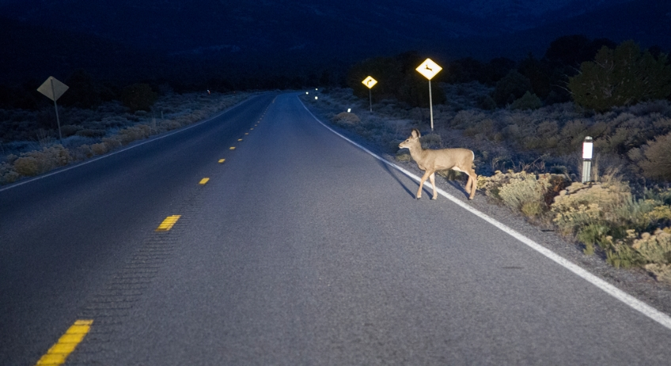
Multi-tasking results in slower response and reaction time
When driving, fractions of seconds can be the time between a crash or no crash, injury or no injury, life or death.
Does it slow you down?
Re-read the sentence above.
Think about an elephant at the same time.
Notes:
Multi-tasking results in slower response and reaction time. When a driver needs to react immediately, there is no margin for error.
ACTIVITY: (The slide builds to facilitate the activity. Another activity can be found in the appendix.)
- Ask the audience to re-read the sentence on the slide carefully, and at the same time, think about an elephant. It is a good example how our minds switch tasks rather than simultaneously multi-task.
- Mental distractions like talking on a mobile phone, even hands-free, slow our reaction time.
More information about multi-tasking:
David Strayer, Professor of Psychology at the University of Utah and his team observed 56,000 drivers as they approached an intersection, the majority of drivers who were talking on their phone failed to stop in accordance with traffic laws. And it didn’t matter if the driver was using a handheld or hands-free device. Even with both eyes on the road and both hands on the wheel, drivers’ performance was impaired
For every information input, the brain must make many decisions; whether to act on information processed, how to act, execute the action and stop the action. While this this process may take only a fraction of a second, all of these steps do take time. When driving, fractions of seconds can be the time between a crash or no crash, injury or no injury, life or death.
Contrary to popular belief, the human brain cannot multitask. Driving and talking on
a mobile/cell phone are two thinking tasks that involve many areas of the brain. Instead of processing both simultaneously, the brain rapidly switches between two cognitive
activities.
Even small amounts of time spent switching between tasks (such as driving and talking on a mobile device) can lead to significant risks from delayed reaction and breaking time. For example, a vehicle is traveling 40 mph (64 kph), it goes 120 feet (36 meters) before stopping. This equals 8 car lengths. A fraction-of-a-second delay would make the car travel several car lengths.

Slide 36
Tips for Taking Action Against Distraction
Safe Driving is Serious Business: Do not use your commute time (or any time) to participate on conference calls while driving – even if just listening in. Always pull over to a safe location to take or make calls and check messages.
Turn off your mobile device when driving: Avoid the temptation to talk or text on your phone, simply turn off and stow your device before you begin driving
Use technology to manage technology Consider using a call or text blocking app to let others know you are driving and to queue calls and texts until you are safety pulled over.
Help others help themselves: Make it a practice when you call someone’s mobile/cell phone to ask if he or she is driving. If the response is “yes’, take it upon yourself to call back later or ask that your call be returned when he or she has reached their destination.
Speak up: If you are a passenger and the driver is not focusing on the road, don’t be afraid to speak up! Offer to help with directions or even make a call or send a text on his or her behalf. You will be looking out for your safety. as well as that of passengers and those sharing the road with you.
Be a role model: Change the greeting on you mobile/cell phone to say something like “I cannot take your call right now, I am either away from my phone or driving. Your call is important to me and I will get back with you when I am able to do so safely.” Others may be inspired by your message to think about the risks of using a mobile device while driving and perhaps change their messages as well.
Enlist your children: Children are great enforcers. If they know your rule is “no phone use while driving” they will remind you to hang up when you forget. And children will do what you do. Demonstrate the behavior you expect from them.
Notes:
FYI: Another list of tips from a national safety group.

Slide 37
- As cars get “Safer”, do we become a more unsafe driver?
- MIT researchers wonder whether driving has become the secondary task behind the wheel:
- Is Driving Now the Distraction?
Notes:
FYI: Another list of tips from a national safety group.

Slide 38
PLEASE STAY ALERT and DRIVE SAFE
Keep a Safe distance
COUNT to 4 – (try it)
- Pay attention to your surroundings
- Work to STOP all distractions
- Enjoy the ride
Notes:
FYI: Another list of tips from a national safety group.

