Slide 1
Virginia’s Peer-to-Peer Leadership Program for
Young Driver and Passenger Safety
Mary King, YOVASO Program Manager
Mary.king@vsp.virginia.gov / (540) 375-9581 / yovaso.org
A Program of the Virginia State Police

Slide 2
About YOVASO
A peer-to-peer education and advocacy program for teen driver and passenger safety
Formed in 2001 by the Virginia DMV Highway Safety Office to address the increasing number of teens killed on Virginia’s roadways
Started as pilot program in SW Va and went statewide in 2007
Funded by grants from the Virginia DMV Highway Safety Office
Program is endorsed by the state
Monitored and evaluated quarterly by the state
A program of the Virginia State Police since October 1, 2014
Membership and all materials and resources are FREE!

Slide 3
To Reach Youth and Teens, We Must Engage Them in Understanding & Addressing Their Risks
Peer-to-Peer programs are recognized by NHTSA and GHSA as an effective countermeasure for addressing the young driver problem at the state and local level. These programs:
Change knowledge and beliefs
Modify attitudes
Improve knowledge and teach new skills
Garner buy-in and support for state GDL and traffic safety laws
“If we want our teens to make healthy decisions, we have to Empower them to Educate and Encourage each other” – National Highway Traffic Safety Administration & Governor’s Highway Safety Association

Slide 4
YOVASO’s Mission
Vision:
Establish generations of safe teen drivers in Virginia
Mission:
Engage, educate, and empower youth to influence a safe driving culture through leadership development and innovative outreach programs
Through YOVASO, students work together in a school-based service-learning club, a project- based learning class (PBL), or a community youth group to develop strategies, programs, and messages that target the specific traffic safety problem in their schools and communities.

Slide 5
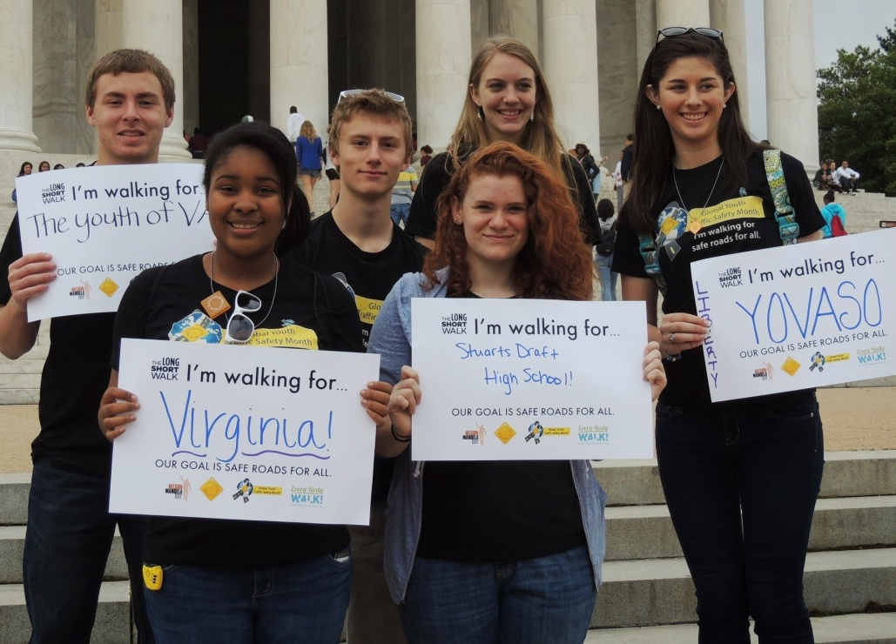
Our Goal
Educate
Engage
Empower
Teens to educate and encourage each other to be safe and responsible drivers and passengers.
YOVASO students are role models and advocates for safe teen driving and passenger safety.

Slide 6
Focus Areas of YOVASO and Our Peer-To-Peer Programs: Top Issues for Teen Drivers and High Schools in Virginia
Seat Belts
Speeding
Underage Drinking/Impaired Driving/Zero Tolerance Law
Distracted Driving
Defensive Driving / Driving Skills
Virginia’s Teen Driving Laws
Risky Driving Behaviors
Driving Attitudes – Through our peer-to-peer clubs, we are striving to create a safety culture in the schools where safe driving and passenger safety is considered the norm and the right “cool” thing to do.

Slide 7
Teens are Influencing a Safer Driving Culture

Slide 8
Teens are Influencing a Safer Driving Culture

Slide 9
How YOVASO Benefits Schools and Communities
Health and Safety
Safer and more responsible young drivers
Fewer crashes, injuries, and fatalities
Promotes a positive driving culture in schools and communities
Promotes positive relationships between teens and law enforcement
Develops Student Leadership Through Project Based Service Learning
Prepares students to be leaders in a project based service-learning environment
Engages students in the community and community service
Provides real-life experience for students interested in careers in health/medical, law enforcement, prevention, teaching, public service, and many others

Slide 10
YOVASO Services to Schools / Youth Groups
Membership in YOVASO is FREE and provides your school / youth group the following free benefits:
Club Set Up and Membership Development
Leadership Training for club members & advisor
Educational Campaigns and Programs
Leadership Retreats for advanced development
Resources to support programs
Support Services to ensure success

Slide 11
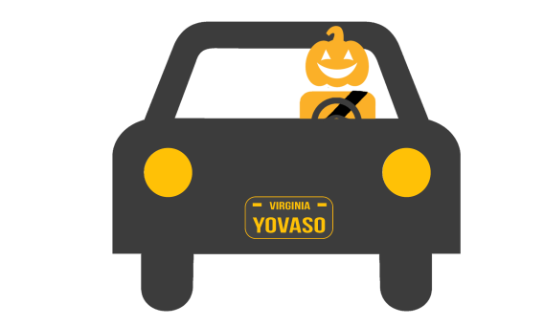
YOVASO Safety Campaigns: (All campaigns include free materials)
Save Your Tailgate: Buckle Up, Slow Down (SYT)
Competition - Open to High & Middle Schools & Youth Groups
Kicks off mid-September and ends mid-October
Goal is to increase seat belt use among youth and teens
Measurement: Pre and post seat belt checks to determine increase in belt use
Halloween Safe Driving Campaign
Open to High/Middle Schools/Youth Groups
Kicks off prior to Halloween
Goal is to encourage teens and youth to buckle up, drive safely & celebrate responsibly without drugs and/or alcohol during Halloween.
Measurement: Statistics / student participation and engagement

Slide 12
Holiday Safe Driving Campaign
Open to High Schools / Youth Groups
Runs between Thanksgiving and New Years
Focus on celebrating safely without alcohol and/or drugs
Measurement: Online pledges, student involvement and engagement
Spring Campaign
Competition - Open to High/Middle Schools and youth groups
Kicks off March 20. Ends May 5.
Focus on high-risk warm weather driving and safe celebrations during prom and graduation
Measurement: Pre/Post Distraction Checks and student attendance in the educational programs and events

Slide 13
Other Resources
YOVASO offers many exciting benefits in support of your youth traffic safety programs:
Vince & Larry Costumes - for Occupant Protection programs
Ghost Out Shirts and Grim Reaper Costume - for Ghost Out Days
DUI Goggles & Concussion Goggles
Txt Later. Buckle Up Now. Field Stencils
Banners, Fun Incentive Items, Posters ….
Field Stencils
Support
Our job is to help school’s be successful!
Notes:
Stencils

Slide 14
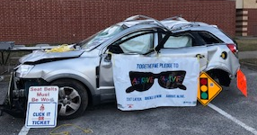
Our ScanEd Program
An interactive teen safe driving and passenger safety program presented by YOVASO and the Virginia State Police
Students rotate between the following two sessions:
Session A : “Physics of a Crash” Troopers lead a 30 minute classroom presentation and discussion on the physics of a crash and the science and biology of what happens to the vehicle and occupants during a crash.
Session B : ScanEd. A wrecked vehicle is set up on site and students use iPads to scan bar codes on the vehicle to learn about the risks they face as drivers and passengers.

Slide 15
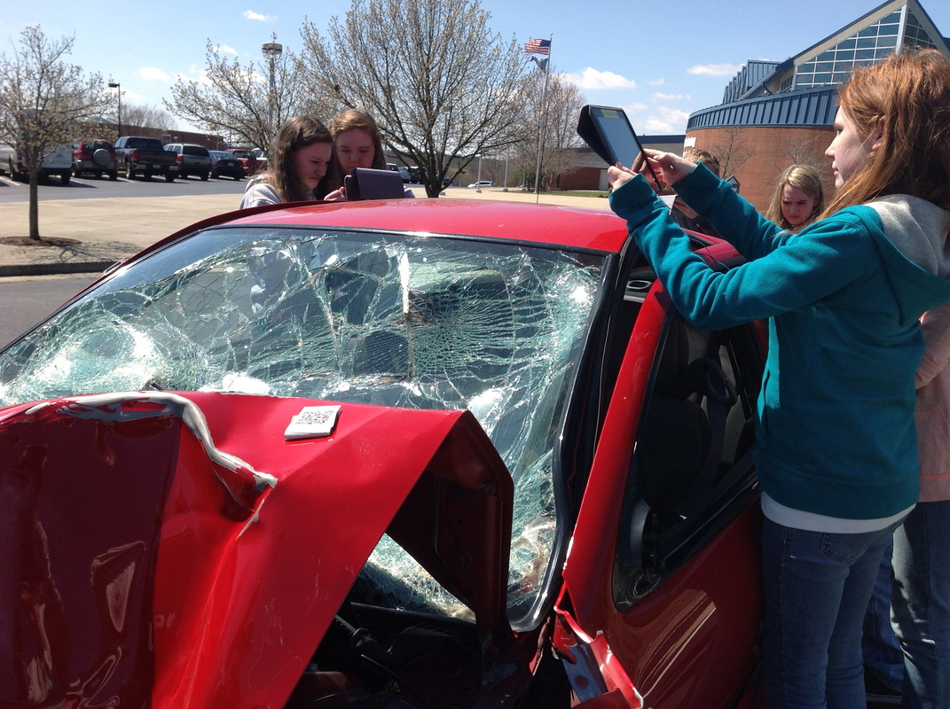
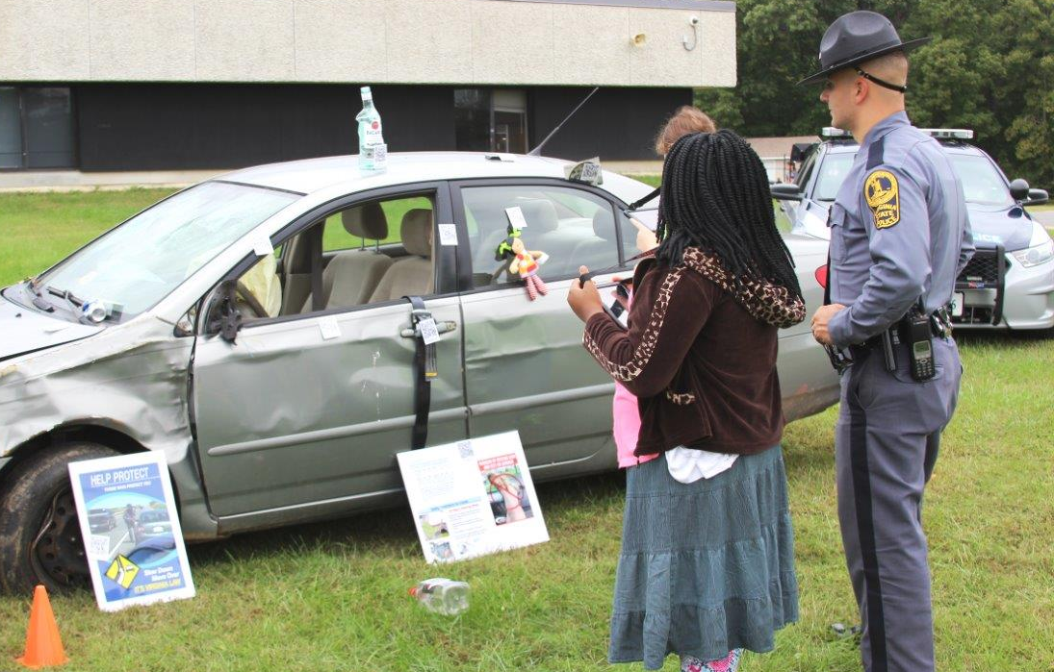
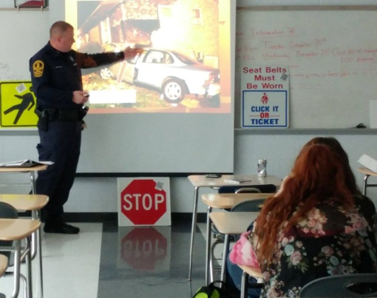
Photos of ScanEd in Action

Slide 16
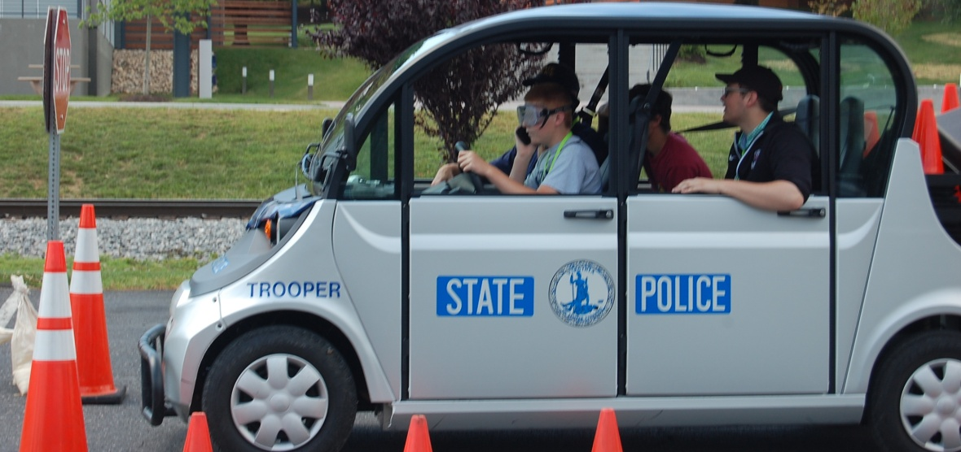
Distracted / Impaired Driving Simulators
These low speed vehicles (LSVs) enable students to experience in real life the dangers of distracted and impaired driving
Students get behind the wheel of the LSV with a trooper and maneuver through a cones course while dealing with everyday distractions such as cell phones, loud music, passenger distractions, etc.
For the impaired driving course, students wear fatal vision goggles while driving the LSV to experience first-hand the dangers of drinking and driving.

Slide 17
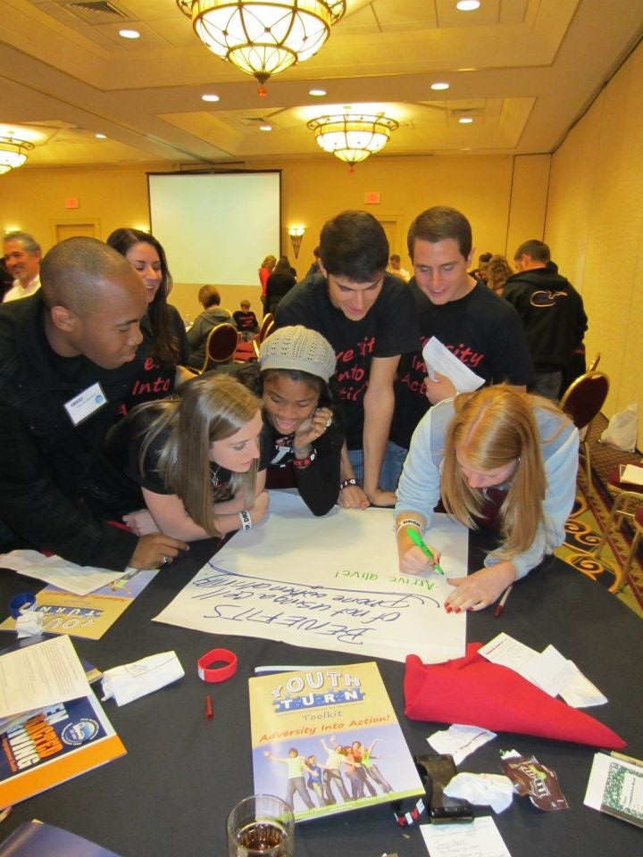
Peer Leadership Training
Provided for all clubs – students and advisors
Content Includes:
Teen crash statistics and laws
Club development
Membership recruitment
Action Planning
Resources and funding sources
Flexible – to accommodate school / youth group schedules

Slide 18
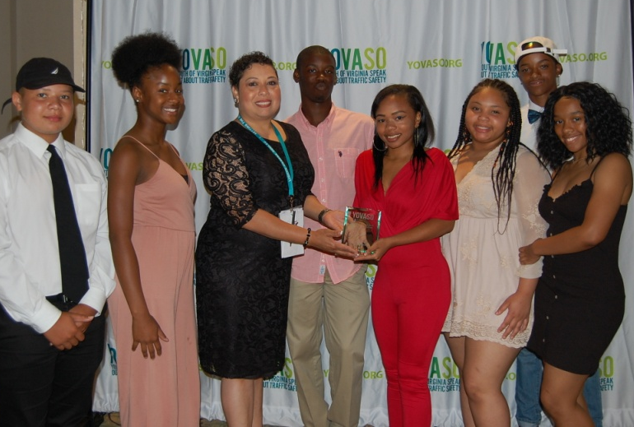
Leadership Retreats / Awards
Summer Leadership Retreat
4 day / 3 night / held at JMU
Open to teams of 6 from member high schools
Advanced Training for Student Leaders & Club Advisors
150 - 200 attendees
Annual Awards Banquet (held during Summer Retreat)
Recognizes schools, students, advisors,
school resource officers, and law
enforcement for exemplary efforts to
promote safe teen driving and
passenger safety.

Slide 19
Turning Tragedy Into Advocacy: A Commitment to Saving Other Young Lives
How Do We Do This in a Positive Way?
Honor the memory of your classmate(s) and friends
Focus on positive, educational, and behavior-changing action
Involve the family and friends if they want to reach out. Personal stories have huge impact.
Successful Ideas from Other Schools:
Banner signing in memory of the student with personal pledge: “I promise to always buckle up and drive responsibly in memory of…”
Symbolic Remembrance – tree, sign, parking space, etc.
Dedicate programs / club mission / theme for the year in memory of the student. Ex: KC’s Miracle – Middlesex High School
Develop a program in memory of the student – “Bronwyn’s Challenge,” FOCUS for ABB” Challenge.
Candlelight Vigil, Balloon Release
Notes:
In honoring this commitment, the chapter adopted the theme KC’s Miracle to use with all programs during the 2013-2014 school year that promote safe teen driving and encourage teens throughout the region to be safer and more responsible drivers.

Slide 20
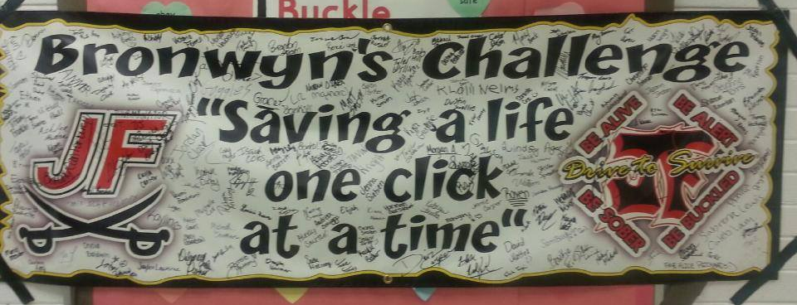
Notes:
the FOCUS for ABB Challenge, a campaign to promote safe driving in memory of her daughter. She wants teens to understand that even when you are doing all the right things, danger can still appear on the road and teens need to be focused on their driving. Partnering with the YOVASO club on the SAVE Your Tailgate Campaign this fall, she handed out wrist bands reminding teen drivers to “focus” on safe driving in her daughter's memory.

Slide 21
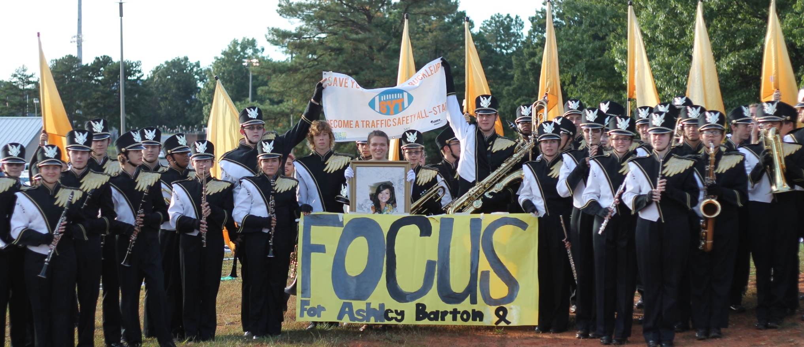
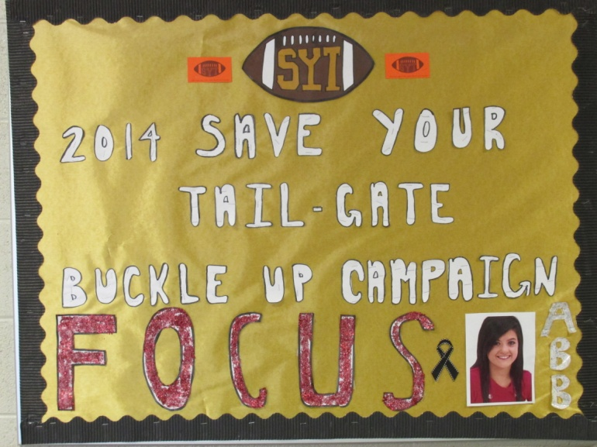
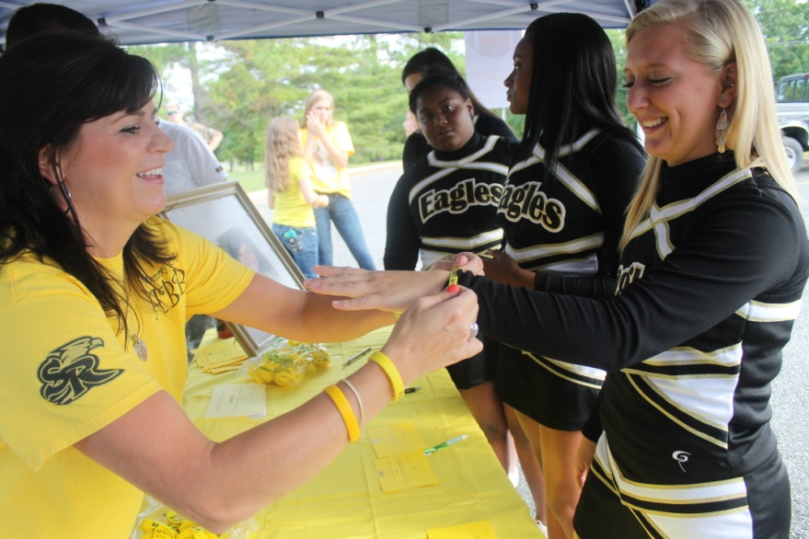

Slide 22
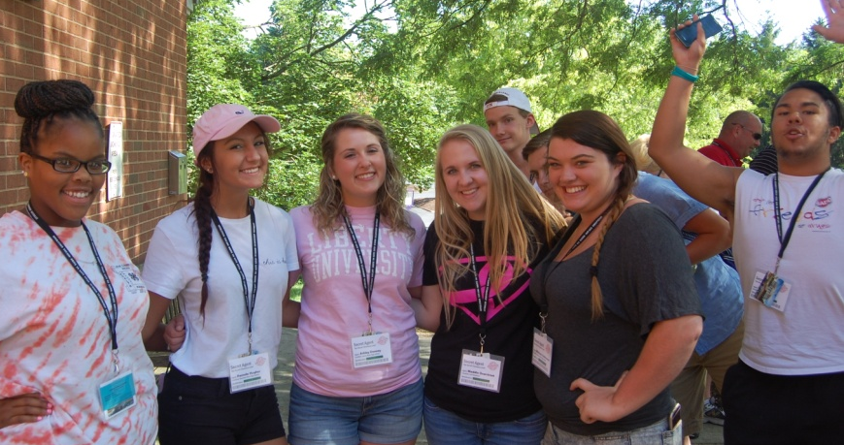
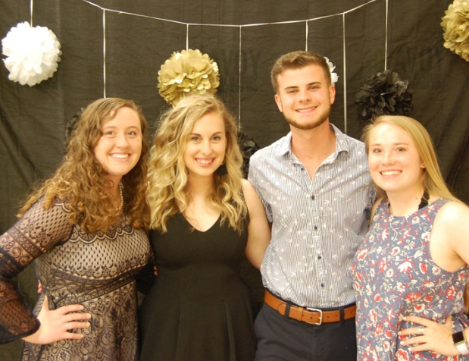
Leadership at the State Level
YOVASO Youth Advisory Council (YAC)
YAC members play a vital role in the mission
of YOVASO and help shape the growth and
direction of the statewide program. Members
work as a team to develop ideas for traffic safety
campaigns, plan the Summer Leadership Retreat,
produce videos and materials, and serve as the
face and voice of YOVASO.
Regional Trainers
YOVASO Regional Trainers are college students who were former leaders of their traffic safety clubs in high school. They work for YOVASO part time and help plan the Summer Leadership Retreat, teach student leadership training sessions, and serve as mentors to member clubs.

Slide 23
Student Expectations & Commitment
By becoming a YOVASO peer leader, students across Virginia are prepared to be role models and mentors for safe driving and passenger safety.
Their work as a YOVASO peer leader will help save many young lives
What does membership involve:
Sign up and stay active with the club
Participate in club meetings and activities – be committed, responsible, and enthusiastic
Share your talents by signing up for projects or committees that need your skills
Lend your creativity – your innovative and unique ideas will encourage more teens to drive safely
Be a role model by continuing to learn and practice safe driving skills and behaviors
Speak out and save lives by encouraging your friends and peers to drive safely and responsibly

Slide 24
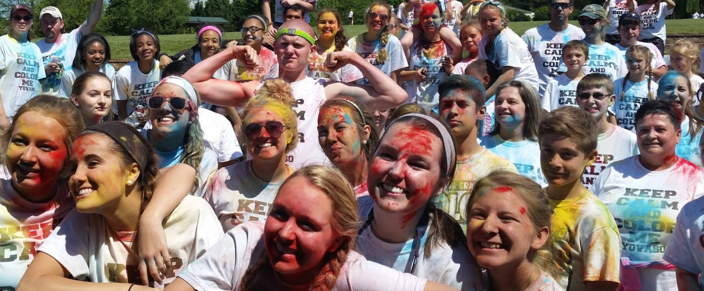
The Keys to a Successful Club
Teen Led
Involve the Whole School
Reach Out to the Community
Take it to the Classroom
Be Active at Sporting Events
Partner with Other Clubs
Keep Programs and Activities FUN and Interactive

Slide 25
We All Have One Mission
YOVASO student advocates can change the driving culture and save lives!

