Slide 1
Vision Zero: Our Steps to Improve Public Health 7th Annual Distracted Driving Summit
Michael B. Sawyer, PE
City Transportation Engineer
September 25, 2019

Slide 2
City’s Transportation Emphasis

Slide 3
What is Vision Zero?
How many traffic fatalities occur in the United States each year?
What is a good goal for the United States?
What is a good goal for your family?
Shouldn’t that be the goal for everyone?
Changing our built environment + shifting our safety culture.

Slide 4
What is Vision Zero?
The Vision Zero is the Swedish approach to transportation safety thinking.
It can be summarized in one sentence:
No injuries or loss of life is acceptable.

Slide 5
Towards Zero Deaths – Virginia’s Plan

Slide 6
Vision Zero Cities in the United States

Slide 7
Why is Vision Zero important?

Slide 8
Since 2013…
5,010 Severe Crashes in the Region (112,499 total)
533 people killed in traffic related deaths
97 people were walking
5,534 people suffer incapacitating injuries
412 people were walking

Slide 9
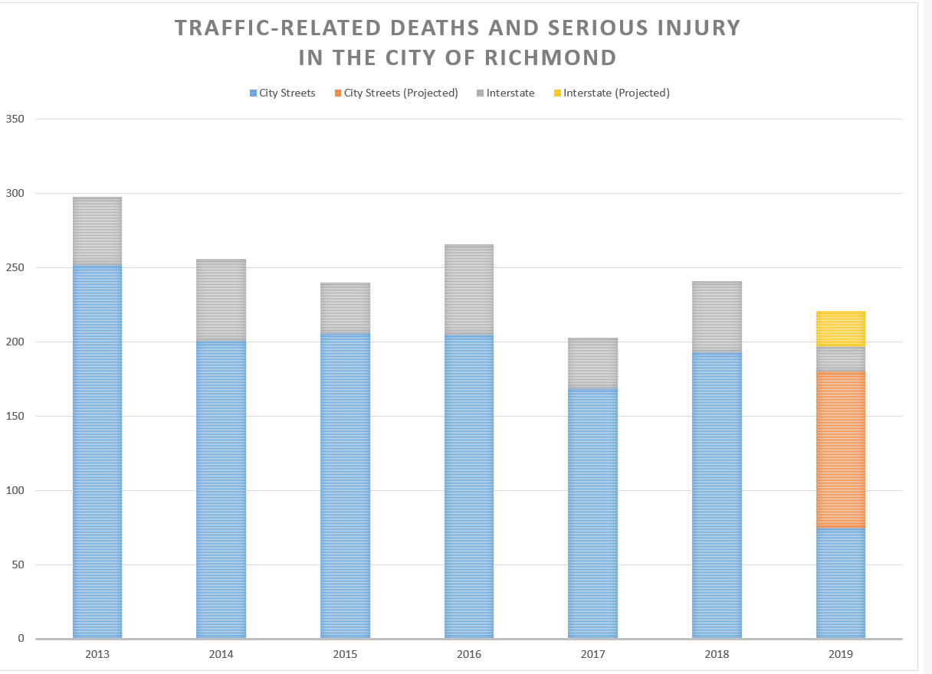
Why is Vision Zero Important?
Notes:
1 every 35 hours within the City limits.

Slide 10
Twelve Steps to Vision Zero
STEP 1: Establish Safe and Healthy Streets Commission
STEP 2: Adopt a Vision Zero Resolution
STEP 3: Sign a Vision Zero Pledge
STEP 4: Issue a Safe and Healthy Streets Challenge
STEP 5: Adopt Vision Zero Action Plan
STEP 6: Establish a Vision Zero Task Force
STEP 7: Establish Year One Priorities and Metrics
STEP 8: Engage community leaders
STEP 9: Shift the safety culture
STEP 10: Vision Zero as DNA
STEP 11: Focus on resources
STEP 12: Keep your head up

Slide 11
STEP 1: Establish a Safety Commission
Next Meeting:
Wednesday October 16, 2019 at 2PM
Main Library
Notes:
Just celebrated 50 years. Formed in 1966. Advises City Council.
Just changed our name. Injury Prevention and Active Transportation
Safety partners (local, state, federal government agencies, non-profits, citizens, consultants)
Health department with CDC fellows.
Pass resolutions of support for grants as well as advice to council

Slide 12
STEP 2: Adopt Vision Zero Resolution
City Council adopted Resolution 2016-R011 in March 2016
Goal of reducing traffic fatalities and serious injuries in road traffic to zero by the year 2030
Developing as part of Master Plan

Slide 13
STEP 3: Our Vision Zero Pledge
Source: RTD

Slide 14
A Vision Zero Pledge affects Workplace Culture
Traditional (Hot Spot)
Systemic
Comprehensive
Policy
Culture

Slide 15
STEP 4: Safe & Healthy Streets Challenge
Mayor Levar M. Stoney issued The Challenge (2017)
Five things one can do…
Share the road
Obey speed limits
Buckle in
Avoid distractions
Drive sober
If we did, it would not be SO BAD…

Slide 16
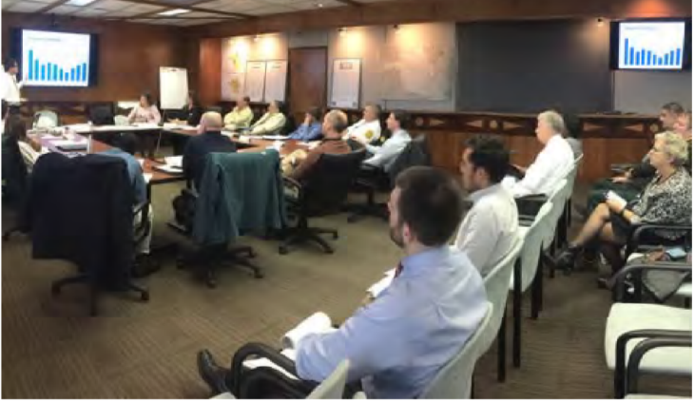
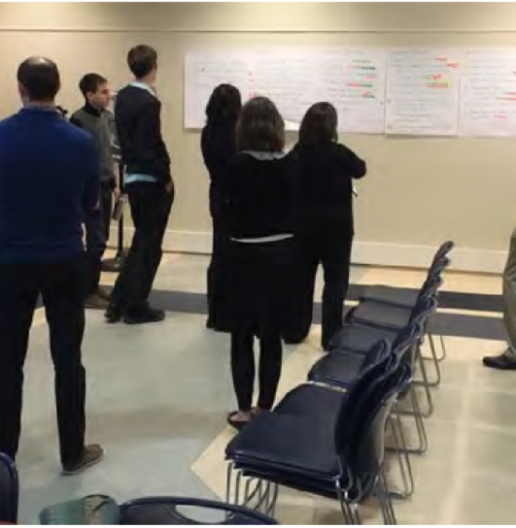
STEP 5: Our Vision Zero Action Plan

Slide 17
High Injury Street Network
58% of death and serious injuries on 16% of city streets

Slide 18
Pedestrian Crashes 2011 to 2016

Slide 19
STEP 6: Vision Zero Task Force & Coordinator
Strong Mayor / CAO vs. City Manager
Implementation takes place in the executive branch
Creates a multi-disciplinary team of involved departments, offices, and authorities led by a Vision Zero Coordinator
Responsible for reporting progress and metrics to Safe and Healthy Streets Commission, City Council, and the Mayor’s Office
VZ Coordinator engages community, non-profit, institutional, private sector, regional, state and federal level resources

Slide 20
STEP 6: Vision Zero Task Force
Department Leaders
Avula, Danny – Richmond Community Health Department | Jones, Korita B. – Human Resources
Baskerville, Robert G. – Department of Social Services | Lawus, Denise – Housing and Community Development
Brown, Jay A. - Budget | Nolan, James S. – Office of Press Secretary
Burrell, Betty J. - Procurement Services | Olinger, Mark A. – Planning and Development Review
Bustamante, Daniel – Office of Multicultural Affairs | Peters, Christie C. – Animal Care and Control
Carter, Melvin D. - Fire | Reid, Lenora G. - DCAO of Finance and Administration
Dunlap, Douglas C. – DCAO of Community Development | Steidel, Robert C. – DCAO of Operations
Durham, Alfred - Police | Summers, Donald R. – Department of Public Works – Capital Projects
Farr, Calvin D. – Department of Public Utilities | Todd, Charles G. – Department of Information Technology
Ferrara, Jane C. – Department of Economic Development | Vincent, Bobby – Department of Public Works
Firestine,Scott R. – Richmond Public Library | Wack, John B. - Finance
Foster, Patricia R. – Minority Business Development | Willoughby, Stephen M. – Department of Emergency Communications
Frelke, Christopher E. – Department of Parks and Recreation | Mitchell, Charles – Greater Richmond Transit Company
Giles, Shunda T. – Department of Social Services | Simmons, Theresa – Richmond Metropolitan Transportation Authority
Gordon, Reginald E. – Office of Community Wealth Building | Decker, Chip – Richmond Ambulance Authority

Slide 21
STEP 7: Yearly Priorities and Metrics

Slide 22
STEP 8: Engage Community Leaders
Start with WHY
2,700 injuries and 13 deaths on city streets annually;
Provide the WHAT
Worked with Richmond District Health Department on messaging;
Leadership Talking Points launched;
Suggest HOW
Public engagement speeches
Community meetings
Neighborhood Newsletters
Attend safety calendar press events

Slide 23
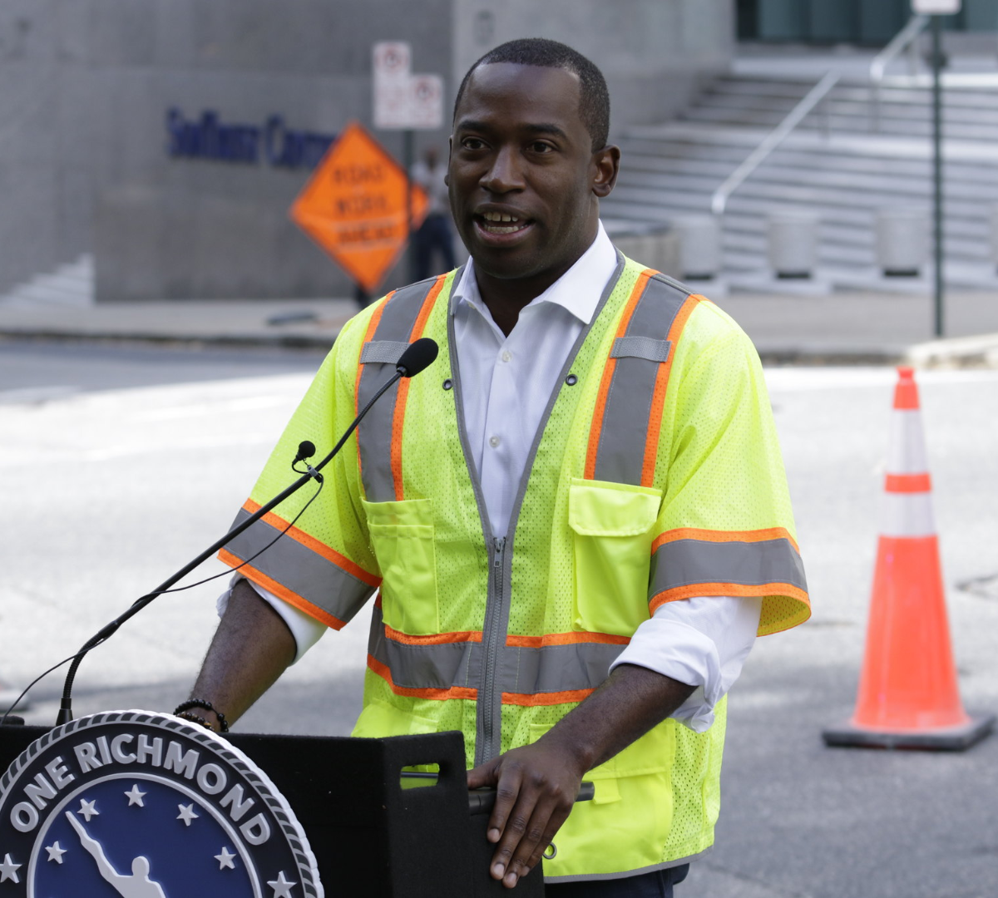
STEP 8: Engage Community Leaders

Slide 24
Vision Zero Champions

Slide 25
Vision Zero Champions

Slide 26
Action to Coordinate Outreach
II-15 Coordinate a transportation safety calendar to promote safety messaging and high visibility enforcement.
SEPTEMBER People who transport children
OCTOBER People who walk
NOVEMBER People who drive drowsy
DECEMBER People who drive impaired
JANUARY People who walk
FEBRUARY People who drive unbelted
MARCH People who cross railroads
APRIL People who work in our roads
MAY People who bike

Slide 27
STEP 9: Shift the Safety Culture
Focus on culture:
Family
Neighborhood
Community
School / Workplace / Places of Worship
Sustain outreach efforts through elected officials, thought leaders, community leaders
Elevate the conversation to “people talking to people”
Ask interesting questions

Slide 28
How do we change our safety culture?
Source: RVA Coffee Stain
Notes:
“Lately I’ve been walking to work a lot (from Leigh to downtown), and am constantly trying to avoid being hit by cars at crosswalks. This morning, while crossing at the crosswalk in front of Bellevue Elementary, a car going pretty fast flew through the crosswalk, almost hitting me. It was close enough that I tapped the side of the car with my lunch bag (which contained one tupperware and two bananas in it). The woman driving the car actually stopped and told me to never touch her car, that I needed to slow down, then called me a jerk. I probably shouldn’t have tapped her car, but I’m tired of almost being hit every time I cross the street. Especially in front of an elementary school.”

Slide 29
Key Legislation – Commonwealth of Virginia
Primary Seat Belt Law for all occupants
Photo Speed Enforcement Law for schools, parks, and work zones
Handheld Ban on all electronic devices
Contributory versus comparative negligence
Clarifying the law for people who cross streets

Slide 30
Safety Culture is complex and multi-faceted
It is the collection the following present in a community:
shared values,
attitudes,
beliefs,
behaviors,
rules,
policies, and
laws

Slide 31
Speed versus Height

Slide 32
Falls versus Motor Vehicle Crashes
Average Annual Deaths and Serious Injuries in City of Richmond:
423 from unintentional falls
199 Slipping, Tripping, and Stumbling
41 Stairs or Steps
12 From Ladder
241 from motor vehicle crashes

Slide 33
10 Leading Causes of Non-Fatal Injuries

Slide 34
But my vehicle has FIVE Stars

Slide 35
Speed and Severity

Slide 36
Death + Serious Injuries for belted at 40MPH

Slide 37
Same impact – Different Age

Slide 38
What do these have in common?
Unbelted daughter in a motor vehicle
Son crossing street to go to school
Mother riding motorcycle
Dad riding bicycle
Grandmother jogging
Grandfather buckled in back seat at 40MPH
Dog running out front door
Deer crossing to the park

Slide 39
Who is vulnerable on city streets?

Slide 40
Who is vulnerable on Virginia’s roads?

Slide 41
Safety Culture – Twitterverse – @000RVA
Established September 1st, 2017
Retweet existing safety messages
Goals
See how many messages are out there related to shifting our safety culture
Describe what Vision Zero is about and what normal people can do to improve
Encourage peer groups to challenge each other
Approximately 7,500+ messages from experts
Over 400,000+ impressions

Slide 42
How do we change our safety culture?
Our Safe and Healthy Streets Challenge
Five things one can do…
Share the road
Obey speed limits
Buckle in
Avoid distractions
Drive sober
If we did, it would not be SO BAD…
Change the built environment to shift up our safety culture

Slide 43
STEP 10: Vision Zero as DNA
Partnerships
Health in all Policies
City Master Plan
Better Streets Manual
Traffic Signal Operations
Bike Infrastructure
Pedestrian Infrastructure
Intersection Design
Typical Sections
New Development
Private Sector
Universities / City Owned

Slide 44
STEP 11: Focus on Resources
Grant writing
Local budget process
Transportation Operations and Enforcement
Traffic Safety Assets
Regulatory and Warning Signs
Crosswalks and School Markings
Traffic Signal Maintenance Replacement
Training for excellent employees
Leverage partnerships and technology

Slide 45
STEP 12: Keep your head up…

