Slide 1
Oro Valley’s Distracted Driving Initiative
By Daniel G. Sharp
Chief of Police
Oro Valley Police Department, AZ
520-229-4901
dsharp@orovalleyaz.gov

Slide 2
January 6, 2017

Slide 3
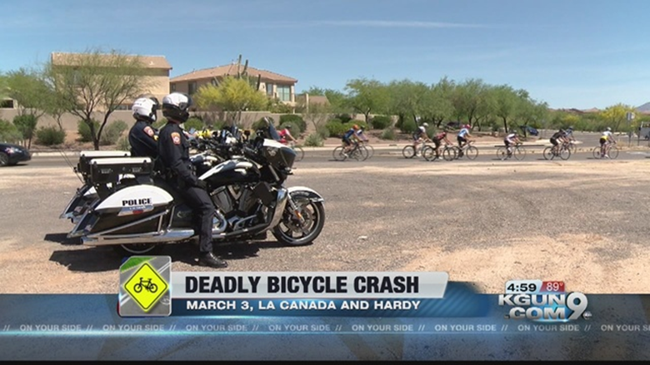
Arizona – Local solution needed when state doesn’t act.

Slide 4
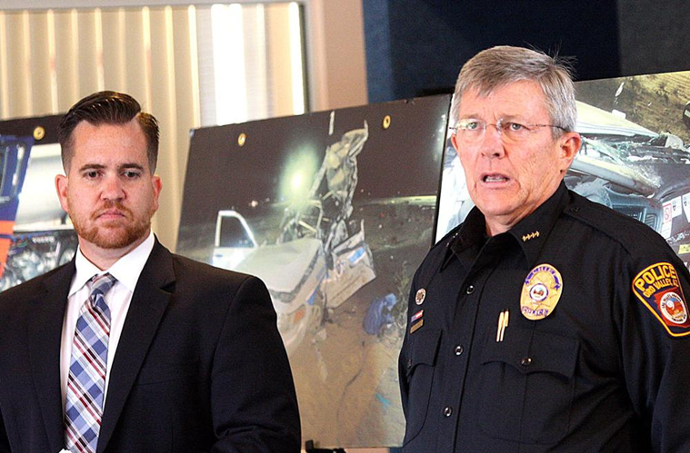
Education
Have a “Community Conversation”
Educate your Elected Officials
Partner with Organizations that Support Traffic Safety Initiatives

Slide 5
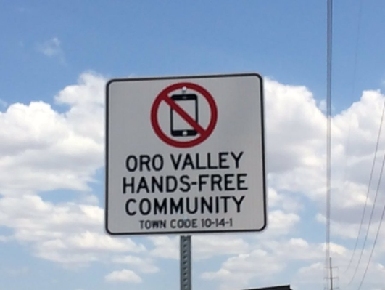
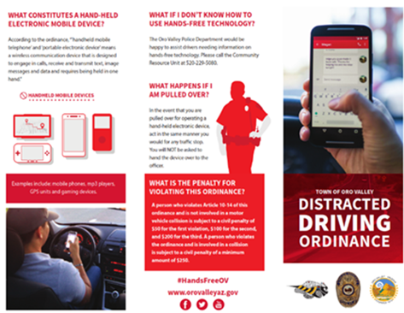
Outreach
Get your message out, “Just Drive”
Provide an “Easy Guide” to understanding the law.
Make sure your department “leads by example”
Get your youth leadership involved

Slide 6
Movie Theater Public Service Announcement

Slide 7
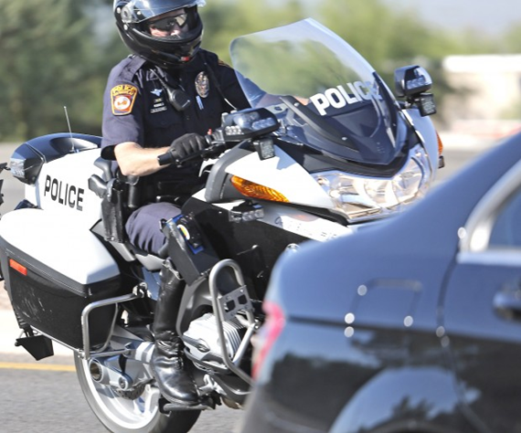
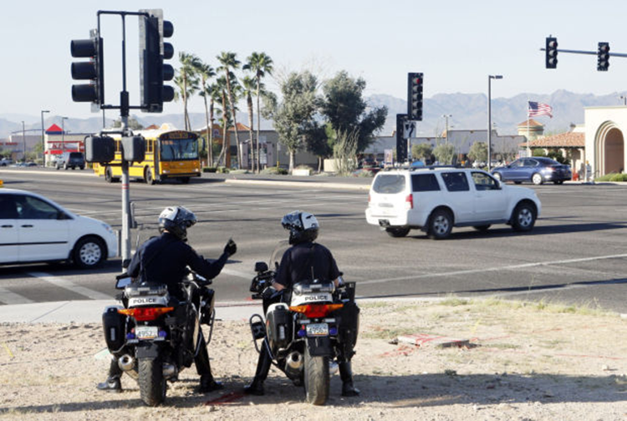
Enforcement and Education

Slide 8
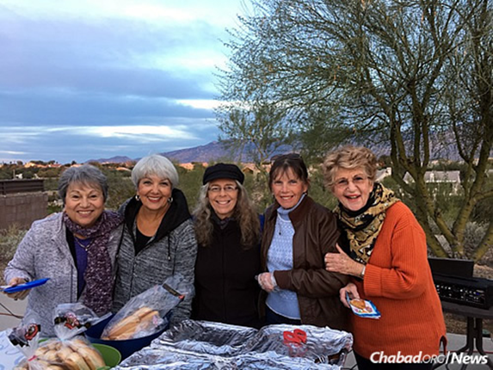
Share Outcomes and Build Relationships

Slide 9
Arizona become 48th State to ban distracted driving

Slide 10
Questions
Daniel G. Sharp
dsharp@orovalleyaz.gov
520-229-4901

