Slide 1
“Safe Driving Habits”

Slide 2
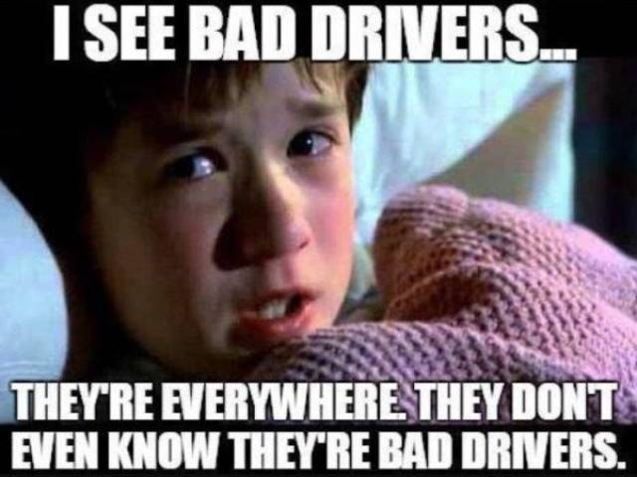
Bad Drivers?
TM

Slide 3
“Safe Driving Habits”
Safety Starters
2. Make Yourself Visible
3. Pre-Plan Your Routes
4. Slow Down
5. Pay Attention!
6. Scan 360°
7. Have an Escape Plan
8. Maintain A Safe Distance
9. Adjust For Weather
10. Stay Back
11. Avoid Parking Lot Collisions
12. Stay Awake and Alert
13. Impaired Driving
14. Maintain Good Habits
15. Safety Attitude

Slide 4
1. Safety Starters
Lock Your Doors
Buckle Up
Adjust Seat and Mirrors
No Loose Articles

Slide 5
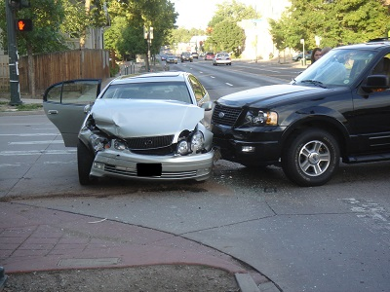
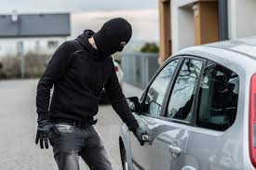
Lock the Doors
Increases the integrity
of your vehicle
during a crash
Keeps unwanted
people from entering
your vehicle
Locked doors keep the good people in
and the bad people out.

Slide 6
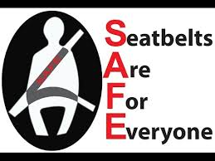
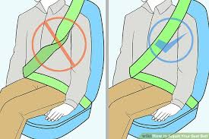
Buckle Up
Seatbelts increase your
chances of survival by 45%
Syneos Health policy:
All must be buckled
Wear across hips,
sternum and clavicle
No slack and no twists

Slide 7
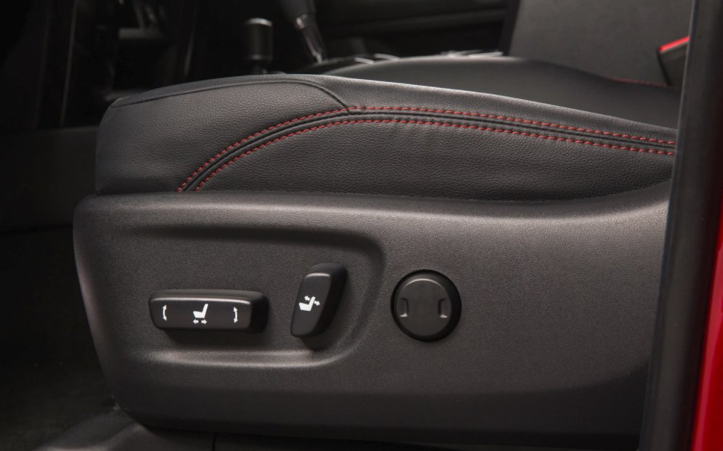
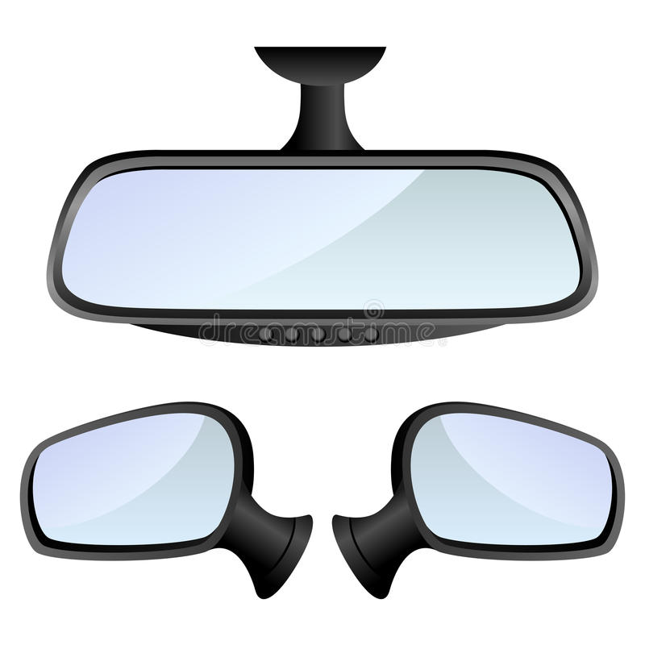
Seats and Mirrors
Adjust seat and mirrors prior to driving

Slide 8
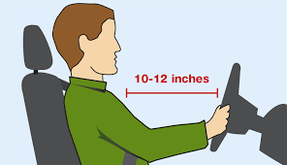
Give the Airbag Room
Stay back at least the length of a piece of paper

Slide 9
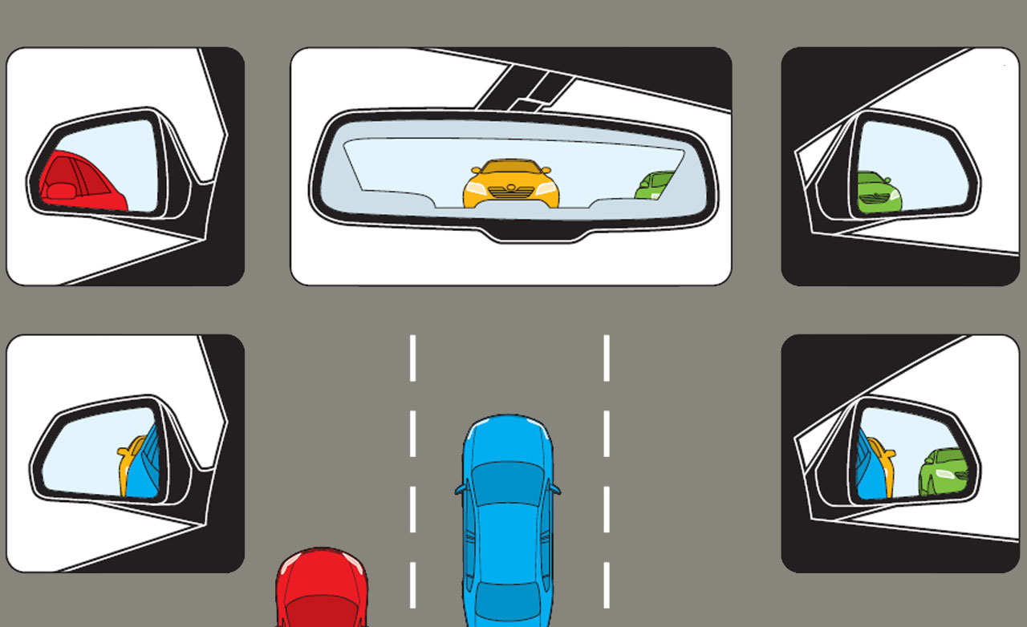
Minimize Blind Spots
Adjust mirrors to minimize blind spots

Slide 10
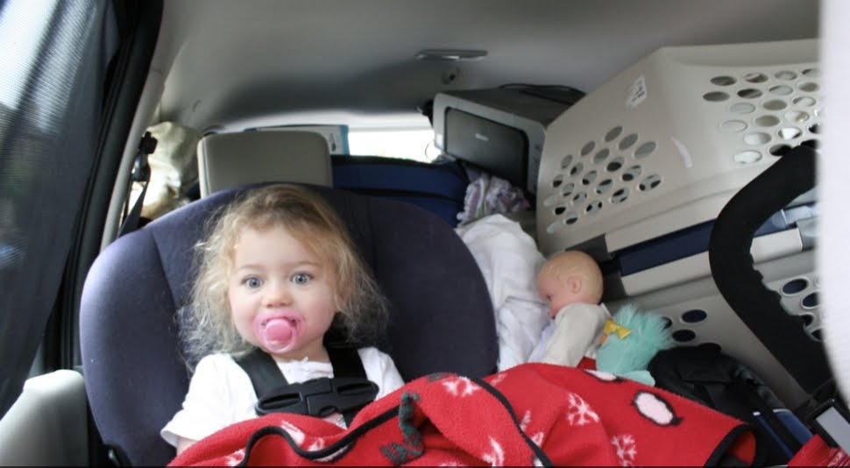
Flying Projectiles
Anything that is loose in a vehicle will
become a flying projectile

Slide 11
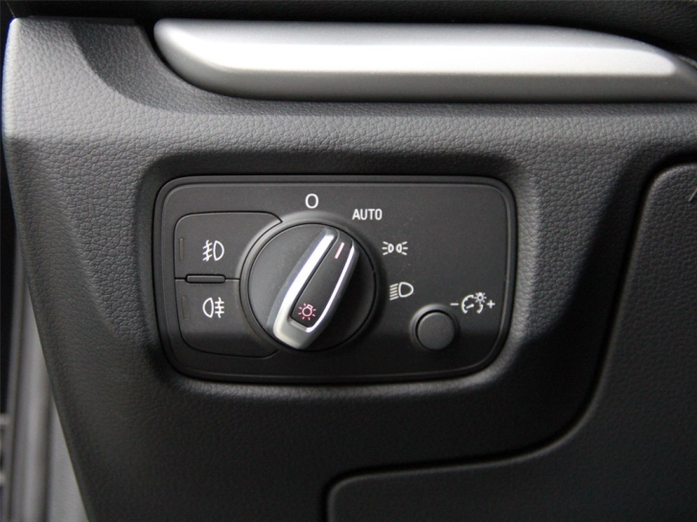
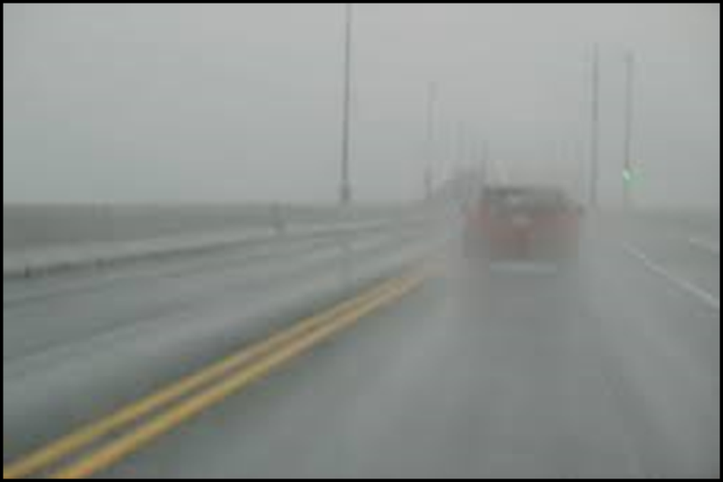
2. Make Yourself Visible
Foul Weather Requirements
Do not depend on “Auto-Switch” in bad weather
Wipers on – Light switch on

Slide 12
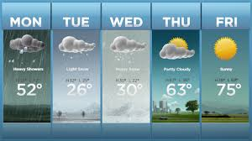
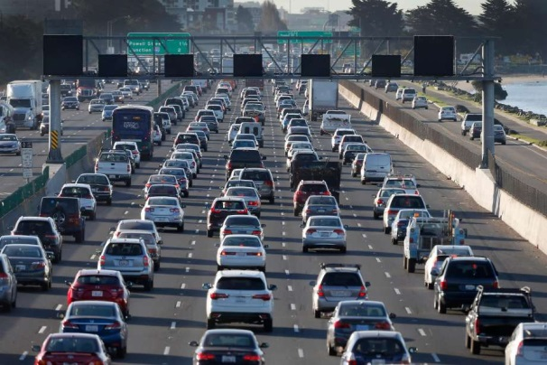
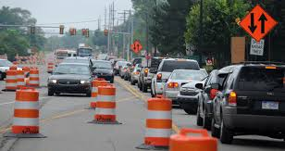
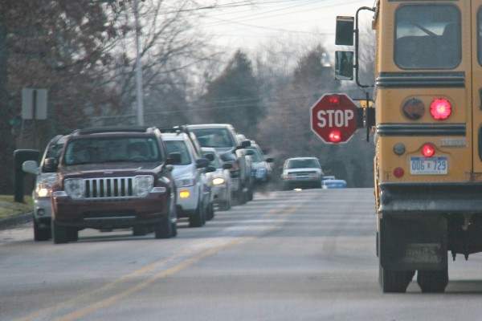
3. Plan Your Routes Wisely
Consider:
Weather Forecasts
Traffic
Construction
School Bus Routes

Slide 13
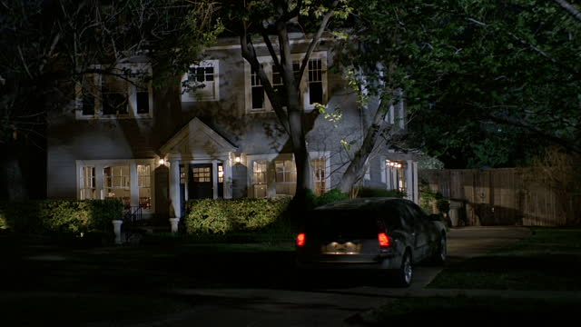
3. Plan Your Routes Wisely
Plan late day meetings close to home

Slide 14
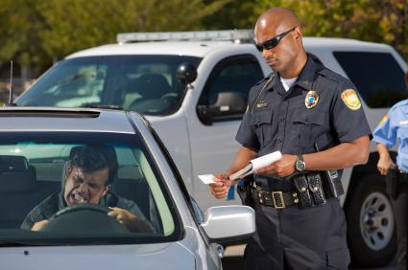
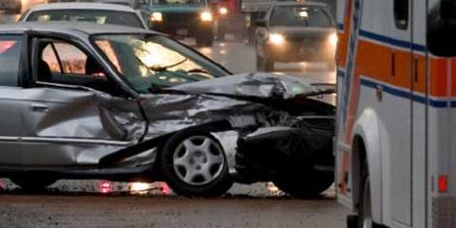
4. Slow Down!
Speeding Leads To:
Violations
Serious Collisions

Slide 15
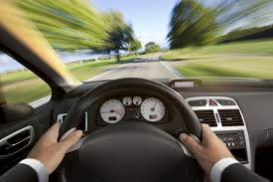
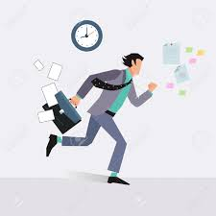
4. Slow Down!
Leading Causes for Speeding:
Habit
Poor Planning

Slide 16
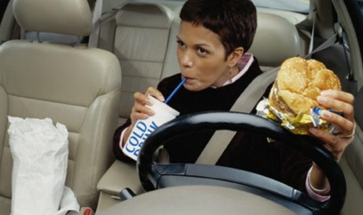
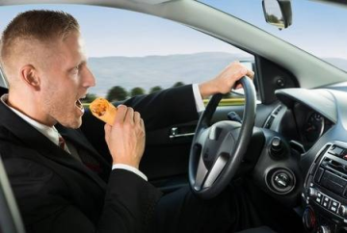
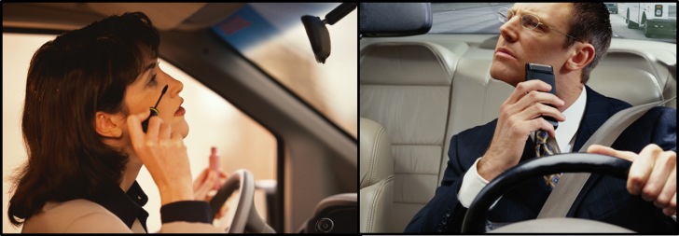
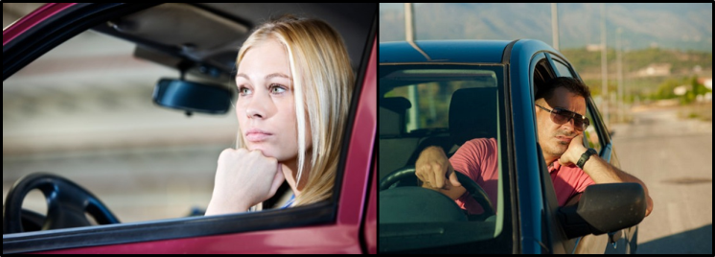
5. PAY ATTENTION!
Common Driving Distractions:
Eating
Grooming
Daydreaming

Slide 17
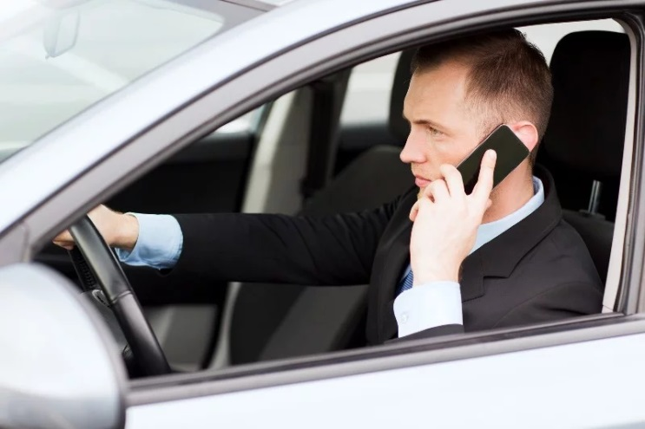
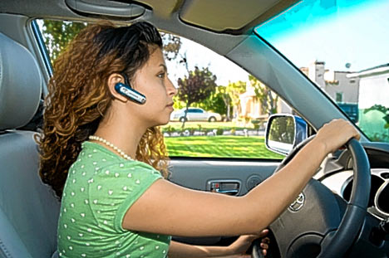
5. PAY ATTENTION!
Common Driving Distractions:
Mobile Devices
Hands free or hand set –
You are as likely to crash as a person who has a
.08% Blood Alcohol Concentration

Slide 18
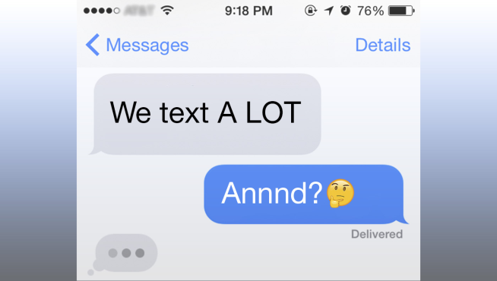
5. PAY ATTENTION!
Common Driving Distractions:
Mobile Devices
You are 23 times more likely to crash if you text, tweet, e-mail or participate in any other similar activity while driving

Slide 19
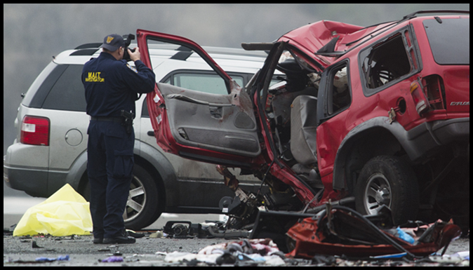
5. PAY ATTENTION!
Crashes Happen in Split Seconds
At just 35 miles per hour, in the time it takes to blink your eye, you will travel 20 feet. Missing a crash by 20 feet is a very good miss.

Slide 20
6. Scan 360°
Forward – Directly in front of you and
to the horizon
Behind – Check mirrors every 5-7 seconds
Side to Side – Use your peripheral vision
and shift you view as your
speed increases

Slide 21
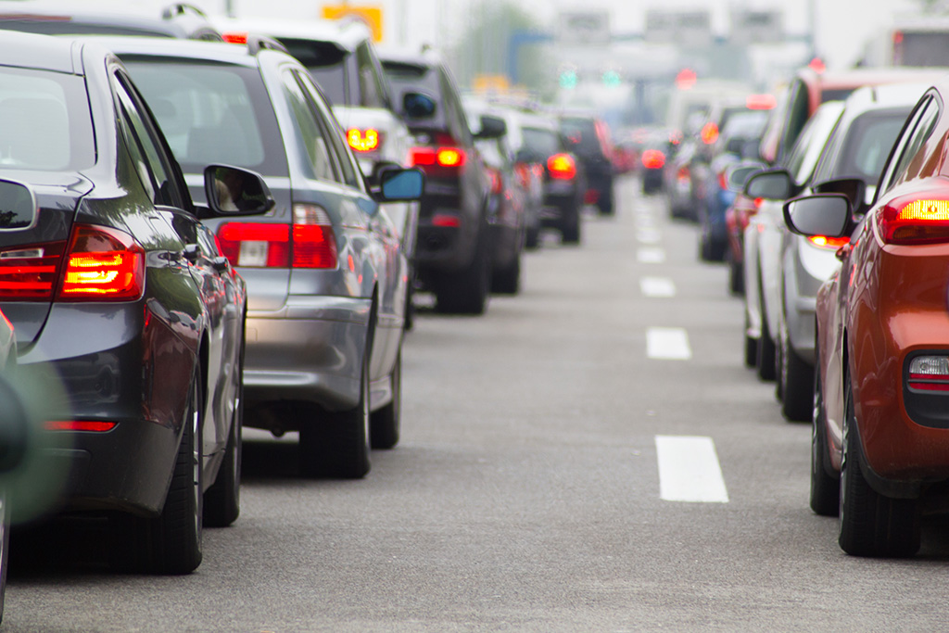
6. Scan 360°
Don’t just place your focus here
Scan far ahead
Forward View

Slide 22
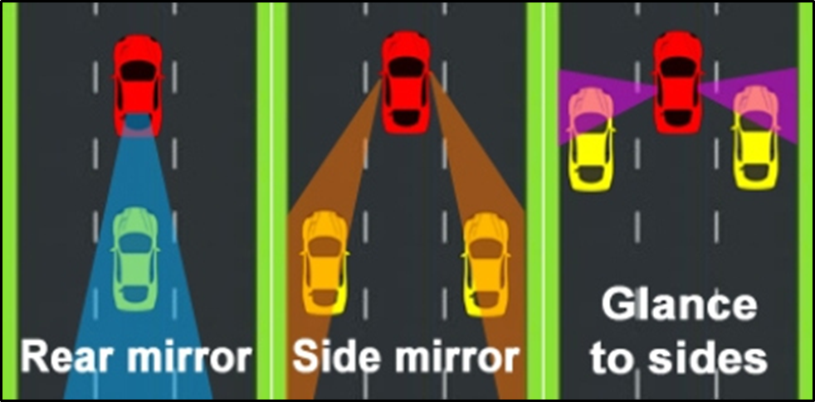
6. Scan 360°
Mirrors
Scan your mirrors every 5-7 seconds
Do the “shoulder glance”

Slide 23
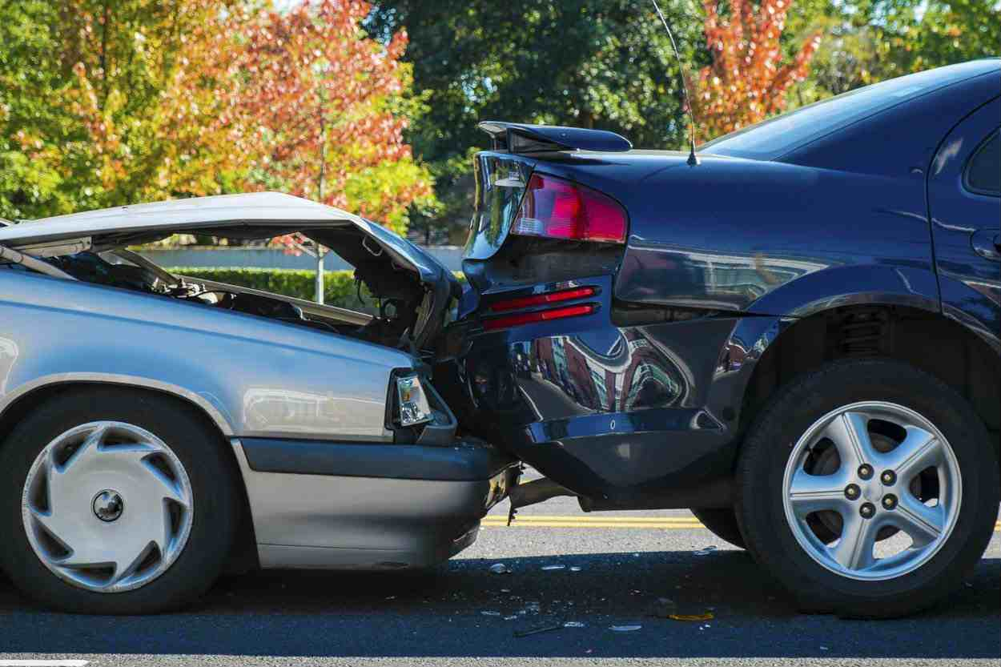
6. Scan 360°
Avoid Being the Victim of a Rear-End Collision
Check your mirrors:
When stopping at intersections
When merging onto highways
In stop and go traffic

Slide 24
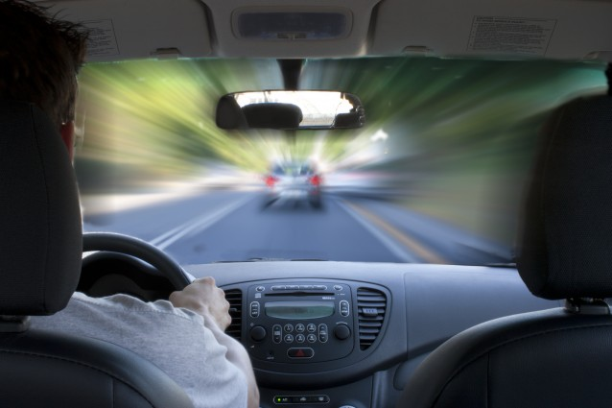
6. Scan 360°
Scan Side to Side
Don’t get “tunnel vision”
As speeds increase, peripheral vision decreases

Slide 25
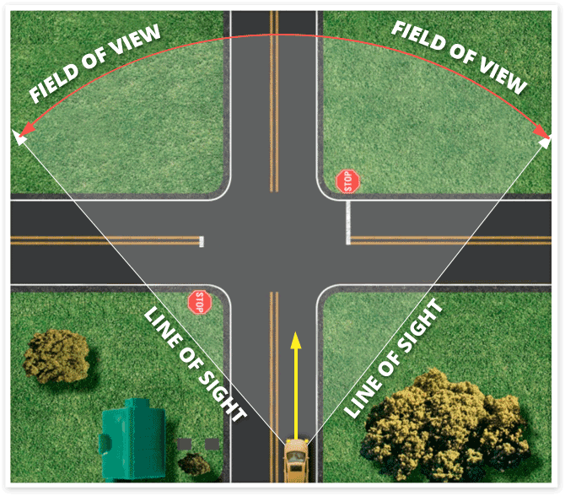
6. Scan 360°
Scan Side to Side
Peripheral vision and reaction space – 35 MPH

Slide 26
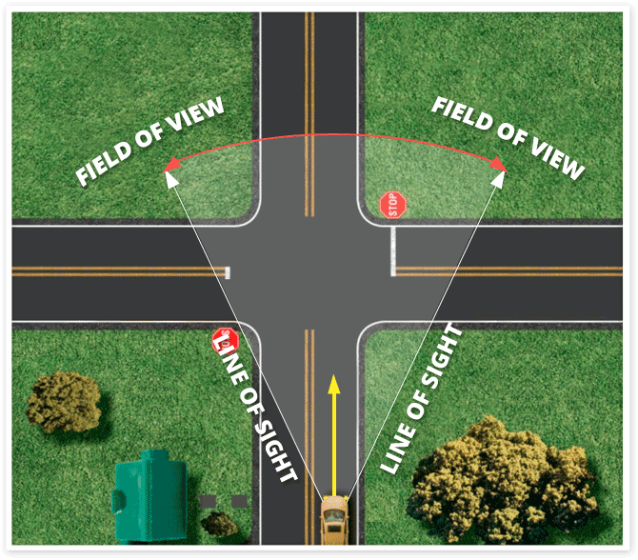
6. Scan 360°
Scan Side to Side
Peripheral vision and reaction space – 45 MPH

Slide 27
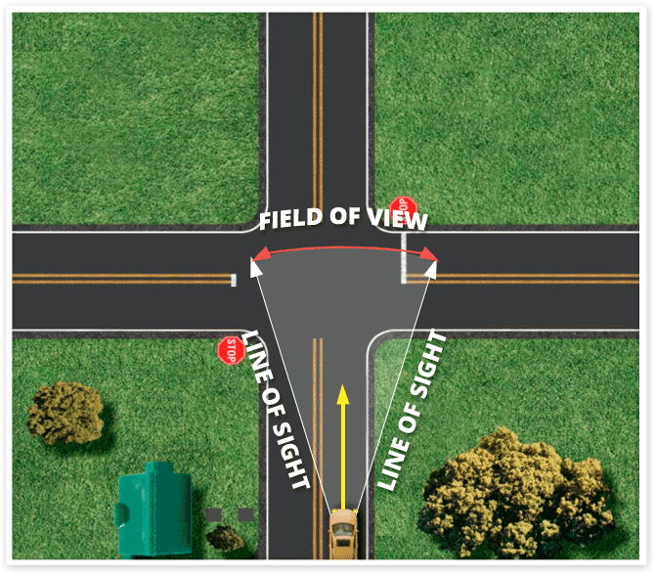
6. Scan 360°
Scan Side to Side
Peripheral vision and reaction space – 55 MPH

Slide 28
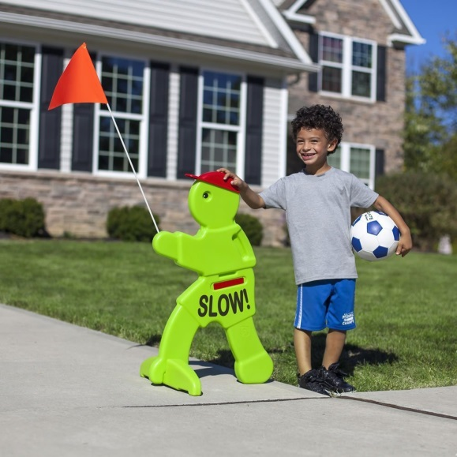
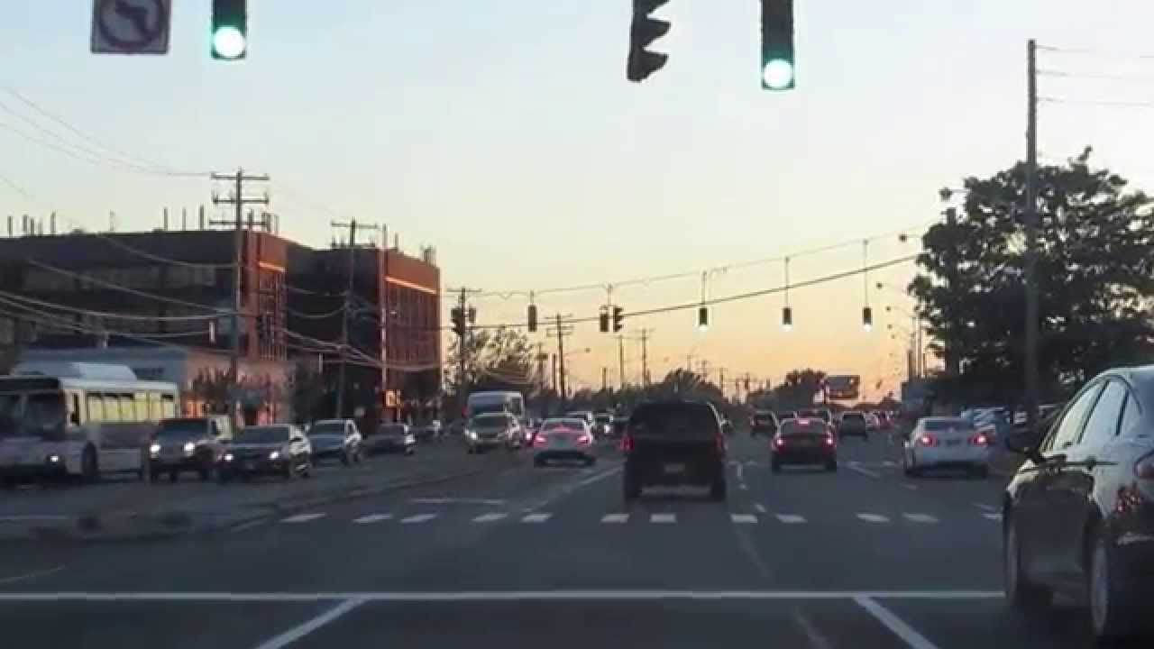
6. Scan 360°
Scan Side to Side
In neighborhoods Door to Door
Approaching intersections and before you pull out

Slide 29
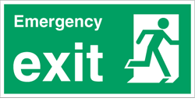
#7. Have An Escape Route
In the event of a driving emergency, you need to
know your escape routes – You have three

Slide 30
Three Escape Routes
Left
Right
Ahead

Slide 31
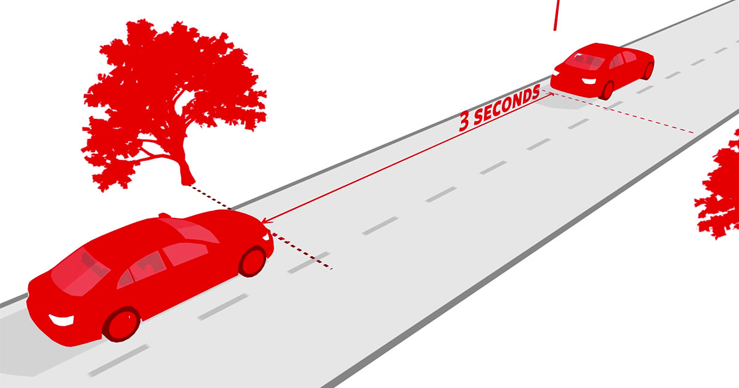
#8 Maintain A Safe Distance
On a dry road maintain at least a
3-second following distance

Slide 32
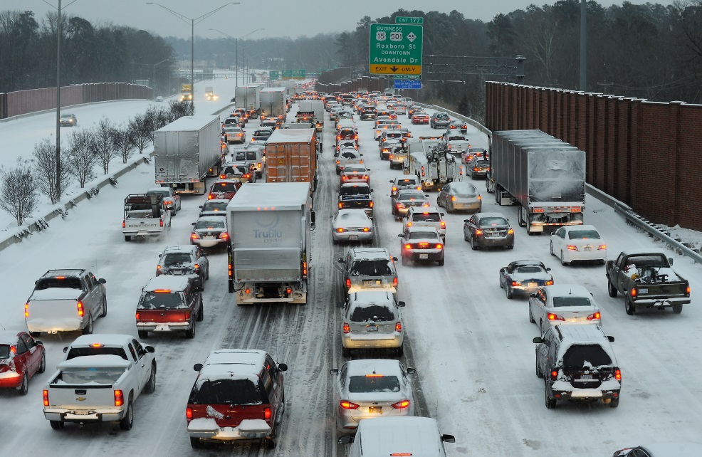
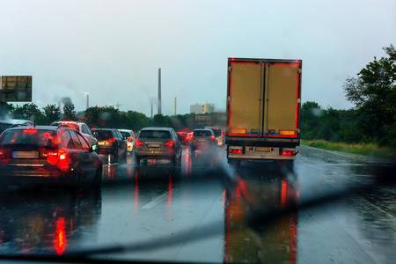
#9. Adjust Your Driving for the Weather
SLOW DOWN!
Allow more travel time – Get up earlier
Increase your following distance

Slide 33
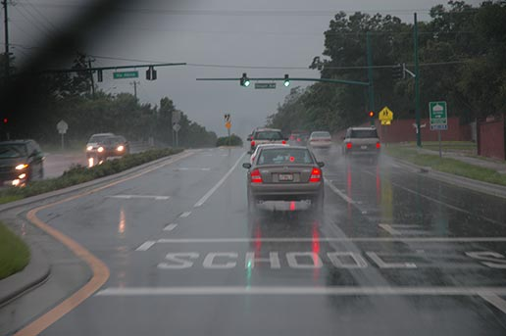
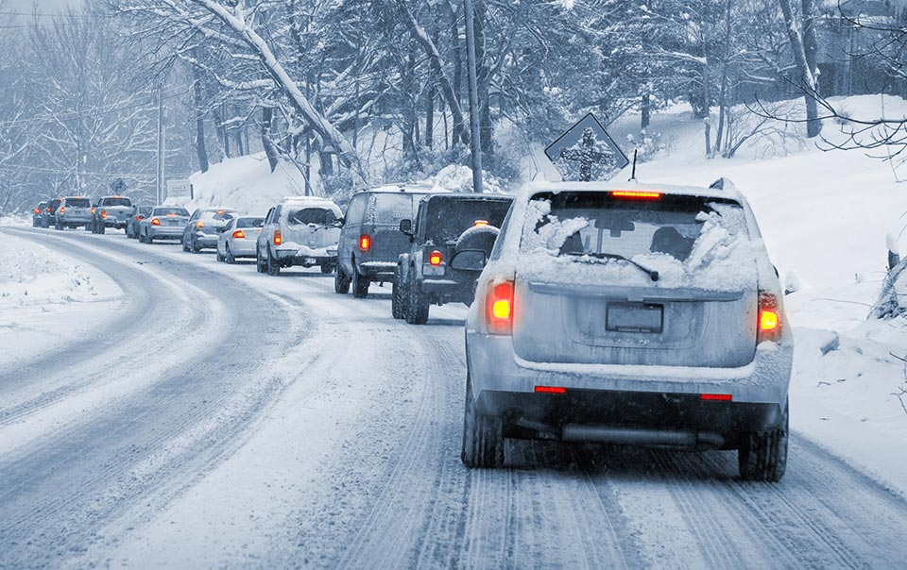
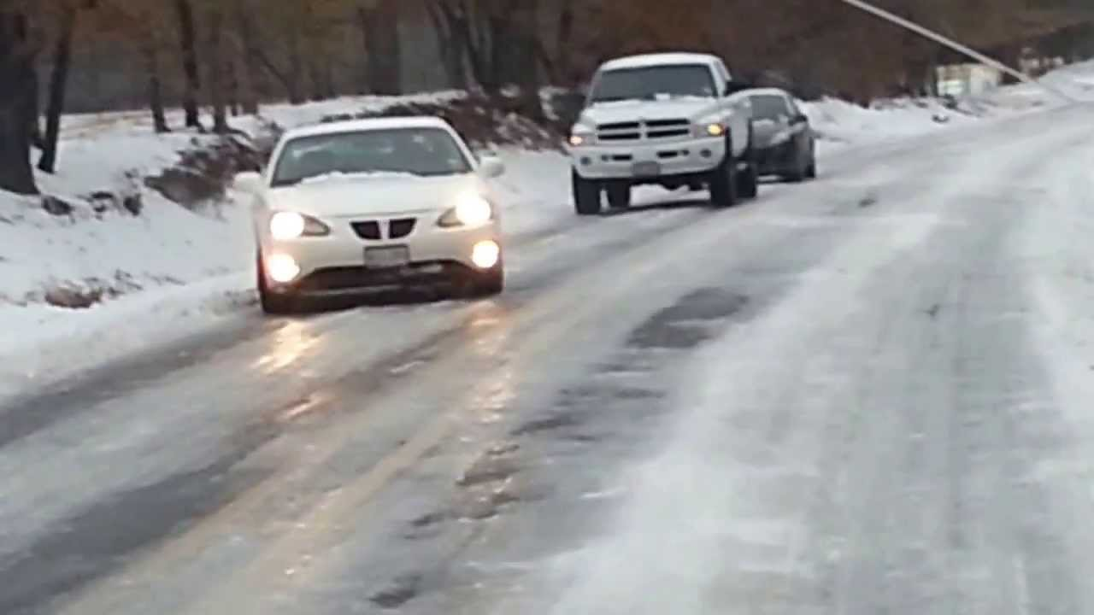
#9. Adjust Your Driving for the Weather
Rain: 6 Seconds
Light Snow: 8-10 Seconds
Ice: Park It!

Slide 34
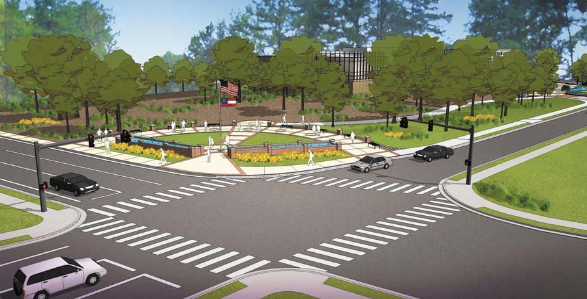
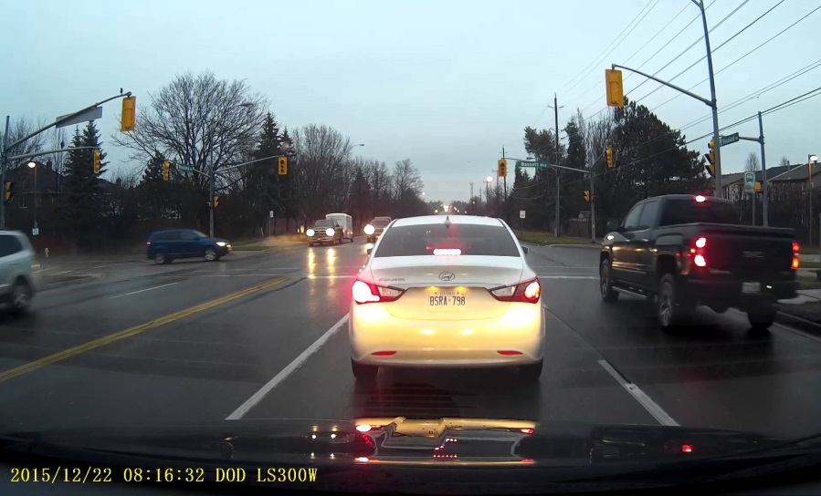
#10 Stay Back
First In Line
Stopped Behind Traffic
Allow Escape space to the front when first in line
See the rear tires of the vehicle in front of you

Slide 35
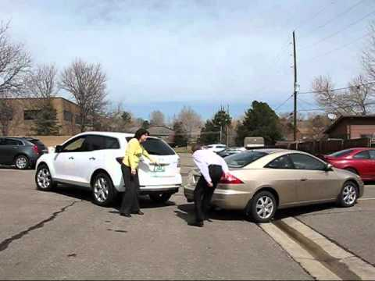
#11 Avoid Parking Lot Collisions
Parking lot reverse collisions - #1 type of collision for Syneos Health
Limited view - Cars are designed to go forwards,
not backwards

Slide 36
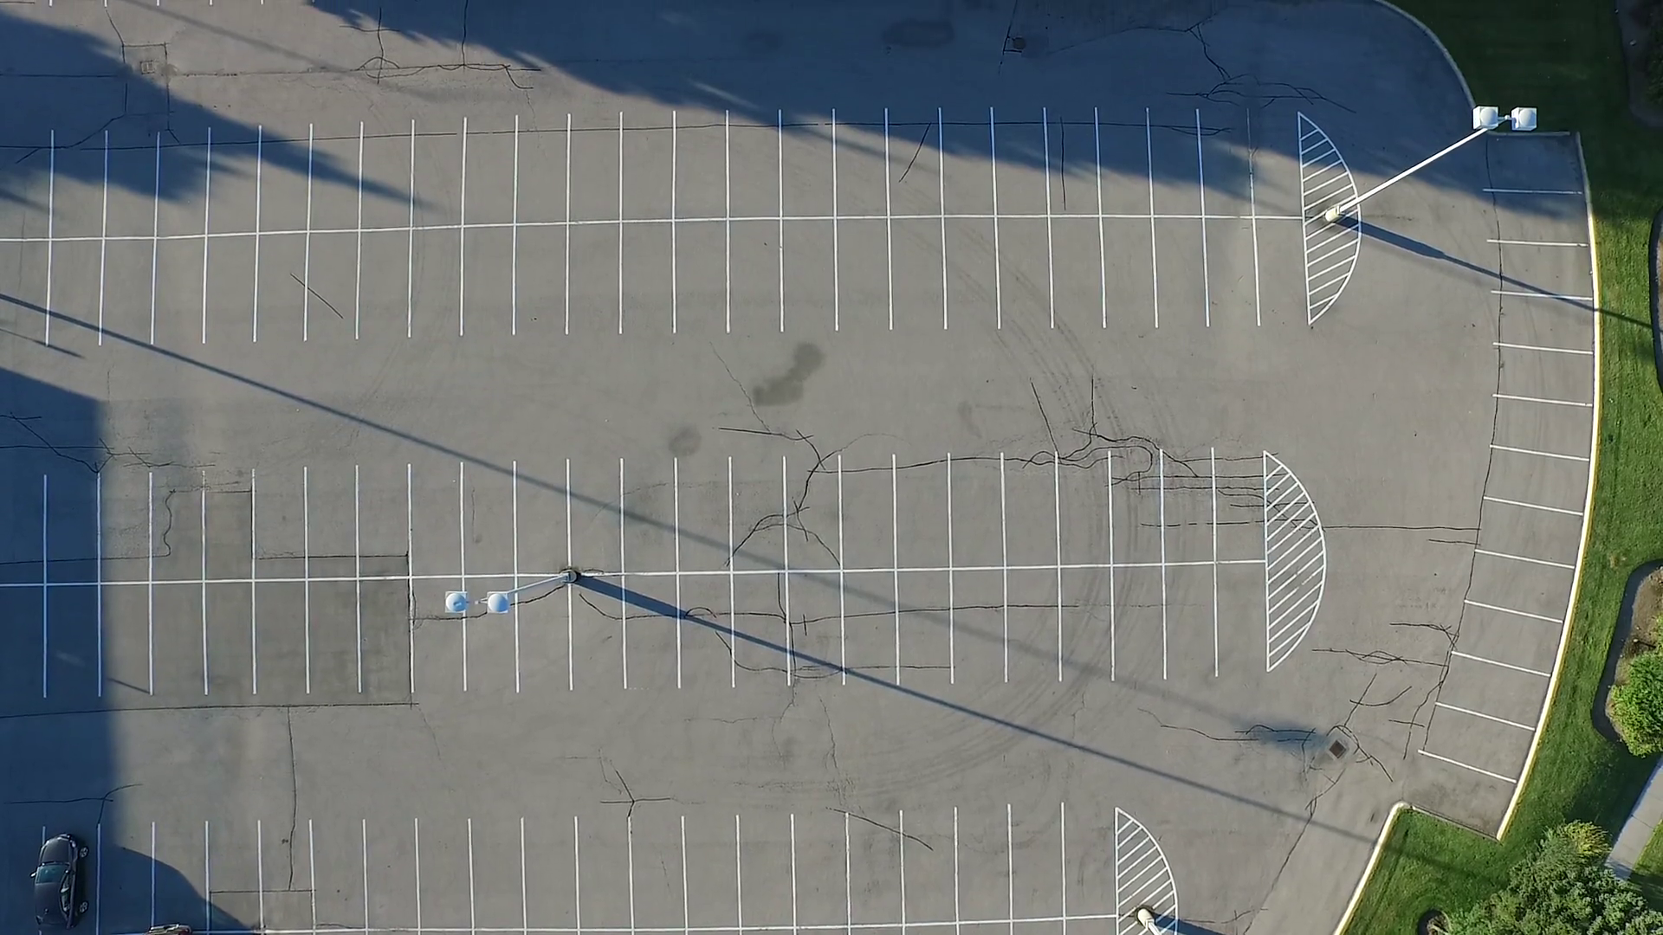
#11 Avoid Parking Lot Collisions
Don’t back up – Pull through

Slide 37
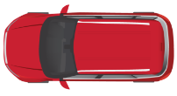
#11 Avoid Parking Lot Collisions
If you can’t pull through – Back in
It is safer to back into a controlled space

Slide 38
#11 Avoid Parking Lot Collisions
There are situations when pulling through
or backing in are not available.
Take precautions prior to driving in reverse.

Slide 39
#11 Avoid Parking Lot Collisions
When Backing – Signal, position your vehicle and watch for impatient drivers and pedestrians

Slide 40
#11 Avoid Parking Lot Collisions
Scan left and then look over right shoulder
Check all mirrors
Check reverse camera
Tap the horn

Slide 41
#11 Avoid Parking Lot Collisions
You will see others and others will see you
You will see hidden objects
Check for damage, leaks and low tires

Slide 42
#11 Avoid Parking Lot Collisions
If you complete work in your vehicle,
prior to backing up - remember
GOAL - Get Out And Look

Slide 43
#12. Stay Awake and Alert

Slide 44
#12. Stay Awake and Alert
Do not depend on short fixes
Loud music
Window down, air on
Caffeine

Slide 45
#12. Stay Awake and Alert
Get enough rest
On long drives – stop regularly
Know your worst times and plan accordingly
Do not push through or try to “make it” – STOP!

Slide 46
#13. No Excuse For Impaired Driving
10,220 lives are lost every year because of people
who decide to drive while impaired.
That equates to a life lost evert 52 minutes

Slide 47
#13. No Excuse For Impaired Driving
Impaired driving involves more than just alcohol

Slide 48
#13. No Excuse For Impaired Driving
Make arrangements before you are impaired

Slide 49
#13. No Excuse For Impaired Driving
Consequences
Arrest
Court
Fines/Costs
Legal Fee$
Loss of License
Jail?
Embarrassment
Job Loss
Is driving while impaired worth all of this?

Slide 50
Avoiding Impaired Drivers
- Weaving ( In Lane)
- Driving Reckless
- Hugging the Lines
- Slow Speed
- Cut Corners Wide & Short
- Fluctuation In Speed
- Last Second Stops
- Failure to Dim Lights
- Delay in Pulling Out
- Dome Light On
- Tailgating
- Looks Intoxicated

Slide 51
#14. Maintain Your Good Habits
Reverse Cameras
Lane Departure Warning
Blind Spot Monitoring
Brake Assist
Scan all areas before backing
Always pay attention
Scan mirrors every 5-7 seconds
Scan to the horizon

Slide 52
#15. Have the Right Attitude
Have the Correct Driver Safety Attitude
Safe driving involves two equally
important elements:
Good Skills
Good Attitude

Slide 53
#15. Have the Right Attitude
Have the Correct Driver Safety Attitude
Remember What’s Important

Slide 54
#15. Have the Right Attitude
Have the Correct Driver Safety Attitude
REMEMBER!
The most important task you accomplish
every day is arriving home.

Slide 55
One More Thing – Steering Wheel
9&3
Don’t “Hook” the Wheel

Slide 57
DDASH Data Driven Approach to Safety & Health

Slide 58
DDACTS
Data-Driven Approaches to Crime and Traffic Safety (DDACTS) is a law enforcement operational model that integrates location-based crime and traffic crash data to determine the most effective methods for deploying law enforcement and other resources.
Identify “hot spots”- areas of high incidence of crimes and crashes
Highly visible, targeted traffic enforcement strategies to fight crime and reduce crashes and traffic violations
But, could it work at a private company spread out across three states?

Slide 59
It begins with the data…

Slide 60
All of it….

Slide 61
But get to the root….
Must find the root cause(s) of the crash
Fully investigate
Driver
Vehicle
Environment
Hazards- Visible or not
Do you share the result of the investigation with other employees to prevent future events?

Slide 62
Injury & Vehicle Events By Month
Injury & Vehicle Events Combined By Month

Slide 63
Motor Vehicle Events
Dart and Other Recordable by Day of Week

Slide 66
If applicable, check location specific data for trends
 | Jan | Feb | Mar | Apr | May | Jun | Jul | Aug | Sep | Oct | Nov | Dec
Injury |  | 2 |  |  |  | 1 | 1 |  |  | 1 | 1
Vehicle | 1 | 3 |  | 1 | 2 | 1 | 1 |  | 2 | 1 | 1
 | Jan | Feb | Mar | Apr | May | Jun | Jul | Aug | Sep | Oct | Nov | Dec
Injury |  | 1 | 1 |  | 3 | 2 | 1 |  | 1 |  | 3 | 1
Vehicle |  | 1 | 1 |  | 3 | 1 |  | 1 | 1 | 3 | 2
 | Jan | Feb | Mar | Apr | May | Jun | Jul | Aug | Sep | Oct | Nov | Dec
Injury |  |  | 2 |  | 1 | 1 |  | 1 | 1 | 1 |  | 1
Vehicle |  | 1 |  |  | 2 | 2 |  |  |  | 1 |  | 1

Slide 67
Keep them informed- DDASH Updates
Safety and Health Alert:
August Stats 2016-2018
Alert Type: August OSHA and Vehicle Events- Last Three Years
Description:
At right are the OSHA events as well as all preventable crashes for the month of August over the past three years.
Injury Events
67% involved employee over 50 YOA
46% occurred on Wed
In addition, 12 insect events during the month
Actions to Prevent Recurrence:
Being aware of past events is vital in keeping ourselves safe in the future.
Only when we focus on the particular task at hand can we prevent an injury or preventable crash.
Focus leads to engagement which leads to commitment.
Vehicle Events
62% between 1000-1230 hours
87% struck fixed object
50% involved a company pickup
Only one on public roadway

Slide 68
Additional data sources- Drive Cam Systems
Comparing driving habits to your driver training program and policies
APCo has total ban on cellphones while driving- are they being used?
Looking for trends, common errors

Slide 69
Additional data sources- Driving Observations
Comparing driving habits to your driver training program
Looking for trends, common errors
“A block away”

Slide 70
Sustainability…..
But did it work…..

