Slide 1


VA Distracted Driving Summit:
Take Action!
Stephanie Hancock, Regional Administrator
NHTSA Region 3
09.26.2019

Slide 2

Continue to Focus on Distracted Driving
1
2
Challenges and Lessons Learned
Key Takeaways
3
Your Role in Distracted Driving
Data
Laws
Awareness
Enforcement
Resources
Research
4

Slide 3

#
Distracted Driving-Continue to Focus
In 2017: there were 34,247 traffic related fatalities;
Nine percent of those fatal crashes were reported as distracted driving crashes;
3,166 lives lost in distracted driving crashes;

Slide 4
Challenges and Lessons Learned
Measuring the problem of distracted driving is difficult
Smartphones part of the problem but also part of the solution?
Better data leads to more targeted enforcement
Enforcement of distracted driving laws can be challenging
Don’t give exemptions

Slide 5
Key Takeaways
Crashes are not accidents
Join VA Partners for Safe Drivers
Buy/read Survive the Drive
There are lots of distractions but let’s focus on the high prevalence/high risk ones
MTMYS -Multi-tasking makes you stupid
Laws need to be enforceable
We to talk to legislators, we need to hear victims’ stories, and we need to do it NOW!
What are we teaching our kids? We need to set the example.
Begin conference calls by asking, “is anyone driving…”
“Change the influence to change the behavior“

Slide 6
#
Your Role: Data
Look at your data, use your data, and get the best data possible.

Slide 7

#
Your Role: Laws
        Can your laws be better?
        Is your distracted driving law as comprehensive as it can be?
        Is your GLD law as comprehensive as it can be?
        Is your seat belt law as comprehensive as it can be?

Slide 8

April is National Distracted Driving Awareness Month
Enforcement
Social norming
Notes:
.

Slide 9

#
Your Role: Awareness
Connect 2 Disconnect
C2D

Slide 10
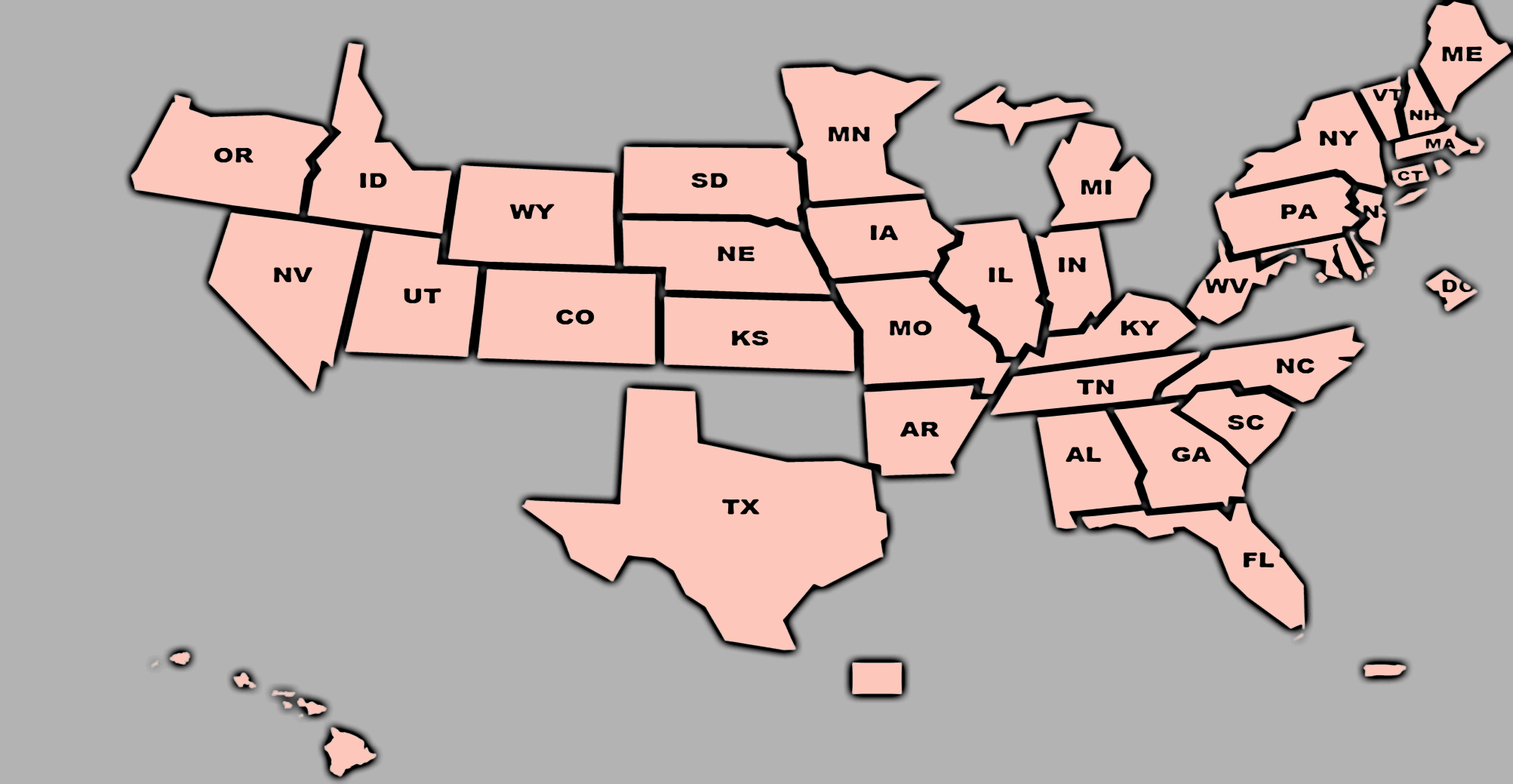
#
C2D Campaign
Participating States

Slide 11

#
Your Role: Enforcement
High-Visibility Cell Phone/
Text Messaging Enforcement

Slide 12
#
Your Role: Resources
Distracted Driving Investigation and Prosecution
Traffic Safety Marketing
TSI Distracted Driving Enforcement Strategies Training
https://www.nhtsa.gov/sites/nhtsa.dot.gov/files/documents/812407-distracteddrivingreport.pdf
Trafficsafetymarkethig.gov
https://www.transportation.gov/transportation-safety-institute
Bill.naff@dot.gov
Stephanie.Hancock@dot.gov

Slide 13

Your Role: Research
Distracted Driving Research Projects (403)
Electronic Device Use and Addictive Behaviors
Using Observations to Increase DD Enforcement
DD Education for Younger Children
Notes:
Electronic Device Use: A Review of the Literature on Addictive Behaviors
The purpose of this project is to gather information and better understand the relationship between mobile phone use while driving and the possible addictive nature of its use while driving.
Using Observations to Increase Distracted Driving Enforcement
The project will encourage law enforcement to enforce distracted driving laws during the annual Distracted Driving campaign in April and throughout the year using distracted driving observations, messaging and an active enforcement plan.
Distracted Driving Education for Younger Children
Increase understanding about the effectiveness of child-to-adult interventions for distracted driving by developing an inventory of on-going child-to adult interventions for distracted driving and conducting a literature review to assess the availability of research on effectiveness.

Slide 14
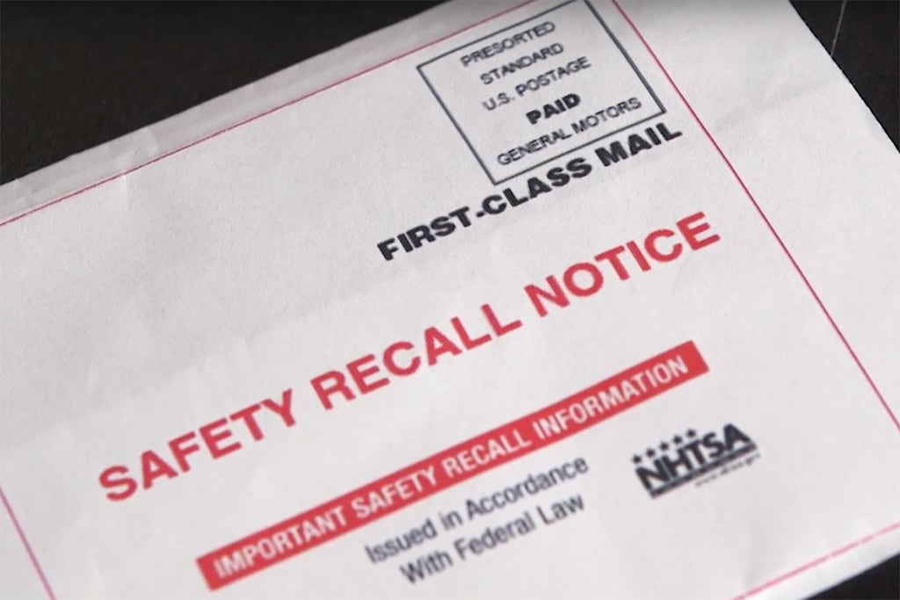

SAFETY OUTREACH INITIATIVES
#
NHTSA Vehicle Recalls
Vehicle Identification Number (VIN) Lookup
NHTSA.gov/recalls
“Where’s Baby?” Heatstroke campaign
34 children have died from heatstroke so far in 2019
Notes:
Where's my VIN?
Look on the lower left of your car's windshield for your 17-character Vehicle Identification Number. Your VIN is also located on your car's registration card, and it may be shown on your insurance card.
What this VIN search tool will show:
An unrepaired vehicle affected by a vehicle safety recall in the past 15 calendar years Vehicle safety recalls from major light auto automakers, including motorcycle manufacturers.
Roughly 41.6 million vehicles equipped with 56 million defective Takata air bags are under recall because these air bags can explode when deployed, causing serious injury or even death.. All vehicle owners should:
Check for Recalls using your vehicle identification number (VIN).
Get the Fix by calling your local dealer; it will be repaired for free.
Sign Up for Recall Alerts about any future recall affecting your vehicle.
HOT CARS CAN KILL
It’s important to understand that children are more vulnerable to heatstroke than adults whether you’re a parent, caregiver, or bystander. A child's body temperature rises three to five times faster than an adult's. When a child is left in a hot vehicle, that child's temperature can rise in a quick and deadly manner. Heatstroke begins when the core body temperature reaches about 104 degrees. A core body temperature of about 107 degrees is lethal. In 2018, 52 children died of vehicular heatstroke.
EIGHT SIMPLE STEPS TO PREVENT HEATSTROKE DEATHS.
Never leave a child in a vehicle unattended—even if the windows are partially open or the engine is running, and the air conditioning is on
Make a habit of looking in the vehicle—front and back—before locking the door and walking away
Ask the childcare provider to call if the child doesn’t show up for care as expected
Place your purse or briefcase in the back seat to ensure your child isn't accidentally left in the vehicle
Write a note or place a stuffed animal in the passenger's seat to remind you that a child is in the vehicle
Teach children that a vehicle is not a play area and store keys out of a child's reach
If you see a child alone in a locked car, get them out immediately and call 911
A child in distress due to heat should be removed from the vehicle as quickly as possible and rapidly cooled

Slide 15
Parting thoughts (or some great quotes from the summit)
“Safety is not everything, it’s the only thing”
“Changing behavior is not rocket science. It is much more difficult”
“Distracted driving is bad”

Slide 16
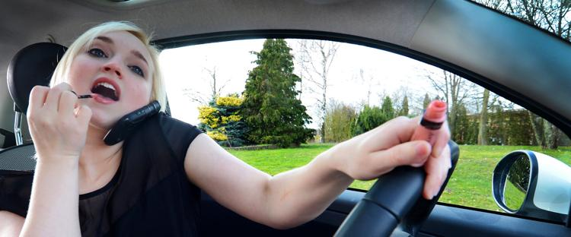
What action will you take?
#

