Slide 1
Traffic Crashes are a TOP KILLER for Teens in America
DRIVE SMART Virginia
drivesmartva.org

Slide 2
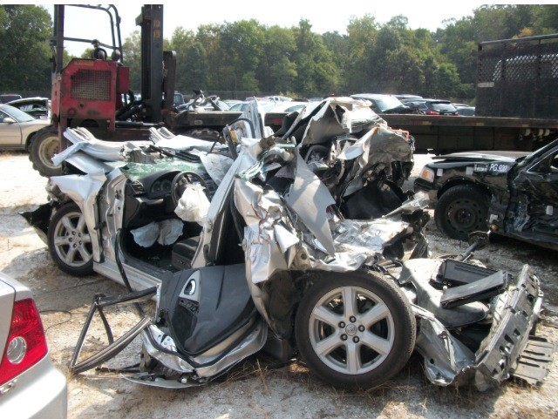
Driving Dangerously Can Lead to THIS…
drivesmartva.org

Slide 3
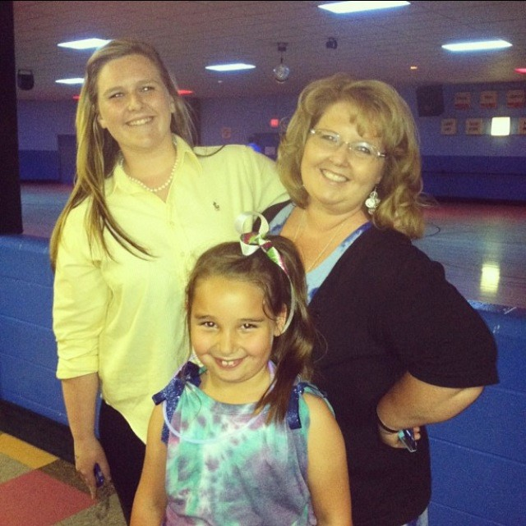
A Distracted Driver in a Flatbed Truck Crashed into That Car and
KILLED 3 Members of the Dempsey Family
The driver said he was reaching for a piece of paper that fell to the floor. He looked away from the road and didn’t have time to react when traffic stopped in front of him.
drivesmartva.org

Slide 4
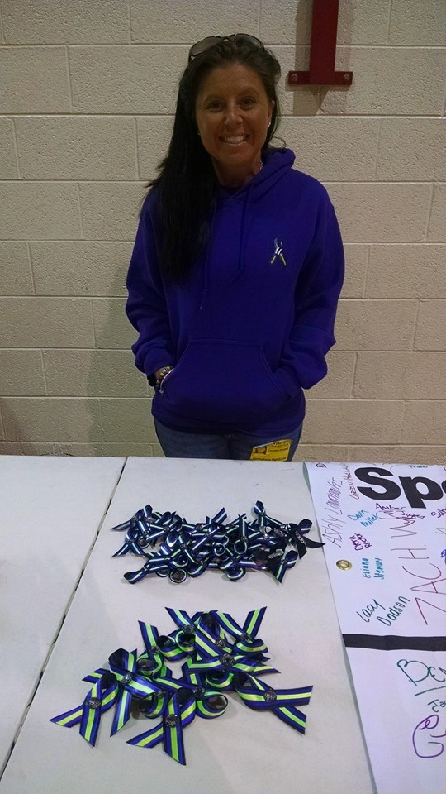
Distracted Driving Kills
Police said the truck was traveling 55mph – and its driver never hit the brakes – killing Bethany, Lauren, and Abby. When it was over, eight vehicles were involved in the crash. The road was shut down for hours. According to investigation reports, the driver of the flatbed truck was distracted for the entire 12.6 seconds prior to the crash.
Christina Dempsey now travels across Virginia talking to teens about how she lost her sister and nieces to a distracted driver. Her program is called Three Ribbons for Three Reasons.
drivesmartva.org

Slide 5
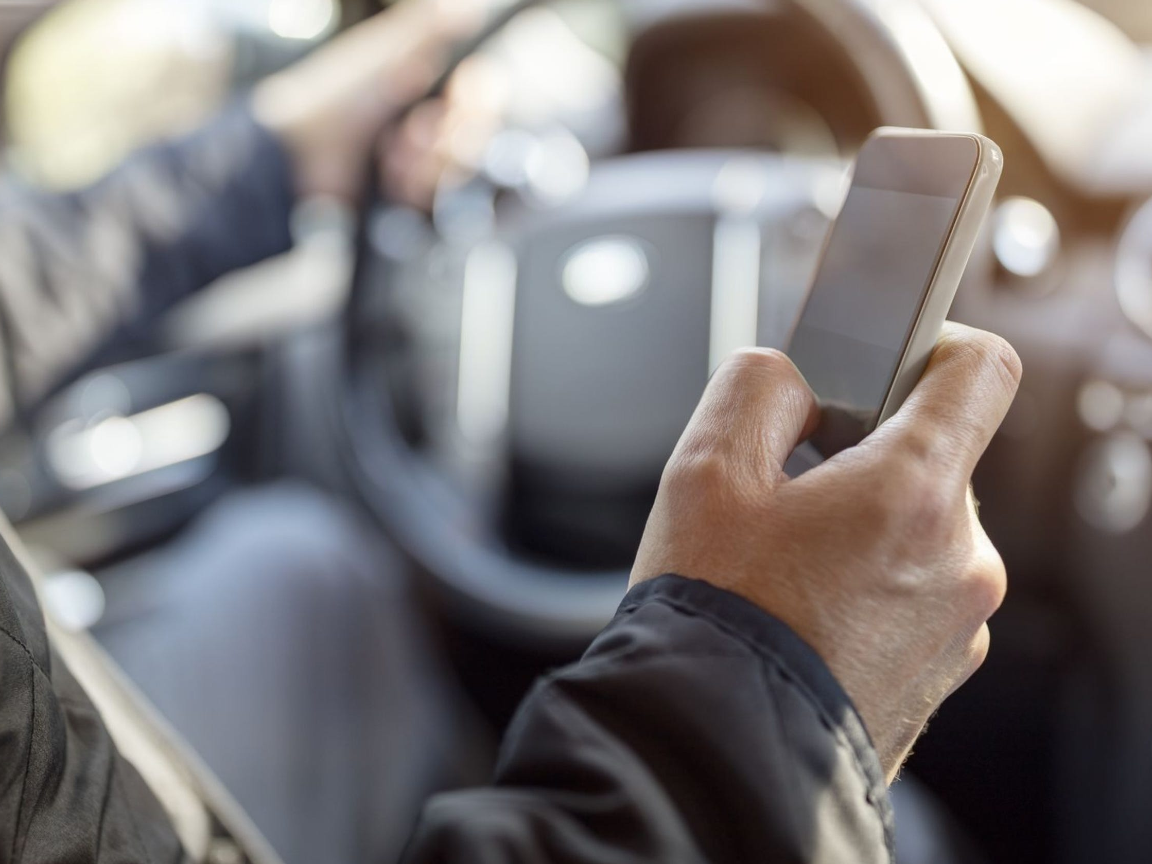
Consider the FACTS
Nearly 60% of teen crashes involves distracted driving (AAA Study)
94% of crashes are due to DRIVER ERROR (NHTSA)
Text messaging increases the risk of crash or near-crash by 23 times (VTTI)
Teen drivers aged 16 to 19 are nearly three times more likely than drivers aged 20 and older to be in a fatal crash (CDC)
drivesmartva.org

Slide 6
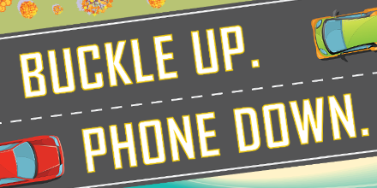
It Is NOT Just the Phone!
Other Common Forms of Distraction:
Interacting with passengers- ESPECIALLY YOUR PEERS!!
Looking at something outside the vehicle (like a billboard or store sign)
Daydreaming
Reaching for an object
Eating or drinking
Changing your music
drivesmartva.org

Slide 7
Drunk Driving is Still a Major Issue
Nearly a third of all deaths on Virginia roadways are alcohol-related
On average, nearly 30 people die each day as a result of drunk driving crashes
Every 2 minutes a person is injured in a drunk driving crash
Nearly 19,000 people are convicted of a DUI in Virginia every year
drivesmartva.org

Slide 8
Designated Drivers are #Heroes
100% of drunk driving crashes are PREVENTABLE!!!
Plan Ahead:
Install Uber/Lyft app on your phone and know how to use it
Familiarize yourself with public transportation
Have an agreement with a friend or family member that you will call them if you need a ride
Keep the number of a local cab service and some cash in your purse or wallet
Designate a sober driver BEFORE drinking begins
drivesmartva.org

Slide 9
Drunk Driving Has MASSIVE Consequences
In Virginia, the fine for a first DUI conviction can cost $2,500 and may also include:
Up to a year in jail
A mandatory ignition interlock device that requires the driver to blow into a breathalyzer to start the engine
A one-year suspension of all driving privileges
drivesmartva.org

Slide 10
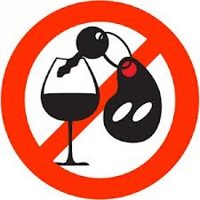
But What if You Are Underage??
If law enforcement stops you while driving after illegal consumption of alcohol, you are subject to administrative license suspension (ALS). If you are convicted of driving after illegally consuming alcohol and were found to have a BAC of 0.02 and less than 0.08, the court penalty will include a suspension of your driving privilege for one year from the date of conviction, and a minimum mandatory fine of $500, or the requirement that you complete at least 50 hours of community service.
Regardless of age, if driving on a DUI suspended or restricted license, you may be charged with DUI if you drive with a BAC of 0.02 percent or higher.
Persons under age 21 who drive while under the influence of drugs or with a blood alcohol content of 0.08 percent or higher are subject to the same penalties as persons age 21 or older.
drivesmartva.org

Slide 11
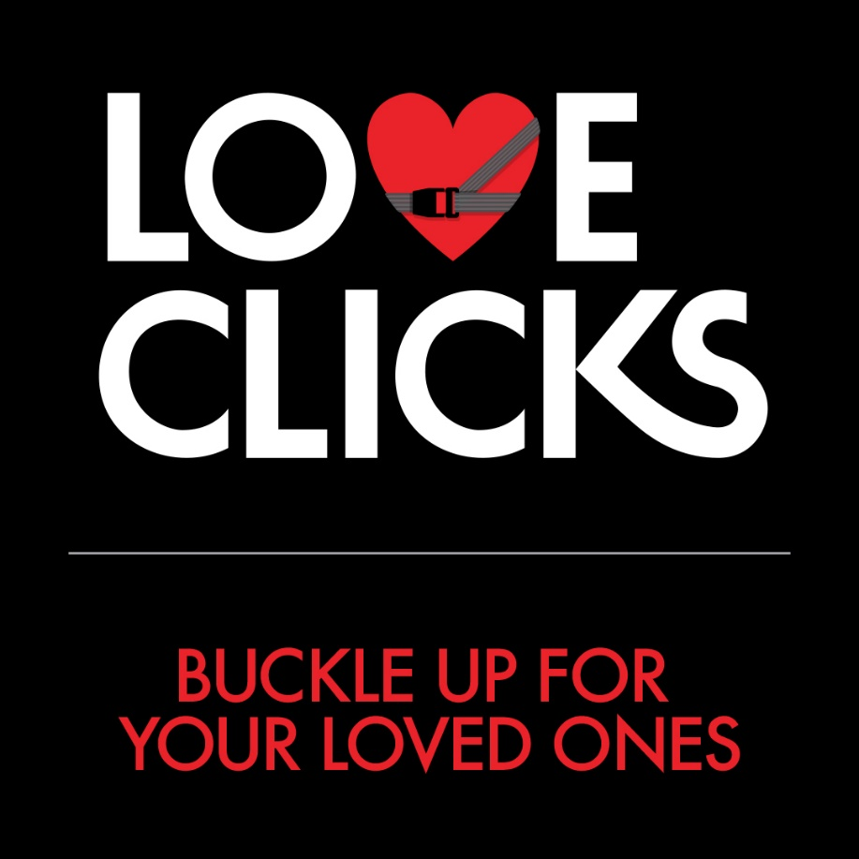
LOVE CLICKS
A seatbelt is your best defense against a distracted or drunk driver
About 52% of Virginia roadway fatalities are unbuckled. (Virginia DMV)
Seat belts save about 14,000 lives each year in America. (NHTSA)
Wearing a seat belt correctly in the front seat reduces your chances of a fatal injury by 45%. (NHTSA)
Among back seat occupants, seat belt use can reduce the risk for death by 60%. (Virginia DMV)
drivesmartva.org

Slide 12
What You Can Do to Stay Safe
Don’t start the vehicle until everyone inside is buckled
Ask a passenger to control the music or answer your phone
If you don’t have any passengers, keep your phone someplace you won’t be tempted to reach for it- or install a “Do Not Disturb” app on your phone
Designate a sober driver and if you aren’t old enough to drink…remember ZERO tolerance for underage drinkers!
drivesmartva.org

Slide 13
Another Story You Need to Hear
Nina Todd lost her two young sons to a distracted driver. The driver was a teenage girl that was on her phone and drifted into Nina’s lane and hit her head-on.
View Nina’s story here…
https://www.youtube.com/watch?v=qAAe55qmhwA
drivesmartva.org

Slide 15
DRIVE SMART!!
Please keep Nina Todd and Christina Dempsey in your minds as you get behind the wheel. No one should have to endure what these families have lost. All because someone was unwilling to keep their focus on the road.
There are millions of stories just like this. Let’s hope you won’t have one too.
Buckle Up. Phone Down.
Designate Before You Celebrate.
drivesmartva.org

Slide 16
THANK YOU!
DRIVE SMART Virginia | drivesmartva.org

