Slide 1
Understanding and preventing young adult distracted driving
Keli A. Braitman & Abby L. Braitman
8th Annual Distracted Driving Summit
Virginia Beach
September 16-17, 2021

Slide 2
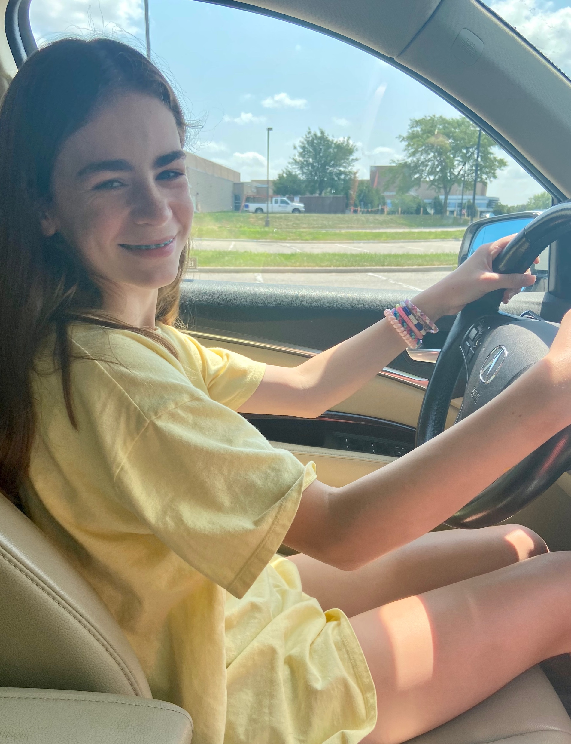
Why this is personal to me

Slide 3
Distracted driving
Any activity that diverts driver attention away from the primary task of driving.
Distracted driving (in any form) was involved in 3,142 fatalities in the United States in 2019 (NHTSA, 2021)
Bans on hand-held cellphone use have been shown to reduce (but not eliminate) phone use among drivers, but not distracted driving crashes. This is because driver distraction is broader than phone use.
There is some emphasis on vehicle technology to prevent distraction. But it may be that drivers themselves will need to play a role in reducing distractions.

Slide 4
Young drivers and distracted driving
It is clear from research that there is an increased crash risk with distraction, and that young drivers are particularly vulnerable.
Young drivers have crash rates (per mile driven) that are nearly 4 times higher than those of drivers 20 and older (IIHS, 2021)
They are also less experienced drivers, and less likely to know how to respond to hazards
Given these challenges, it is particularly important to find ways to reduce young driver distracted driving

Slide 5
Our program of research in young driver distracted driving
Study 1
Identified naturally occurring profiles of distracted driving behaviors; distinguished personality traits associated with these profiles
Study 2
Examined the role of perceived norms in distracted driving behavior
Study 3 (Current)
Developing measure to identify strategies young drivers use (or could use) to prevent distracted driving.

Slide 6
Study 1
Personality types of distracted drivers

Slide 7
Participants
266 young adult drivers (from 2 U.S. higher-education institutions) competed online self-report surveys that included questions about distracted driving behaviors and personality characteristics

Slide 8
Distracted driving survey
35 items assessed the frequency with which respondents engage in potentially distracting activities while driving, ranging from 1 (Never) to 5 (Every time I drive).
Items were developed by the researchers in consultation with colleagues and students.

Slide 9
Sample activities include:
Making hand-held phone calls
Making hands-free phone calls
Read text messages
Send text messages
Program music
Look at paper map
Using navigation
Watch videos
Eat or drink
Talk with passenger(s)
Put on make-up or other grooming

Slide 10
Sample activities include:
(Most common behaviors in red)
Making hand-held phone calls
Making hands-free phone calls
Read text messages
Send text messages
Program music
Look at paper map
Using navigation
Watch videos
Eat or drink
Talk with passenger(s)
Put on make-up or other grooming

Slide 11
Distracted driving survey
Also rated how distracting each behavior is, from 1 (Not at all distracting) to 5 (Very distracting)
Asked whether they talked on their phone, texted, or used their phone in other ways in known high-risk conditions (i.e., during rush hour, free-flowing high speed traffic, stop-and-go traffic, at night, and in bad weather).

Slide 12
Personality survey
“Big 5” Inventory (John, Donahue, and Kentle, 1991)
Agreeableness
e.g., “Is helpful and unselfish with others”
Conscientious
e.g., “Does a thorough job”
Neuroticism
e.g., “Gets nervous easily”
Extraversion
e.g., “Is talkative”
Openness to experience
e.g., “Is curious about many different things”

Slide 13
Three ‘classes’ of distracted drivers
Latent profile analysis was used to develop “classes” of drivers based on how frequently they report engaging in distracted driving behaviors
Class 1 (28.9%) ‘‘LOW DISTRACTED DRIVING” class, had the lowest engagement in distracted driving behaviors.
Class 2 (53.3%), ‘‘MEDIUM DISTRACTED DRIVING” class, was comprised of the majority of the sample, and represented medial levels of distracted driving behaviors.
Class 3 (17.8%), ‘‘HIGH DISTRACTED DRIVING” class, had the highest engagement in distracted driving behaviors.

Slide 15
Relationship with personality
Wald tests of mean equalities were used to examine differences in personality among the 3 classes of distracted drivers
Variable | Class 1: LOW DISTRACTED DRIVING | Class 2: MEDIUM DISTRACTED DRIVING | Class 3: HIGH DISTRACTED DRIING
Extraversion | 3.10ª | 3.40^{b} | 3.60^{b}
Agreeableness | 3.87 | 3.92 | 3.82
Conscientiousness | 3.69 | 3.67 | 3.68
Neuroticism | 2.88 | 2.69 | 2.89
Openness | 3.60 | 3.45 | 3.35
Note. Means with differing superscripts within rows are significantly different at the p < .05 level

Slide 16
Perceptions of distraction
Drivers rated how distracting each of the behaviors (e.g., making hand-held phone calls; make hands-free phone calls; reading text messages; talking with a passenger; eating or drinking, etc.) is on a 5-point scale
Interestingly, the HIGH distracted driving group rated these behaviors as fairly distracting, but reported engaging in them most frequently.

Slide 17
Conclusions
Extraversion emerged as a risk factor predictive of engaging in high risk behaviors while driving, even in high-risk driving situations.
The group of drivers that reported the highest amount of distracted driving rated the behaviors fairly high in terms of perceived level of distraction, yet did them anyway.
Findings suggest that highly extraverted individuals are more compelled to talk or text while driving despite reporting that such behaviors are distracting.

Slide 18
Study 2
Study 1 revealed that drivers who engage in distracted driving the most still recognize that this is highly distracting.
Why do they do this?
Examined the role of perceived norms in distracted driving behavior

Slide 19
Types of norms
Descriptive norms
How often someone thinks their peers engage in a given behavior
e.g., How much do they think their friends engage in distracted driving
Injunctive norms
Perception of how acceptable someone thinks their peers find a behavior
e.g., How acceptable do they think their friends think distracted driving is?

Slide 20
Methodology
408 undergraduate students (young adult drivers) completed an online survey
Completed the distracted driving survey from Study 1
Measure of of descriptive norms
How often they think a typical student at their institution engages in each distracted driving behavior (5-point response scale)
Measure of injunctive norms
Perceived level of acceptability by typical student at their institution for each distracted driving behavior (5-point response scale)

Slide 21
Findings – Particularly strong correlation between descriptive norms and frequency of distracted driving; r = .42, r² = .180, p < .001
This is a medium to large effect

Slide 22
Conclusions
Young drivers’ perceptions of how frequently others engage in distracted driving correlate with how much drivers themselves engage in distracted driving
These may be promising avenues for campaigns to help reduce young driver distracted driving

Slide 23
Study 3 (ongoing)
Study 1 – Identified who was at most risk – extraverted young drivers
Study 2 – Dispelling normative misperceptions could motivate young drivers to reduce their own distractions behind the wheel
How can young drivers successfully curb distracted driving?
What strategies do they use?
Examine strategies young drivers use to prevent distraction

Slide 24
Step 1: Focus groups
Focus groups with young adult drivers were conducted to learn about their strategies for avoiding distracted driving. The drivers were college students who participated for course credit or to be entered in a raffle for a gift card.
25 strategies emerged. Shared with student researchers who reviewed the list for clarity and to indicate if any other strategies should be included.

Slide 25
Example of strategies:
Pre-create music for driving (for example, phone playlist for driving, bringing CDs)
Limit passengers
Pull over to eat, use phone, or other distraction
Use apps to block notifications when driving
Silence notifications
Put phone out of sight (for example, in pocket, face down)
Memorize route before trip
Type in address to GPS before you start driving

Slide 26
Step 2: Scale development
Survey administered to 157 young adult drivers (Aiming for 500)
Strategies for curbing distracted driving
• 25 items that emerged from the focus groups • 4-point response scale: 0 = Never through 3 = Always
Distracted driving survey (from Study 1)
Attachment to Phone survey

Slide 27
Preliminary Findings
Data collection is ongoing
n = 157 participants
Aiming for 500

Slide 28
Exploratory Factor Analysis
With initial data, the one-factor solution was the best fit
This suggests the tendency to engage in strategies to avoid distracted driving may be a singular construct rather having multiple subscales (types of strategies)
Some items had low factor loadings and may be eliminated pending more data

Slide 29
Most common strategies
Type address in GPS before driving
Use phone hands-free for talking
Have a passenger help with non-driving tasks (e.g., navigate, send texts, unwrap food)
Use a button on the steering wheel to change music
Pre-create music for driving (e.g. phone play-list)
Only interact with a phone when stopped (e.g., at a light)
Use phone hands-free for other functions like placing or making calls or dictating text

Slide 30
Initial correlations: Curbing strategies, phone addiction, and distracted driving
Young drivers who are more attached to their phones are more likely to engage in distracted driving (+.15) and less likely to use curbing strategies (-.28).
Also, the more strategies young drivers use to curb distracted driving, the less they engage in such behaviors (-.12). However, this relationship may be more nuanced than it appears.

Slide 31
Regression suggested both linear (β = -0.23, p = .017) and quadratic β = 0.27, p = .004) countermeasures significantly predict distracted driving

Slide 32
Implications and future research
More data will shed light on the relationship between distracted driving and strategies to curb such behaviors
Targeted interventions may focus on higher risk individuals – those who are extraverted and more attached to their phones
Interventions that provide personalized normative feedback (dispel misconceptions about their peers’ behavior) may be a promising approach
Dispelling normative misperceptions and providing strategies for avoiding distracted driving could also be addressed in driver education for all new drivers

Slide 33
Thank you!
Keli Braitman: braitmank@william.jewell.edu
Abby Braitman: abraitma@odu.edu

