Slide 1
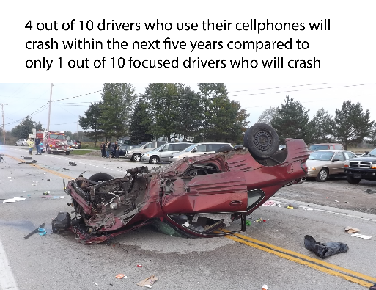
Changing norms to change behavior
Brittany shoots-reinhard

Slide 2
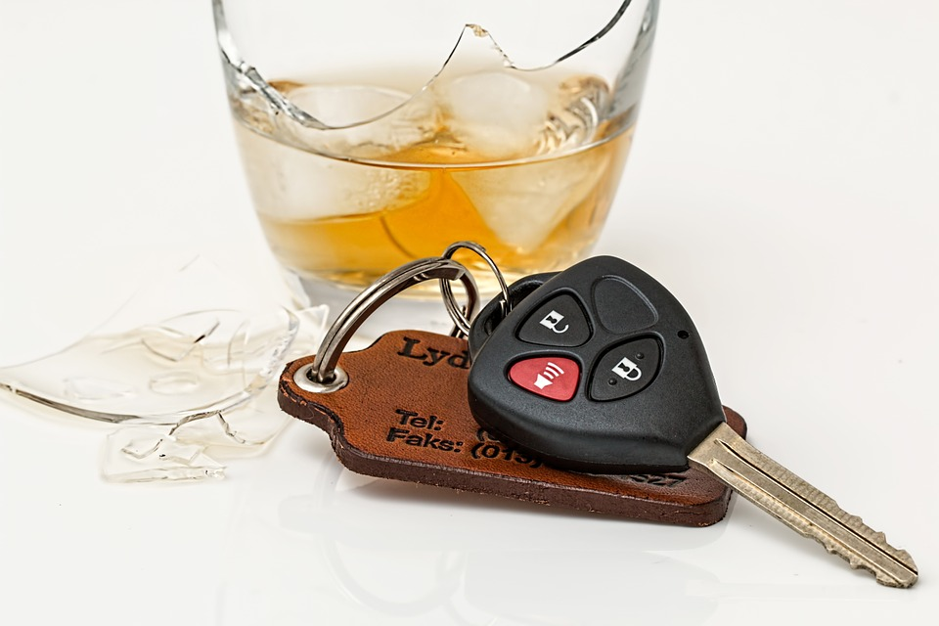
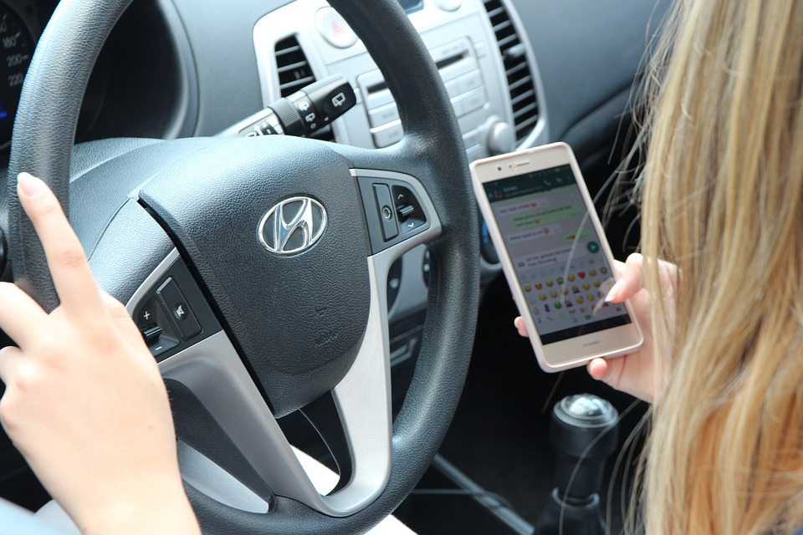
Two Types of norms
Descriptive (what other people are doing)
Injunctive (what is acceptable)
Notes:
Cialdini, R. B. (2003). Crafting normative messages to protect the environment. Current Directions in Psychological Science, 12(4), 105-109.
Cialdini, R. B., Reno, R. R., & Kaligren, C. A. (1990). A focus theory of normative conduct: Recycling the concept of norms to reduce littering in public places. Journal of Personality and Social Psychology, 58(6), 1015-1026.
Reno, R. R., Cialdini, R. B., & Kallgren, C. A. (1993). The transsituational influence of social norms. Journal of Personality and Social Psychology, 64(1), 104–112. https://doi.org/10.1037/0022-3514.64.1.104
Slaunwhite, J. M., Smith, S. M., Fleming, M. T., & Fabrigar, L. R. (2009). Using normative messages to increase healthy behaviours. International Journal of Workplace Health Management, 2(3), 231-244. doi: http://dx.doi.org/10.1108/17538350910993421
Atchley, P., Hadlock, C., & Lane, S. (2012). Stuck in the 70s: The role of social norms in distracted driving. Accident Analysis & Prevention, 48, 279-284. doi: https://doi.org/10.1016/j.aap.2012.01.026
1. In 2012 Atchley pointed out the difference between norms for drunk vs. distracted—people rated texters as more responsible than drunk drivers, but $3200 vs. $2500 in fines and 2-3 vs. 1 day in jail in their college student sample

Slide 3
Predicting self-reported driving behavior
Higher acceptability
(lower injunctive norm)
Greater prevalence
(higher descriptive norm)
Greater manual CUWD
Greater perceived benefits
Lower perceived risks
Greater CUWD self-efficacy
Notes:
Shoots-Reinhard, Huang, Pierce, & Bradshaw, in process , N=1200 Ohio drivers recruited from MTurk and Facebook
“People doing X are doing nothing wrong” “% of the time average Ohio driver X”
Cestac, J., Paran, F., & Delhomme, P. (2014). Drive as I say, not as I drive: Influence of injunctive and descriptive norms on speeding intentions among young drivers. Transportation Research Part F: Traffic Psychology and Behaviour, 23, 44-56. doi: https://doi.org/10.1016/j.trf.2013.12.006
Manual use appears to be the most dangerous – when people are actively using phones:
Caird, J. K., Simmons, S. M., Wiley, K., Johnston, K. A., & Horrey, W. J. (2018). Does talking on a cell phone, with a passenger, or dialing affect driving performance? An updated systematic review and meta-analysis of experimental studies. Human Factors, 60(1), 101-133. doi: 10.1177/0018720817748145
Dingus, T. A., Guo, F., Lee, S., Antin, J. F., Perez, M., Buchanan-King, M., & Hankey, J. (2016). Driver crash risk factors and prevalence evaluation using naturalistic driving data. Proceedings of the National Academy of Sciences, 113(10), 2636-2641. doi: 10.1073/pnas.1513271113

Slide 4
1. correct descriptive norms
Drivers may have inaccurate descriptive norms
Report manual use while driving on 14% of trips (30% report no manual use), but estimate average driver’s manual use is 44% of trips
But, what about the people using phones less often?
Drivers only use phones 14% of trips!
Notes:
Clapp, J. D., Lange, J. E., Russell, C., Shillington, A., & Voas, R. B. (2003). A failed norms social marketing campaign. Journal of studies on alcohol, 64(3), 409-414. doi: 10.15288/jsa.2003.64.409
Schultz, P. W., Nolan, J. M., Cialdini, R. B., Goldstein, N. J., & Griskevicius, V. (2007). The Constructive, Destructive, and Reconstructive Power of Social Norms. Psychological Science, 18(5), 429-434.

Slide 5
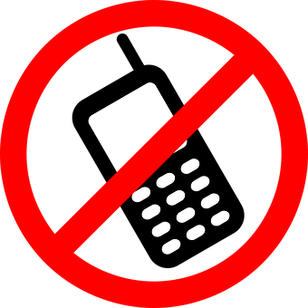
2. Communicate injunctive norms
97% of Dukes disapprove when you text and drive
Less prone to backfiring
Key is highlighting approval/disapproval
Notes:
Lawrence, N. K. (2015). Highlighting the injunctive norm to reduce phone-related distracted driving. Social Influence, 10(2), 109-118. doi: 10.1080/15534510.2015.1007082
Schultz, P. W., Nolan, J. M., Cialdini, R. B., Goldstein, N. J., & Griskevicius, V. (2007). The Constructive, Destructive, and Reconstructive Power of Social Norms. Psychological Science, 18(5), 429-434.

Slide 6
3. Avoid contradictory messages
Avoid inadvertently increasing descriptive norm
“Millions of distracted drivers endanger road users”
“Distracted driving is increasing every year”
Depict negative outcome or disapproval of distraction
Notes:
Slaunwhite, J. M., Smith, S. M., Fleming, M. T., & Fabrigar, L. R. (2009). Using normative messages to increase healthy behaviours. International Journal of Workplace Health Management, 2(3), 231-244. doi: http://dx.doi.org/10.1108/17538350910993421
Cialdini, R. B. (2003). Crafting normative messages to protect the environment. Current Directions in Psychological Science, 12(4), 105-109.

Slide 7
4. Recommend without forceful language
Notes:
N=628 Ohio drivers
Shoots-Reinhard, Svensson, Shihab, & Peters, in prep
Risk/benefit, prevalence, reactance, and intentions, standardized and averaged
Control got facts but no images and no choice/call to action
Images > no images
Depicting negative outcome + emphasizing choice had best results

Slide 8
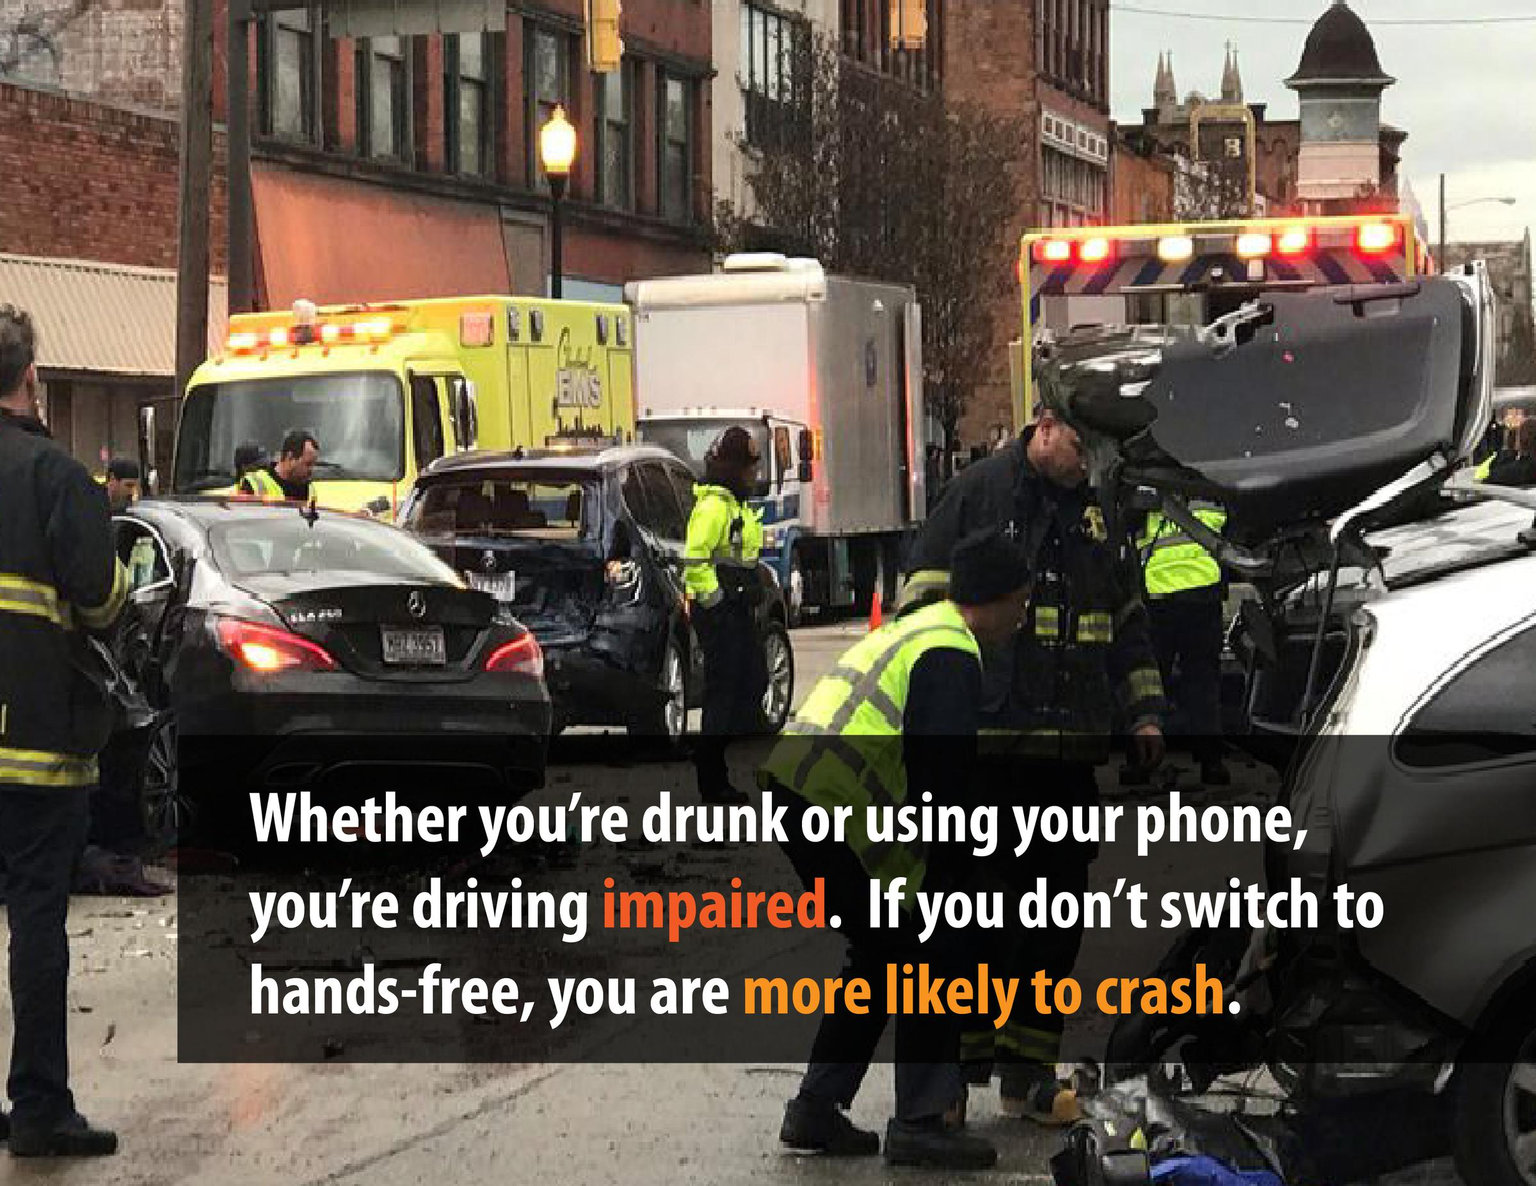
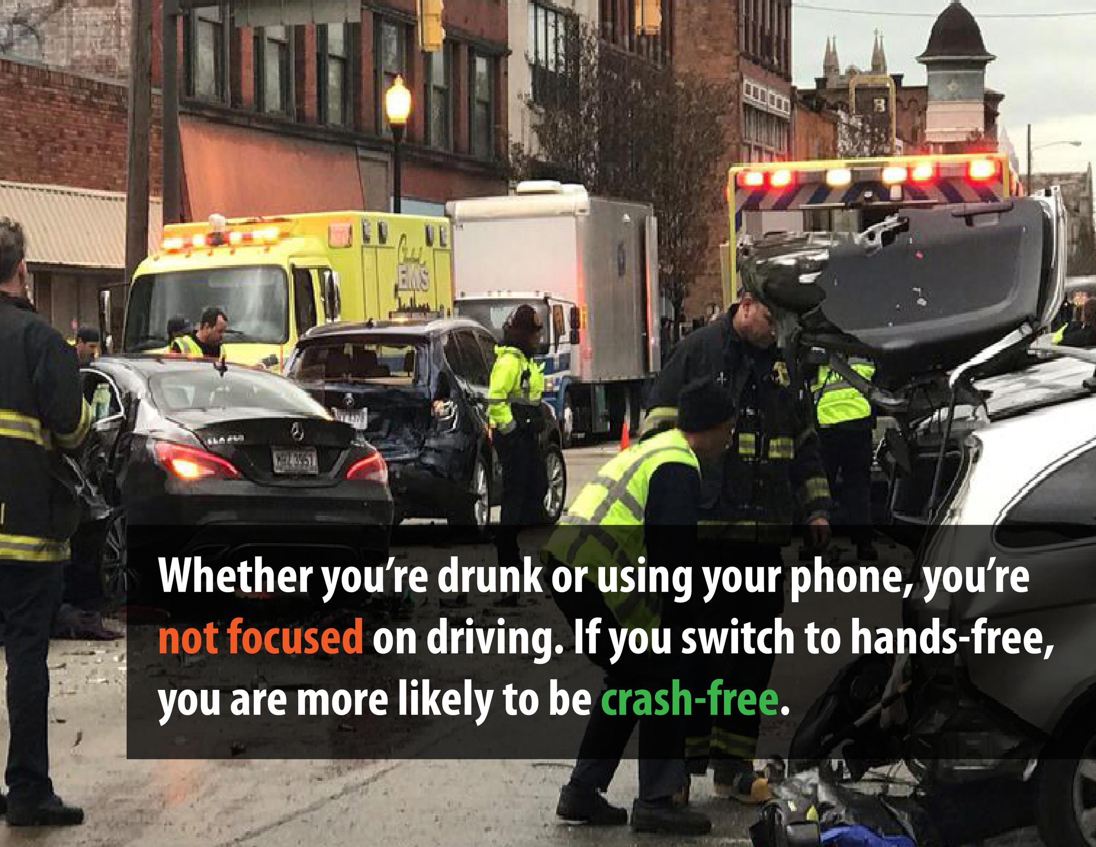
5. Describe cellphone use as “Impaired”
Notes:
N=445 Shoots-Reinhard, Huang, Pierce, & Bradshaw, in process
3 messages for each condition, MWD beliefs already very low, but people do it anyway—impaired didn’t show an effect on acceptability because it was already low, but did reduce intentions

Slide 9
Summary
Making people feel like distraction is uncommon (descriptive norm) and unacceptable (injunctive norm) should reduce distraction
People overestimate prevalence of distraction (descriptive norm), but descriptive norms can backfire
Show negative consequences, not the problematic behavior
Crash images can provoke reactance/defensiveness
Expressing disapproval, particularly of a valued group (injunctive norm) can have cross-situational, long-term effects
Emphasize personal choice and unacceptability of distraction
Describe distraction as “impaired”

Slide 10
Thank you
Collaborators: Ellen Peters, Zhenhua Chen, Motao Zhu, Hayley Svensson, Blake Pierce, Mason Shihab, Jeremy Huang, Maggie Hart, Logan Bradshaw
Funders: Ohio Department of Transportation, Ohio Department of Public Safety, The Risk Institute at the Ohio State University Fisher College of Business, Nationwide Children’s Hospital Center for Injury Research and Policy
shoots-reinhard.1@osu.edu

