Slide 1
Using Positive Factors to Address Societal Challenges
Chief (ret.) Daniel G. Sharp, Oro Valley Police Dept. (AZ)
Contact: acdsharp@aol.com

Slide 2
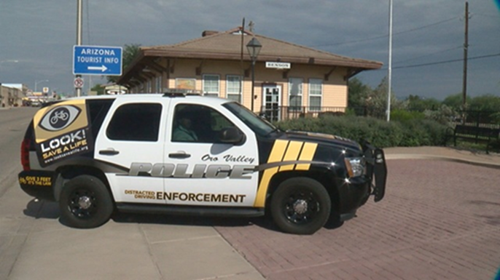
The Elephant in the Room
Political and social push to eliminate traffic stops.
Defining “equity” in traffic safety (GHSA report)
Defining “equity” in traffic enforcement.

Slide 3
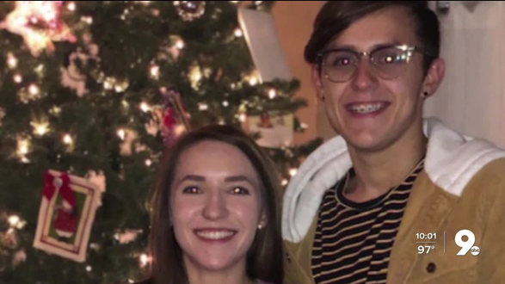
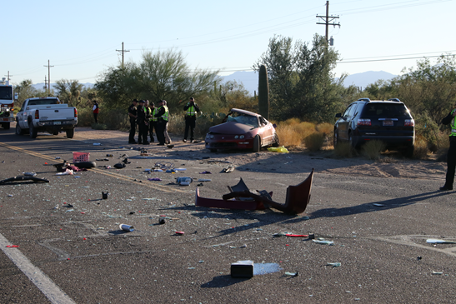
Traffic Safety is Public Safety
Everyone is affected by traffic and transportation modes.
Not everyone is affected by violent crime, but everyone is affected by traffic safety.
Traffic safety is a quality-of-life issue.

Slide 4
Departmental Engagement
Policing with a purpose.
Provide a mission.
Provide support through police resources, and training.
Get “buy-in” from officers.

Slide 5
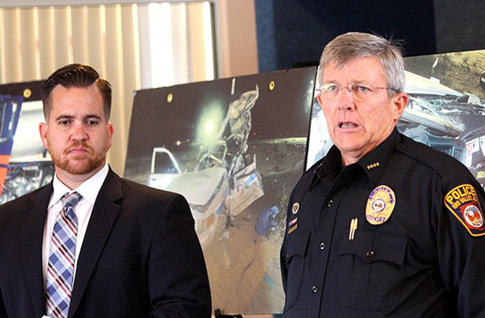
Community Engagement
Outreach and ensure you are meeting community expectations.
Share data and be transparent.
Be clear about goals and outcomes.

Slide 6
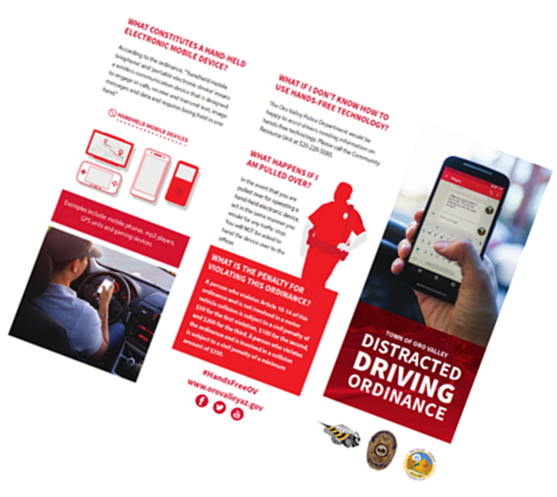
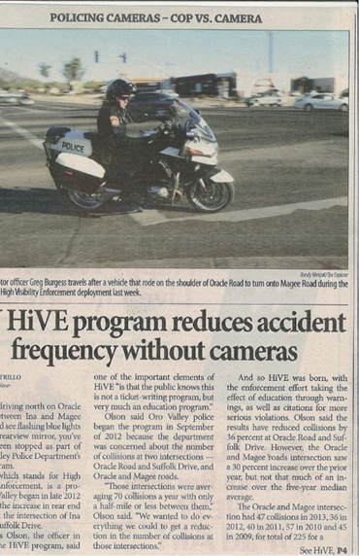
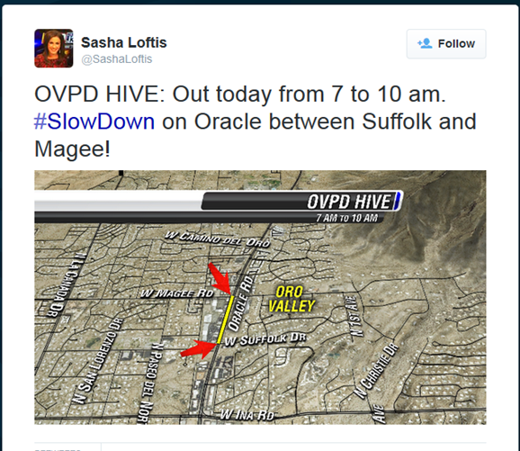
Media Engagement
Develop partnerships, think “long-game.”
TV & radio, print, and social media.
Timely and transparent information.
Be clear about goals and outcomes.

Slide 7
Case Study

Slide 8
QUESTIONS

