Slide 1
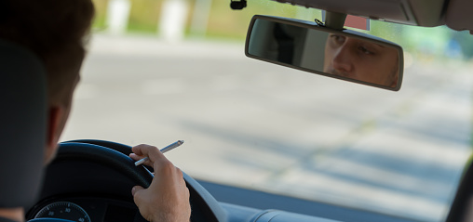
STATEWIDE
IMPAIRED DRIVING
Informing the Campaign through Testing

Slide 2
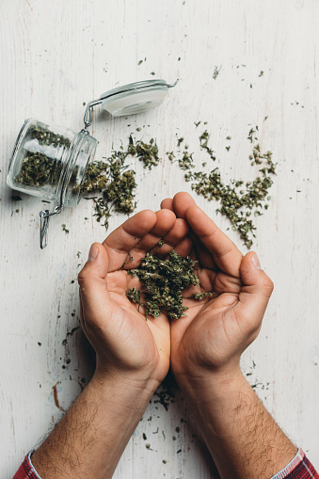
OBJECTIVES
Measure how prevalent driving after consuming marijuana is in Texas
Understand perceptions surrounding danger of driving under the influence of marijuana
Test messages designed to change behavior and mindset surrounding marijuana impaired driving

Slide 3
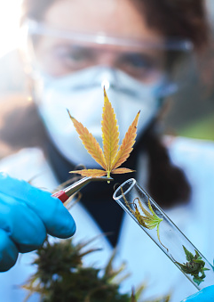
WHAT THIS PROJECT IS NOT
This project is not:
  A study related in any way to the legalization of marijuana
  A study related to the science behind marijuana impairment
  A study related to the number of crashes or fatalities caused by marijuana impairment

Slide 4
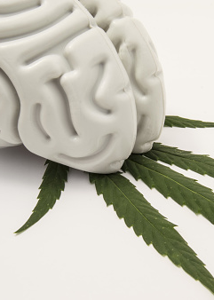
QUANTITATIVE METHODOLOGY
Poll fielded January 11–21, 2019
775 sample size using internet panels
  300 quota of current marijuana users
  75 quota of Spanish dominant speakers
Weighted and balanced to be representative of Texas across geographic, demographic and psychographic categories

Slide 5

QUALITATIVE METHODOLOGY
Focus groups conducted March 19–21, 2019
Two focus groups conducted in each of three cities: Dallas, El Paso and Houston
  Two groups conducted in Spanish: One 18–24 year old and one 25–40 year old
  Four groups conducted in English: One 18–24 year old and three 25–40 year old
All participants current marijuana users, mix of all other characteristics

Slide 6
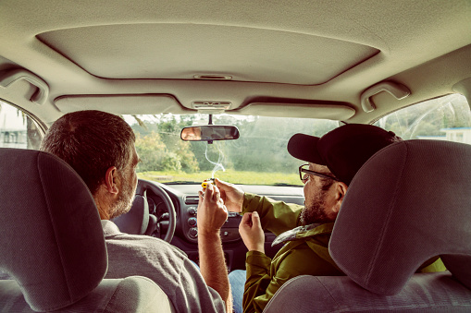
QUANTITATIVE RESULTS
KEY FINDING ONE
Texans are engaging in dangerous behaviors with regard to usage of marijuana and driving

Slide 7
QUANTITATIVE RESULTS
KEY FINDING ONE:
Texans are engaging in dangerous behaviors with regard to usage of marijuana and driving
15%
Texans who have driven at least once a month over the past year after using marijuana
9%
Texans who have driven at least once a month over the past year impaired by alcohol

Slide 8
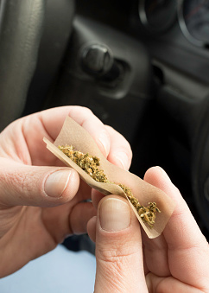
QUANTITATIVE RESULTS
Certain demographic characteristics correlate to having driven at least one time a month over the past year after using marijuana
28%
31%
26%
21%
21%
20%
20%
10%
11%
9%
Less than college
9%
18-24 year old
9%
25-40 year old
6%
Women
Some college
Unmarried
Hispanic
Married
Men
College
or higher
White
Black
40+

Slide 9
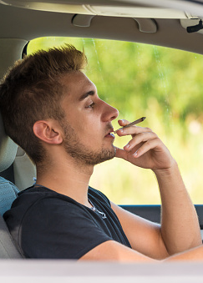
QUANTITATIVE RESULTS
KEY FINDING ONE:
Texans are engaging in dangerous behaviors with regard to usage of marijuana and driving
The overwhelming majority of marijuana users (67%) report either not having a plan or having a weak or inconsistent plan for a sober ride after they have used marijuana

Slide 10
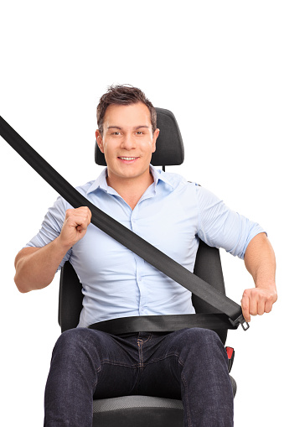
QUANTITATIVE RESULTS
KEY FINDING ONE:
Texans are engaging in dangerous behaviors with regard to usage of marijuana and driving
More than one—third of Texans (35%) report they have been a passenger in a vehicle driven by someone under the influence of marijuana this year

Slide 11
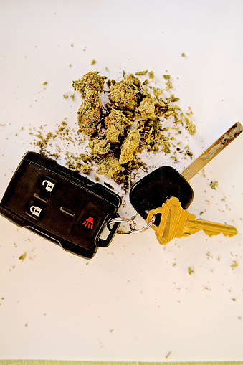
QUANTITATIVE RESULTS
KEY FINDING TWO
Texans are not knowledgeable about the
dangers of driving after using marijuana

Slide 12
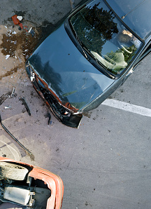
QUANTITATIVE RESULTS
Danger of Crash
28%
Texans that view driving after using marijuana as extremely dangerous
51%
Texans that view driving under the influence of alcohol as extremely dangerous

Slide 13
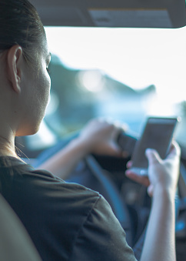
QUANTITATIVE RESULTS
Danger of Crash
Users are far less likely (20%) to view driving after using marijuana as extremely dangerous than the total population
Fewer people believe marijuana is extremely dangerous than driving while texting or driving after using other illegal drugs

Slide 14
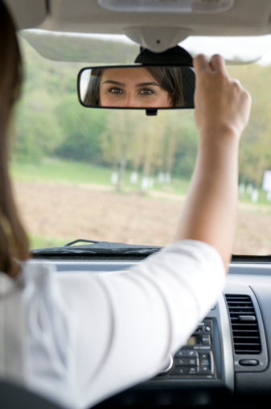
QUANTITATIVE RESULTS
Danger of Crash
When forced to chose whether driving after using marijuana made one a safer or less safe driver, 33% of Texans state marijuana makes a person a safer driver

Slide 15
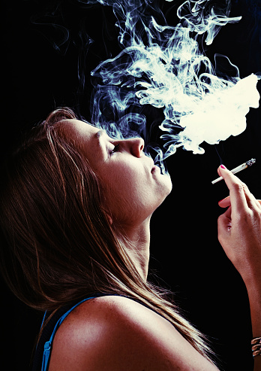
QUANTITATIVE RESULTS
Danger of Crash
59%
    Marijuana users believe it makes them a safer driver
17%
    Non-users believe marijuana makes a person a safer driver

Slide 16
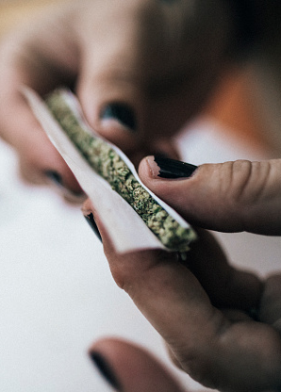
QUANTITATIVE RESULTS
Danger of Arrest
37% of respondents believe driving under the influence of marijuana is either not illegal or has a lower penalty than driving under the influence of alcohol
31% of Texans report a police officer would have no way of knowing if someone was under the influence of marijuana upon being pulled over

Slide 17
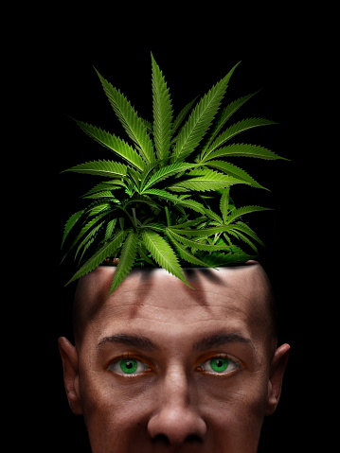
QUANTITATIVE RESULTS
MOST EFFECTIVE MESSAGING
Notes:
Tested using regression analysis against three seperate pre and post message battery ballots
1) perception of danger of driving after marijuana use
2) likelihood of being pulled over
3) likelihood to have a sober ride

Slide 18
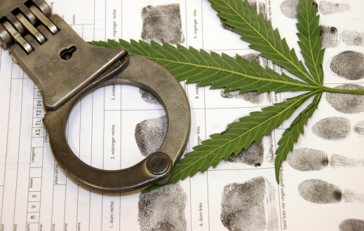
QUANTITATIVE RESULT
Police departments are investing in new equipment and training officers to detect people driving under the influence of marijuana

Slide 19
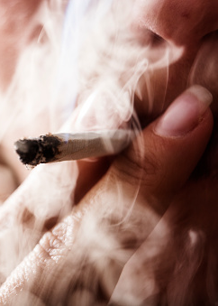
QUANTITATIVE RESULTS
If a person gets behind the wheel while under the influence of marijuana, they could get in a crash and kill themselves

Slide 20
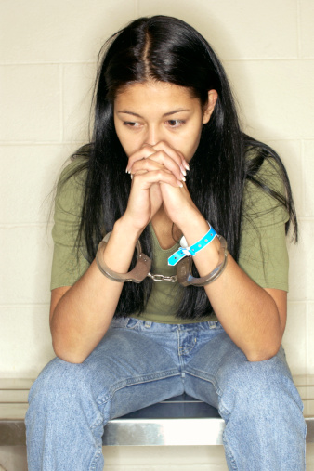
QUANTITATIVE RESULTS
The penalties for operating a motor vehicle under the influence of marijuana are the same as operating a vehicle under the influence of alcohol

Slide 21
AUDIENCES
Poll results show incredible divergence on
both mindset and willingness to change based.
Two distinct audiences emerged:
General public
Current marijuana users

Slide 22
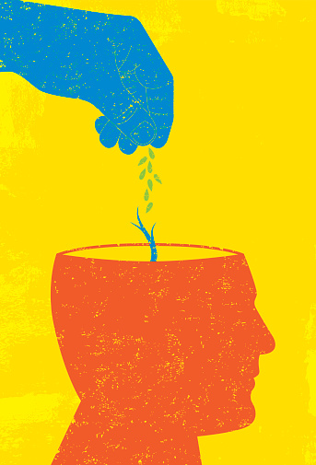
AUDIENCES
General Public
Mindset far more mailable with higher likelihood to switch positions
Important audience to create social change

Slide 23
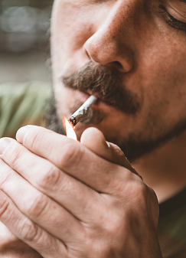
AUDIENCES
Current Marijuana Users
Tend to have firm engrained opinions
    This is the audience we must reach to reduce incidence of driving after using marijuana

Slide 24

QUALITATIVE FINDINGS
KEY FINDING ONE
Driving under the influence of marijuana
is extremely common

Slide 25
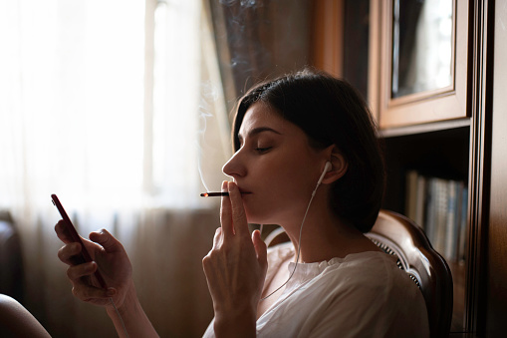
QUALITATIVE FINDINGS
Key Finding One
Driving under the influence of marijuana is
extremely common
  Average age of first use: 16
  Most users consume multiple times per week and often daily
  Marijuana users state they enjoy smoking while driving without being prompted
  Many users drive multiple times per week after using marijuana
  This contrasts with alcohol where the average drunk driver drives 80 times prior to their first arrest

Slide 26
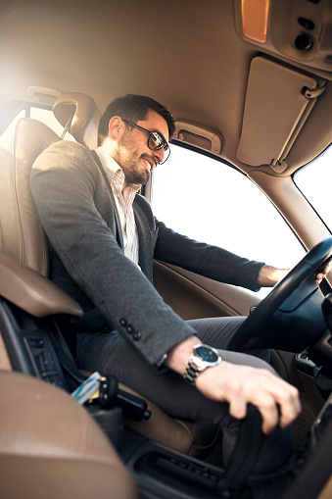
QUALITATIVE FINDINGS
KEY FINDING TWO
Marijuana perceived as improving driving ability

Slide 27
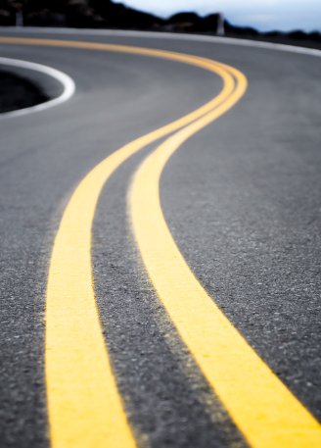
QUALITATIVE FINDINGS
Key Finding Two
Marijuana perceived as improving driving ability
  Increases focus
  Drive slower
  More patient
  Isolated examples of members of some groups state they personally can not drive after using marijuana
      These people are all fully comfortable riding in a vehicle with people who have used marijuana

Slide 28

QUALITATIVE FINDINGS
Key Finding Two
Marijuana perceived as improving driving ability
  When asked if they would find it acceptable that a school bus driver would drive their children after having consumed marijuana almost all responded they were fine with that

Slide 29
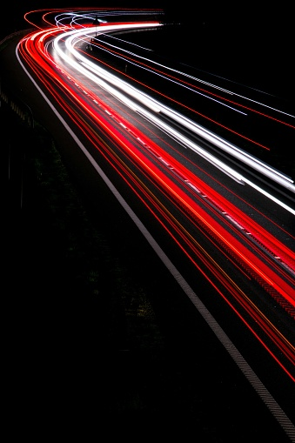

QUALITATIVE FINDINGS
Key Finding Two
Marijuana perceived as improving driving ability
  “I think for the most part you’re pretty safe. You’re just in a flow state kind of thing, where you’ll play some music and just drive away. I mean, it can even be like therapeutic, at least for me. I like driving…Yeah, you’re in the zone.”
  — El Paso participant
Notes:
DON'T PLAY

Slide 30
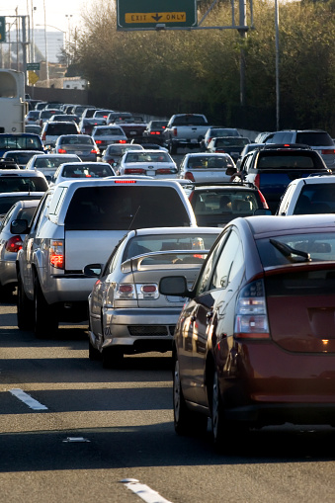
QUALITATIVE FINDINGS
Key Finding Two
Marijuana perceived as improving driving ability
  “I got a big old line of traffic. As all of us know, living in Houston, 45, 59, Beltway, it don’t matter; it’s always crowded and most of us probably drive in rush hour. For me, it is a way to not have road rage, to not hate the process…”
  — Houston participant
Notes:
PLAY

Slide 31
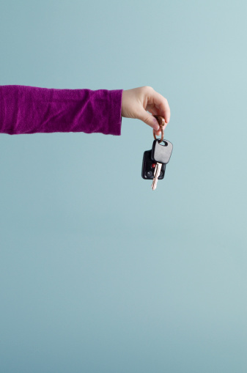
QUALITATIVE FINDINGS
KEY FINDING THREE
Planning for a sober ride not even a consideration

Slide 32
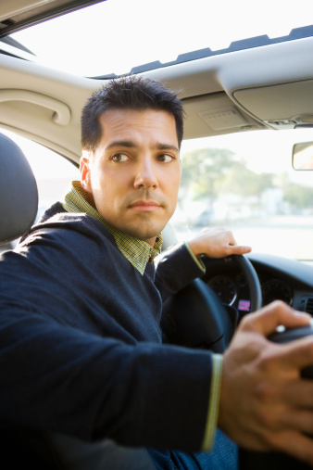
QUALITATIVE FINDINGS
Key Finding Three
Planning for a sober ride not even a consideration
  Participants believe police cannot tell who is driving under the influence of marijuana since driving ability is not impacted
      They believe appearance of smoke or smell of smoke is only clue
  Many do have a plan for after smoking that involves going through a drive-through fast food restaurant or driving to a grocery store for the munchies
  This contrasts with alcohol where almost all participants in these focus groups always have a plan for a sober ride

Slide 33
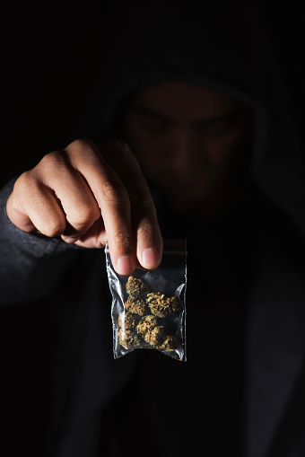
QUALITATIVE FINDINGS
Key Finding Three
Planning for a sober ride not even a consideration
  “I will get in a car with somebody that’s high,
  but I won’t get in the car with somebody that’s drunk.”
  — Houston participant
Notes:
DON'T PLAY

Slide 34
QUALITATIVE FINDINGS
Key Finding Three
Planning for a sober ride not even a consideration
  “If I’m drunk and trying to get home, I would probably take an Uber. It would be safer for me, versus if I was stoned at a friend’s house or a club. I’m like, ‘I can get home fine.’”
  — Houston participant
Notes:
PLAY

Slide 35

QUALITATIVE FINDINGS
KEY FINDING FOUR
Marijuana users sensitive to two stereotypes

Slide 36
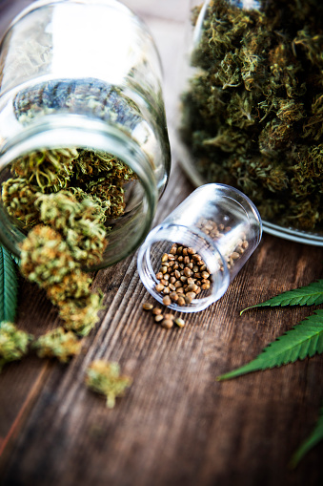
QUALITATIVE FINDINGS
Key Finding Four
Marijuana users sensitive to two stereotypes
  Reefer madness
    The belief that marijuana is evil and will cause one to “go crazy”
  Cheech and Chong
    The belief that marijuana makes a person a joke
  Respondents react to any platforms that play on either of these stereotypes by immediately dismissing all messaging

Slide 37
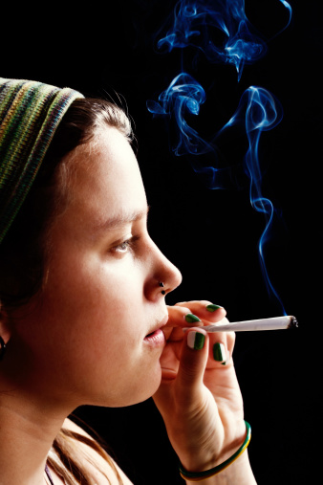
QUALITATIVE FINDINGS
Key Finding Four
Marijuana users sensitive to two stereotypes
  “They portray them as goofy, silly, something bad is going to happen or they’re not proper or something like that. I’ve never seen a positive—it ended up fine, but it’s always a comedy, you know.
  It’s either one extreme or the other. Totally serious, ‘Oh, my god, they’re going to have a wreck and die,’ because they were high, or super silly, like driving 30 miles an hour on the freeway.”
  — Houston participants
Notes:
DON'T PLAY

Slide 38
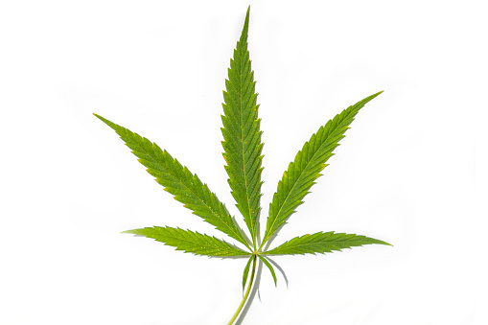
QUALITATIVE FINDINGS
MESSAGE TESTING

Slide 39
QUALITATIVE FINDINGS
If a person gets behind the wheel while under the influence of marijuana, they could get in a car crash and kill themselves

Slide 40
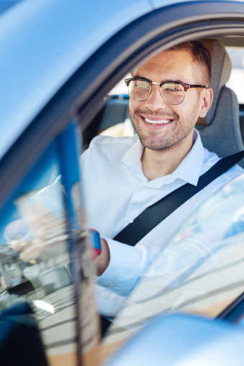
QUALITATIVE FINDINGS
Completely ineffective
Audiences feel safer to drive on marijuana than otherwise
Felt message was a scare tactic
Any examples of crashes dismissed since people can get in crashes totally sober

Slide 41
QUALITATIVE FINDINGS
  “Yeah, it’s just a driver’s bad whether they’re high or not.
  I don’t think that weed has any affect on them.”
  — El Paso participant
Notes:
DON'T PLAY

Slide 42
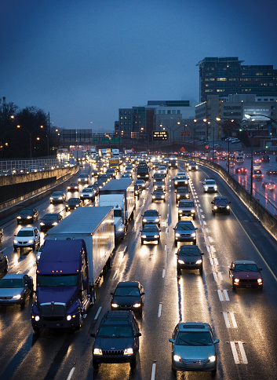
QUALITATIVE FINDINGS
  “I think anyone that drives is at risk of crashing and dying, not necessarily because you smoked. Someone else could have been smoking or drinking and hit you. It’s not just because of the marijuana. It’s for other reasons.”
  — Houston Spanish dominant
  (Translator in audio)
Notes:
PLAY

Slide 43
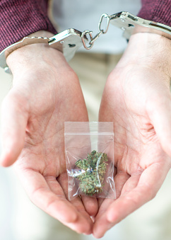
QUALITATIVE FINDINGS
It could cost a person up to $17,000 in fines, court costs, and legal fees if convicted of operating a motor vehicle under the influence of marijuana

Slide 44
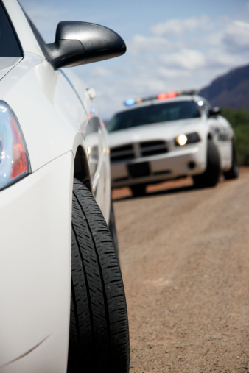
QUALITATIVE FINDINGS
Somewhat motivational in that cost makes them pay attention
However, respondents feel they would not be pulled over
Also, respondents believe even if they were pulled over for something else, police would not know or care if they were under the influence of marijuana

Slide 45
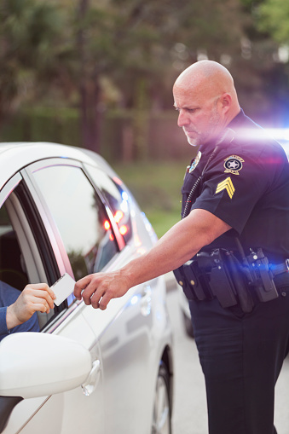
QUALITATIVE FINDINGS
  “Even cops know weed is not a big problem. I’ll be honest with you all, I’ve been arrested and I’ve had weed in the car before…
  If you look crazy and if you’re acting crazy and you have a little bit of weed, he’s going to think there’s going to be other stuff, you’ve got other kind of dope. But if you just act normal, if you’re cool, like if you’re just regular cool and if you happen to come up on some weed, they’ll probably just throw it away and tell you to get out of there.”
  — El Paso participant
Notes:
DON'T PLAY

Slide 46
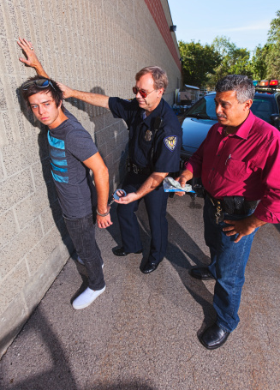
QUALITATIVE FINDINGS
Police departments are investing in new equipment and training officers to detect people driving under the influence of marijuana

Slide 47
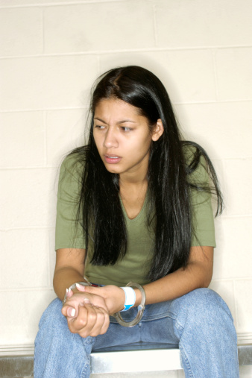
QUALITATIVE FINDINGS
Several respondents believed this statement
Most felt it was motivational
Most became defensive and stated police resources should be spent elsewhere
Some showed skepticism on existence of new equipment

Slide 48
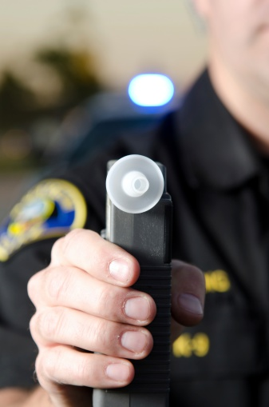
QUALITATIVE FINDINGS
  “I believe that there’s some kind of device that they have or that’s in development or close to being used for that, but not that I know it’s effectively being used or being used here in Texas. I had heard, as recently as a year or two ago, that they were close to having a breathalyzer version of looking for THC…”
  — Dallas participant
Notes:
DON'T PLAY

Slide 49
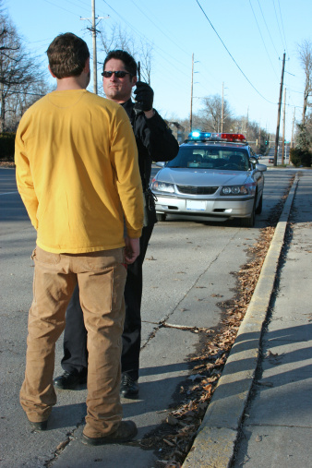
QUALITATIVE FINDINGS
The penalties for operating a vehicle under
the influence of marijuana are the same as operating a vehicle under the influence of alcohol

Slide 50
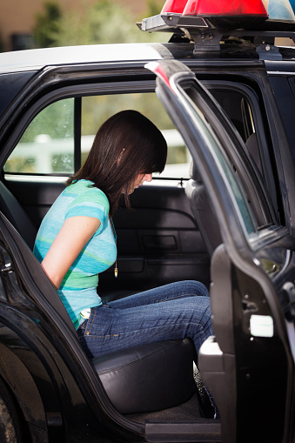
QUALITATIVE FINDINGS
Statement was moderately motivational as DUI is seen as a big deal by respondents
Respondents do not believe police would pull them over
Respondents do not believe police would be able to tell that they had used marijuana

Slide 51
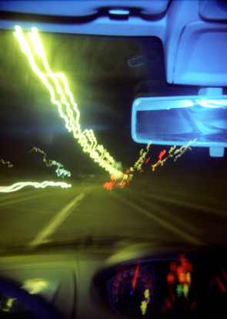
QUALITATIVE FINDINGS
If you feel different, you drive different

Slide 52
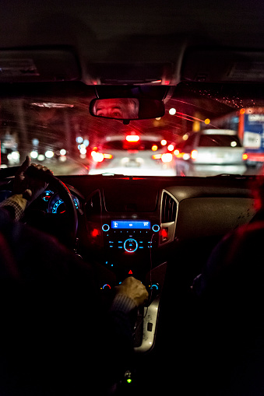
QUALITATIVE FINDINGS
Respondents expressed universal agreement with statement
Respondents continually emphasized different does not mean bad. In this instance different is better.
This statement could encourage people to drive under the influence of marijuana

Slide 53
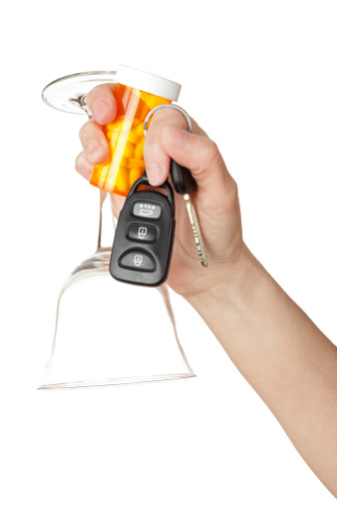
QUALITATIVE FINDINGS
  “I think the main issue is that alcohol and some of these other things, prescription drugs and Prozac and stuff, they’ll affect your motor skills. You’ll get physically tired. You might get a little mentally slow, but you can still function if you’re high. I might drive a little slower. I might be less motivated to be weaving in and out of traffic, but I’m still fine, even if I am different because I’m high. If I was drunk, I might be doing some dumb things just because it’s leaving my mind and also affecting my body in a negative way, too, where marijuana isn’t doing that.”
  — Dallas participant
Notes:
DON'T PLAY

Slide 54
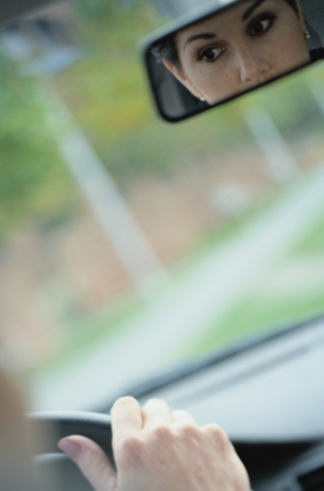
QUALITATIVE FINDINGS
  “If they try to use that as a tagline of, ‘Obviously you’re not driving your best right now because you feel different.’ It’s like, ‘Yeah, but I feel better. I feel awesome. I feel relaxed. I feel great.’ You know what I mean? Don’t try to tell me that, because I feel different, now I’m under the influence and I’m obviously a danger to people driving on the road and whatnot and a danger to myself. That’s somewhere where I think they try to take that. It’s like, that’s rude and presumptuous and untrue and, I think, a dangerous rhetoric to start.”
  — Dallas participant
Notes:
PLAY

Slide 55
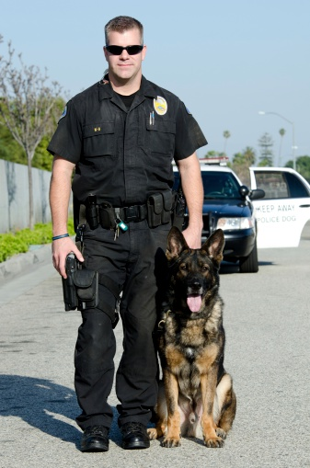
MOVING FORWARD
The goal of an effective campaign is to change behavior. This does not mean finding messages that marijuana users like or make them feel better about themselves.
To change behavior messages must resonate with users. Enforcement messaging that shows:
    Marijuana impaired driving is a priority for law enforcement
    There is a real risk you will be pulled over
    Once pulled over, law enforcement has technology to test you and officers are trained to detect if you are under the influence

Slide 56
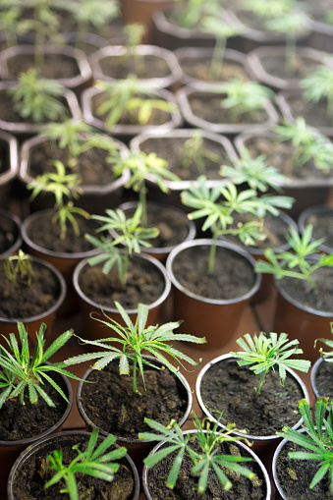
MOVING FORWARD
Tone is vitally important in creative
    Not over the top
    Not comedic
Vitally important to test all creative with users prior to production

Slide 57
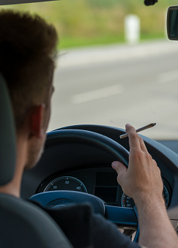
MOVING FORWARD
For societal change, an effective campaign would utilize messaging targeting all Texans that stressed:
  It is dangerous to drive after using marijuana
  It is also illegal to drive after using marijuana
  The state is now taking marijuana impaired driving seriously and investing in training officers and in new technology

