Slide 1
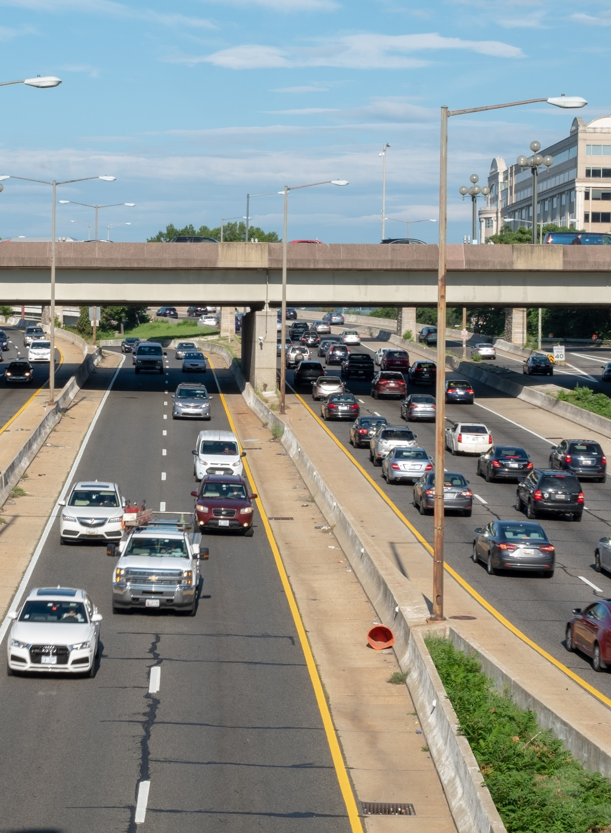
Can technology save us from distracted driving
Drive Smart Virginia Distracted Driving Summit
September 17, 2021
David S. Zuby
Chief Research Officer

Slide 2
Countermeasure: automated enforcement

Slide 3
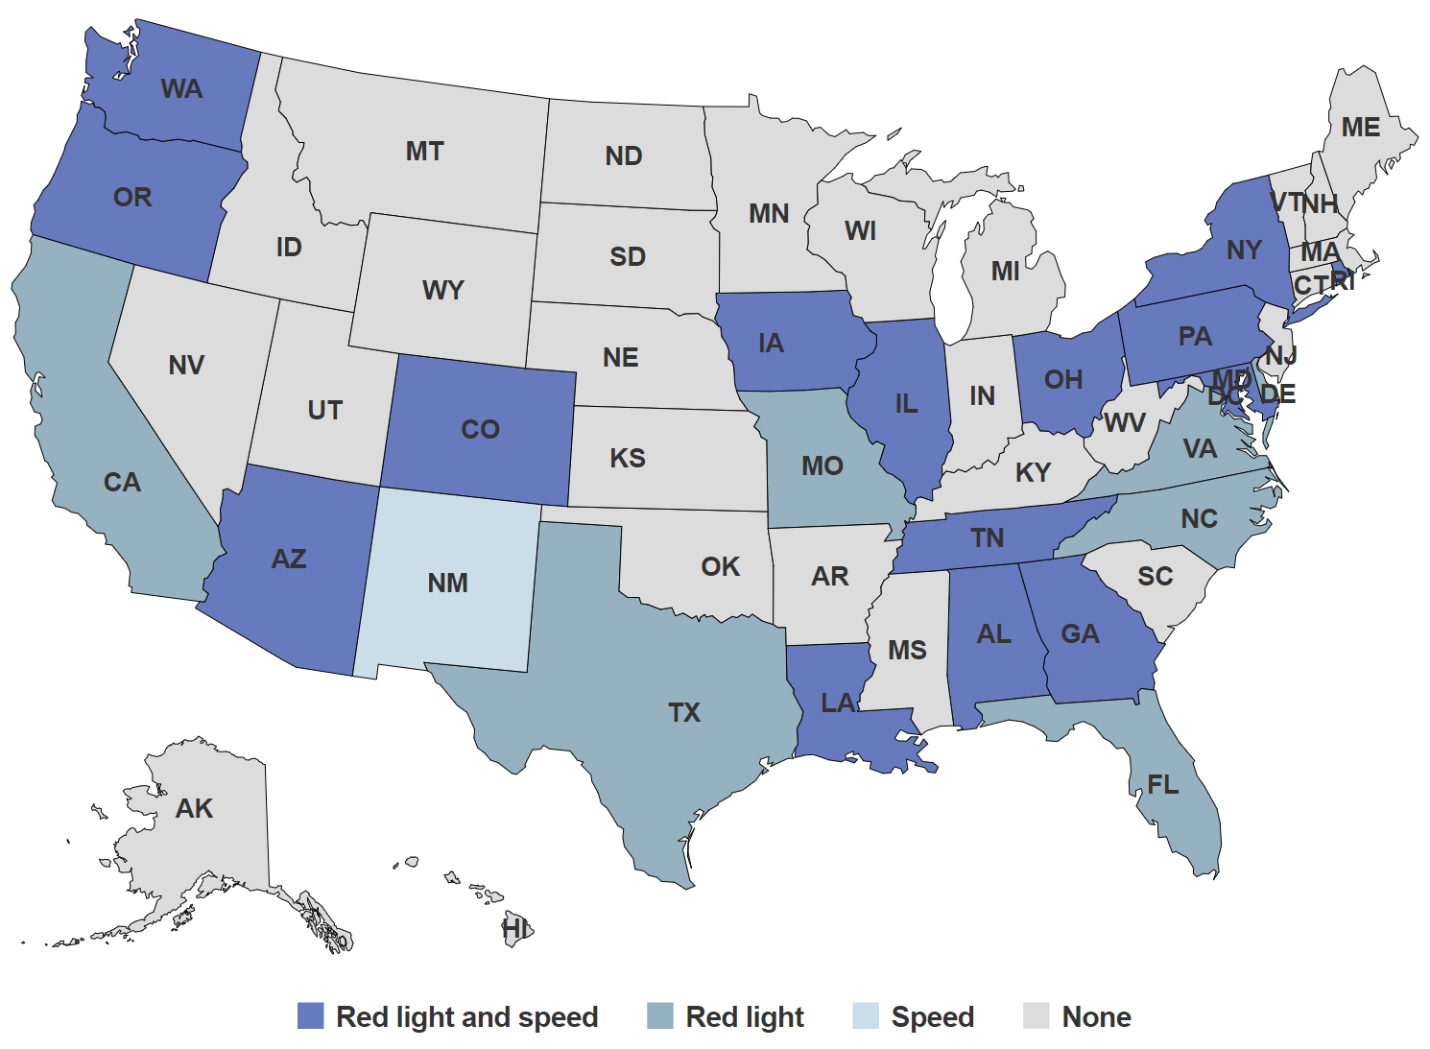
States where red light cameras or speed cameras are currently used
Red light and speed
Red light
Speed
None
Notes:
IIHS public site
As of 8/24/21

Slide 4
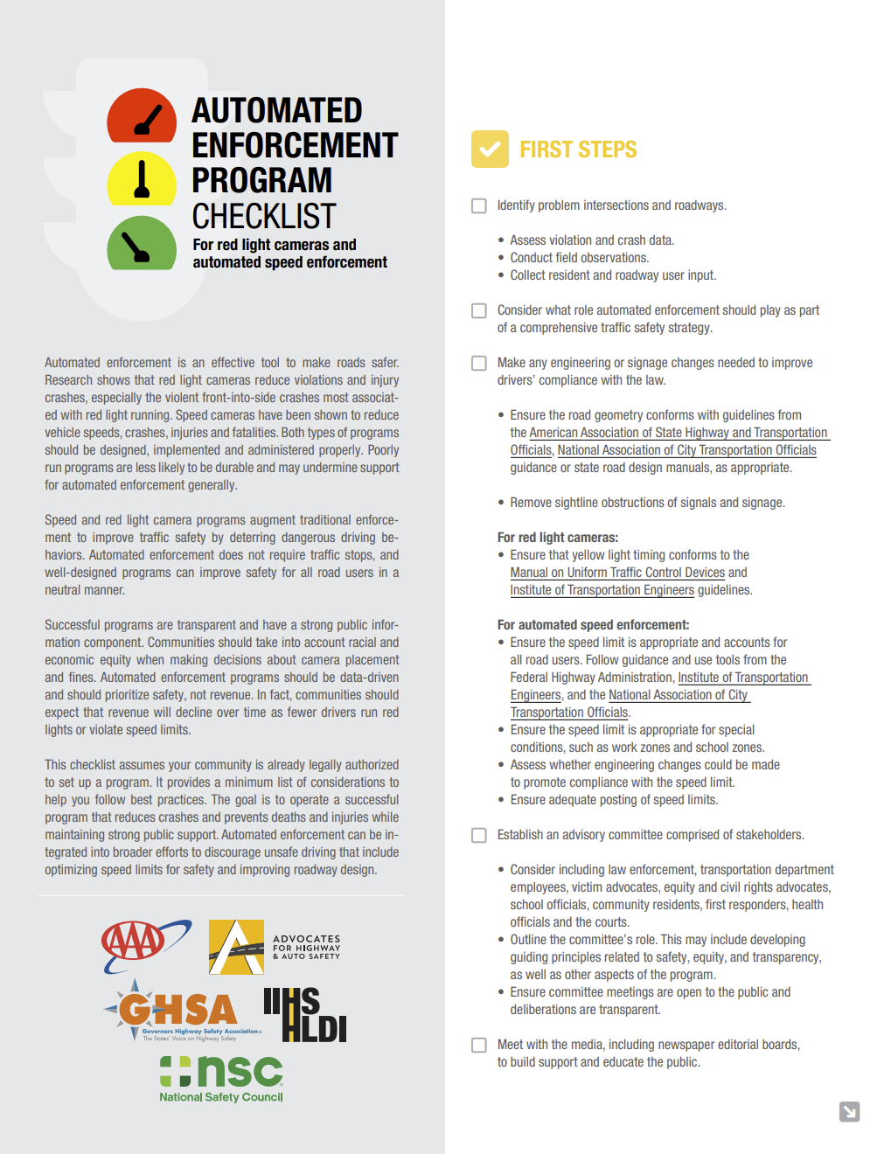
Automated enforcement program checklist
Outlines best practices for establishing successful red light camera and automated speed enforcement programs with broad public support.

Slide 5
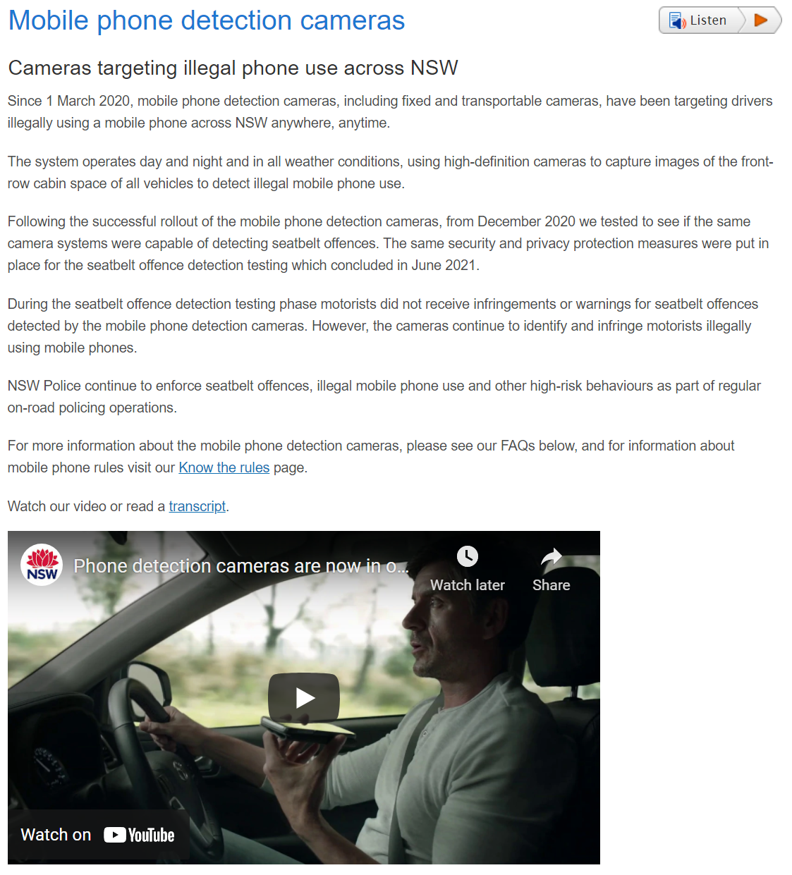
Mobile phone detection cameras
Cameras targeting illegal phone use across NSW

Slide 6
Countermeasure: crash avoidance technology

Slide 7
Connection between distraction, performance, and crash type
Visual-manual distraction elevates crash risk significantly
regardless of distraction source
lateral control and hazard detection are degraded
inopportune glances
Distraction driving crashes fit a pattern (Stutts et al., 2001)
70 percent of distraction-related crashes were either rear-end collisions or single vehicle crashes (e.g., run off road), most of remaining 30 percent were angle collision
Conversely, 82 percent of crashes where driver was inattentive but not distracted (i.e., “looked but did not see”) were angle collisions
See also Owens et al. (2018)
Notes:
Stutts et al. 2001 is based on an analysis of 5 years of NASS CDS crash data. They compare distributions of crashes as a function of drivers’ attention code (distracted, attentive, looked but not seen, unknown, fatigue)
Owens et al 2018 is SHRP2
Both funded by AAA

Slide 8
Most crash avoidance technologies are living up to expectations
Effects on relevant police-reported crash types
All severities
Injury
Statistically significant
Notes:
FCW, AEB: front-to-rear strikes
LDW: single-vehicle, head-on, sideswipes
Blind spot: lane-change crashes

Slide 9
New vehicle series with autonomous emergency braking
By model year

Slide 10
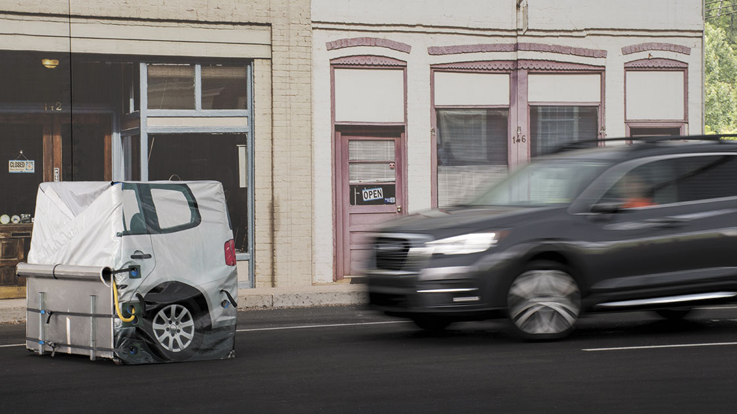
Automakers’ commitment to make AEB standard by 2022-23
Tesla | 100%
Volvo | 100%
Audi | 99%
BMW | 99%
Subaru | 99%
Volkswagen | 98%
Mercedes-Benz | 97%
Toyota | 97%
Mazda | 96%
Hyundai | 96%
Honda | 94%
Nissan | 93%
Ford | 91%
Kia | 75%
Porsche | 55%
Maserati | 48%
General Motors | 47%
Mitsubishi | 39%
Stellantis | 14%
Jaguar Land Rover | 0%
10 automakers fulfill automatic emergency braking
pledge ahead of schedule
December 17, 2020

Slide 11
Estimated registered vehicles by feature
Calendar years 2019 and 2024

Slide 12
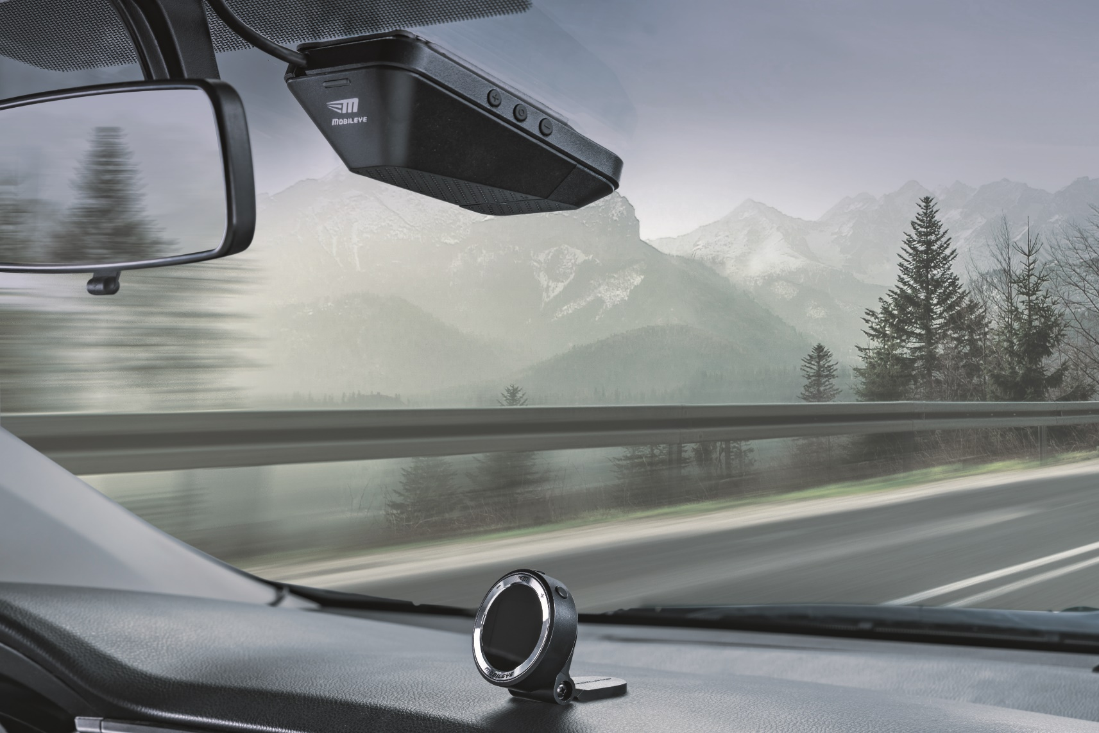
IIHS field operational test setup
Camera-based sensor
In-vehicle display

Slide 13
Field study timeline and analysis plan
4-week baseline, warnings silent | 8-week treatment, warnings active
Installations May 2017
Warnings activated
Notes:
Warning thresholds and volumes locked for duration of study
Analyzed weekly warning rates (per 100 miles driven) for FCW, LDW, HWM, UFCW, and PCW for drivers with telematics

Slide 14
Large reduction in warning rates during treatment phase
Percent change from baseline
Notes:
Increased time headway provides cushion for reaction time
FCW provided in case ACC braking capacity exceeded
First versus last month of active phase, 31 percent increase in time driven with ACC, 53 percent increase in ACC activations. Benefits to safe driving behavior may increase with increased length of ownership as increase in driver trust and perceived usefulness leads to more system use -

Slide 15
Countermeasure: infotainment systems designed to minimize distraction

Slide 16
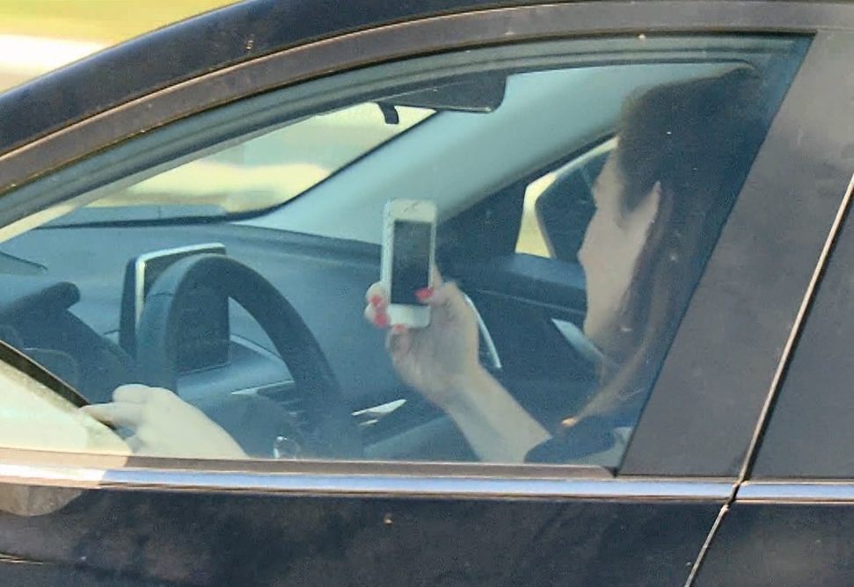
Drivers of all ages interact with cellphones
Different design approaches of embedded manual and voice interfaces may be experienced differently by drivers of different ages
Volvo Sensus’s menu-based voice interface
Multiple short steps, error prevention and recovery
Chevrolet MyLink’s one-shot voice interface
Single compound command

Slide 17
Average proportion of time driver’s eyes were on forward roadway was greatest for voice interfaces, particularly for MyLink

Slide 18
Estimated average proportion of time driver’s eyes were on forward roadway, by driver age
Advantage of MyLink’s voice interface increased with driver age
-0.4% per decade
-2.5% per decade
-1.2% per decade
-3.1% per decade

Slide 19
Countermeasure: cellphone blockers

Slide 20
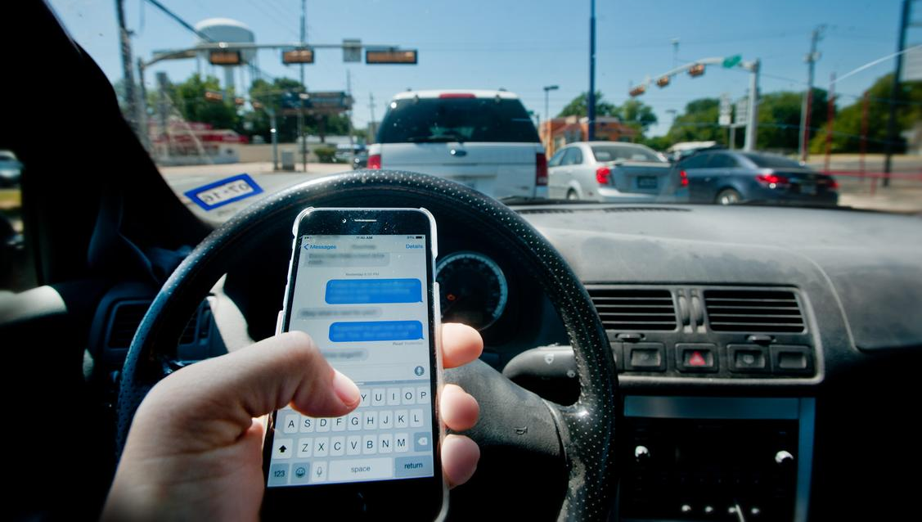
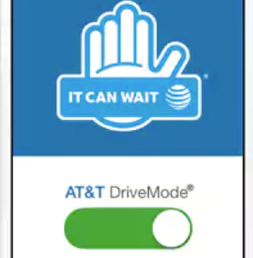
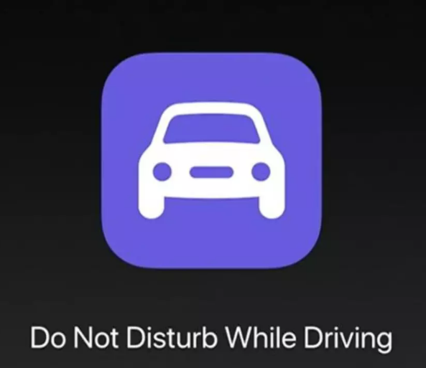
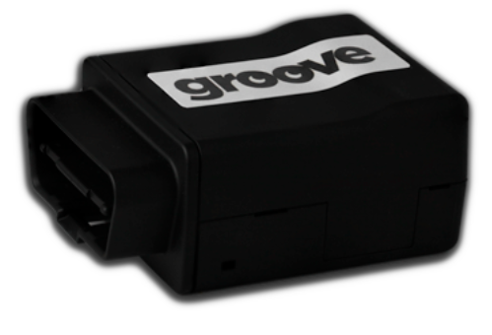
Background
Smartphone uses sensors to detect driving, mute incoming communications, and limit manual interaction with phone
NHTSA recommends blocking apps as part of distraction guidelines for portable devices
Typically software applications developed by wireless providers or app developers
Require users to download or “opt in”
iPhone’s Do Not Disturb While Driving: first application offered by cellphone producer
Part of software update (iOS 11, Fall 2017)

Slide 21
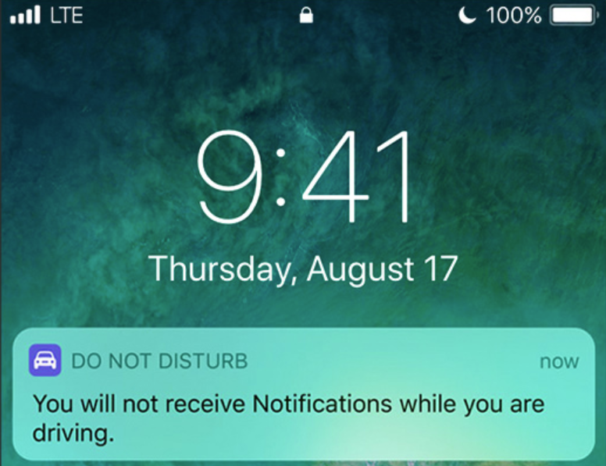
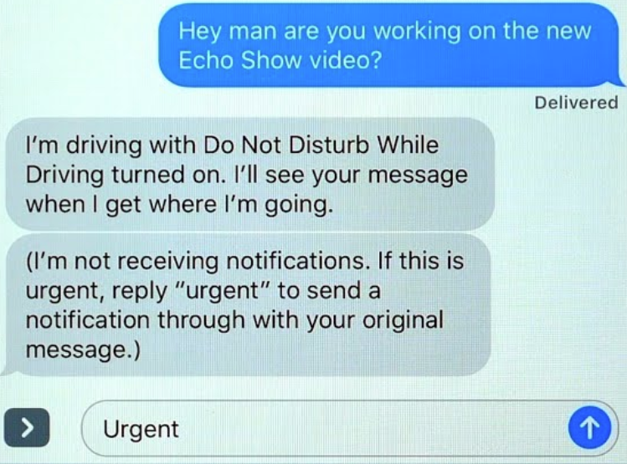
iPhone 6 or newer models support full functionality of the app
“Do you want to try Do Not Disturb While Driving?”
“Turn on while driving” app activates automatically when it detects you may be driving
“Not now” app is off; can be activated manually but owner must access settings to turn on
When app is turned on
phone screen stays dark and alerts are muted
reminder message displayed when phone is handled
option provided to override app to use manual input
auto-replies to text messages
voice input (Siri) permitted; handsfree calling (with Bluetooth)

Slide 22
Do Not Disturb While Driving activation setting
Most iPhone owners do not use it
Manually
50%
Automatically when connected to Bluetooth
2%

Slide 23
Drivers who have ever used Do Not Disturb While Driving who reported overriding app
Most know it can be overridden, but most who use it do not do so very often
Notes:
Driver’s spent 42% of their driving time engaged in at least one secondary behavior; On trips without phone use 34% of time was spent on secondary activities
We were interested in seeing what other activities people were doing when they were talking on their phone compared with all other times
We saw a reduction in a number of behaviors when people were on their phone which illustrates the complexity of the distraction problem as it takes many forms that are interdependent
Examined video and other data (e.g., vehicle speed) for sample of trips
Calculated percent of driving time using cellphones or engaging in other potentially distracting behaviors

Slide 24
Some drivers with Do Not Disturb While Driving could be convinced to try app if prompted again
Among drivers with app set to activate manually
Notes:
Driver’s spent 42% of their driving time engaged in at least one secondary behavior; On trips without phone use 34% of time was spent on secondary activities
We were interested in seeing what other activities people were doing when they were talking on their phone compared with all other times
We saw a reduction in a number of behaviors when people were on their phone which illustrates the complexity of the distraction problem as it takes many forms that are interdependent
Examined video and other data (e.g., vehicle speed) for sample of trips
Calculated percent of driving time using cellphones or engaging in other potentially distracting behaviors

Slide 25
Cellphone blockers among drivers with non-iPhone 6/iOS 11 smartphones
19 percent reported having a cellphone blocker
Of those reporting having a cellphone blocker:
48 percent used it all or almost all the time when driving in the past 30 days
Of those reporting not having a cellphone blocker:
23 percent agreed they would consider using one
55 percent somewhat or strongly agreed that providers should put cellphone blockers on phones that work like the iPhone app

Slide 26
Countermeasure: advanced driver assistance & automated driving

Slide 27
Levels of driving automation
 | Who or what is driving? |  | Fallback | Where and when does it operate?
 | Sustained control | Detection & response
Level 0: none |  |  | none | n/a
Level 1: assistance |  |  |  | limited
Level 2: partial |  |  |  | limited
Level 3: conditional |  |  |  | limited
Level 4: high |  |  |  | limited
Level 5: full |  |  |  | unlimited
+

Slide 28
Crash prevention potential of two domain-restricted automated driving systems
Percent of crashes, 2019

Slide 29
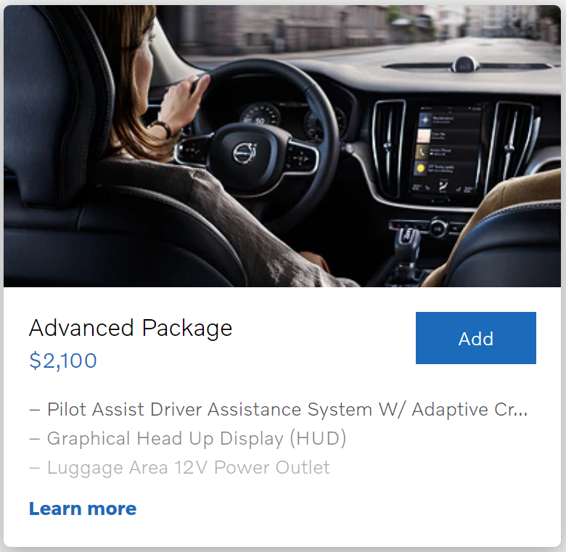
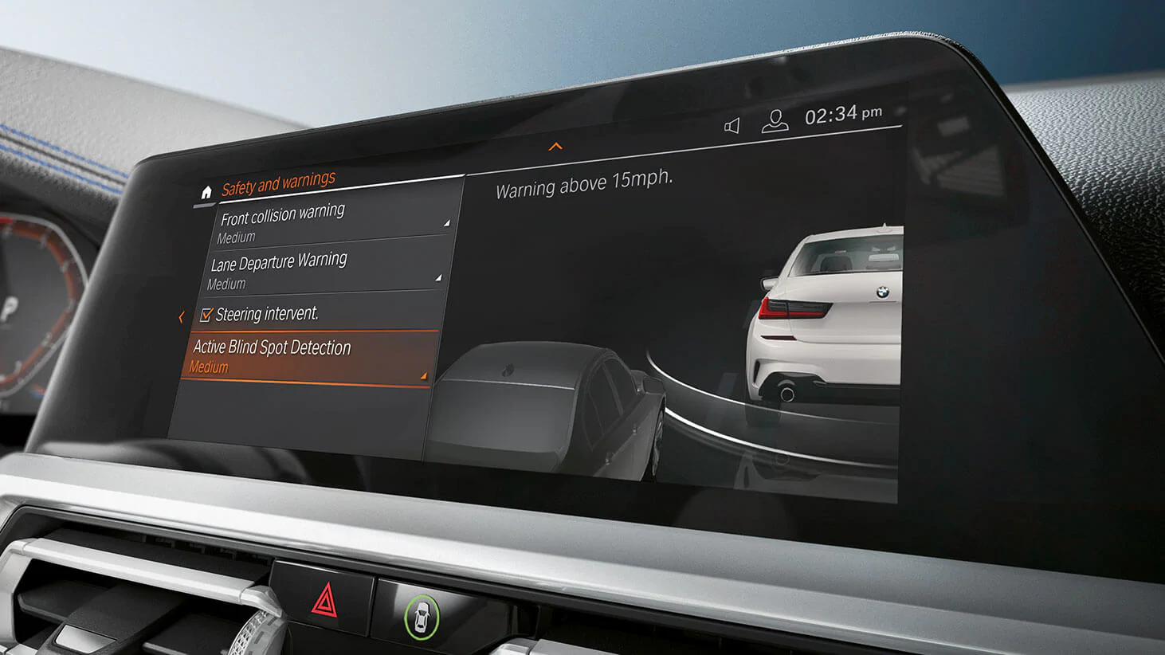
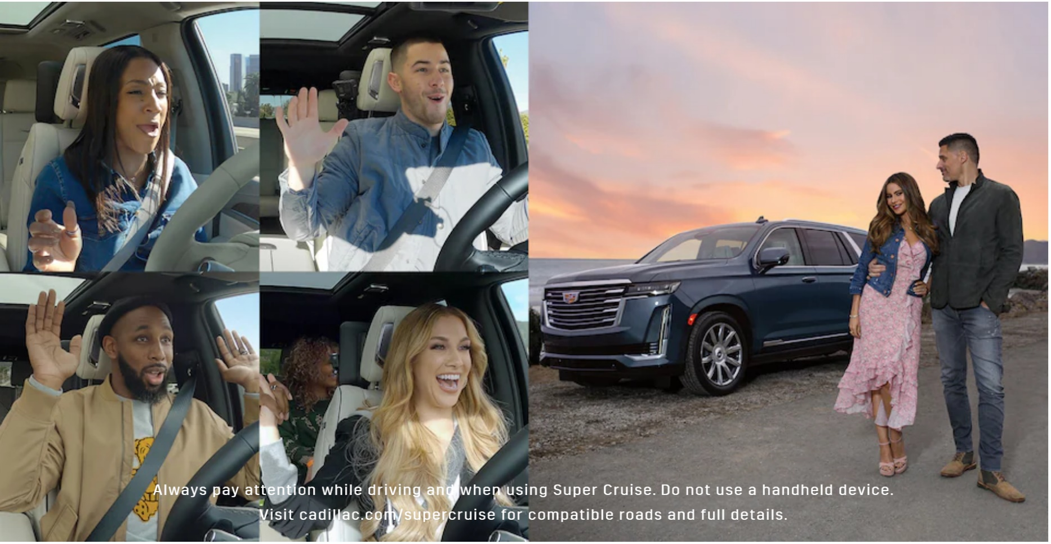
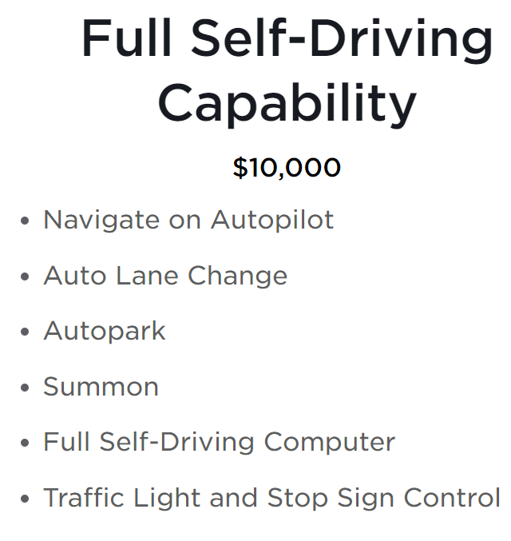
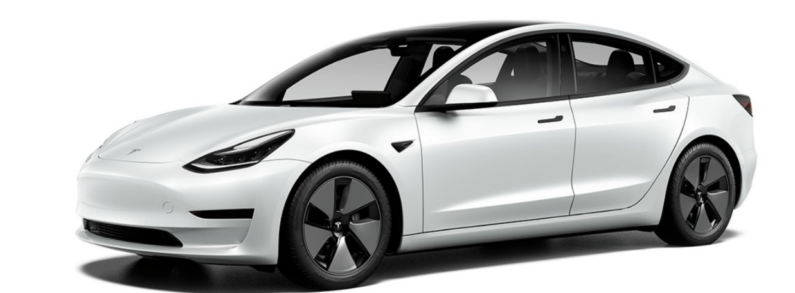
Volvo
BMW safety innovations.
The available Driving Assistance Professional Package eases the stress of every drive with Active Cruise Control with Stop & Go, Active Lane Keeping Assistant with Side Collision Avoidance, and more.
Super Cruise

Slide 30
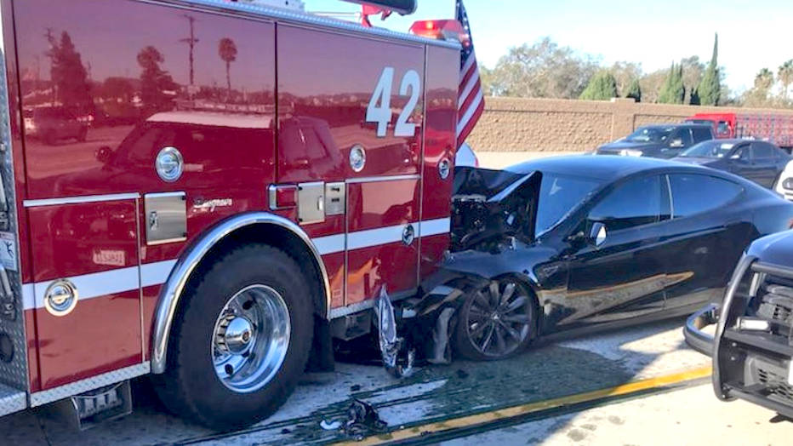
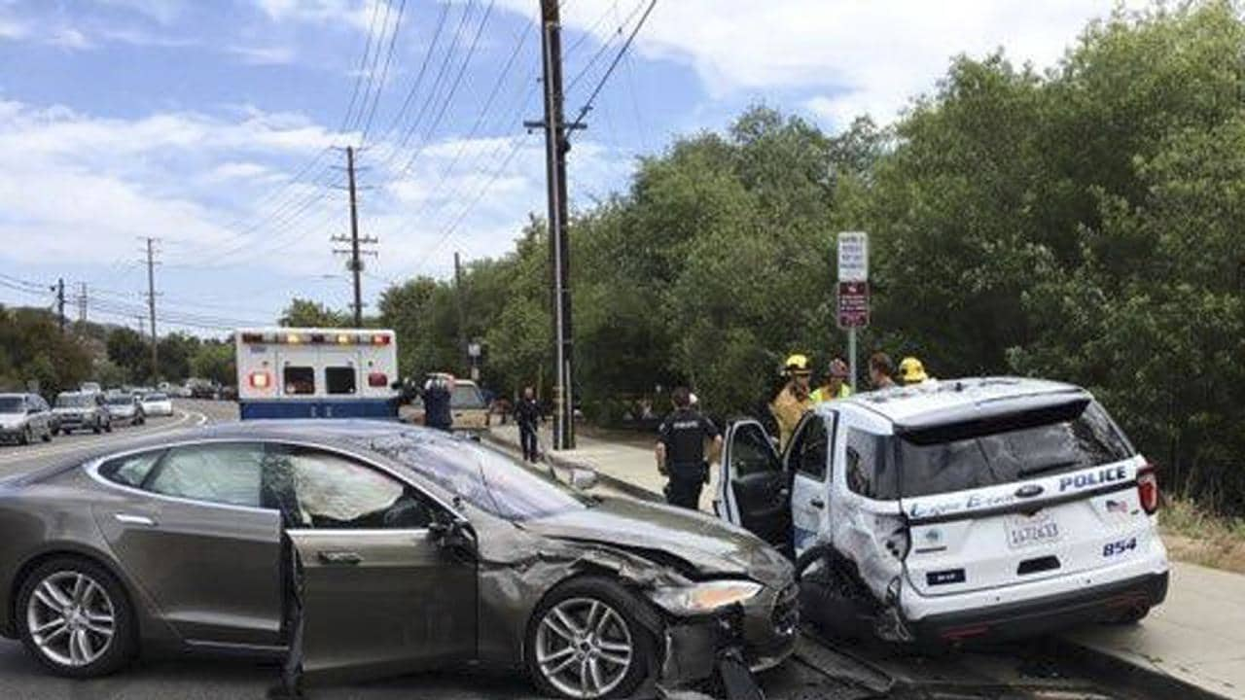
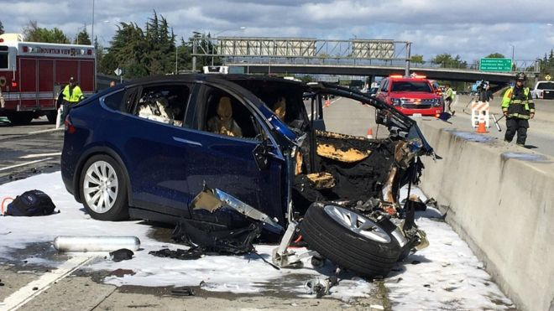
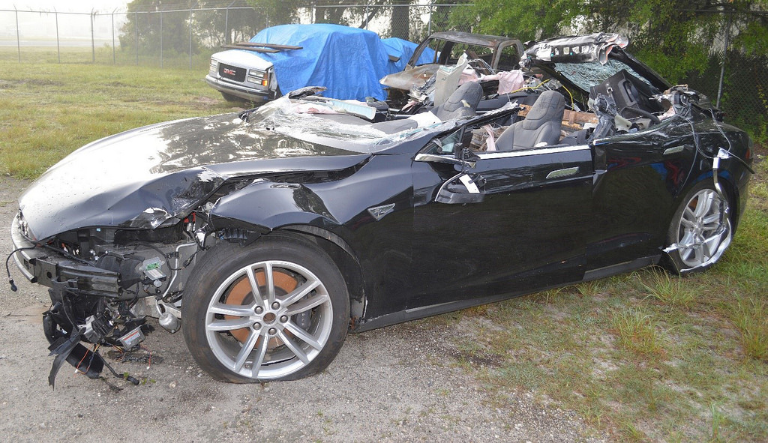
Drivers were not vigilant in Tesla Autopilot crashes

Slide 31
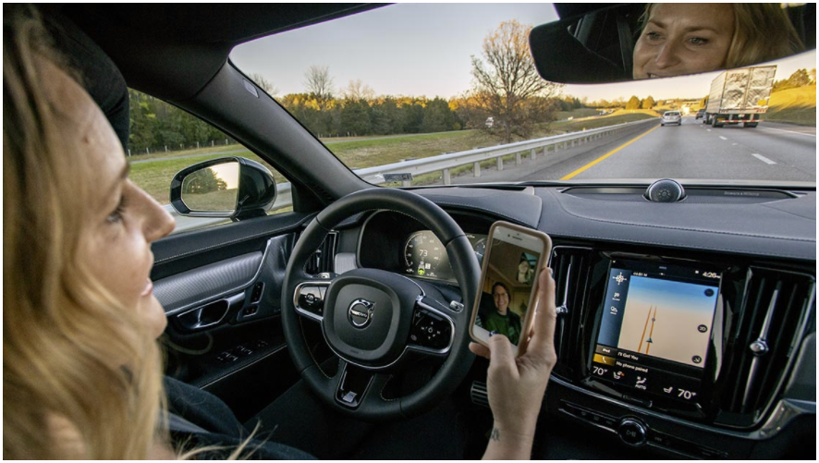
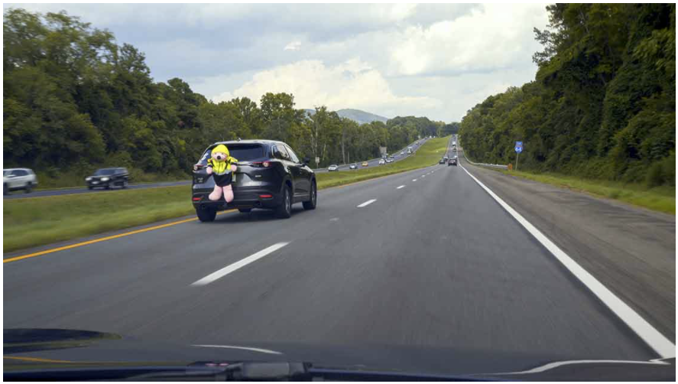
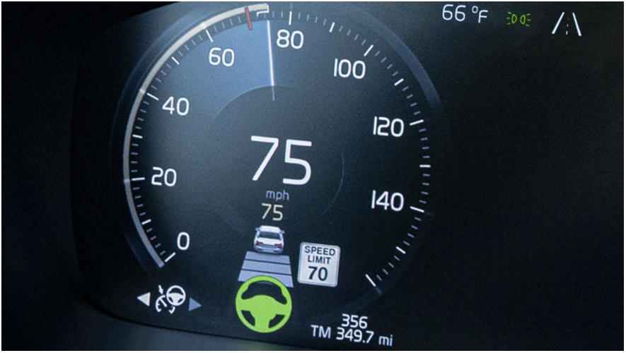
IIHS recent research
November 19, 2020
Drivers let their focus slip as they get used to partial automation
March 2, 2021
Automated assistance systems may
-Help improve experienced drivers’ situational awareness
-Lead to situational blindness among inexperienced drivers
March 11, 2021
Adaptive cruise control spurs drivers to speed

Slide 32
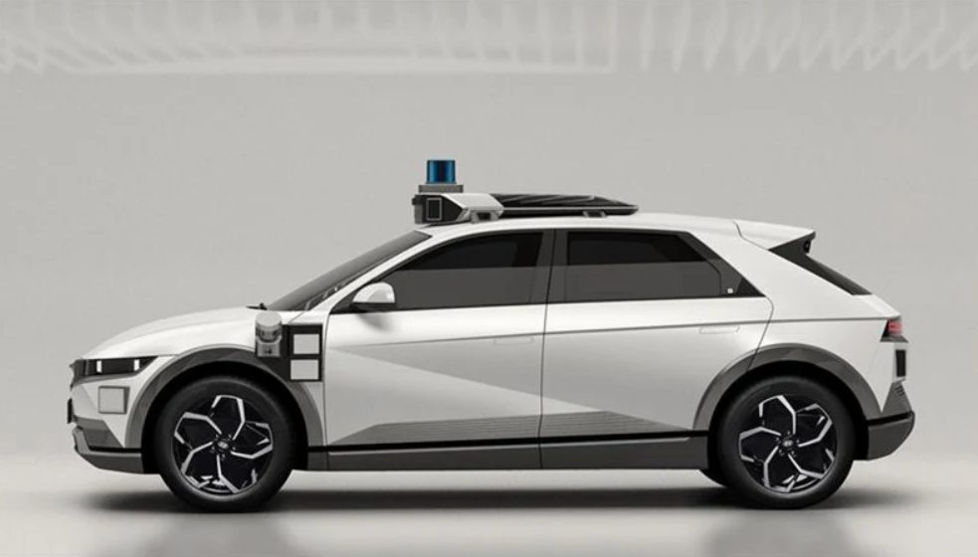
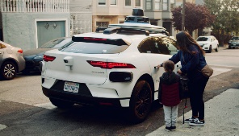
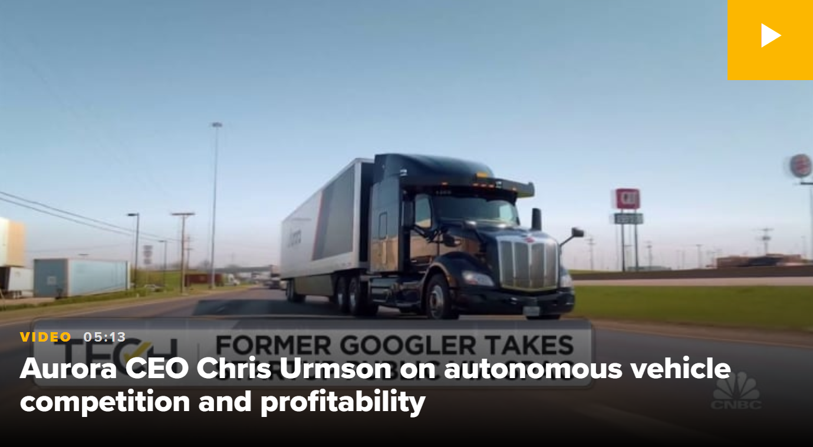
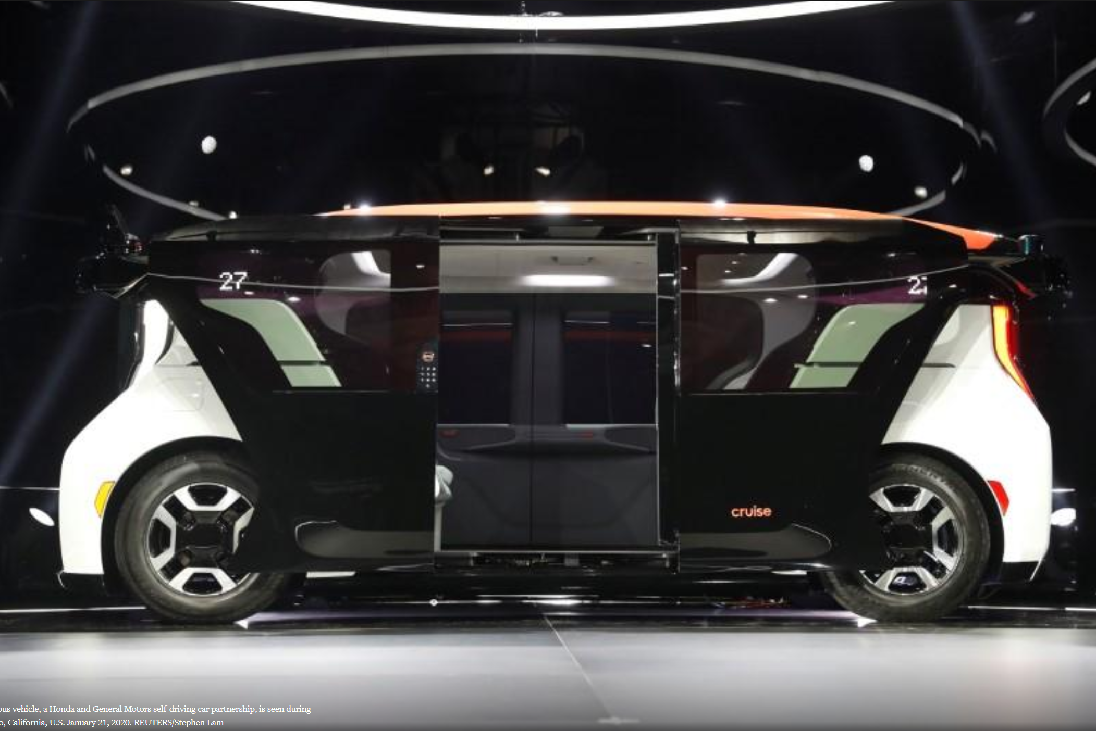
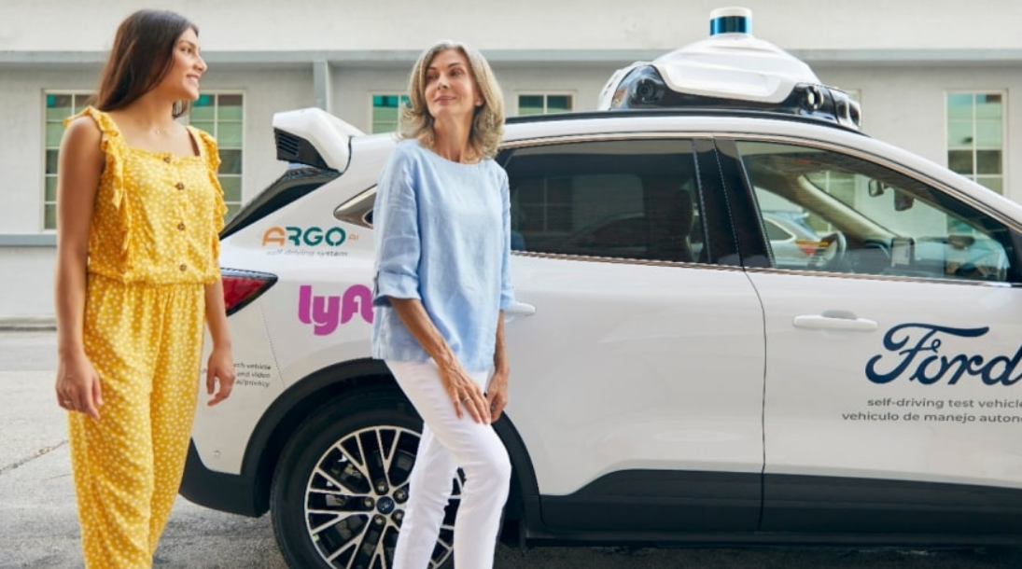
AUTOMOTIVE NEWS
August 31, 2021
TECH CRUNCH
August 24, 2021
Hyundai, Motional robotaxi sports more
than 30 sensors for 2023 debut
Waymo Launches robotaxi service in San Francisco
The all-electric crossover is expected to begin public service in two years through a partnership with ride-hailing giant Lyft.
Waymo, the self-driving vehicle company under Alphabet, has launched a robotaxi service that will be open to certain vetted riders in San Francisco.
By Hans Greimel
Rebecca Bellan
CNBC
July 15, 2021
REUTERS (SAN FRANCISCO)
January 21, 2020
Autonomous driving start-up Aurora plans to go public through SPAC deal with initial value of $11 billion
GM’s Cruise unit unveils driverless prototype vehicle for ride-sharing service
General Motors Co’s GM.N self-driving car unit, Cruise, unveiled a prototype electric vehicle for use in its planned autonomous ride-sharing service.
With partners including Toyota, Uber and Volvo, Aurora is targeting a wide range of vehicles, delivery services and mobility firms for its technology.
By Jane Lanhee Lee, Sampath Kumar
Phil LeBeau
FORD MEDIA CENTER
July 21, 2021
Argo AI and Ford to launch self-driving vehicles on Lyft network by end of 2021
Argo AI and Ford will deploy self-driving cars, with safety drivers, on the Lyft network, as part of a network access agreement, with passenger rides beginning in Miami later this year and in Austin starting in 2022.

Slide 33
Summary
Untapped potential for cellphone blockers (e.g. Do Not Disturb While Driving)
Significantly less cellphone use for those who use blockers
Phone makers or network providers could likely increase use with prompts
Most drivers agree that all phones should have blockers
Infotainment interface design is a work in progress
Voice interfaces reduce visual\manual attention demand
Effects vary by specific implementation and driver age
Crash avoidance features reduce crashes regardless of cause
Aftermarket systems have the potential to increase availability
Advanced driver assistance exhibits plusses and minuses
Humans will be passengers in true AVs, but these are a long way off

Slide 34
David S. Zuby
Chief Research Officer
dzuby@iihs.org

