Slide 1
We Passed a New Distracted Driving Law.
Now What?
drivesmartva.org

Slide 2
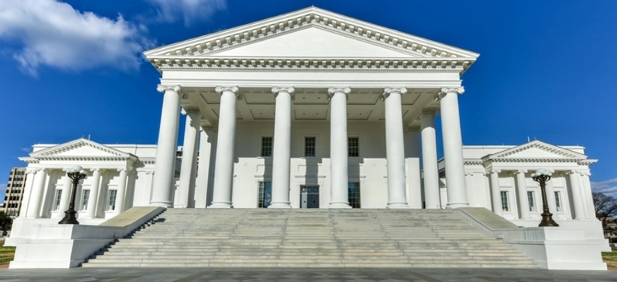
The Charge
The Virginia General Assembly mandated that traffic safety organizations like DRIVE SMART Virginia shall develop and provide educational materials to the public regarding the provisions of this act prior to its effective date.
The effective date was delayed for six months in order to provide the time to deliver this education to the public.
drivesmartva.org

Slide 3
Strategies
Created the Hands-Free Virginia Advisory Council in order to ensure that educational programming would meet the needs of all residents in a fair and inclusive way.
Leveraged the Virginia Partners for Safe Driving, a group of businesses, organizations, and government entities committed to encourage safe driving behaviors to help raise awareness of the new law.
Developed a communications plan based upon a variety of strategies to reach diverse audiences, including paid and organic social media, roadway signage, variable messaging signs, radio and digital PSAs, press conferences, print materials, a dedicated website and more.
drivesmartva.org

Slide 4
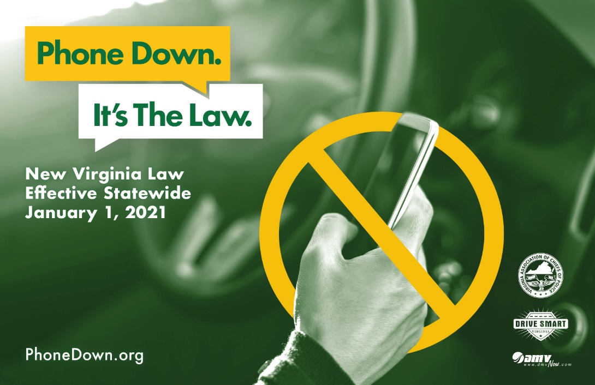
Partnered with the Virginia Highway Safety Office to create the campaign.
The message needed to be clean and direct.
drivesmartva.org

Slide 5
Tactic: To create a campaign that would be direct, relatable and appealing to a diverse audience.
drivesmartva.org

Slide 6
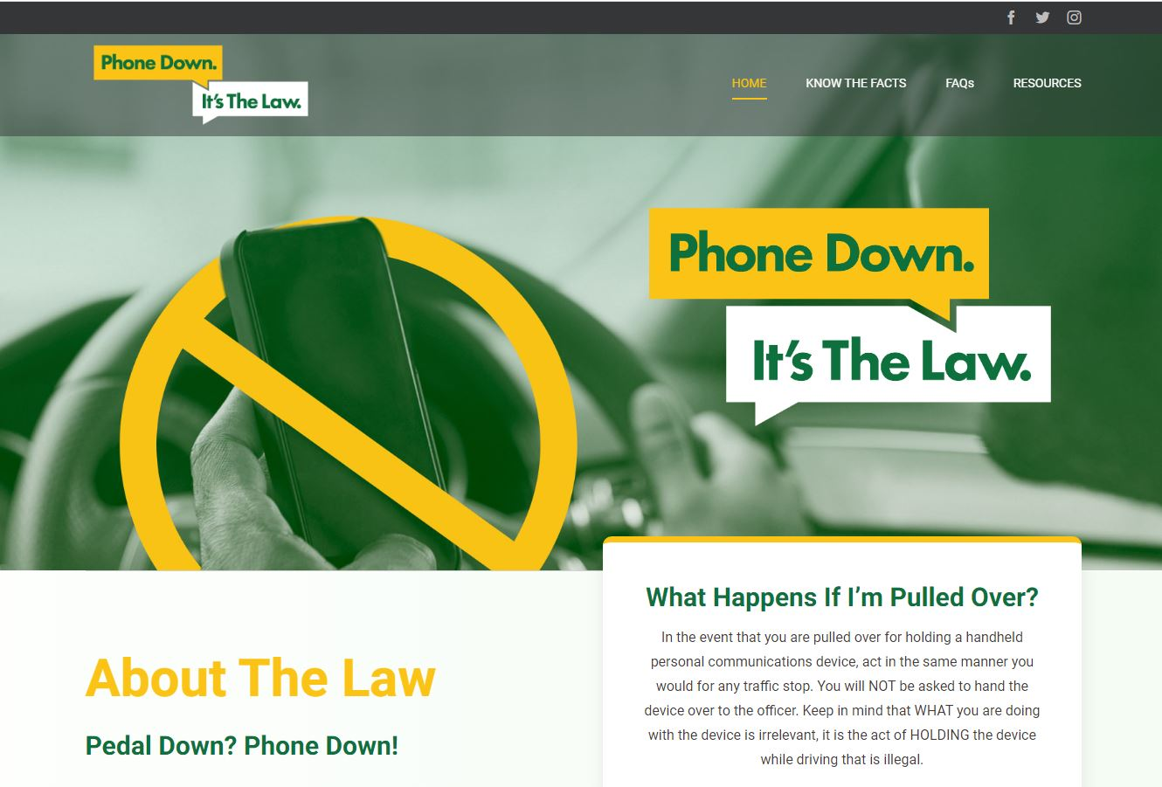
Website
drivesmartva.org

Slide 7
Poster
drivesmartva.org

Slide 8
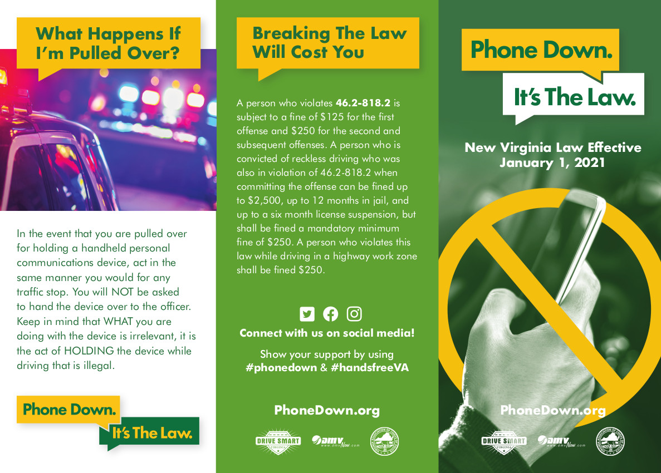
Tri-Fold Brochure
drivesmartva.org

Slide 9
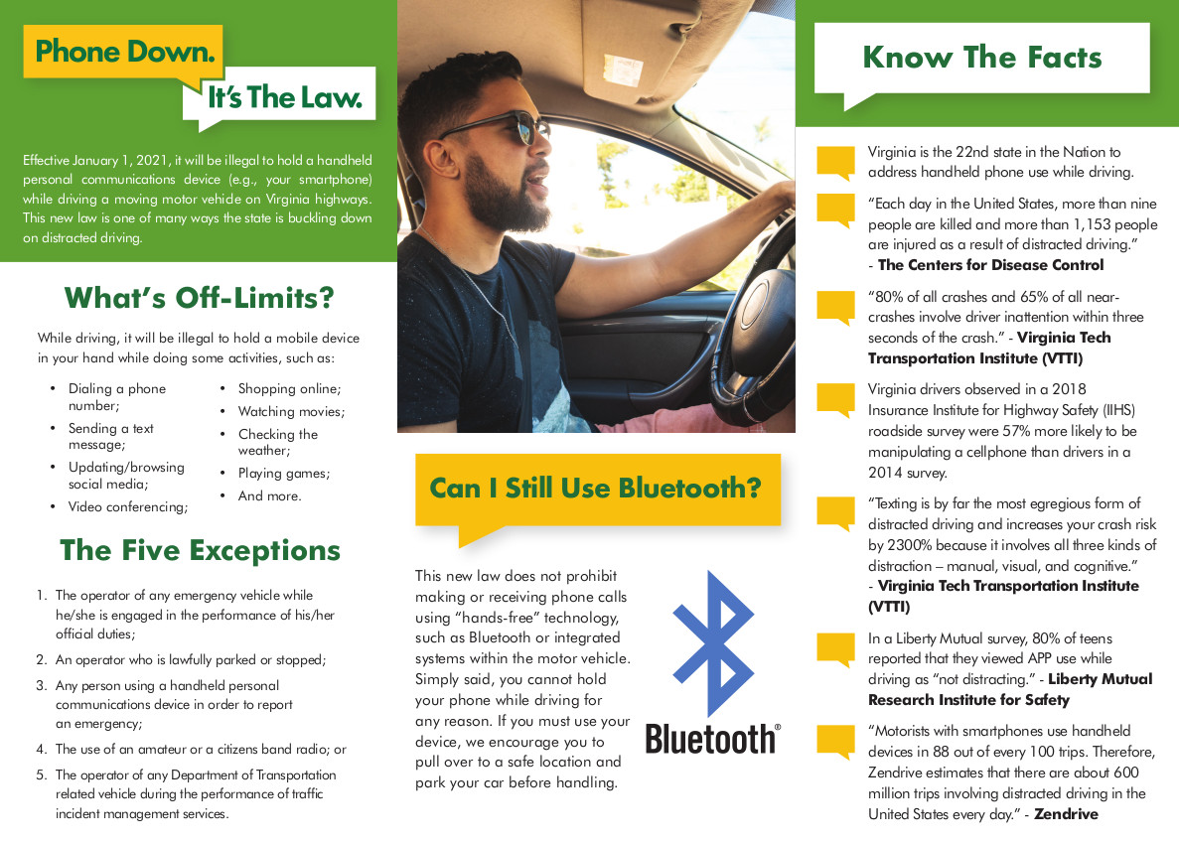
Tri-Fold Brochure (inside)
drivesmartva.org

Slide 10
Tactic: To mobilize and motivate community champions through the Hands-Free Virginia Advisory Council and the Virginia Partners for Safe Driving to help get the word out.
AAA Tidewater added a message to their phone system to advise that the new law was upcoming.
Carilion New River Medical Center distributed posters and e-posters and sent mass email to all employees.
Henrico PD filmed a PSA in partnership with their surrounding counties about the new law.
National Safety Council sent a newsletter to all of the Virginia members
drivesmartva.org

Slide 11
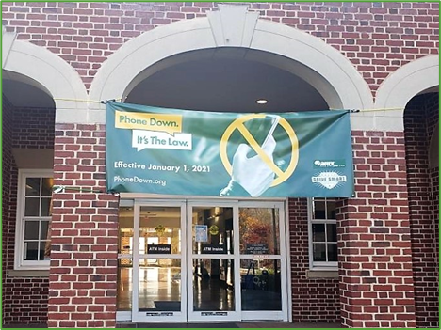
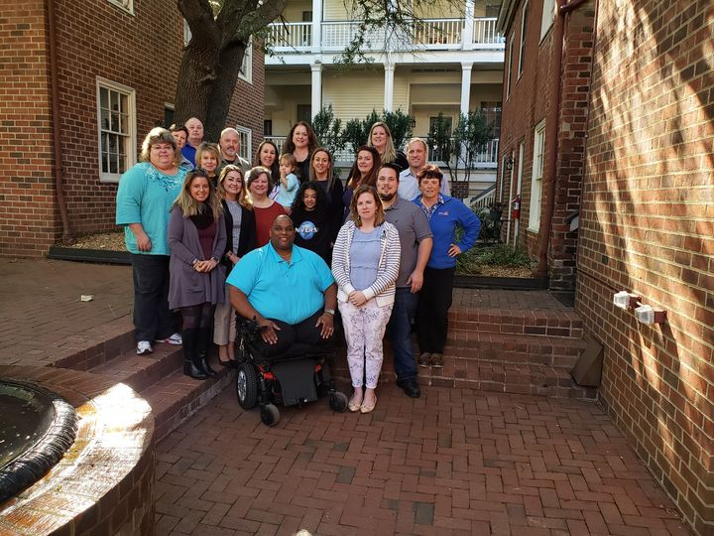
drivesmartva.org

Slide 12
VDOT
Displayed information on VMS statewide
Posters in public spaces and bathrooms
Banner message on 511 Virginia website and phone recording
Messaging on interstate CMS
Messaging from online toolkits posted to internal electronic bulletin boards
Wrote a story for VDOT employees on "Inside VDOT" about the law
Created a VDOT-TV episode about the law
Assisted with big social media push
drivesmartva.org

Slide 13
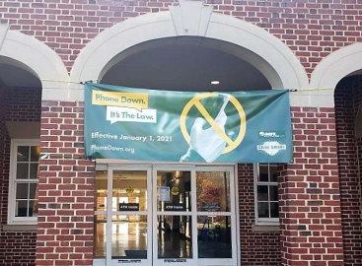
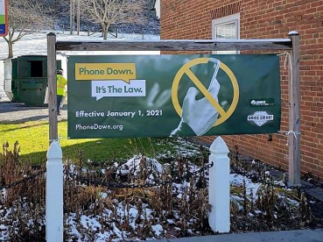
VDOT
Placed banners at rest areas:
drivesmartva.org

Slide 14
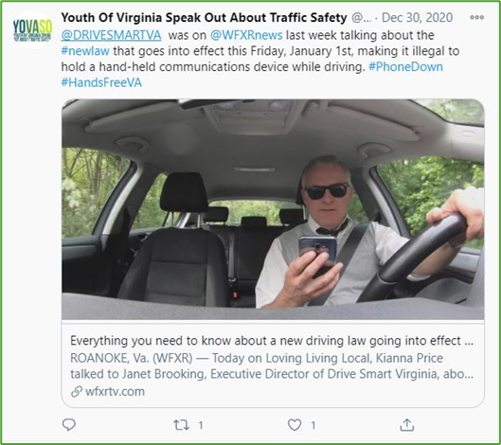
YOVASO
Youth of Virginia Speak Out About Traffic Safety (YOVASO) incorporated the message into all of their fall campaign messaging
Posted to Facebook and Twitter
Shared information with Youth Advisory Council, Advisory Board and almost 200 schools/school groups,
Participated in two TV media interviews about the new law
Added message to YOVASO holiday email.
drivesmartva.org

Slide 15
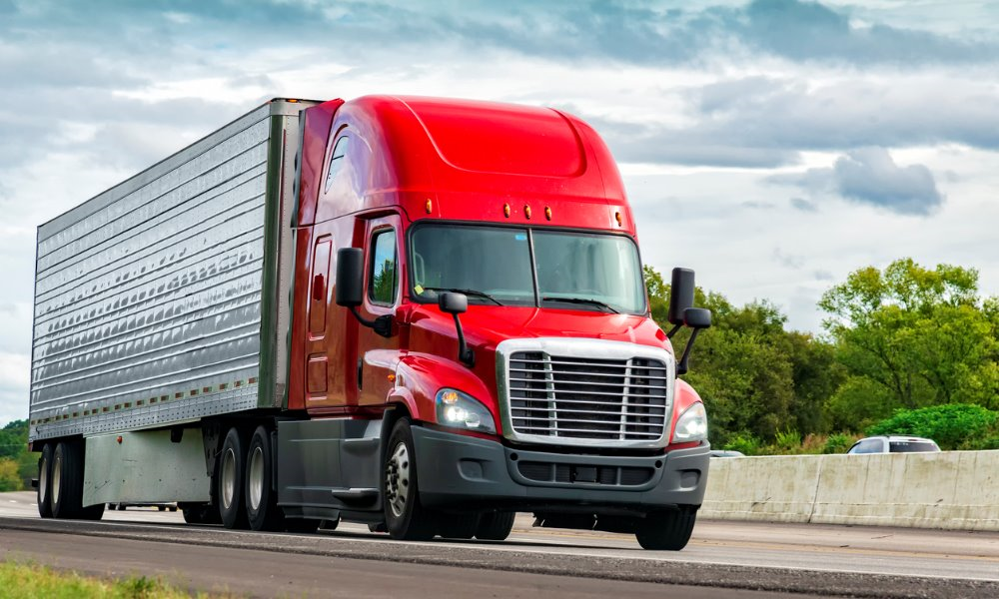
Virginia Trucking Association
The Virginia Trucking Association Shared information during truck driver appreciation event. Placed signage at weigh stations. Sent the word out to members.
drivesmartva.org

Slide 16
Community Partners helped increase the footprint of this project significantly.
* More than 300 partners ordered materials from our FREE online store
* 46% of brochures ordered were ordered by law enforcement. 30% of posters were ordered by non-profits
* Hundreds of entities shared our content on social media and used our hashtags #handsfreeVA #phonedown
drivesmartva.org

Slide 17
Tactic: To leverage our social media platforms to push the “Phone Down, It’s the Law” message out
drivesmartva.org

Slide 18
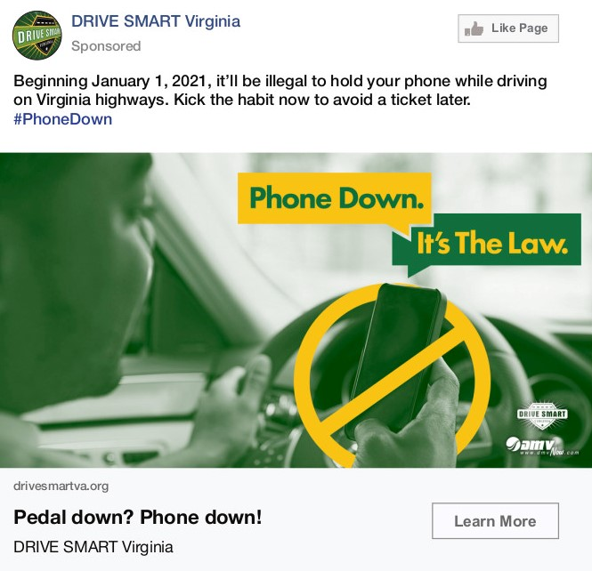
Twitter Ad
Impressions | Audience | Follows | Duration
2,518,022 | Virginia | 686 | 20 Days
Phone Down, It’s The Law
drivesmartva.org

Slide 19
Facebook Ad
Reach | Engagement | Shares | Duration
116,200 | 74,340 | 1,358 | 19 Days
Phone Down, It’s The Law
drivesmartva.org

Slide 20
Instagram Ad
Impressions | ThruPlays | Results Rate | Duration
324,419 | 330,200 | 101.85% | 19 Days
Phone Down, It’s The Law
drivesmartva.org

Slide 21
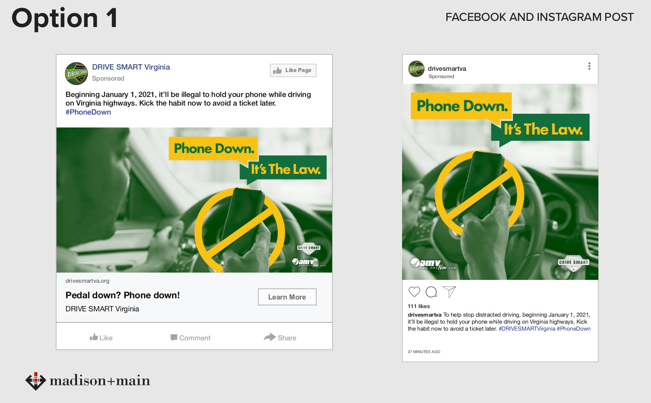
drivesmartva.org

Slide 22
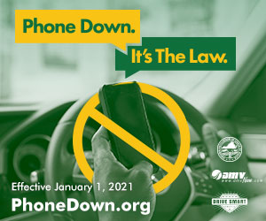
drivesmartva.org

Slide 23
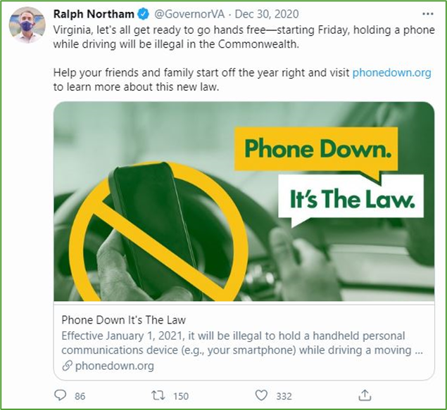
Continued to Engage the Virginia Governor and Bill Patrons
Bill Signing Press Conference
December Press Conference
drivesmartva.org

Slide 24
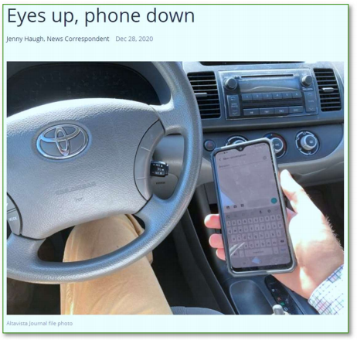
Tactic: To leverage earned media opportunities to reach the widest, most diverse population possible.
19 Newspaper Stories
30 Television Stories
7 Online Stories (blogs, etc.)
drivesmartva.org

Slide 25
Public Service Announcement
State Farm Insurance funded a PSA to raise awareness about the new law.
drivesmartva.org

Slide 26
Radio PSA
DRIVE SMART Virginia produced a 30-second PSA. The Virginia Association of Broadcasters distributed the PSA to its 230 member radio stations.
https://soundcloud.com/user-351119834/newlaw
drivesmartva.org

Slide 27
Podcast
DRIVE SMART Virginia produces an interview-format podcast focused on traffic safety. This year, The Road We Travel did a 3-part series on the new law and distracted driving.
Episode 3: VTTI, Dr. Charlie Klauer
drivesmartva.org

Slide 28
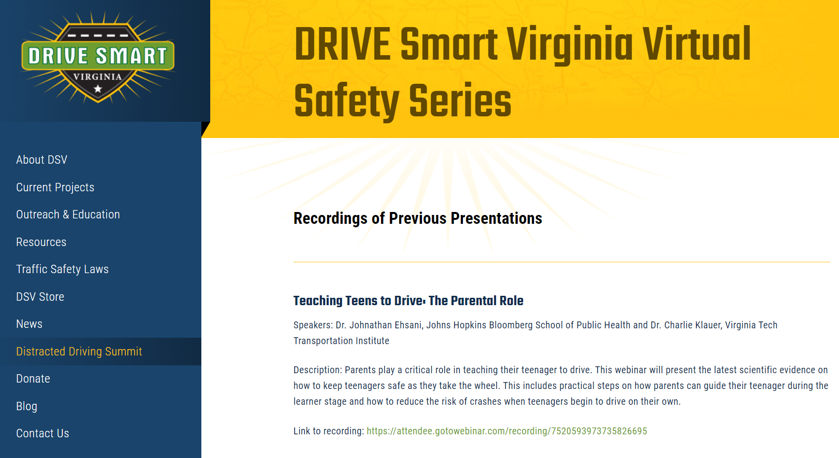
Distracted Driving Summit
Since 2013, this annual conference focuses on how we can tackle distracted driving through advocacy, enforcement, corporate policies, education, and research. Hundreds of attendees hear experts from around the country talk about the most cutting-edge solutions for distracted driving.
For 2020, DRIVE SMART Virginia conducted a series of 12 webinars related to distracted driving. We had over 2,000 registrants and over 900 unique registrants.
drivesmartva.org

Slide 29
Janet Brooking
DRIVE SMART Virginia
janet.brooking@drivesmartva.org
drivesmartva.org

