Slide 1
Cultivating An Influential workplace safety culture to improve roadway safety
Matthew Camden

Slide 2
What Is Organizational Safety Culture?
Your Safety Culture
Safety Programs
Safety Countermeasures
Mitigation of Unsafe Behavior
Improved Safety Performance
Employees’ values, attitudes, beliefs, and behaviors regarding safety
They are shared across the organization
Organizational Safety Culture = “It’s the way we do things around here”

Slide 3
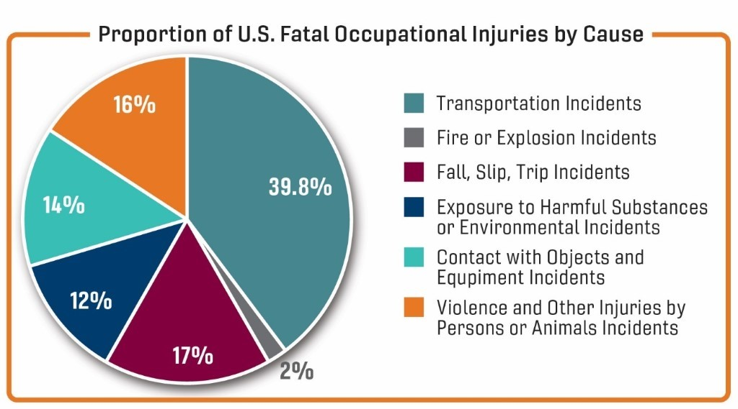
Why is organizational Safety Culture Important for road safety?
#1 work-related death
2,122 fatalities in 2019
Affects nearly every industry
Not just trucks/buses
55% of workers were not in a motor vehicle operator job
$40 billion costs to companies

Slide 4
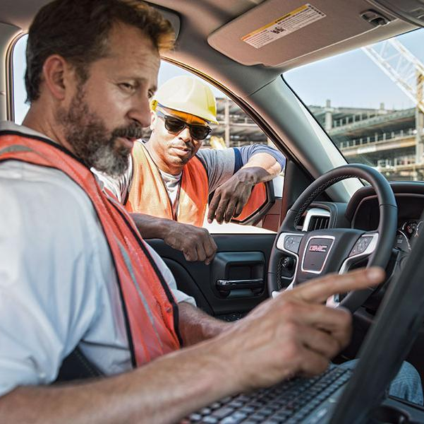
Improving Safety Culture
Focus on the Employee
Starts with getting the correct (i.e., the safe) employee the first time
Get to know how the applicant is
Stick to your hiring criteria as it relates to driving
Competitive pay & benefits
Driving-focused safety training
Training to reinforce importance of safety
Not just for new employees
Leverage technology

Slide 5
Building an Influential road Safety Culture
Senior level commitment and employee buy-in
1
Benchmarking safety
2
Policies and procedures
3
Vehicle selection and maintenance
4
Safety awareness
5
Safety program evaluation
6

Slide 6
Senior-Level Commitment to Safety
Getting employees to buy-in
Senior management provides
Leadership
Sets policies
Allocates resources
Encourage participation from everyone
“Walk the talk”
Define roles and responsibilities
Management
Drivers

Slide 7
Benchmarking safety
Evaluate current state of risky driving in fleet
Identify the following
3 most frequent risky behaviors
Other severe risky behaviors
Frequency compared to industry
Management’s response
Contributing factors
Factors reinforcing risky behaviors

Slide 8
Policies and Procedures
Policies to cover risky behaviors
Driver agreements
Procedures for motor vehicle record (MVR) checks
Crash reporting and investigations
Reward/ incentive programs to encourage safe driving
Disciplinary action systems

Slide 9
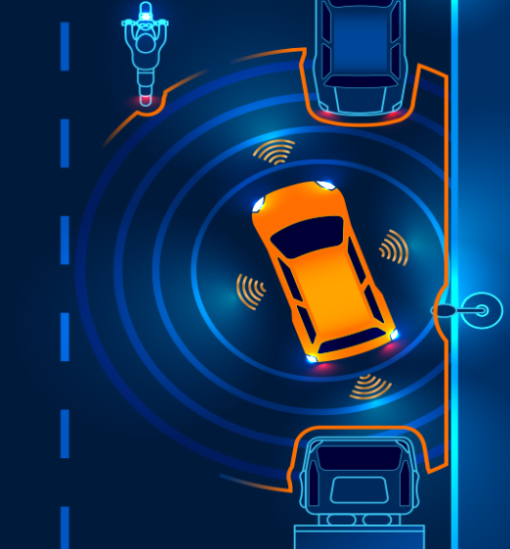
Vehicle Selection and Maintenance
Consider the addition of advanced safety features
Prevent crashes
Save lives
Positive ROI
Importance of preventative maintenance
Post trip inspections
Process for reporting issues

Slide 10
Safety Awareness
Introduce new emphasis on fleet safety
Reasons for increased focus
Roles/responsibility
New policies and procedures
Consider new education/training
Defensive driver training
Examine how safety information is shared
Newsletters
Online training
Weekly safety meetings/emails

Slide 11
Safety Program & Culture Evaluation
Collect Data
Evaluate Program
Emerging Risky Behaviors
Identify Operational Changes
Improve Effectiveness
Ongoing communication
Regularly review data
Operational changes
Data suggests safety not improved
New technologies/task added
Consider:
Are procedures working?
Emerging risky behaviors?
Safety now vs. be

Slide 12
Matt Camden
mcamden@vtti.vt.edu

