Slide 1
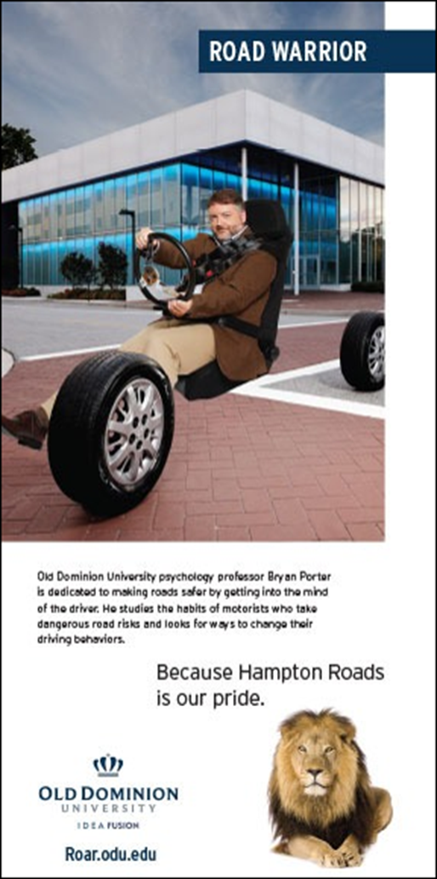
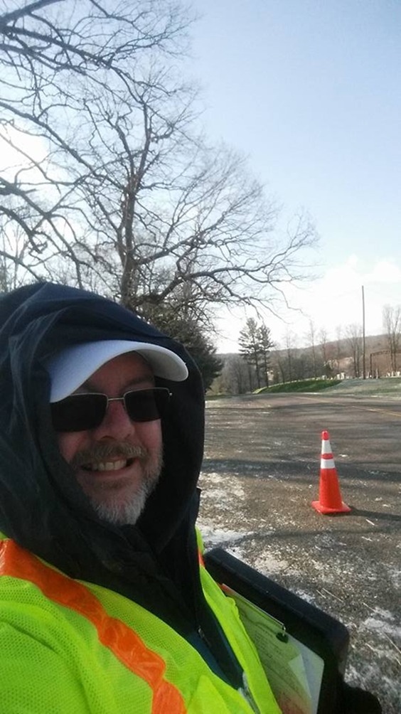


Brain to Functional Behavior Control
Foundations of the Distracted Driver
Bryan E. Porter, Ph.D.
Associate Dean of the Graduate School
& Professor of Psychology
+1-757-683-3259
bporter@odu.edu

Slide 2

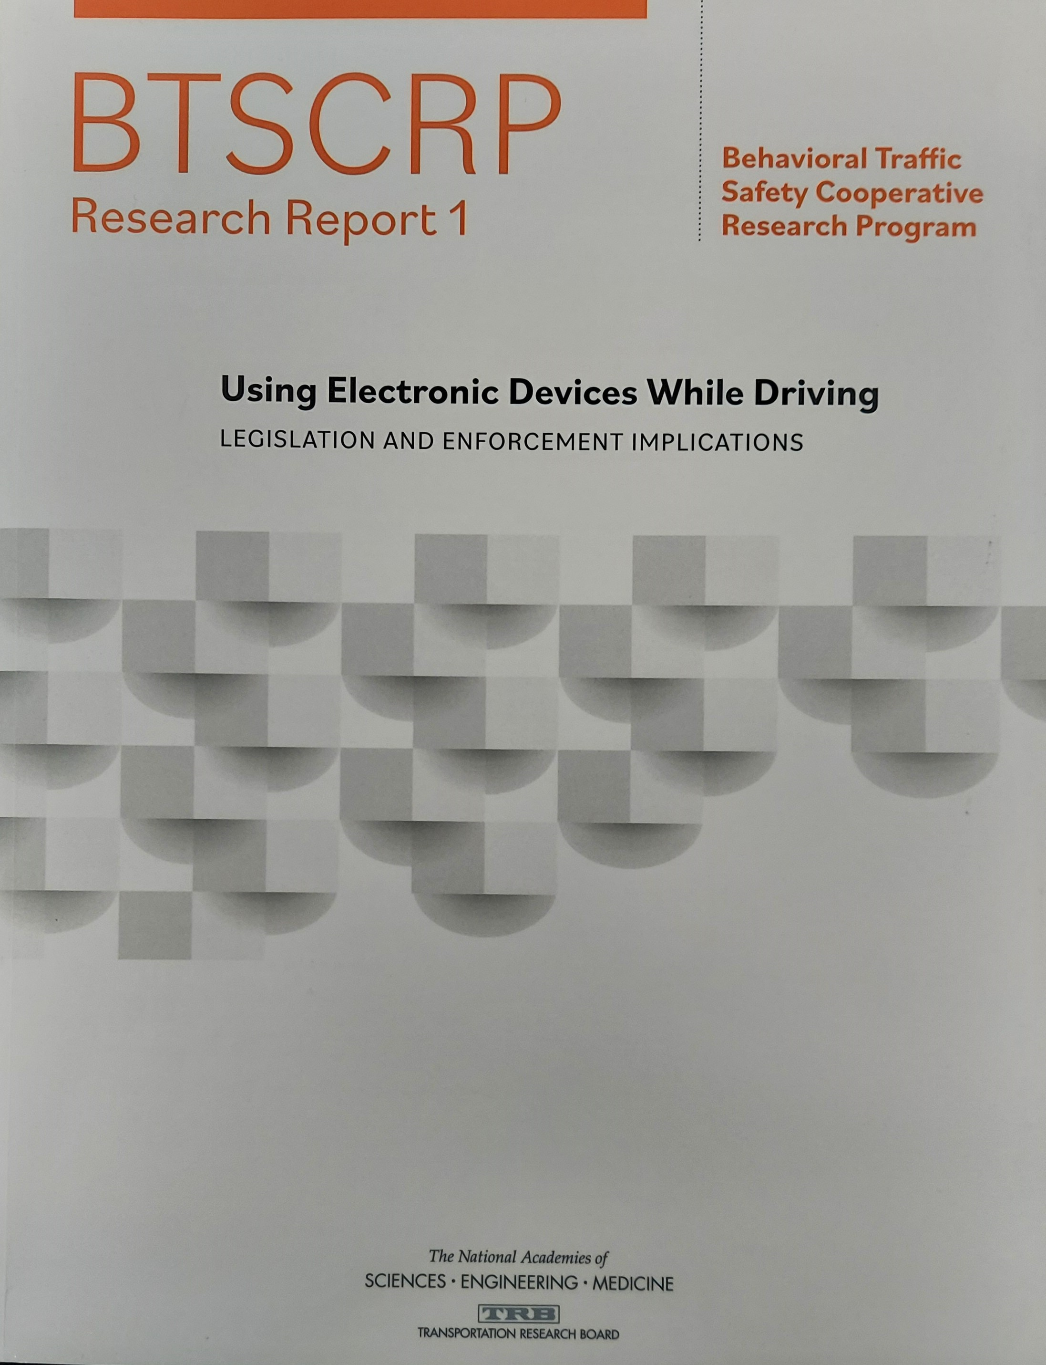
Some reading material…and not just my work!

Slide 3
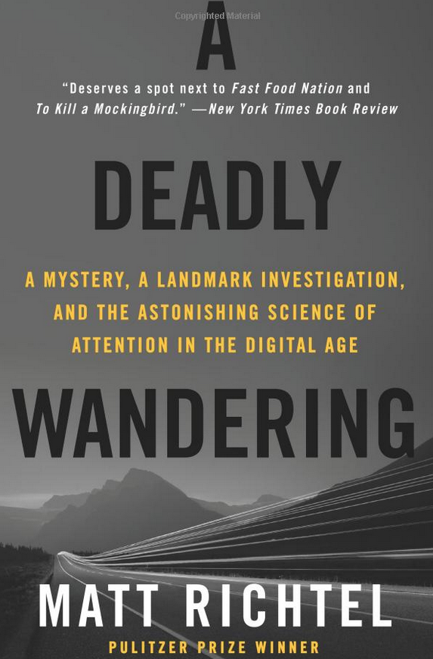
A few years ago, at this Summit…

Slide 4
In the next 15 minutes…
1. “CRASH” course in dopamine pathways (cliff notes’ version).
2. “LIGHTNING” round course in CONDITIONING theories in psychology.
3. Why do we care? Applications to phone use habits that impact distractions.
4. Countermeasure hopes...

Slide 5
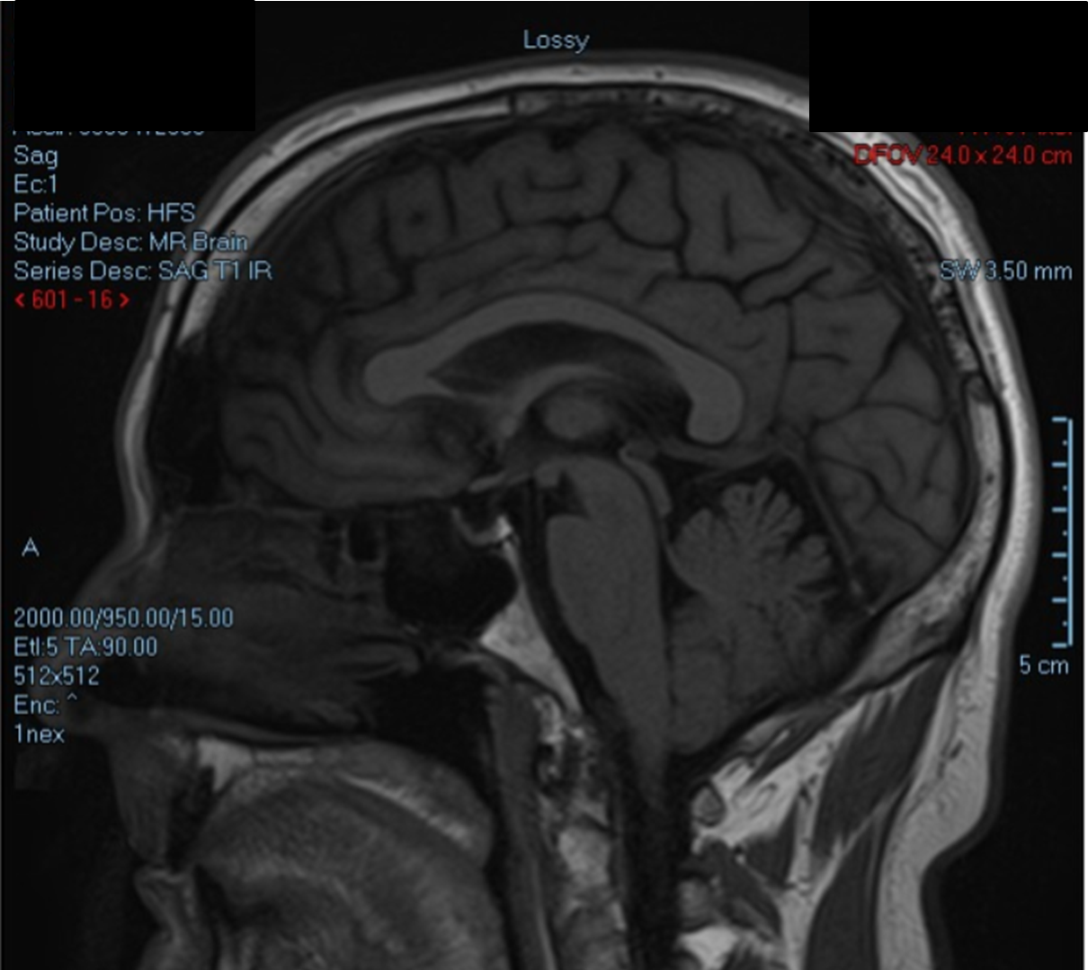
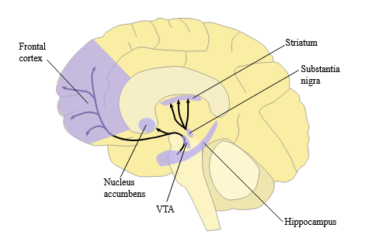
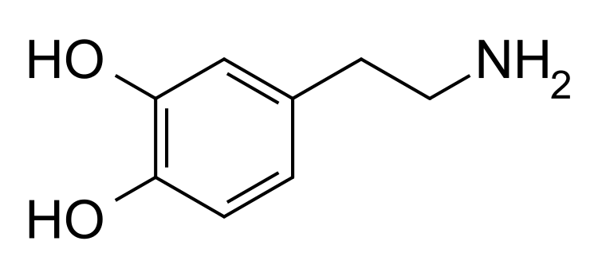
Dopamine

Slide 6
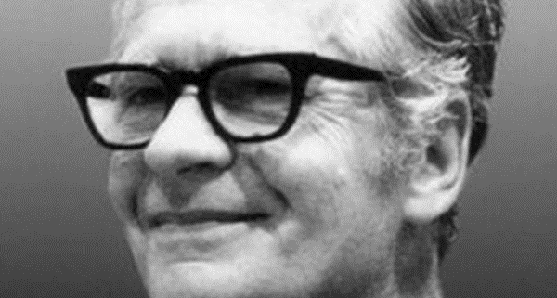
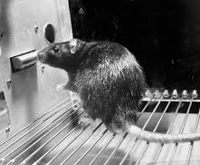
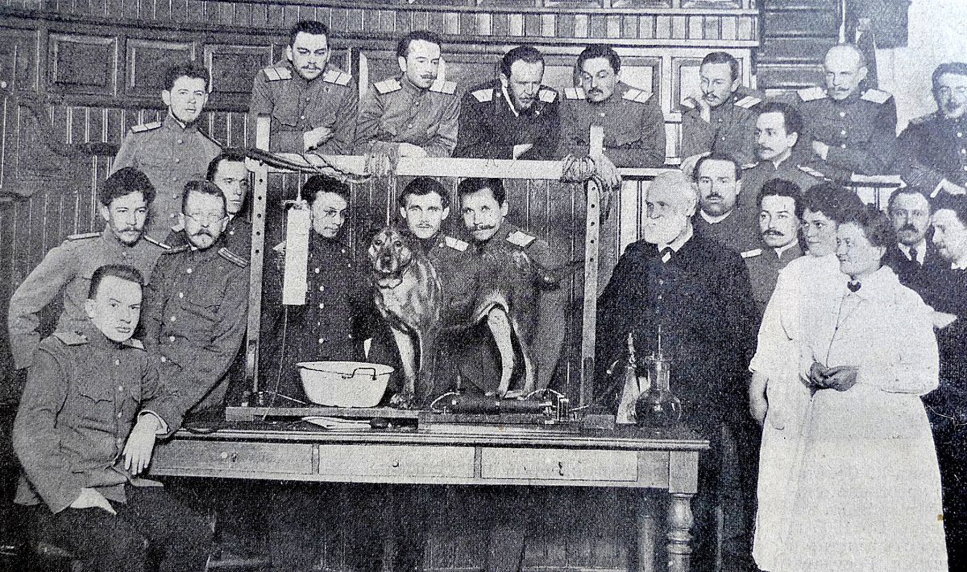
Conditioning

Slide 7
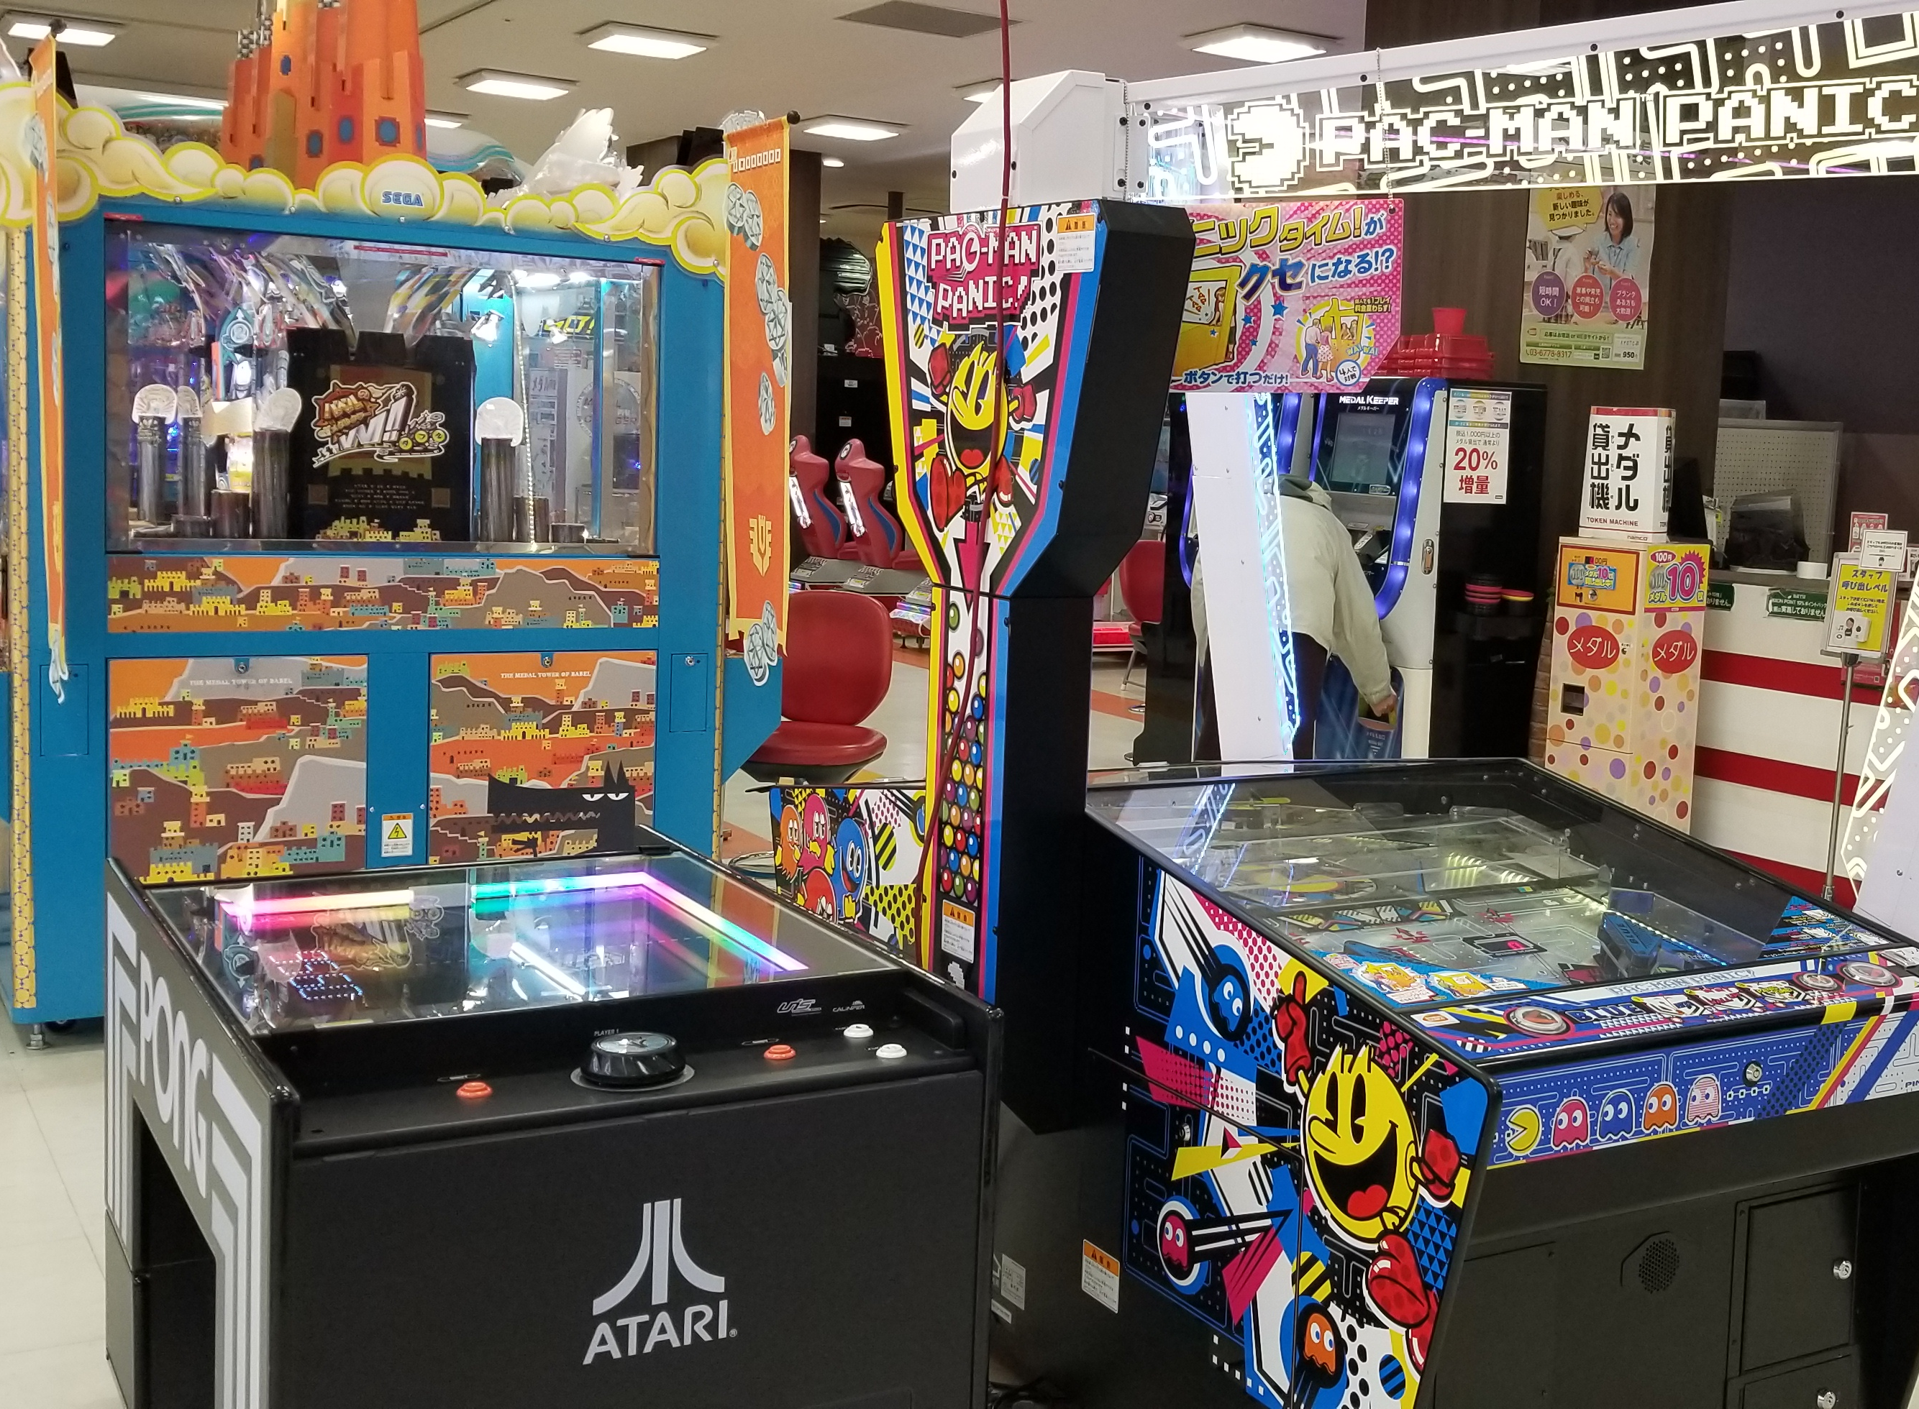
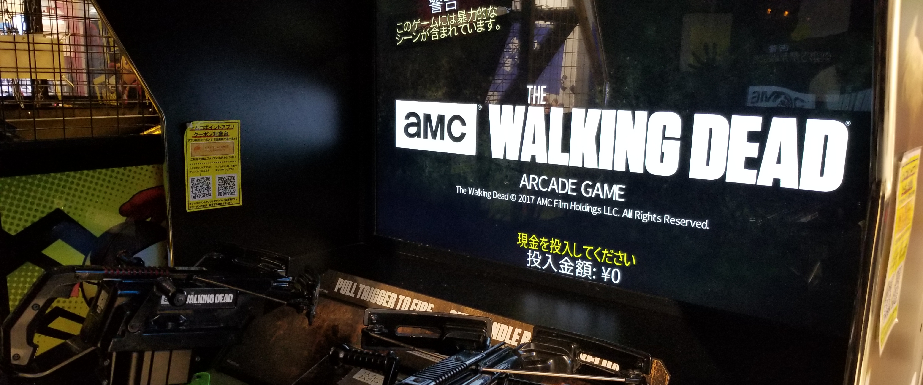
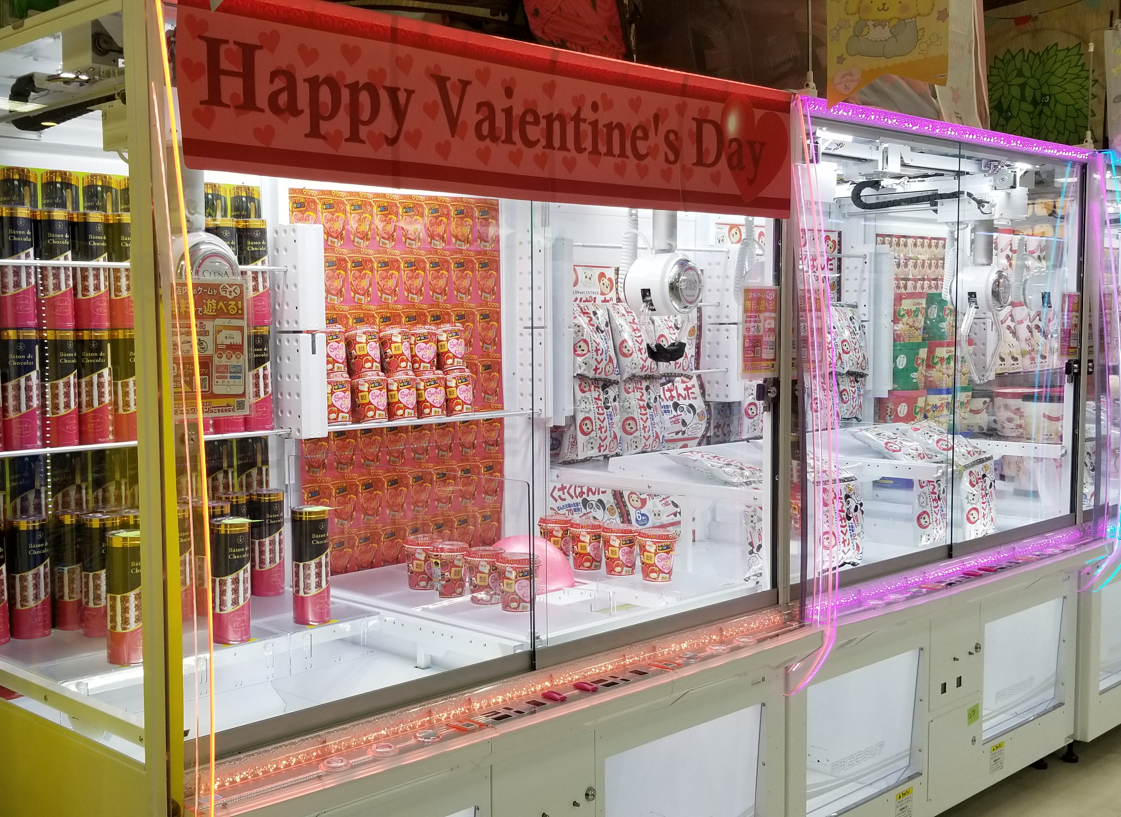
Why do we care?

Slide 8
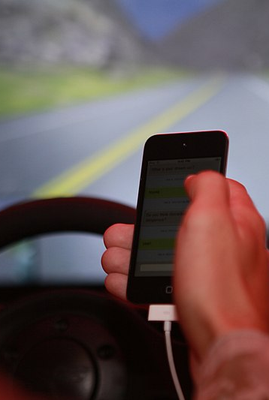
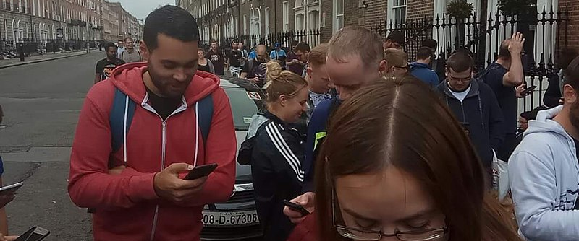
And now our phones, habits, & hopes for behavior change

Slide 9
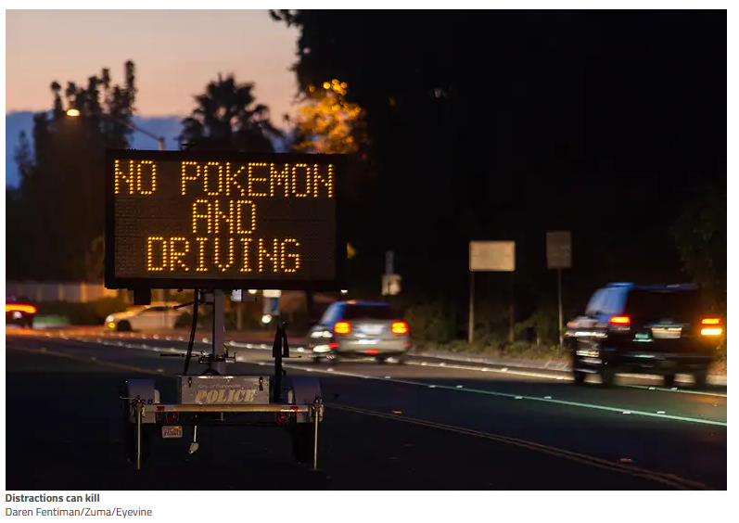

Slide 10
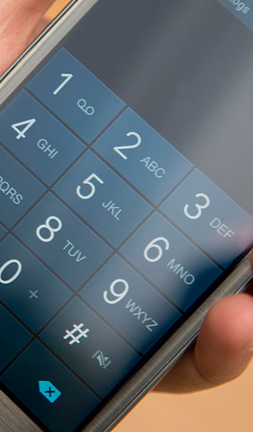

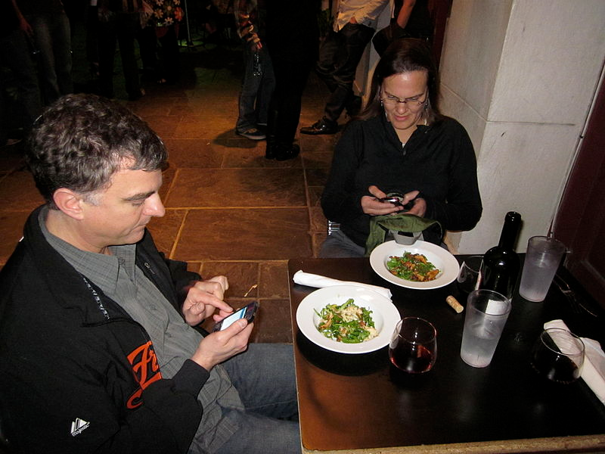
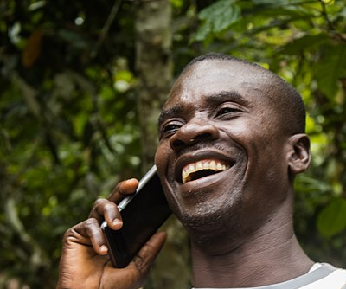

Slide 11
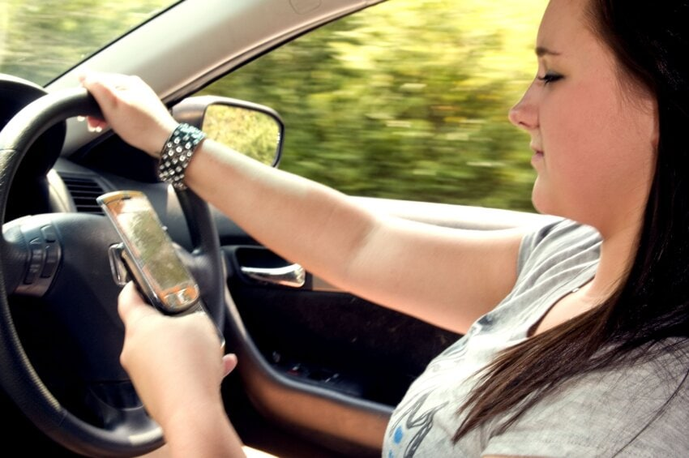
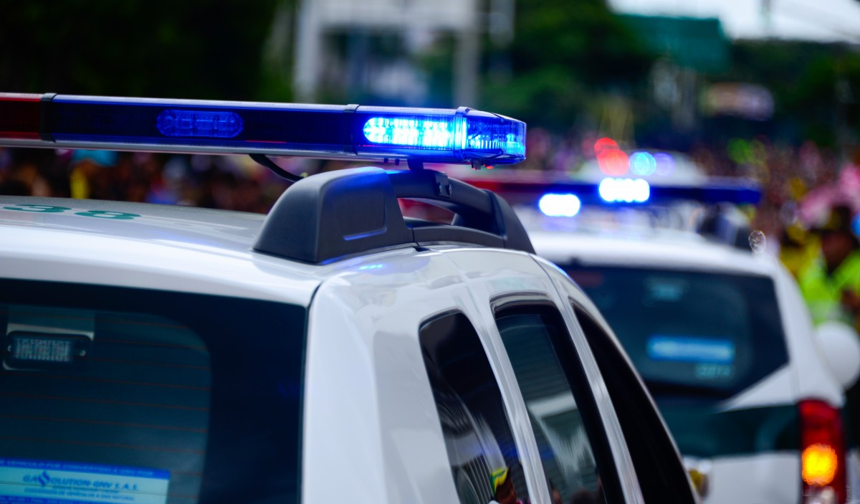
Extinguishing the habit…
…countermeasures (that work)…

Slide 12
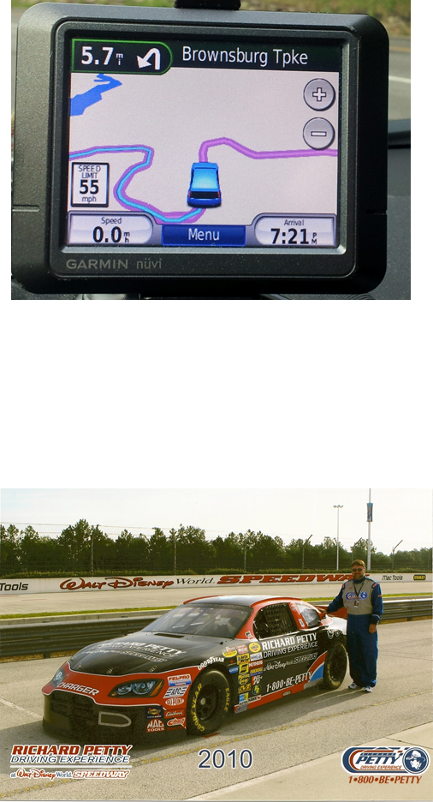


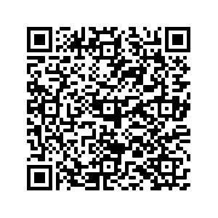
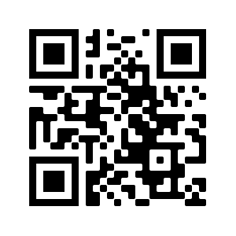


Contact Information
THANK YOU for your attention!
Bryan E. Porter, Ph.D.
Associate Dean of the Graduate School
& Professor of Psychology
2102 Monarch Hall
Old Dominion University
Norfolk, Virginia 23504, USA
+1-757-683-3259
bporter@odu.edu

