Slide 1
Passengers Will Speak Up if They Know What to Say and Are Confident They Will be Successful
Drive Smart Virginia Distracted Driving Summit
Norfolk, Virginia | August 18, 2022
Joel D Feldman, Esq., MS
Info@EndDD.org

Slide 2
Casey Feldman, 1988 - 2009
Notes:
Casey Feldman was killed by a distracted driver. She was just 21. She was killed when a driver took his eyes off the road to reach for his GPS. He rolled through a stop sign and hit Casey who was walking in the crosswalk. —she was killed because a driver decided that what he wanted to do was more important than the safety of others—the driver was 58 years old. Just a few seconds of distraction cost Casey her life—there are so many tragic stories like Casey’s—they happen each and every day. You will learn more about Casey and her death later in the presentation.
Her father drove distracted like many of us before Casey’s death. After her death he realized that he had been taking chances driving for years. He realized that he had not been a safe driver but rather a lucky driver. It took Casey’s death for him to change the way that he drove. Sometimes it takes a personal tragedy for us to change… Must it take a personal tragedy for each of us to change the way we drive? That is why I am here today—hoping that you can decide to drive safer before you lose a friend or family member, or before you cause a crash and inure of kill someone else.

Slide 3
Reasons Teens Give for NOT Speaking Up When Driver is Distracted
“They will get angry if I say anything about their driving.”
“I don’t know what to say.”
“I don’t know if it will work.”
Notes:
These are the obstacles, the barriers for speaking up-especially for teens. Worry about offending the driver and not knowing what to say and whether what is said will really work. Remove the barriers and they will speak up and be very effective. Remember there are 2 parties to this conversation. Understanding how both parties might feel/react in an intervention is crucial.

Slide 4
How Do Drivers Feel When Passengers Speak Up?
De Sales University Focus Group 8-1-22

Slide 5
Passengers Concerns
What do I say, and if I do say something will it work?

Slide 6
Using “I” Statements to Effectively Speak Up When Others Drive Distracted
“I don’t feel safe when you drive me and look at your phone.”
Non-confrontational.
Respectful.
Not demanding anything—just stating how one feels.
Notes:
Let’s talk about the difference between speaking up using an “I” statement or a “you” statement. How you speak up makes all the difference. An “I” statement tells another person how you feel. It does not blame them, it does not accuse them of anything and is respectful. I don’t feel safe when you look at your phone while driving me. That’s very different from saying “You are a terrible driver,” or “You will cause a crash.” “You” statements are confrontational and won’t be appreciated by your driver.
“You” statements are confrontational and blaming. Think of this one from mom or dad
“You never clean up your room!” You likely would get defensive and angrily respond “yes I do.”
Would you feel differently if a parent said, “After working all day and doing other chores I get tired and really could use some help keeping our house clean.”

Slide 7
How would you like your passenger to speak with you?
“Get off your phone you idiot!”
“You will kill me and everyone on the road!”
“I don’t feel safe when you drive me and look at your phone and not the road.”
Notes:
How would you like your passenger to speak with you?
And just have that be on the slide and with successive clicks have these appear:
“Get off your phone you idiot!”
“You will kill me and everyone on the road!”
“I don’t feel safe when you drive me and look at your phone and not the road.”

Slide 8
EndDD.org and Safe Roads Alliance Elementary School Distracted Driving Lesson Plans
2-3rd grade & 4-5th grade
30-45 minutes
Teacher’s guide, power point, step by step notes, with 3 videos
Notes:
EndDD.org and Safe Roads Alliance Elementary School Distracted Driving Lesson Plans
2-3rd grade & 4-5th grade
30-45 minutes
Teacher’s guide, power point, step by step notes, with 3 videos

Slide 9
Elementary School Curriculum
Notes:
ESLp the 3rd video

Slide 10
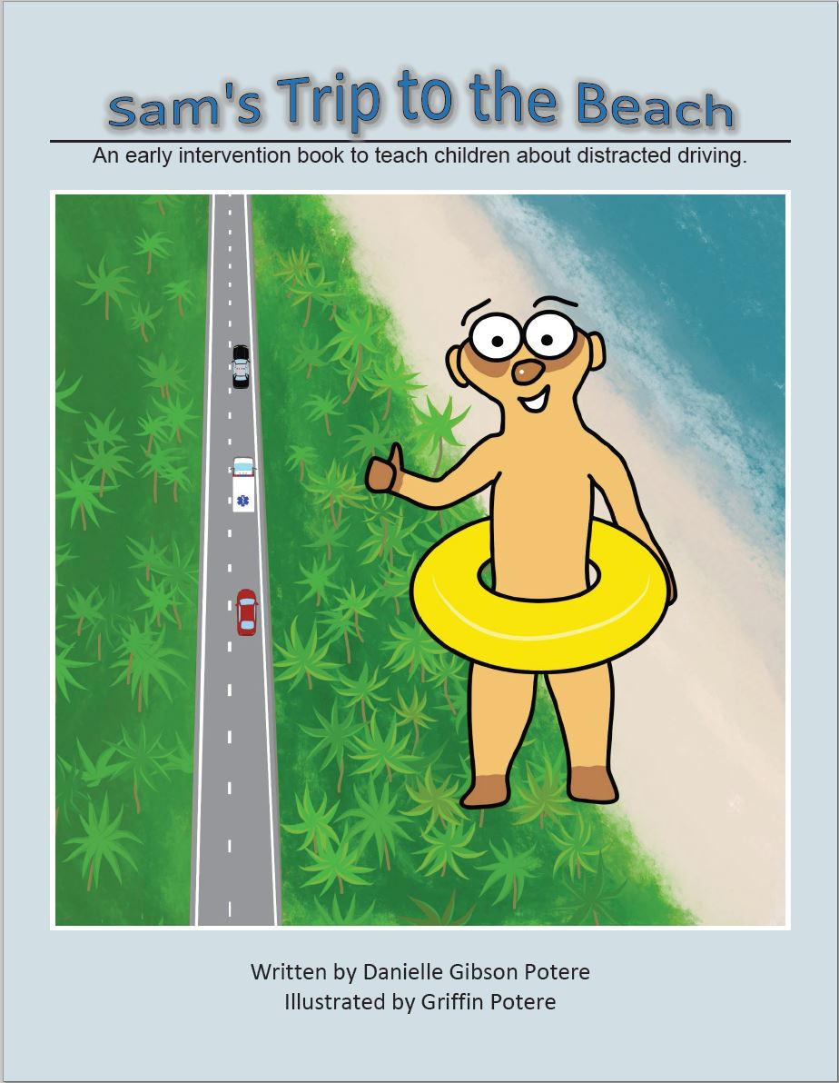

Slide 13
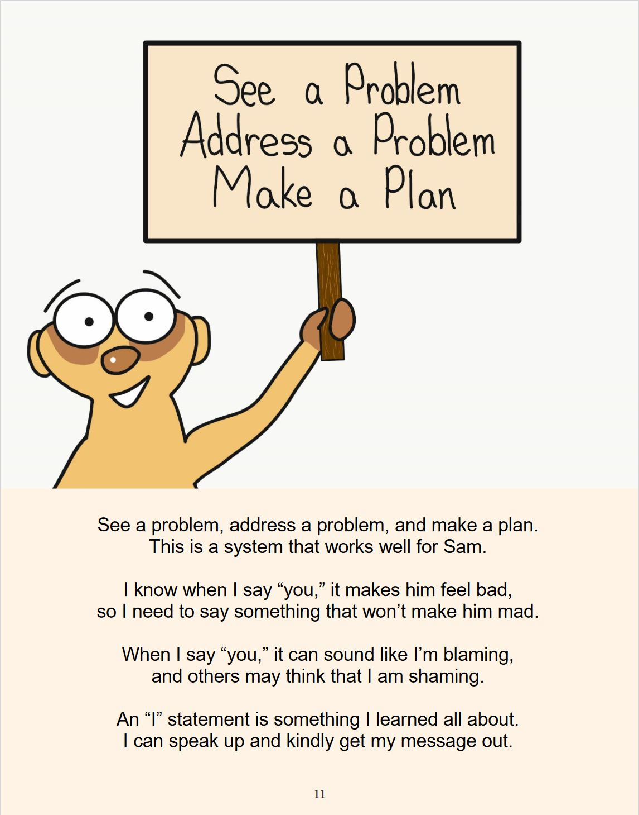

Slide 14
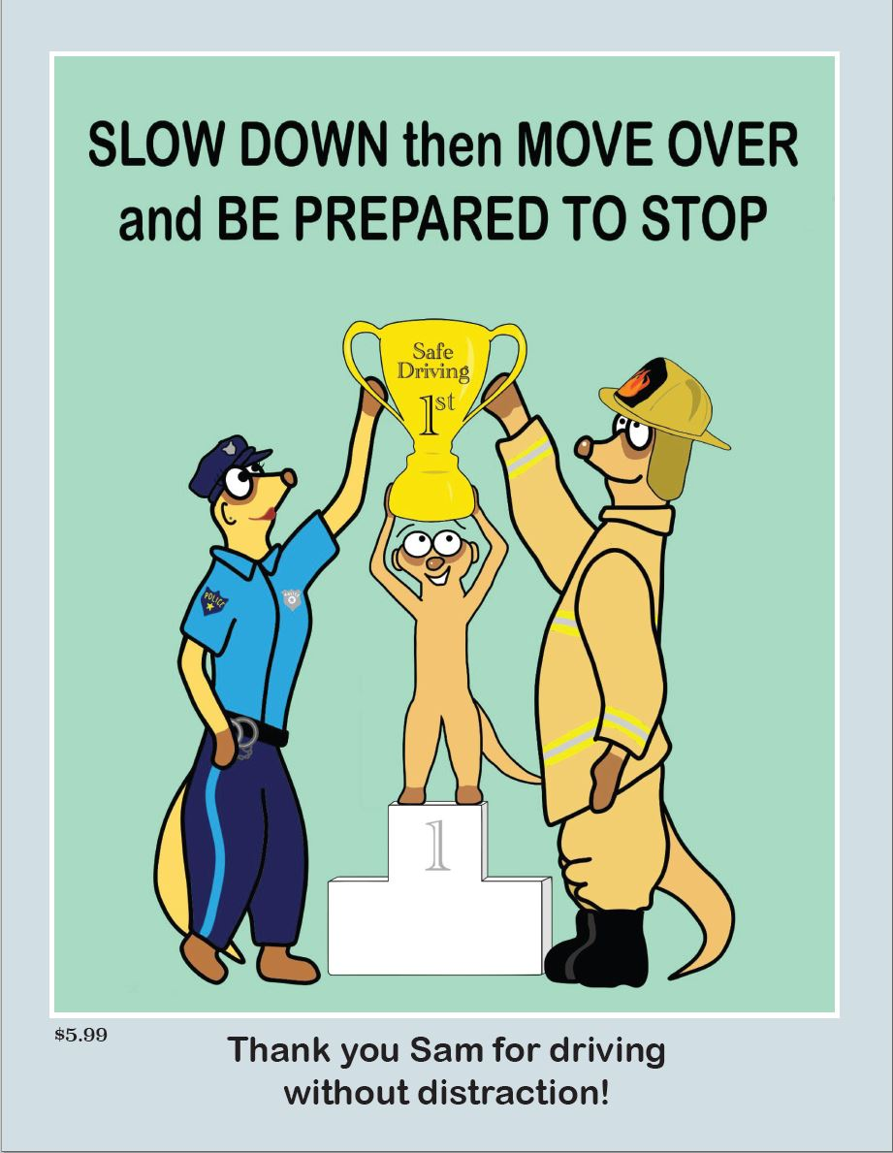

Slide 15
WHAT PERCENTAGE OF TEENS WOULD PUT THEIR PHONES DOWN IF A FRIEND SAID SOMETHING ABOUT IT?
A. 25%
B. 45%
C. 65%
D. 90%

Slide 16
TEENS HAVE THE POWER TO KEEP FRIENDS SAFE
You can keep your friends safe!
78% of teen drivers say they’re likely not to text and drive if friends tell them it's wrong or stupid.
90% say they’d stop if a friend in the car asked them to.
44% say that they would be thankful if a passenger complained about their texting while driving.
AT&T and Connect Safely Survey-2012
Notes:
[Speaker’s Notes: Teens have the power to keep themselves safe and to keep their friends safe. Contrary to what many teens believe, their friends will not be angry if they speak up and tell them they are concerned when they look at their phones and not at the road.
These results can be empowering for teens since the chances of them being successful are so high. http://www.att.com/Common/about_us/pdf/connect_safely_survey_twd.pdf
http://blogs.att.net/consumerblog/story/a7785894]
These statistics should give you confidence that if you do speak up you can be successful in having your friend put down their phone. You can speak up and let your friends know you care about them or you can sit there and hope nothing bad happens.
Each and every one of you has the power to save lives.
Who would be willing to speak up to keep a friend safe?
Lets talk about an effective way to speak up.

Slide 17
What did parents say would be the strongest deterrents to phone use while driving?
Laws
87%
Pressure from children
87%
77%
Employer cell phone possibilities
Educational campaigns
58%
NSC/Cumberland Valley Volunteer Firemen’s Association, March 2021.
Notes:
So, look how effective kids can be when they do speak up when mom and dad drive distracted! Just as effective as passing laws to restrict phone use while driving. You can keep yourself and your family safe just by speaking up respectfully using “I” statements.
https://nsccdn.azureedge.net/nsc.org/media/site-media/docs/newsroom/distracted-parents-results.pdf pages 21-23.

Slide 18
Learning How to Speak Up and Having the Confidence That You Will Be Successful
Health Belief Model
Theory of Planned Behavior
Social Norming
Motivational Interviewing
Notes:
Learning How to Speak Up and Having the Confidence That You Will Be Successful
Health Belief Model
Theory of Planned Behavior
Social Norming
Motivational Interviewing

Slide 19
There are no do-overs in life. Speak up when your driver drives distracted.
Notes:
[Speaker notes-Joel Feldman tested numerous statements before 4 groups of 30 parents. “Mom/dad I love you, but I don’t feel safe when you drive me and look at your phone” was clearly the most effective statement. A number of moms and dads in the audience were visibly shaken, had tears and committed right then to be better role models for their kids.
If you are concerned by your driver’s actions speak up then and there using an “I” statement. You may not get a second chance.

Slide 20
THANK YOU!
Joel Feldman
EndDD.org
info@EndDD.org
Notes:
THANK YOU!
Joel Feldman
EndDD.org
info@EndDD.org

