Slide 1
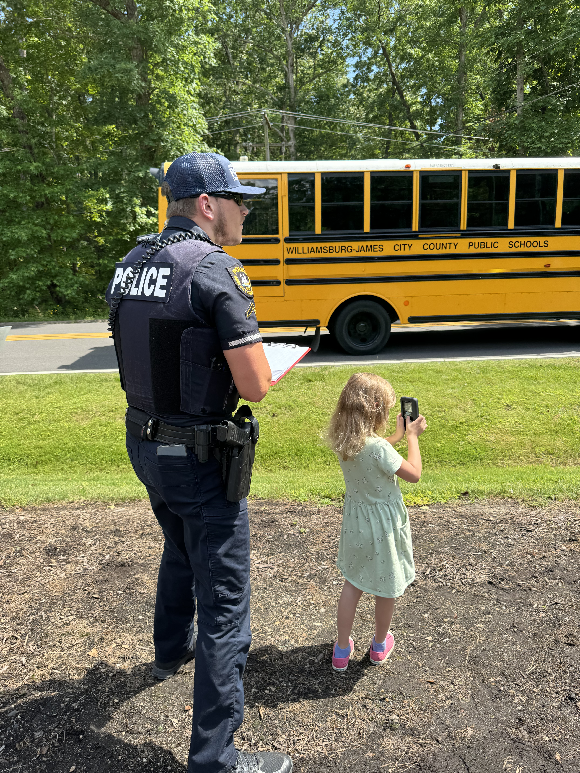
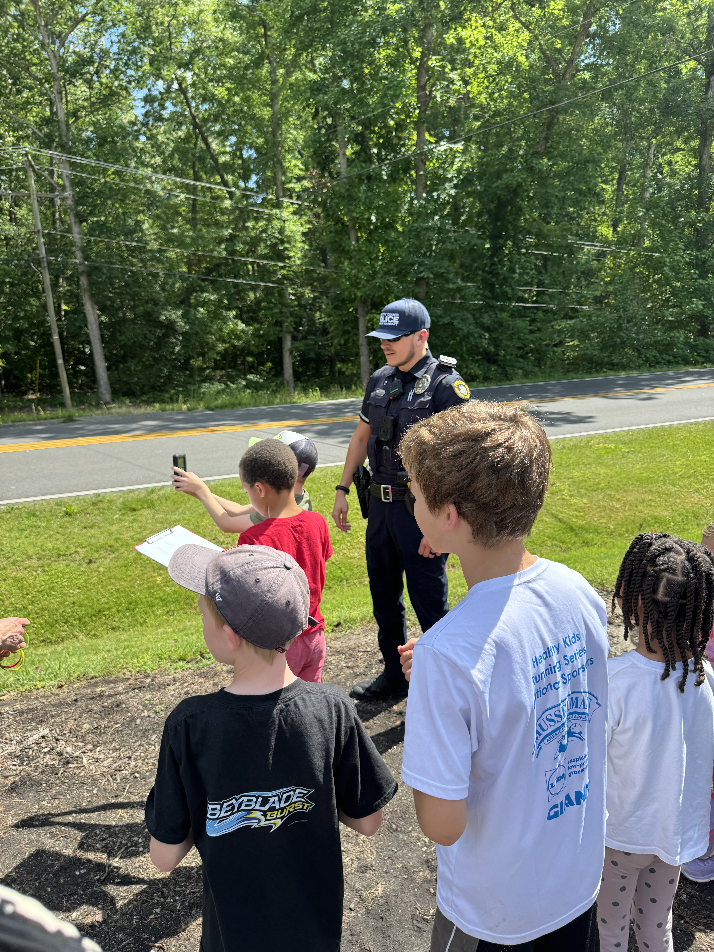
Welcome Jr. Speed Busters!

Slide 2
Seat Belts- required in every seat every time for every age!
Safe Speeds-driving too fast is dangerous especially in school zones.
As a Jr. Speed Buster
I agree to be:
SAFE by

Slide 3
As a Jr. Speed Buster I agree to be:
FOCUSED
No Distractions- remind adults no cell phones while driving and don’t be a distraction to the driver.
Pay Attention- while walking or biking

Slide 4
Make Safe Choices- and remind adults to follow the rules too!
Community Helper- by reminding friends about staying safe on the roads.
As a Jr. Speed Buster I agree to be SMART:

