Slide 1


Distracted Driving Awareness
DRIVE SMART Virginia
drivesmartva.org

Slide 2

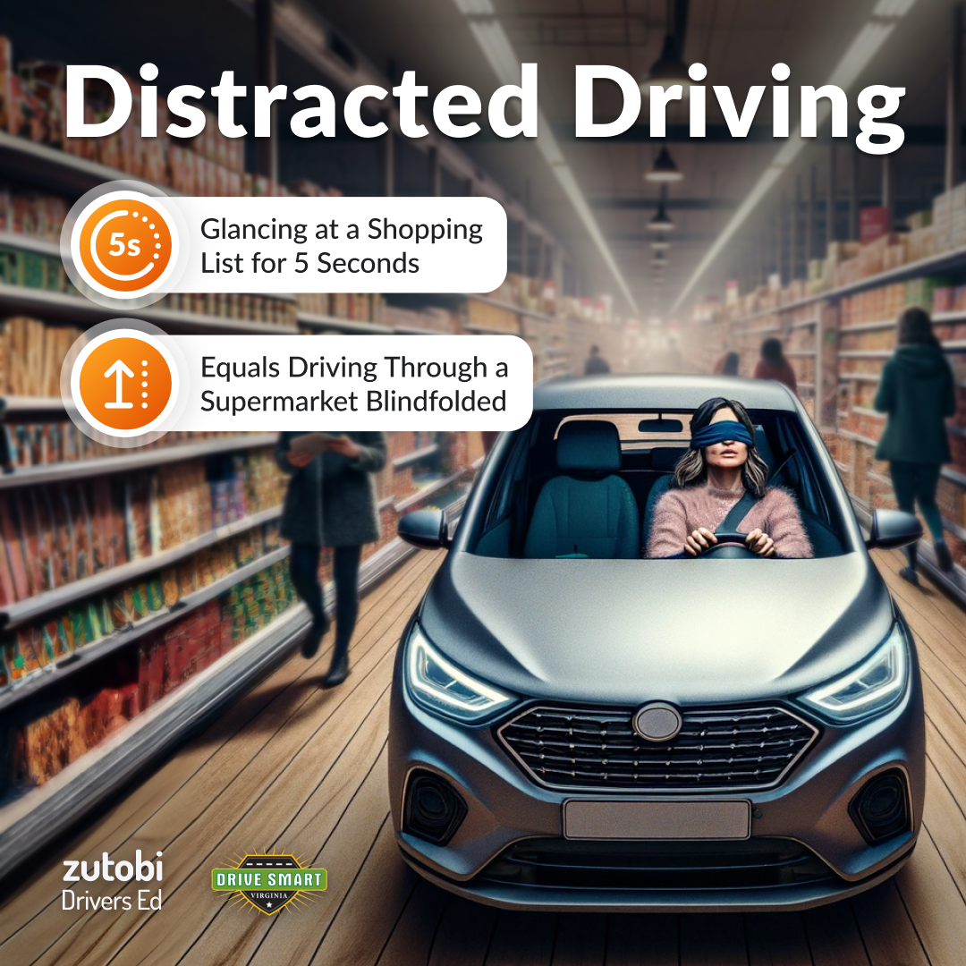
Distracted Driving:
Anything a driver does which draws their attention away from the task of driving.
Today’s driver is faced with more potential distractions than ever before.
drivesmartva.org

Slide 3
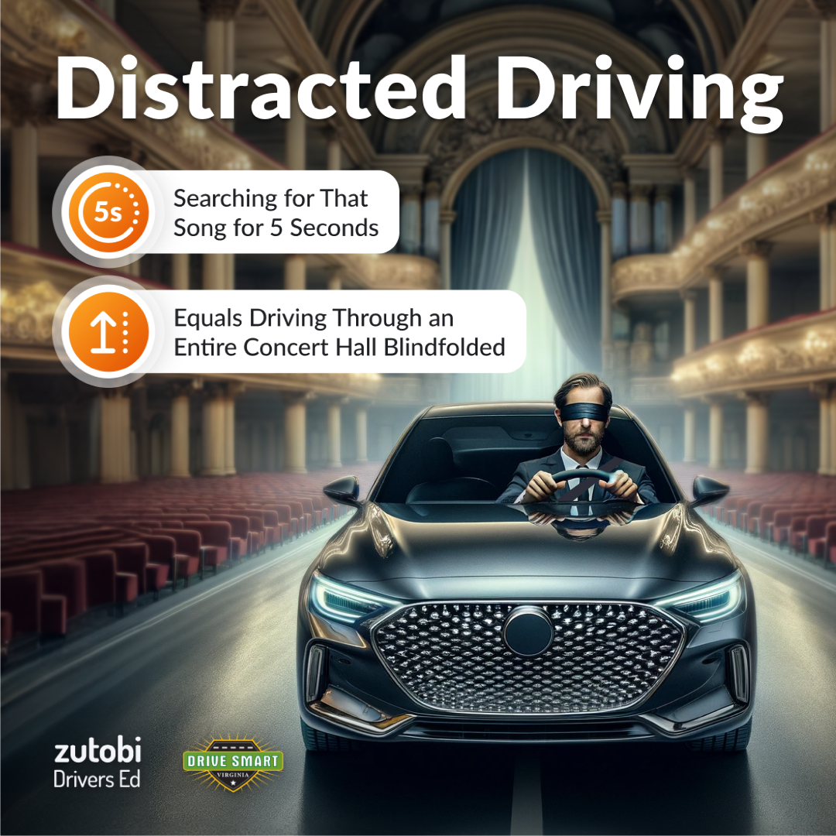
Eating, Grooming, Searching for a Song, Entering Address Into GPS, Calming a Child Passenger, Looking at a Roadside Incident, Checking Social Media, Reading Email, Texting, Applying Makeup, Reaching for an Object…
What can YOU think of?
drivesmartva.org

Slide 4
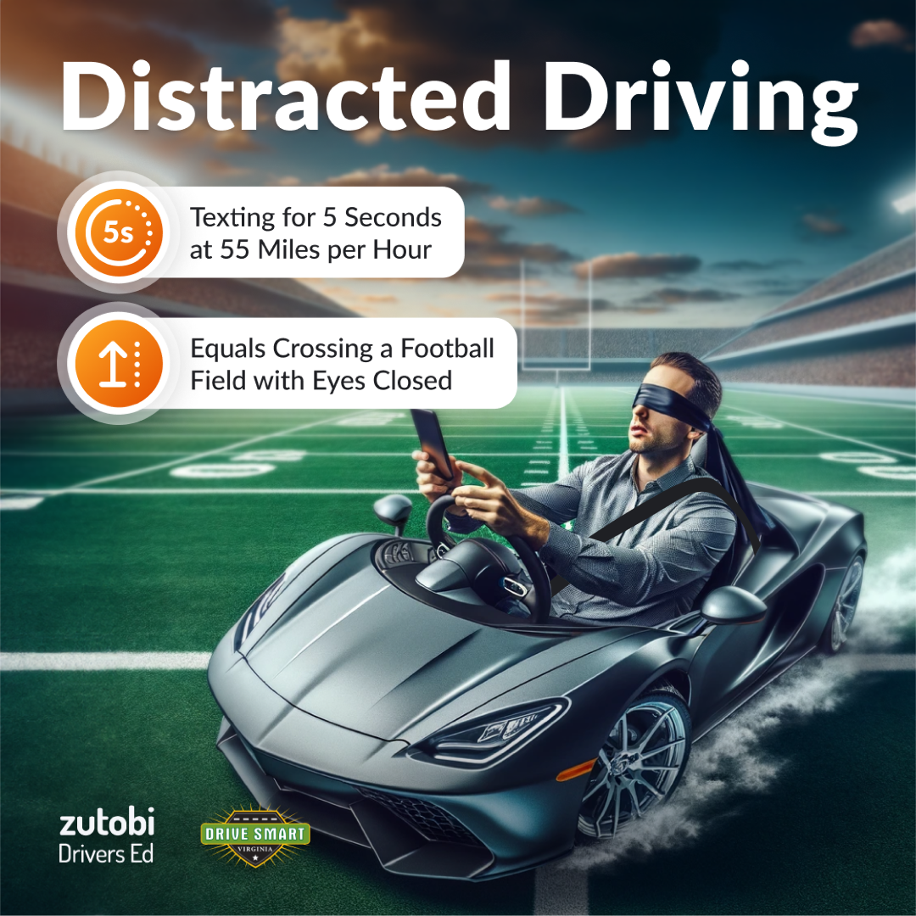
In Virginia In 2023:
64 People Were Killed
11,521 People Were Injured
Top 3 Distracted Driving Behaviors:
    Eyes Not On Road
    Cell Phone/Texting
    Looking At Roadside Incident
drivesmartva.org

Slide 5
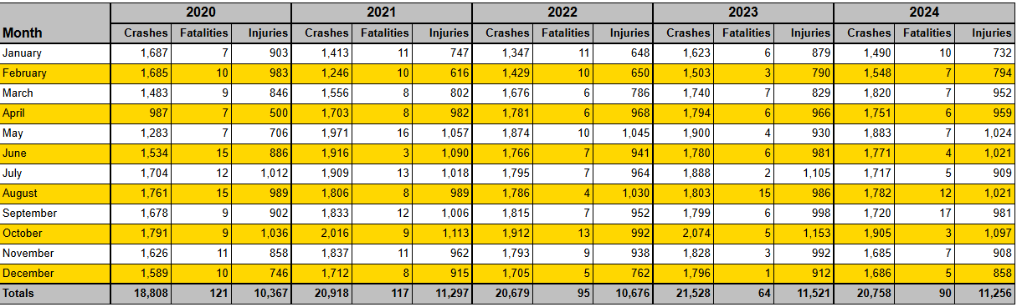
Date Range: 1/1/2020 to 12/31/2024
Region: All Virginia
Jurisdiction: All
Grouped By: Month
Crashes Filtered By: Distraction Involved
* 2024 Numbers Are Preliminary
drivesmartva.org

Slide 6
*
Statistics based on police-reported crash data almost certainly underestimate the role of distraction in fatal crashes. Police crash reports aren’t a reliable way to count cellphone-related collisions because drivers often don’t volunteer that they were on the phone and there is usually a lack of other evidence to determine drivers’ phone use.
drivesmartva.org

Slide 7
According to data from Cambridge Mobile Telematics…
Drivers spent 1 minute and 56 seconds per driving hour tapping their phone screens in 2024.
CMT’s research shows that drivers highly engaged in Usage Based Insurance programs are 65% safer and that these programs can help risky drivers reduce distraction by 20%. As a result, as more drivers join these programs, roads get safer.
drivesmartva.org

Slide 8
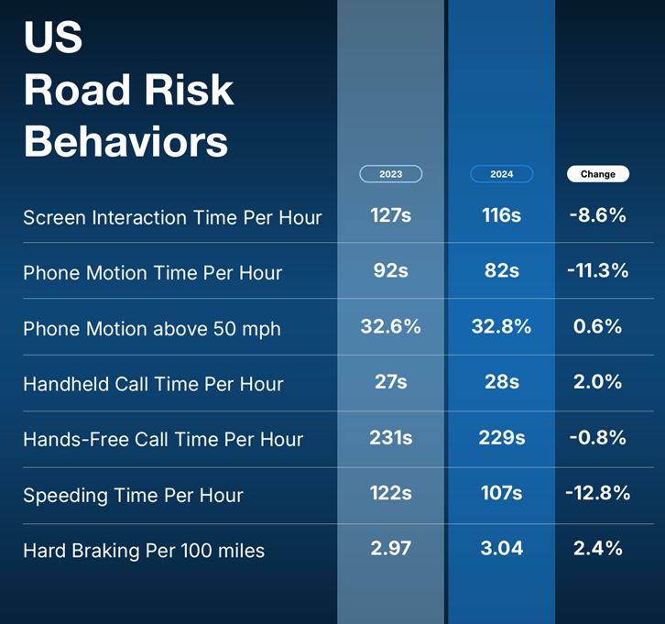
According to data from Cambridge Mobile Telematics…
drivesmartva.org

Slide 9

Surveys indicate that adults recognize distracted driving is dangerous when it’s someone else…
but they find excuses for their own risky driving behavior.
It CAN happen to YOU!
drivesmartva.org

Slide 10
People who use cellphones more frequently while driving may be riskier drivers in other respects.
In an IIHS study of drivers who were continuously monitored for one year, the drivers who spent the greatest amount of their driving time interacting with a cellphone also had the highest rates of near crashes and crashes.
drivesmartva.org

Slide 11

There are three main types of distraction:
Visual: taking your eyes off the road
Manual: taking your hands off the wheel
Cognitive: taking your mind off driving
drivesmartva.org

Slide 12
Using a cell phone while driving is especially dangerous because it involves ALL 3 Types of distraction!
drivesmartva.org

Slide 13
Follow These Tips to a Distraction-Free Drive:
Download an app. Enable a “Do Not Disturb” app to block incoming calls or messaging while the vehicle is in motion.
Park before eating. Before you spill anything, pull into a safe space to eat or drink.
Hands-free isn’t risk-free. Even if the phone isn’t in your hand, there are still dangers involved when a driver doesn’t fully concentrate on the road.
Be a good passenger. Do your best to help the driver and be an extra set of eyes on the road.
drivesmartva.org

Slide 14
Follow These Tips to a Distraction-Free Drive:
Have a plan. Plan to silence your phone, turn it off, or put it somewhere out of reach when you’re driving.
Have a strong, clear policy. Make it a rule: No handheld phones while driving.
Protect yourself. A seat belt is your best defense against a distracted driver.
Speak up. Request your driver stop driving distracted. After all, your life is in their hands.
Change your voicemail. Notify callers that you are driving or otherwise unavailable.
drivesmartva.org

Slide 15
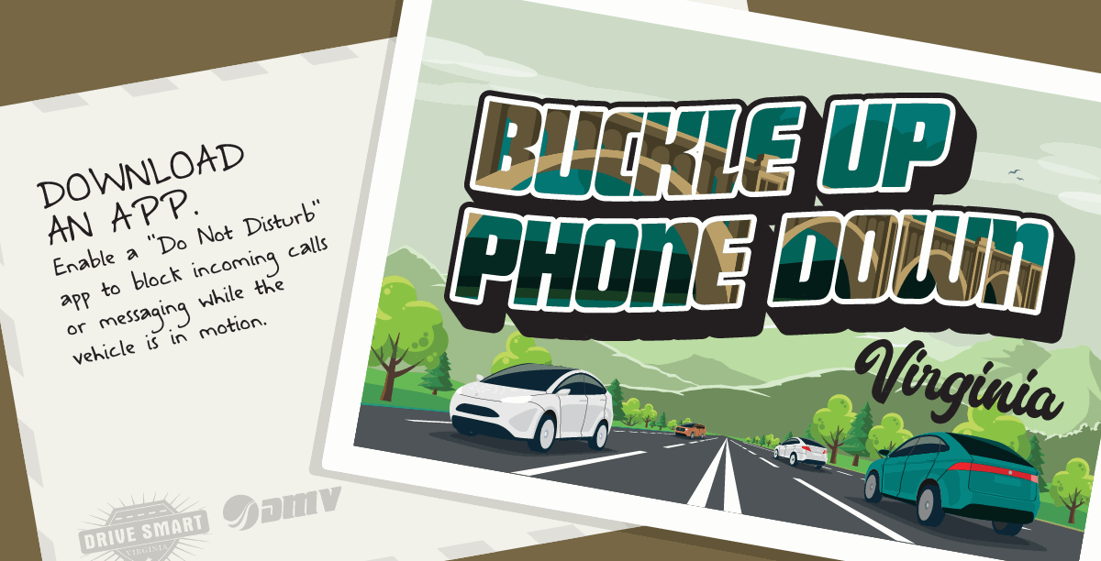
drivesmartva.org

Slide 16

Learn More at drivesmartva.org
drivesmartva.org

Slide 17
THANK YOU!
rich.Jacobs@drivesmartva.org
drivesmartva.org

