Slide 1

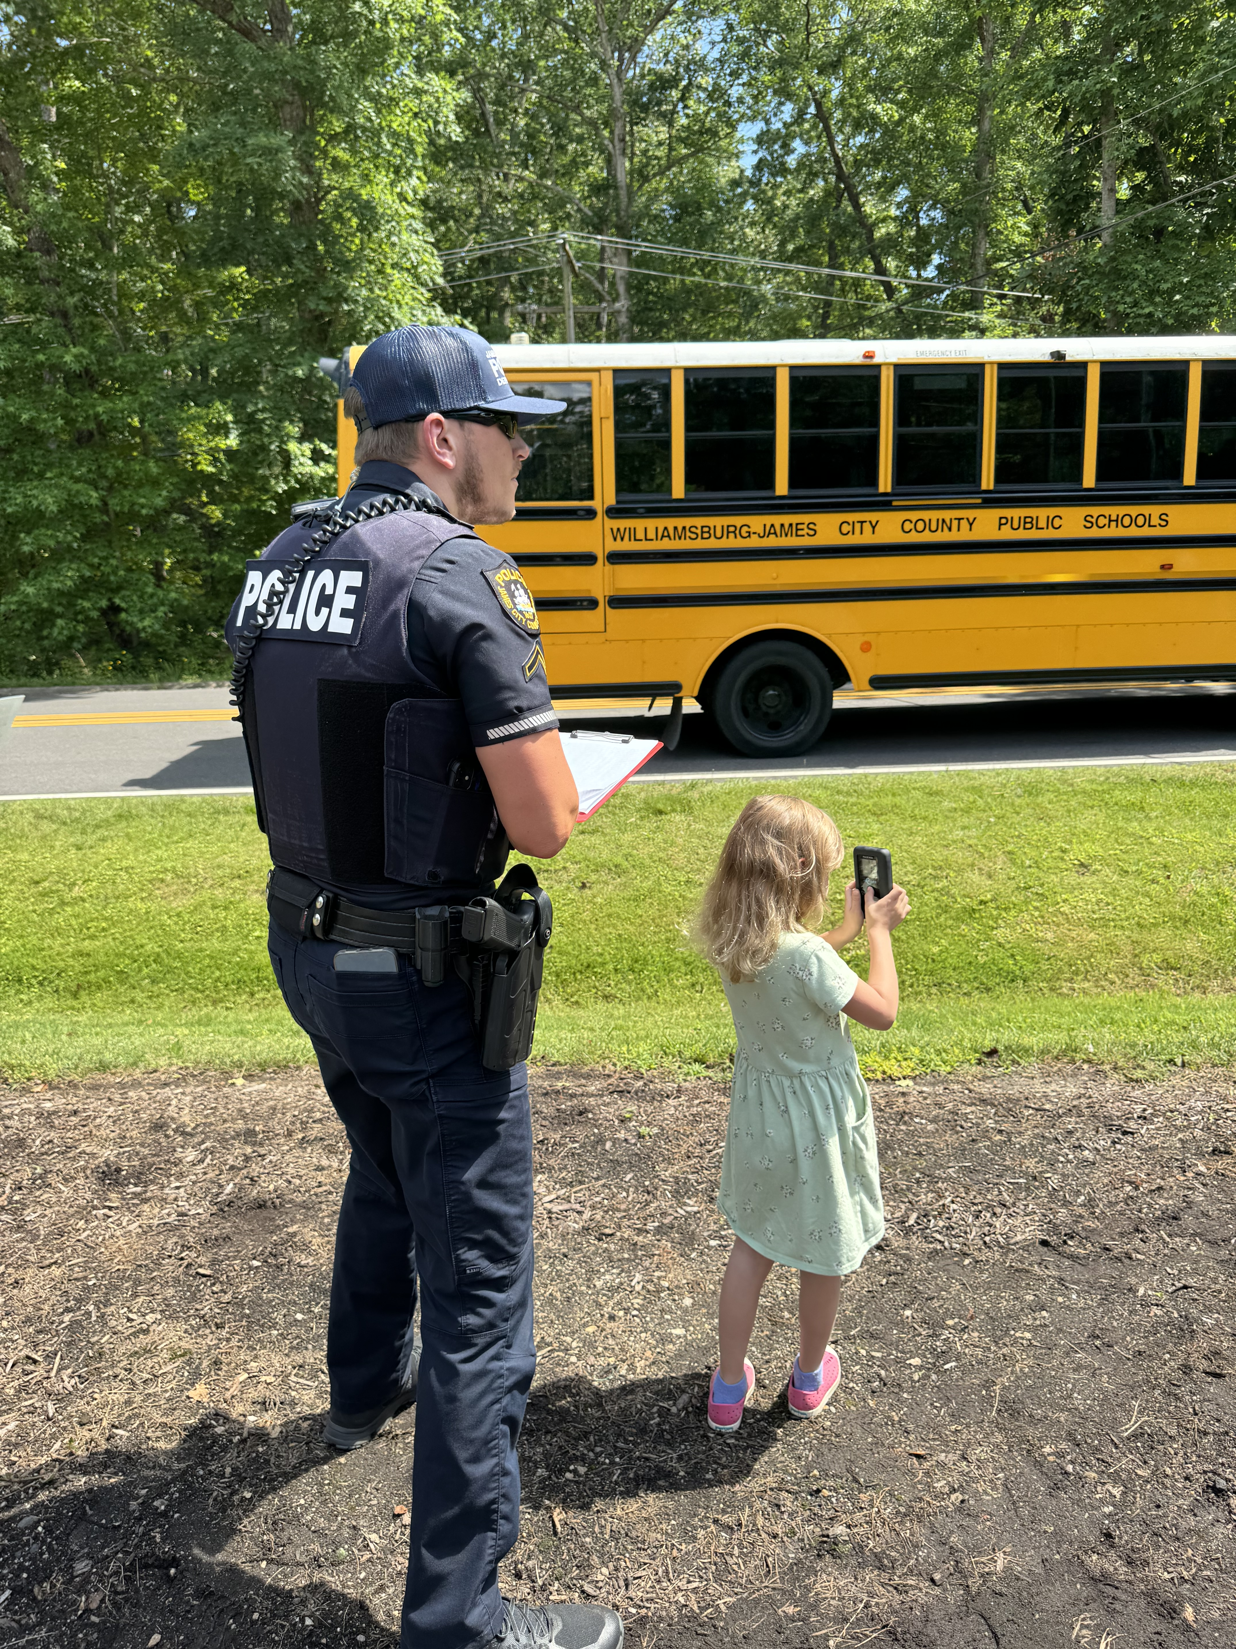
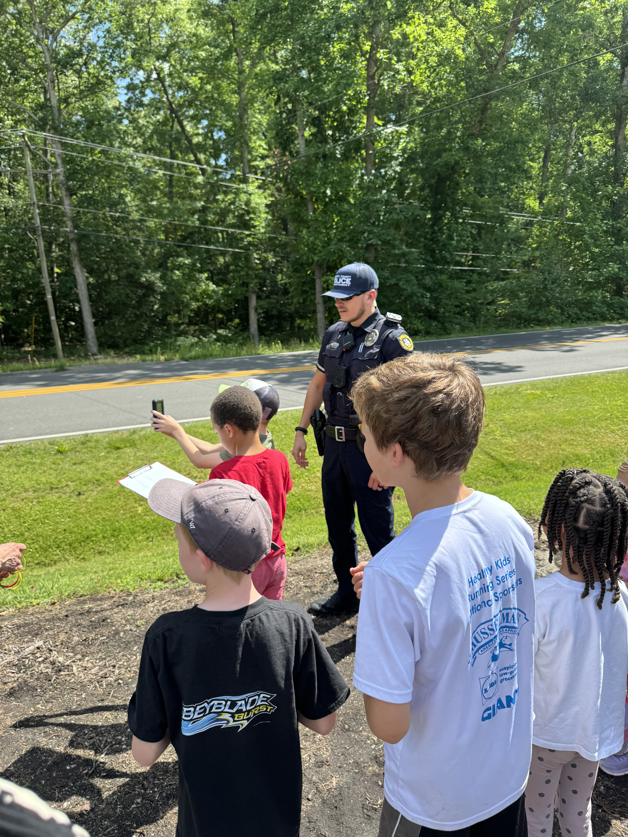
Welcome Jr. Speed Busters!

Slide 2
SAFE
FOCUSED
SMART
Before you officially become a Jr Speed Buster, you MUST agree to be:
Are you ready?!

Slide 3
Be a Seat Belt SUPERSTAR- Buckle up every car ride
Helmet and Pads- Our secret armor for bike and scooter fun!
As a Jr. Speed Buster
I agree to be:
SAFE

Slide 4
As a Jr. Speed Buster I agree to be:
FOCUSED
Be a Super Explorer- Use your eyes and ears when walking, riding your bike or scooter
Use your Super Vision- Look BOTH ways before crossing the street
Driving time is NO-PHONE TIME

Slide 5
Be a Super Helper- Look out the window for other cars and people. YOUR eyes can keep EVERYONE safe!
Be Super Cool- Tell ALL your friends about the fun of being safe!
As a Jr. Speed Buster I agree to be:
SMART

